Slide 1
Topic 9: Wave phenomena - AHL
9.2 – Single-slit diffraction
Topic 9.2 is an extension of Topic 4.4. Both single and the double-slit diffraction were considered in 4.4.
Essential idea: Single-slit diffraction occurs when a wave is incident upon a slit of approximately the same size as the wavelength.
Nature of science: Development of theories: When light passes through an aperture the summation of all parts of the wave leads to an intensity pattern that is far removed from the geometrical shadow that simple theory predicts.
Understandings:
• The nature of single-slit diffraction
Notes:
© 2015 By Timothy K. Lund

Slide 2
Topic 9: Wave phenomena - AHL
9.2 – Single-slit diffraction
Applications and skills:
• Describing the effect of slit width on the diffraction pattern
• Determining the position of first interference minimum
• Qualitatively describing single-slit diffraction patterns produced from white light and from a range of monochromatic light frequencies
Notes:
© 2015 By Timothy K. Lund

Slide 3
Topic 9: Wave phenomena - AHL
9.2 – Single-slit diffraction
Guidance:
• Only rectangular slits need to be considered
• Diffraction around an object (rather than through a slit) does not need to be considered in this sub-topic (see Physics sub-topic 4.4)
• Students will be expected to be aware of the approximate ratios of successive intensity maxima for single-slit interference patterns
• Calculations will be limited to a determination of the position of the first minimum for single-slit interference patterns using the approximation equation
Notes:
© 2015 By Timothy K. Lund

Slide 4
Topic 9: Wave phenomena - AHL
9.2 – Single-slit diffraction
Data booklet reference:
• θ = λ / b
Theory of knowledge:
• Are explanations in science different from explanations in other areas of knowledge such as history?
Utilization:
• X-ray diffraction is an important tool of the crystallographer and the material scientist
Aims:
• Aim 2: this topic provides a body of knowledge that characterizes the way that science is subject to modification with time
• Aim 6: experiments can be combined with those from sub-topics 4.4 and 9.3
Notes:
© 2015 By Timothy K. Lund

Slide 5

Topic 9: Wave phenomena - AHL
9.2 – Single-slit diffraction
Diffraction through a single-slit and around objects
•If a wave meets a hole in a wall that is of comparable size to its wavelength, the wave will be bent through a process called diffraction.
•If the aperture (hole, opening, etc.) is much larger than the wavelength, diffraction will be minimal to nonexistent.
REFLECTED WAVE
DIFFRACTED WAVE
INCIDENT WAVE
FYI •Diffraction is caused by objects within the medium that interact with the wave. It is not caused by two mediums and their boundary.
Notes:
© 2015 By Timothy K. Lund

Slide 6

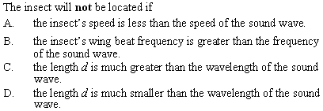
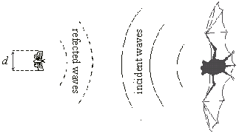
Topic 9: Wave phenomena - AHL
9.2 – Single-slit diffraction
Diffraction through a single-slit and around objects
•If d is too small the bat’s sound waves will not even be disturbed enough for the bat to detect the insect.
Notes:
© 2015 By Timothy K. Lund

Slide 7

Topic 9: Wave phenomena - AHL
9.2 – Single-slit diffraction
Diffraction through a single-slit and around objects
•Christian Huygens explained the behavior of diffraction through his famous principle:
“Every point on a wavefront emits a spherical wavelet of the same velocity and wavelength as the original wave.”
•Note that it is because of Huygen’s principle the waves can turn corners.
Notes:
© 2015 By Timothy K. Lund

Slide 8
Topic 9: Wave phenomena - AHL
9.2 – Single-slit diffraction
Diffraction through a single-slit and around objects
•The reason waves can turn corners is that the incoming wave transmits a disturbance by causing the medium to vibrate.
•And wherever the medium vibrates it becomes the center of a new wave front as illustrated to the right.
•Note that the smaller the aperture b the more pronounced the diffraction effect.
b
b
b
FYI •The aperture size must be of the order of a wavelength in order for diffraction to occur.
b = 2λ
b = 6λ
b = 12λ
Notes:
© 2015 By Timothy K. Lund

Slide 9
Topic 9: Wave phenomena - AHL
9.2 – Single-slit diffraction
Path difference
•This animation showing two coherent (in-phase and same frequency) wave sources S₁ and S₂ will show the following:
path difference = nλ
condition for constructive interference
n is an integer
L₁ = 4λ
L₂ = 3λ
P₁
L₁ = 4λ
L₂ = 2λ
S₁
S₂
Notes:
© 2015 By Timothy K. Lund

Slide 10
Topic 9: Wave phenomena - AHL
9.2 – Single-slit diffraction
Path difference
•This animation showing two coherent wave sources S₁ and S₂ will show the following:
path difference = (n + ½)λ
condition for destructive interference
n is an integer
L₂ = 4λ
P₂
L₁ = 3.5λ
L₁ = 3λ
L₂ = 2.5λ
S₁
S₂
Notes:
© 2015 By Timothy K. Lund

Slide 11
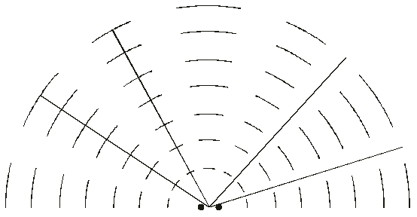
Topic 9: Wave phenomena - AHL
9.2 – Single-slit diffraction
Double-source interference
PRACTICE: Two identical wave sources in a ripple tank produce waves having a wavelength of λ. The interference pattern is shown. Four reference lines are labeled A through D.
(a) Which reference line or lines represent constructive interference? ________
(b) Which reference line or lines represent destructive interference? ________
B
C
A
D
A and B
C and D
Notes:
© 2015 By Timothy K. Lund

Slide 12
Topic 9: Wave phenomena - AHL
9.2 – Single-slit diffraction
Double-source interference
PRACTICE: Two identical wave sources in a ripple tank produce waves having a wavelength of λ. The interference pattern is shown. Four reference lines are labeled A through D.
(c) Which reference line or lines represent a path difference of 2.5λ? ________
•2.5λ is a condition for destructive interference.
•These two represent the smallest difference 0.5λ.
•C represents 1.5λ difference, and D is thus 2.5λ.
B
C
A
D
D
Notes:
© 2015 By Timothy K. Lund

Slide 13
Topic 9: Wave phenomena - AHL
9.2 – Single-slit diffraction
Diffraction through a single-slit
•Huygen’s wavelets not only allow the wave to turn corners, they also interfere with each other.
Constructive interference
RELATIVE INTENSITY
Destructive interference
Notes:
© 2015 By Timothy K. Lund

Slide 14

Topic 9: Wave phenomena - AHL
9.2 – Single-slit diffraction
Diffraction through a single-slit
Derive the formula θ = λ / b for the position of the first minimum of the diffraction pattern of a single slit.
•Consider a single slit of width b.
•From Huygen we know that every point within the slit acts as a new wavelet.
•At the central maximum we see that the distance traveled by all the wavelets is about equal, and thus has constructive interference.
•Consider slit points x at one edge and y at the center:
•At the 1st minimum, the difference in distance (blue and red dashed) must be λ / 2. Why?
1st min →
x
b
y
Destructive condition.
Notes:
© 2015 By Timothy K. Lund

Slide 15
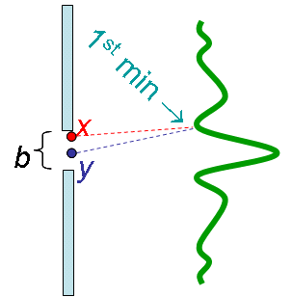
Topic 9: Wave phenomena - AHL
9.2 – Single-slit diffraction
Diffraction through a single-slit
•We will choose the midpoint of the slit (y) as our reference.
•And we will call the angle between the reference and the first minimum θ.
•We construct a right triangle as follows:
•Why does the side opposite θ equal λ / 2?
θ
x
b
2
θ
θ
Because of the condition for destructive interference.
y
λ
2
Notes:
© 2015 By Timothy K. Lund

Slide 16
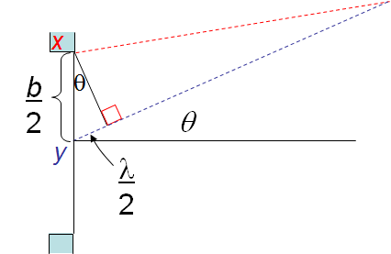
Topic 9: Wave phenomena - AHL
9.2 – Single-slit diffraction
Diffraction through a single-slit
•From the right triangle we see that
sin θ = (λ / 2) / (b / 2)
sin θ = λ / b.
•Perhaps you recall that if θ is very small (and in radians) then
sin θ ≈ θ (θ in radians).
•Finally…
θ = λ / b
location of first minimum in single slit diffraction
(θ in radians)
Notes:
© 2015 By Timothy K. Lund

Slide 17
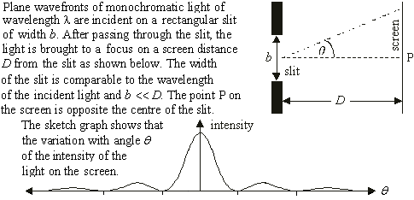

Topic 9: Wave phenomena - AHL
9.2 – Single-slit diffraction
Diffraction through a single-slit
Cent
•Caused by path length difference (PLD) along b.
2nd
1st
2nd
•1st min → PLD = λ/ 2.
•2nd min → PLD = 3λ/ 2.
•Central max → PLD = 0.
•2nd max → PLD = λ.
Notes:
© 2015 By Timothy K. Lund

Slide 18

Topic 9: Wave phenomena - AHL
9.2 – Single-slit diffraction
Diffraction through a single-slit
d
•θ = λ / b
•tan θ = d / D
•tan θ ≈ θ for small θ.
•θ = d / D = λ / b.
•d = λD / b.
Notes:
© 2015 By Timothy K. Lund

Slide 19
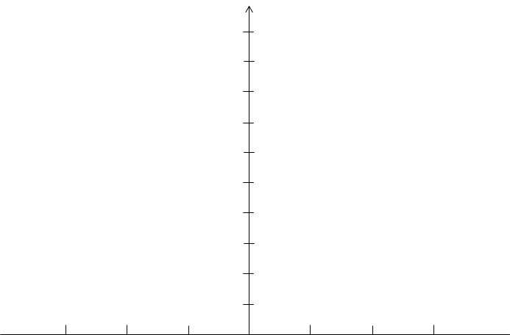
Topic 9: Wave phenomena - AHL
9.2 – Single-slit diffraction
Intensity of a single-slit diffraction pattern
•IBO expects you to know the relative intensities of the maximums.
•IBO expects you to know the positioning of the minimums.
I
I₀
I₀ / 20
I₀ / 50
I₀ / 100
λ
b
2λ
b
3λ
b
θ
Notes:
© 2015 By Timothy K. Lund

Slide 20



Topic 9: Wave phenomena - AHL
9.2 – Single-slit diffraction
Shape of a single-slit diffraction pattern – change b
•IBO expects you to know how the shape of the diffraction pattern depends on the ratio of the slit width b to the wavelength λ.
•Since θ = λ / b it is easy to see that the bigger b is, the closer together the maximums and minimums will be.
I
b = λ
b = 5λ
θ
b = 10λ
monochrome, change b only
Notes:
© 2015 By Timothy K. Lund

Slide 21



Topic 9: Wave phenomena - AHL
9.2 – Single-slit diffraction
Shape of a single-slit diffraction pattern – change λ
•IBO expects you to know how the shape of the diffraction pattern depends on the ratio of the slit width b to the wavelength λ.
•Since θ = λ / b it is easy to see that the smaller λ is, the closer together the maximums and minimums will be.
I
b = λ
b = 5λ
θ
b = 10λ
change λ only
Notes:
© 2015 By Timothy K. Lund

Slide 22

Topic 9: Wave phenomena - AHL
9.2 – Single-slit diffraction
Shape of a single-slit diffraction pattern – white light
PRACTICE:
Suppose white light is projected through a single slit. Predict what the diffraction pattern will look like.
SOLUTION:
•White light consists of all the colors.
•The previous slide shows the relative widths of three of those colors.
•Thus we see the following pattern.
Notes:
© 2015 By Timothy K. Lund

