Slide 1
Topic 8: Energy production
8.2 – Thermal energy transfer
Essential idea: For simplified modelling purposes the Earth can be treated as a black-body radiator and the atmosphere treated as a grey-body.
Nature of science: Simple and complex modelling: The kinetic theory of gases is a simple mathematical model that produces a good approximation of the behaviour of real gases. Scientists are also attempting to model the Earth’s climate, which is a far more complex system. Advances in data availability and the ability to include more processes in the models together with continued testing and scientific debate on the various models will improve the ability to predict climate change more accurately.
Notes:
© 2006 By Timothy K. Lund

Slide 2
Topic 8: Energy production
8.2 – Thermal energy transfer
Understandings:
• Conduction, convection and thermal radiation
• Black-body radiation
• Albedo and emissivity
• The solar constant
• The greenhouse effect
• Energy balance in the Earth surface / atmosphere system
Notes:
2
© 2006 By Timothy K. Lund

Slide 3
Topic 8: Energy production
8.2 – Thermal energy transfer
Applications and skills:
• Sketching and interpreting graphs showing the variation of intensity with wavelength for bodies emitting thermal radiation at different temperatures
• Solving problems involving the Stefan–Boltzmann law and Wien’s displacement law
• Describing the effects of the Earth’s atmosphere on the mean surface temperature
• Solving problems involving albedo, emissivity, solar constant and the Earth’s average temperature
Notes:
3
© 2006 By Timothy K. Lund

Slide 4
Topic 8: Energy production
8.2 – Thermal energy transfer
Guidance:
• Discussion of conduction and convection will be qualitative only
• Discussion of conduction is limited to intermolecular and electron collisions
• Discussion of convection is limited to simple gas or liquid transfer via density differences
• The absorption of infrared radiation by greenhouse gases should be described in terms of the molecular energy levels and the subsequent emission of radiation in all directions
Notes:
4
© 2006 By Timothy K. Lund

Slide 5
Topic 8: Energy production
8.2 – Thermal energy transfer
Guidance:
• The greenhouse gases to be considered are CH₄, H₂O, CO₂ and N₂O. It is sufficient for students to know that each has both natural and man-made origins.
• Earth’s albedo varies daily and is dependent on season (cloud formations) and latitude. The global annual mean albedo will be taken to be 0.3 (30%) for Earth.
Notes:
5
© 2006 By Timothy K. Lund

Slide 6
Topic 8: Energy production
8.2 – Thermal energy transfer
Data booklet reference:
• P = eσAT⁴
• λ_{max} (meters) = 2.90×10⁻³/ T (kelvin)
• I = power / A
• albedo = P_{SCATTERED} / P_{INCIDENT}
Notes:
6
© 2006 By Timothy K. Lund

Slide 7
Topic 8: Energy production
8.2 – Thermal energy transfer
International-mindedness:
• The concern over the possible impact of climate change has resulted in an abundance of international press coverage, many political discussions within and between nations, and the consideration of people, corporations, and the environment when deciding on future plans for our planet. IB graduates should be aware of the science behind many of these scenarios.
Notes:
7
© 2006 By Timothy K. Lund

Slide 8
Topic 8: Energy production
8.2 – Thermal energy transfer
Theory of knowledge:
• The debate about global warming illustrates the difficulties that arise when scientists cannot always agree on the interpretation of the data, especially as the solution would involve large-scale action through international government cooperation. When scientists disagree, how do we decide between competing theories?
Notes:
8
© 2006 By Timothy K. Lund

Slide 9
Topic 8: Energy production
8.2 – Thermal energy transfer
Utilization:
• Climate models and the variation in detail/processes included
• Environmental chemistry (see Chemistry option topic C)
• Climate change (see Biology sub-topic 4.4 and Environmental systems and societies topics 5 and 6)
• The normal distribution curve is explored in Mathematical studies SL sub-topic 4.1
Notes:
9
© 2006 By Timothy K. Lund

Slide 10
Topic 8: Energy production
8.2 – Thermal energy transfer
Aims:
• Aim 4: this topic gives students the opportunity to understand the wide range of scientific analysis behind climate change issues
• Aim 6: simulations of energy exchange in the Earth surface–atmosphere system
• Aim 8: while science has the ability to analyse and possibly help solve climate change issues, students should be aware of the impact of science on the initiation of conditions that allowed climate change due to human contributions to occur. Students should also be aware of the way science can be used to promote the interests of one side of the debate on climate change (or, to hinder debate).
Notes:
10
© 2006 By Timothy K. Lund

Slide 11
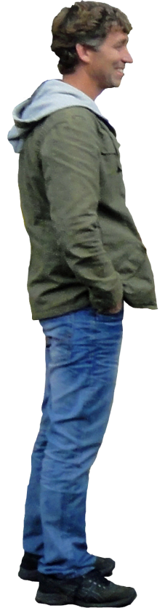
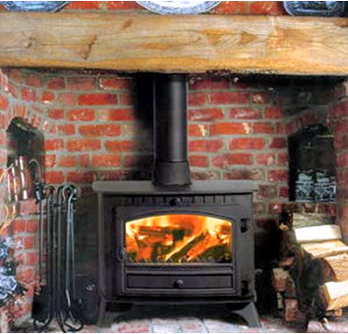
Topic 8: Energy production
8.2 – Thermal energy transfer
Conduction, convection and thermal radiation
•Thermal energy can be transferred from a warmer mass to a cooler mass by three means: conduction, convection, and radiation.
•Only thermal radiation transfers heat without any physical medium such as solid, liquid or gas.
EXAMPLE: The heat from a wood-burning stove can be felt from all the way across the room because photons carrying infrared energy can travel through space. When these photons strike you, they are absorbed as heat. This process of thermal energy transfer is called thermal radiation.
Notes:
© 2006 By Timothy K. Lund

Slide 12
Topic 8: Energy production
8.2 – Thermal energy transfer
Conduction, convection and thermal radiation
•When two solids of different temperatures touch, thermal energy is transferred from the hotter object to the cooler object through a process called conduction.
•When atoms of one portion of a material are in contact with vibrating atoms of another portion, the vibration is transferred from atom to atom.
•Since we associate motion with temperature, high T portions vibrate more than low T portions, so we can imagine the vibration “impulse” to travel through the material, from high T to low T.
H
O
T
H
O
T
C
O
L
D
Notes:
12
© 2006 By Timothy K. Lund

Slide 13
Topic 8: Energy production
8.2 – Thermal energy transfer
Conduction, convection and thermal radiation
•Metals are good heat conductors because they have lots of free electrons (the same reason they are good electrical conductors).
•The rate ΔQ / Δt at which heat energy is transferred depends directly on the cross-sectional area A and inversely with the length d of the conductor.
•That rate, ΔQ / Δt, is also proportional to the difference in temperature ΔT, between the two ends.
H
O
T
H
O
T
C
O
L
D
d
A
ΔQ / Δt = kAΔT / d
thermal conduction
Notes:
13
© 2006 By Timothy K. Lund

Slide 14
Topic 8: Energy production
8.2 – Thermal energy transfer
Conduction, convection and thermal radiation
EXAMPLE: A brick has a thermal conductivity of k = 0.710 J / m·s·C°, and the dimensions shown.
•Two heat sources are placed in contact with the ends of the brick, as shown. Find the rate at which heat energy is conducted through the brick.
SOLUTION: A = 0.750×0.500 = 0.375 m². Why?
•Then
ΔQ / Δt = kAΔT / d
= 0.710×0.375×(100 – 20) / 2.50 = 8.52 J s⁻¹.
2.50 m
0.500 m
20°C
0.750 m
100°C
Notes:
14
© 2006 By Timothy K. Lund

Slide 15
Topic 8: Energy production
8.2 – Thermal energy transfer
Conduction, convection and thermal radiation
•Another form of heat transfer is called convection.
•Convection requires a fluid as a medium of heat transfer.
•For example, hot air is less dense than cold air, so it rises.
•But as it rises it cools, and so becomes denser and sinks.
•We thus obtain a cycle, which forms a circulation called a convection current.
•Convection currents drive many interesting physical systems as the next slides illustrate.
Convection current
Notes:
15
© 2006 By Timothy K. Lund

Slide 16
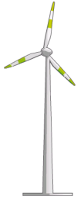
Topic 8: Energy production
8.2 – Thermal energy transfer
Conduction, convection and thermal radiation
EXAMPLE: Atmospheric convection - winds.
Air Falls
Air Rises
Convection Current
Partial Vacuum
Low Pressure
Land (c is small)
Wind Turbine
Heats/cools QUICKLY
Water (c is big)
Heats/cools SLOWLY
Notes:
16
© 2006 By Timothy K. Lund

Slide 17
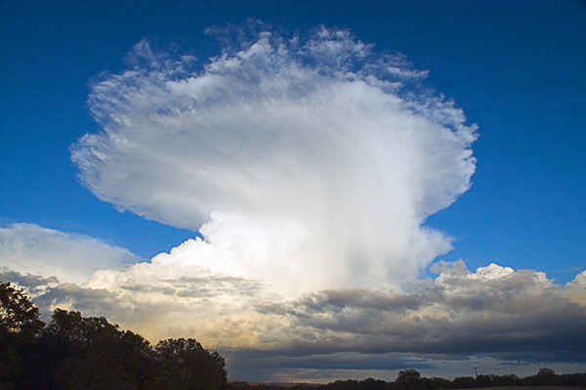
Topic 8: Energy production
8.2 – Thermal energy transfer
Conduction, convection and thermal radiation
EXAMPLE: Atmospheric convection - thunderheads.
Notes:
17
© 2006 By Timothy K. Lund

Slide 18
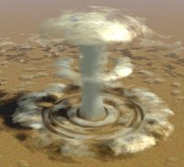
Topic 8: Energy production
8.2 – Thermal energy transfer
Conduction, convection and thermal radiation
EXAMPLE: Atmospheric convection - nuclear detonation.
Notes:
18
© 2006 By Timothy K. Lund

Slide 19
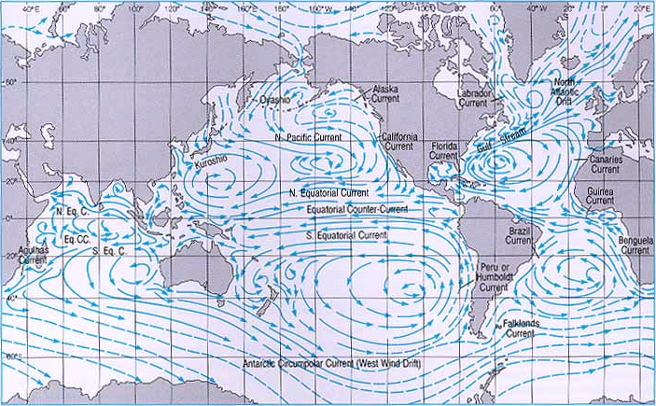
Topic 8: Energy production
8.2 – Thermal energy transfer
Conduction, convection and thermal radiation
EXAMPLE: Oceanic convection - currents.
Notes:
19
© 2006 By Timothy K. Lund

Slide 20
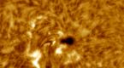
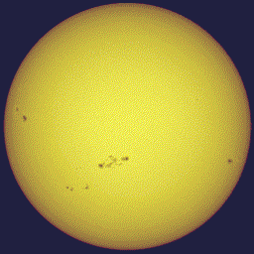
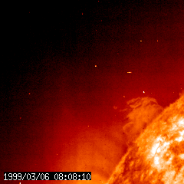
Topic 8: Energy production
8.2 – Thermal energy transfer
Conduction, convection and thermal radiation
EXAMPLE: Solar convection – sunspots and flares.
Notes:
20
© 2006 By Timothy K. Lund

Slide 21
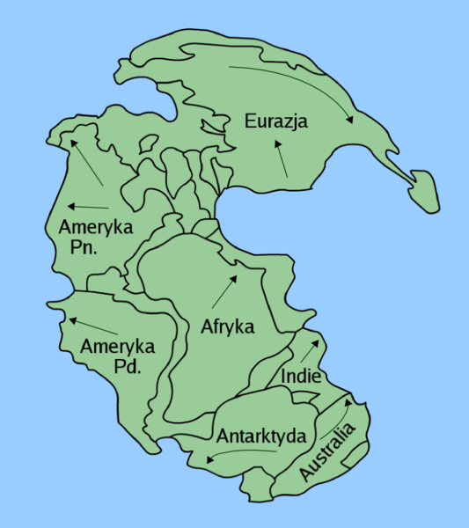
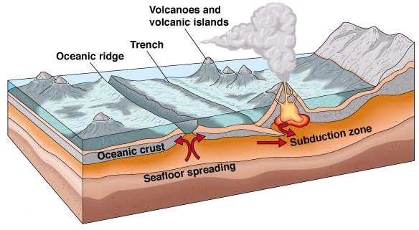
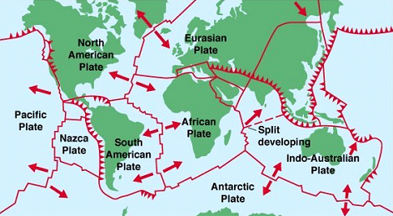
Topic 8: Energy production
8.2 – Thermal energy transfer
Conduction, convection and thermal radiation
EXAMPLE: Mantle convection – continental drift.
Notes:
21
© 2006 By Timothy K. Lund

Slide 22
Topic 8: Energy production
8.2 – Thermal energy transfer
Black-body radiation
•Solids can absorb many more wavelengths than the atmospheric gases.
•Depending on the color of a solid you can determine what wavelengths it cannot absorb.
•For example, a green object reflects (and therefore does not absorb) green light.
•A black object absorbs all wavelengths.
When bathed in white light a solid is the color of the light that it cannot absorb.
FYI
•A black-body absorbs all wavelengths. As it heats up it emits all wavelengths, called black-body radiation.
Notes:
© 2006 By Timothy K. Lund

Slide 23
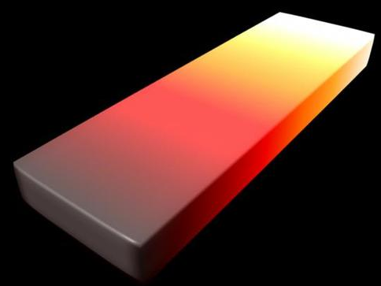
Topic 8: Energy production
8.2 – Thermal energy transfer
Black-body radiation
•Solids can be heated to incandescence (glowing) and different temperatures will have different visible radiation.
•If we heat a black-body to incandescence we observe:
•Two trends emerge:
-The higher the tempera- ture the greater the intensity at all wavelengths.
-The higher temperature the smaller the wavelength of the maximum intensity.
5000 K
4000 K
3000 K
2000 K
1000 K
Intensity
visible radiation
UV radiation
IR radiation
1000
2000
3000
4000
5000
Wavelength (nm)
Notes:
© 2006 By Timothy K. Lund

Slide 24
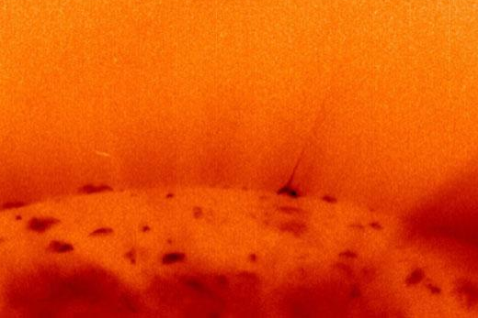
Topic 8: Energy production
8.2 – Thermal energy transfer
Black-body radiation
•A simple law called Wein’s displacement law tells us the wavelength of the maximum intensity λ_{max} for blackbodies at temperature T in Kelvin:
λ_{max}= 2.90×10⁻³/ T
Wien’s displacement law
700 600 500 400
Wavelength λ / nm
Visible Light
EXAMPLE: The sun’s surface has a temperature of 4500 K. What is the prevalent wavelength of light?
SOLUTION:
λ_{max} = 2.90×10⁻³/ 4500
λ_{max} = 6.44×10⁻⁷ m = 644 nm.
Intensity
1000
2000
3000
4000
5000
Wavelength (nm)
Notes:
© 2006 By Timothy K. Lund

Slide 25
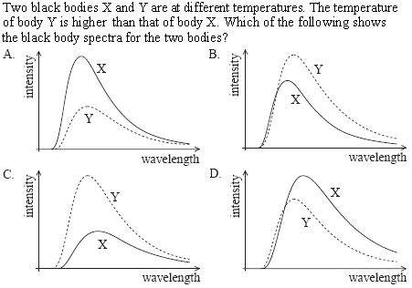
Topic 8: Energy production
8.2 – Thermal energy transfer
Solving problems involving Wien’s displacement law
• Higher temperature = higher intensity so Y is above X.
• Higher temperature = smaller wave-length at peak
Notes:
© 2006 By Timothy K. Lund

Slide 26
Topic 8: Energy production
8.2 – Thermal energy transfer
The Stefan-Boltzmann law
•Without proof, the Stefan-Boltzmann law is as follows:
•σ is called the Stefan-Boltzmann constant.
•The Stefan-Boltzmann law shows the relationship between the temperature of a black-body and the power emitted by the black-body’s surface area.
P = σAT ⁴
the Stefan-Boltzmann law
where σ = 5.67×10⁻⁸ W m⁻² K⁻⁴.
FYI
•A black-body emits as much power as it absorbs.
•Thus the Stefan-Boltzmann law works for both emission and absorption problems.
Notes:
© 2006 By Timothy K. Lund

Slide 27
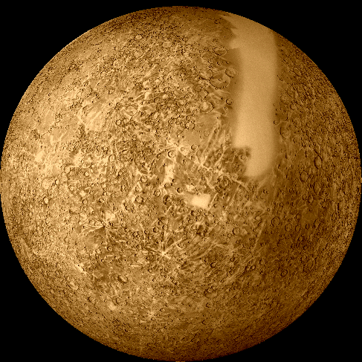
Topic 8: Energy production
8.2 – Thermal energy transfer
Solving problems involving the Stefan-Boltzmann law
EXAMPLE: Mercury has a radius of 2.50×10⁶ m. Its sunny side has a temperature of 400°C (673 K) and its shady side -200°C (73 K). Treating it like a black-body, find its power.
SOLUTION:
•A_{sphere} = 4π(2.50×10⁶)² = 7.85×10¹³ m².
•For T use T_{AVG} = (673 + 73) / 2 = 373 K
P = σAT ⁴ = (5.67×10⁻⁸)(7.85×10¹³)373⁴ = 8.62×10¹⁶ W.
FYI
•Since no body is at absolute zero (K = 0) it follows from the Stefan-Boltzmann law that all bodies radiate.
•Be sure that T is in Kelvin, not Celsius.
Notes:
© 2006 By Timothy K. Lund

Slide 28

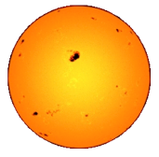
Topic 8: Energy production
8.2 – Thermal energy transfer
The solar constant
PRACTICE: The sun radiates energy at a rate of 3.90×10²⁶ W. What is the rate at which energy from the sun reaches Earth if our orbital radius is 1.5×10¹¹ m?
SOLUTION: A_{SPHERE} = 4πr².
•Recall that intensity is the rate at which energy is being gained per unit area.
•Then I = P / [ 4πr² ]
= 3.90×10²⁶ / [ 4π(1.5×10¹¹)² ]
= 1380 W m⁻².
•This value is called the solar constant.
intensity = power / A
intensity
P_{sun} = 1380 W m⁻²
the solar constant
Notes:
© 2006 By Timothy K. Lund

Slide 29
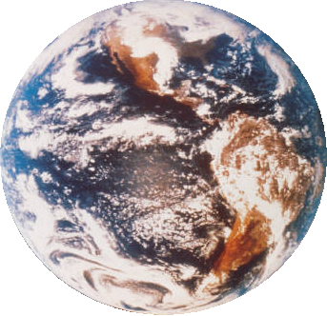
Topic 8: Energy production
8.2 – Thermal energy transfer
The solar constant
PRACTICE:
Explain why the solar intensity is different for different latitudes.
SOLUTION:
•The following diagram shows how the same intensity is spread out over more area the higher the latitude.
1380 W/m²
Notes:
29
© 2006 By Timothy K. Lund

Slide 30
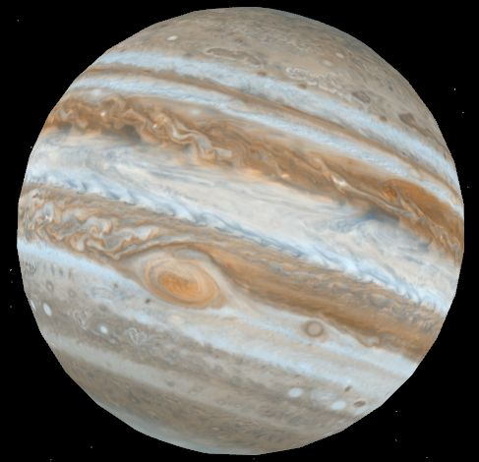
Topic 8: Energy production
8.2 – Thermal energy transfer
The solar constant
PRACTICE: The sun radiates energy at a rate of 3.90×10²⁶ W. What is the rate at which energy from the sun reaches Jupiter if its orbital radius is 7.8×10¹¹ m? (This is Jupiter’s solar constant.)
SOLUTION: Use I = P / [ 4πr² ]
I = P / [ 4πr² ] = 3.90×10²⁶ / [ 4π(7.8×10¹¹)² ]
I = 51 W m⁻².
•This is 51 J / s per m².
Notes:
© 2006 By Timothy K. Lund

Slide 31

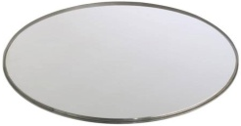
Topic 8: Energy production
8.2 – Thermal energy transfer
Emissivity
•The emissivity e of a body is a number between 0 and 1 that quantifies the emission and absorption properties of that body as compared to a blackbody of equal size.
•A black-body is a perfect emitter / absorber of radiation and has an emissivity of e = 1.
•A body that can’t emit / absorb radiation at all has an emissivity of e = 0.
•The emissivity of a body is the ratio of the power emitted by the body, to the power emitted by a black-body of the same size.
charcoal
e = 0.95
mirror
e = 0.05
e = P_{BODY} / P_{BLACK-BODY}
emissivity
e = P_{BODY} / [ σAT ⁴ ]
Notes:
© 2006 By Timothy K. Lund

Slide 32
Topic 8: Energy production
8.2 – Thermal energy transfer
Emissivity
•A black-body is a perfect emitter/absorber (e = 1).
•A small sphere covered with lamp black makes a pretty good black-body and has an emissivity somewhat close to 1.
•An even better black- body is the metal- cavity black-body:
•If we know e, the Stefan-Boltzmann law can be amended:
e = 0.9
e = 0.5
better black-body
tallow candle
incident thermal radiation
P = eσAT ⁴
the Stefan-Boltzmann law
where σ = 5.67×10⁻⁸ W m⁻² K⁻⁴.
Notes:
© 2006 By Timothy K. Lund

Slide 33

Topic 8: Energy production
8.2 – Thermal energy transfer
P_{INCIDENT}
Albedo
•When light strikes an object, some of it is absorbed, and some of it is scattered.
•If light strikes a mirror, nearly all of it will be scattered:
•If light strikes a surface covered with lamp black, nearly all of it will be absorbed:
•We define albedo in terms of scattered and incident power:
P_{SCATTERED}
heat
P_{SCATTERED}
P_{INCIDENT}
heat
albedo = P_{SCATTERED} / P_{INCIDENT}
albedo
FYI
•The mirror has an albedo of almost 1.
•The black-body has an albedo of almost 0.
Notes:
33
© 2006 By Timothy K. Lund

Slide 34
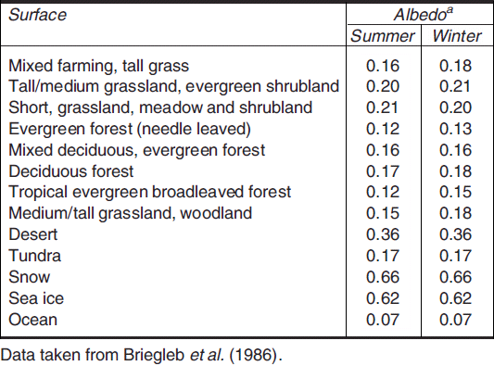
Topic 8: Energy production
8.2 – Thermal energy transfer
Albedo
•Landforms, vegetation, weather, and seasons affect a planet’s albedo.
•The table shows that different terrains have different albedos.
•Ocean water scatters little light (7%).
•Snow and ice scatter a lot of light (62% to 66%).
•Desert (36%).
Notes:
34
© 2006 By Timothy K. Lund

Slide 35
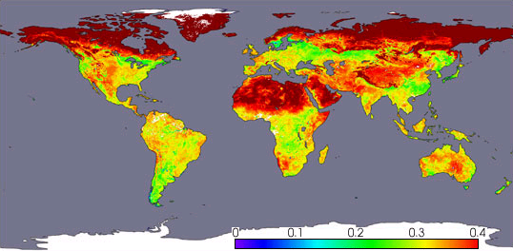
Topic 8: Energy production
8.2 – Thermal energy transfer
Albedo
EXAMPLE: Satellites are used to map out monthly albedos.
White and gray areas: No data.
Albedo
April, 2002, Terra satellite, NASA
Notes:
35
© 2006 By Timothy K. Lund

Slide 36
Topic 8: Energy production
8.2 – Thermal energy transfer
Albedo
•From the previous table and satellite map it is clear that calculating the overall albedo of a planet is quite complex.
•Clouds (and even contrails) also contribute to the albedo.
•Overall, Earth’s mean yearly albedo is about 0.3 (or 30%).
•The actual albedo depends on season, latitude, cloud cover, and snow cover.
•It varies daily!
Notes:
36
© 2006 By Timothy K. Lund

Slide 37
Topic 8: Energy production
8.2 – Thermal energy transfer
Solving problems involving albedo
EXAMPLE: Assuming an albedo of 0.30, find, for Earth:
(a) the power of the sunlight received.
SOLUTION: Use I = 1380 W m⁻² and I = P / A.
•The radius of Earth is r = 6.37×10⁶ m so its cross-sectional area is
A = πr² = π(6.37×10⁶)² = 1.27×10¹⁴ m².
•An albedo of 0.30 means that 70% of the sunlight is absorbed (because 30% is scattered). Thus
P =(0.70)IA =(0.70)(1380)(1.27×10¹⁴) = 1.23×10¹⁷ W.
•Thus Earth intercepts energy from the sun at a rate of 1.23×10¹⁷ W.
Notes:
© 2006 By Timothy K. Lund

Slide 38
Topic 8: Energy production
8.2 – Thermal energy transfer
Solving problems involving albedo
EXAMPLE: Assuming an albedo of 0.30, find, for Earth:
(b) the predicted temperature due to the sunlight reaching it.
SOLUTION:
•From the previous example P = 1.23×10¹⁷ W.
•But this power is distributed over the whole rotating planet, which has an area A_{sphere} = 4πr².
•From Stefan-Boltzmann we have
P = σAT⁴
1.23×10¹⁷ = (5.67×10⁻⁸)4π(6.37×10⁶)²T⁴
T = 255 K (-18°C).
Notes:
© 2006 By Timothy K. Lund

Slide 39
Topic 8: Energy production
8.2 – Thermal energy transfer
Solving problems involving emissivity and Earth’s average temperature
EXAMPLE: If the average temperature of Earth is 289 K, find its emissivity.
SOLUTION: We determined that Earth absorbs energy from the sun at a rate of P = 1.23×10¹⁷ W.
•Since the temperature of Earth is relatively constant, we can assume it is radiating power at the same rate of P_{BODY} = 1.23×10¹⁷ W.
•At 289 K the power radiated by a black-body of the same size as Earth is:
P_{B-B} = (5.67×10⁻⁸)4π(6.37×10⁶)²289⁴ = 2.02×10¹⁷ W.
•Thus e = P_{BODY} / P_{BLACK-BODY} = 1.23 / 2.02 = 0.61.
Notes:
© 2006 By Timothy K. Lund

Slide 40
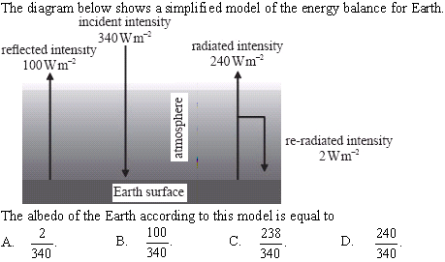
Topic 8: Energy production
8.2 – Thermal energy transfer
Solving problems involving albedo
•albedo = P_{SCATTERED} / P_{INCIDENT}
•P_{INCIDENT} = 340 W m⁻²
•P_{SCATTERED} = 100 W m⁻²
•albedo = 100 / 340
Notes:
40
© 2006 By Timothy K. Lund

Slide 41
Topic 8: Energy production
8.2 – Thermal energy transfer
net heat gain
The greenhouse effect
•When solar radiation strikes a planet that has a gaseous atmosphere, the gases comprising the atmosphere can absorb infrared radiation (heat).
•The remainder of the incoming radiation then reaches the ground to either be scattered back into the atmosphere, or absorbed.
•Solids can absorb all frequencies of radiation, and convert them to infrared wavelengths.
•The heated ground can then emit infrared radiation back into the atmosphere, which then intercepts more of the energy on the way out.
•The result is that the atmosphere traps heat and causes the temperature of the planet to rise.
Notes:
© 2006 By Timothy K. Lund

Slide 42
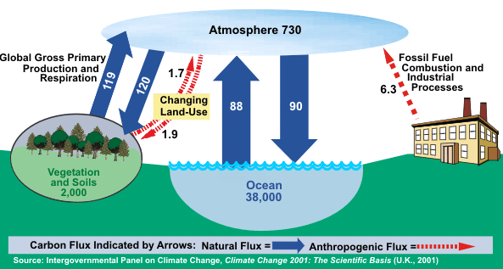
Topic 8: Energy production
8.2 – Thermal energy transfer
The greenhouse effect
•The process outlined on the previous slide is the so-called greenhouse effect.
•The main gases that are particularly effective in absorbing infrared radiation are methane (CH₄), water vapor (H₂O), carbon dioxide (CO₂), and nitrous oxide (N₂O).
•Note that there are both natural and man-made (anthropogenic) contributions and changes (flux).
C-sink
Global Carbon Cycle (Billion Metric Tons Carbon)
C-sink
C-sink
Notes:
© 2006 By Timothy K. Lund

Slide 43
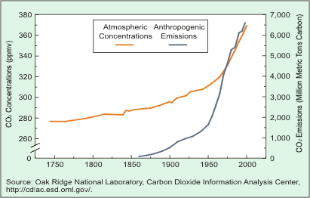
Topic 8: Energy production
8.2 – Thermal energy transfer
Greenhouse gases – CO₂
•This graph shows the correlation between increasing atmospheric concentration of CO₂ and our fossil fuel emissions of CO₂.
•Anthropogenic means “human.”
Trends in Atmospheric Concentrations and Anthropogenic Emissions of Carbon Dioxide
Notes:
© 2006 By Timothy K. Lund

Slide 44
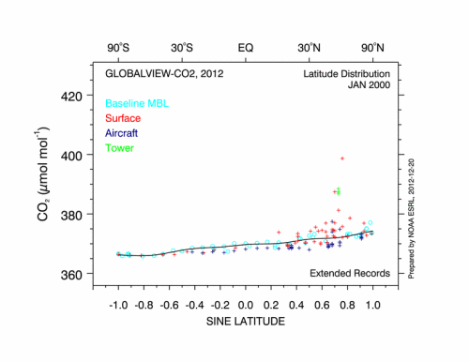
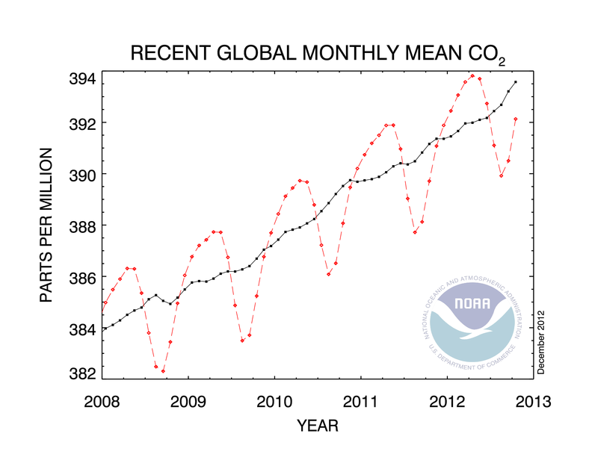
Topic 8: Energy production
8.2 – Thermal energy transfer
Greenhouse gases – CO₂
EXAMPLE: How are the levels of CO₂ determined?
SOLUTION: Observatories and aircraft.
cooling months
warming months
Notes:
© 2006 By Timothy K. Lund

Slide 45
Topic 8: Energy production
8.2 – Thermal energy transfer
Absorption of infrared radiation by greenhouse gases
•Recall that solar radiation strikes the earth at a rate of 1380 W m⁻² or less, the farther from the equator you are.
•That energy is carried in the form of photons, which are quanta of light.
•The atmosphere is made up of gases, which are the first layer of matter that the sun's rays interact with.
•If a photon is at the precise energy for an electron to jump to a different energy level in an atom, it will be absorbed.
Small, medium and large electron jumps may occur, even to the point of ionization
Notes:
© 2006 By Timothy K. Lund

Slide 46
Topic 8: Energy production
8.2 – Thermal energy transfer
Absorption of infrared radiation by greenhouse gases
•The excited gases will eventually de-excite and release photons.
•The absorption and release of photons by the gases is called scattering.
•Scattering does not produce a net increase in heat energy in the atmosphere.
•However, some of the scattered photons may be in the infrared region – able to be absorbed as internal energy and kinetic energy via the mechanisms illustrated on the next slides:
Notes:
© 2006 By Timothy K. Lund

Slide 47

Topic 8: Energy production
8.2 – Thermal energy transfer
Absorption of infrared radiation by greenhouse gases
•Greenhouse gases are all molecular in nature, (meaning comprised of more than one atom).
•For our purposes we will consider the triatomic molecule CO₂.
•A simple model of CO₂ has springs connecting the two oxygen atoms to the carbon atom:
•Recall that heat energy can be stored in molecules as internal energy in the form of potential (the springs) and kinetic (the vibrations).
O
C
O
Notes:
© 2006 By Timothy K. Lund

Slide 48
Topic 8: Energy production
8.2 – Thermal energy transfer
Absorption of infrared radiation by greenhouse gases
•The difference between these two CO₂ molecules is in their internal potential energies:
•The above E_{P} storage does not contribute to the increase in temperature of the CO₂. Rather, it is the kinetic energy E_{K} of the molecule that determines its temperature.
•There are three ways an extended molecule such as CO₂ can store kinetic energy: Via vibration, via translation, and via rotation.
O
C
O
O
C
O
E_{P} big
E_{P} small
Notes:
© 2006 By Timothy K. Lund

Slide 49
Topic 8: Energy production
8.2 – Thermal energy transfer
Absorption of infrared radiation by greenhouse gases
•Vibration refers to the molecules oscillating in conjunction with the springs:
•The natural frequency of greenhouse gases is in the infrared region of the spectrum and thus greenhouse gases are prone to absorb such frequencies.
C
O
O
C
O
O
vibration
Notes:
© 2006 By Timothy K. Lund

Slide 50
Topic 8: Energy production
8.2 – Thermal energy transfer
Absorption of infrared radiation by greenhouse gases
•Translation refers to the molecule moving as a unit in a straight line:
•Rotation refers to the molecule spinning about its center of mass.
•All three E_{K} modes can absorb and hold infrared radiation simultaneously.
O
C
O
translation
O
C
O
rotation
Notes:
© 2006 By Timothy K. Lund

Slide 51

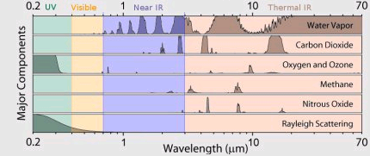
Topic 8: Energy production
8.2 – Thermal energy transfer
Absorption of infrared radiation by greenhouse gases
•Different gases absorb different wavelengths:
Notes:
© 2006 By Timothy K. Lund

Slide 52
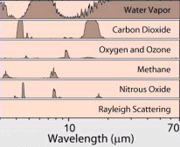
Topic 8: Energy production
8.2 – Thermal energy transfer
Absorption of infrared radiation by greenhouse gases
PRACTICE: Consider the absorption graphs below:
(a) Which portion of the electromagnetic spectrum is represented?
(b) Which greenhouse gas contributes the most to the greenhouse effect?
(c) Which gas is the least significant contributor?
SOLUTION:
(a) Infrared (heat).
(b) Water vapor!
(c) Oxygen and ozone.
Notes:
© 2006 By Timothy K. Lund

Slide 53
Topic 8: Energy production
8.2 – Thermal energy transfer
Energy balance in Earth surface / atmosphere system
•Although we calculated the intensity of solar radiation to be 1380 W m⁻² by the time it reaches Earth, the earth is spherical, and so not all surfaces will receive this intensity.
•We will take the average for our models to be
I_{AVG} = 340 W m⁻²
average incident solar radiation
1380 W/m²
Notes:
© 2006 By Timothy K. Lund

Slide 54
Topic 8: Energy production
8.2 – Thermal energy transfer
Energy balance in Earth surface / atmosphere system
EXAMPLE: Draw a Sankey diagram for a model of the earth without greenhouse gases.
SOLUTION: First draw Earth/atmosphere blocks:
•Draw incoming solar energy (340 W m⁻²):
•Draw energy reflected by atmosphere (clouds):
•Draw energy reflected by ground (snow, etc.):
•Draw energy absorbed by ground (Q = mcΔT):
•Draw energy radiated by ground (P = σAT⁴):
340
75
235
30
235
NON-GREENHOUSE ATMOSPHERE
235
GROUND
Notes:
© 2006 By Timothy K. Lund

Slide 55
Topic 8: Energy production
8.2 – Thermal energy transfer
Energy balance in Earth surface / atmosphere system
PRACTICE: Show that at the space/atmosphere interface and at the ground/atmosphere interface the net power flow is zero.
SOLUTION:
•Space/atmosphere interface:
= 340 IN
235 + 75 + 30 = 340 OUT.
•Ground/atmosphere interface:
235 IN and 235 OUT.
340
75
235
30
FYI
•Since I_{IN} = I_{OUT}, the temperature in each region is constant.
235
NON-GREENHOUSE ATMOSPHERE
235
GROUND
Notes:
© 2006 By Timothy K. Lund

Slide 56
Topic 8: Energy production
8.2 – Thermal energy transfer
Energy balance in Earth surface / atmosphere system
EXAMPLE: Draw a Sankey diagram for a model of the earth with greenhouse gases.
SOLUTION: Put in the blocks (or sinks) first (Greenhouse gases):
•I_{IN} (340 W m⁻²):
•I_{REFLECT}(105 W m⁻²):
•I_{GND,abs} (165 W m⁻²):
•I_{ATMOS,abs} (70 W m⁻²):
•I_{GND,radiate} (390 W m⁻²):
•I_{convection} (100 W m⁻²):
•I_{ATM,radiate} (195 W m⁻²):
340
75
195
30
165
520
70
GREENHOUSE ATMOSPHERE
350
325
40
100
490
GROUND
Notes:
© 2006 By Timothy K. Lund

Slide 57
Topic 8: Energy production
8.2 – Thermal energy transfer
Energy balance in Earth surface / atmosphere system
PRACTICE: Find the net power flow at the space / atmosphere interface and at the ground / atmosphere interface.
SOLUTION:
•Space/atmosphere interface: 340 IN.
195 + 75 + 30 + 40 = 340 OUT.
•Ground/atmosphere interface:
165 + 325 = 490 IN
350 + 40 + 100
= 490 OUT.
Net = 0 W m⁻².
340
75
195
30
165
520
Net = 0 W m⁻².
70
FYI
•This model also shows stable temperatures.
GREENHOUSE ATMOSPHERE
350
100
325
40
490
GROUND
Notes:
© 2006 By Timothy K. Lund

Slide 58
Topic 8: Energy production
8.2 – Thermal energy transfer
Energy balance in Earth surface / atmosphere system
PRACTICE: Find the net power flow at the ground / atmosphere interface.
SOLUTION:
•We have:
I_{IN} = 165 + 335
= 500 W m⁻².
I_{OUT} = 360 + 20 + 110
= 490 W m⁻².
•The net power flow is thus
I_{IN} – I_{OUT} = 500 – 490 = + 10 W m⁻².
340
75
195
30
165
540
70
GREENHOUSE ATMOSPHERE
360
335
20
110
500
GROUND
FYI
•This model shows increasing ground temperatures.
Notes:
© 2006 By Timothy K. Lund

Slide 59
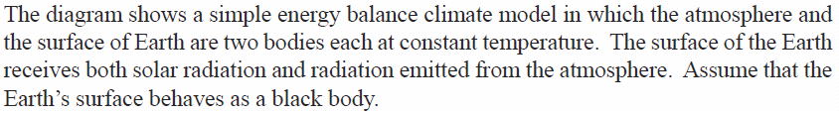
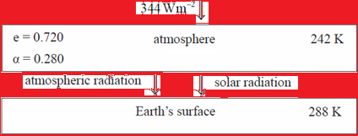
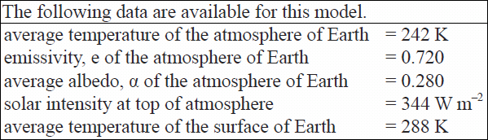
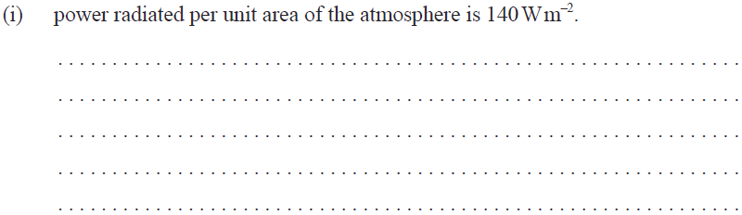
Topic 8: Energy production
8.2 – Thermal energy transfer
Energy balance in Earth surface / atmosphere system
•From Stefan-Boltzmann we have P = eσAT⁴ so that
P / A = (0.72)(5.67×10⁻⁸)242⁴ = 140 W m⁻².
Notes:
© 2006 By Timothy K. Lund

Slide 60
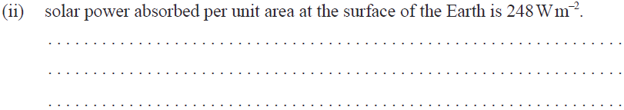
Topic 8: Energy production
8.2 – Thermal energy transfer
Energy balance in Earth surface / atmosphere system
•P / A = (1)(5.67×10⁻⁸)288⁴ = 390 W m⁻² (amount radiated)
•P / A = 140 W m⁻² (amount absorbed from atmosphere)
•390 – 140 = 250 W m⁻² (amount absorbed from sun).
Notes:
© 2006 By Timothy K. Lund

Slide 61

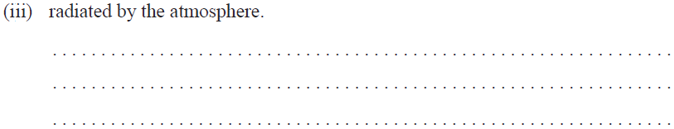
Topic 8: Energy production
8.2 – Thermal energy transfer
Energy balance in Earth surface / atmosphere system
•P / A = (0.72)(5.67×10⁻⁸)(242 + 6)⁴ = 154 W m⁻².
Notes:
© 2006 By Timothy K. Lund

Slide 62
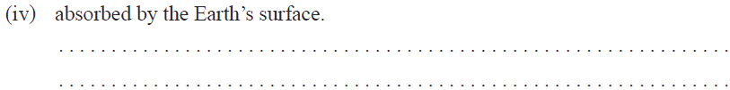
Topic 8: Energy production
8.2 – Thermal energy transfer
Energy balance in Earth surface / atmosphere system
•Amount absorbed from sun 250 W m⁻² is still same.
•P / A = 154 W m⁻² + 250 W m⁻² = 404 W m⁻².
Notes:
© 2006 By Timothy K. Lund

Slide 63
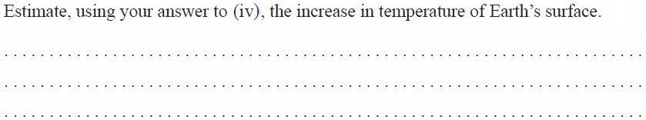
Topic 8: Energy production
8.2 – Thermal energy transfer
Energy balance in Earth surface / atmosphere system
•From Stefan-Boltzmann we have P = σAT⁴.
•Thus P / A = σT⁴ or 404 = 5.67×10⁻⁸T⁴, and
•T = 291 K, or an increase of 291 – 288 = 3 K.
Notes:
© 2006 By Timothy K. Lund

Slide 64
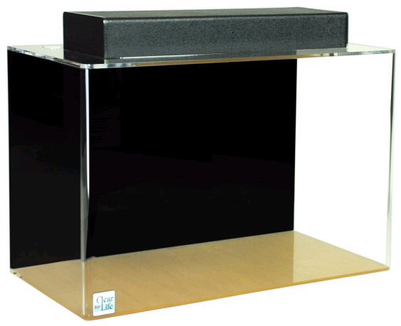
Topic 8: Energy production
8.2 – Thermal energy transfer
A simple Excel global warming model
•Real global warming models are complex, because the earth and all of its energy-exchanging and storing systems are extremely complex. Supercomputers are used with some success.
•To gain some sort of insight into computer modeling, consider the following simple model:
•5 kg of water is added to an aquarium once each second.
•10% of the water is removed from the aquarium once each second.
FYI •Water IN represents the incoming energy and water OUT represents the outgoing energy.
Notes:
© 2006 By Timothy K. Lund

Slide 65
Topic 8: Energy production
8.2 – Thermal energy transfer
A simple Excel global warming model
•At first glance it might appear that the water level will never stop increasing.
•But consider the time when 5 kg is exactly 10% of the total water in the aquarium.
•From that time on, the water will be removed exactly as fast as it is added.
•Thus, at that time the “energy” represented by the water mass will have reached equilibrium.
•The challenge is to find out how long it takes to reach equilibrium.
•Hand calculations are tedious but possible:
Notes:
© 2006 By Timothy K. Lund

Slide 66
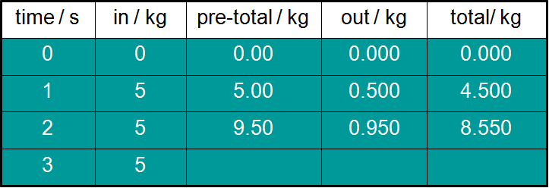
Topic 8: Energy production
8.2 – Thermal energy transfer
A simple Excel global warming model
PRACTICE: For the water model just proposed, complete the table:
SOLUTION:
•The next cell would be 8.55 + 5 = 13.55.
•The next cell would be 0.10(13.55) = 1.355.
•The next cell would be 13.55 – 1.355 = 12.195.
13.55
1.355
12.195
Notes:
© 2006 By Timothy K. Lund

Slide 67


Topic 8: Energy production
8.2 – Thermal energy transfer
A simple Excel global warming model
EXAMPLE: Create a spreadsheet to determine what the mass will be when the aquarium reaches equilibrium and how many seconds it will take.
SOLUTION: Create a new spreadsheet with five columns as shown here:
•Highlight cell A3 and type in =A2+1 as shown.
•This will increment the A cells by 1 second.
Notes:
© 2006 By Timothy K. Lund

Slide 68

Topic 8: Energy production
8.2 – Thermal energy transfer
A simple Excel global warming model
EXAMPLE: Create a spreadsheet to determine what the mass will be when the aquarium reaches equilibrium and how many seconds it will take.
SOLUTION:
•Highlight cell B2 and enter 5.
•Highlight cell C3 and type in =B3+E2 as shown.
•This will add the new input of 5 to the previous total.
Notes:
© 2006 By Timothy K. Lund

Slide 69


Topic 8: Energy production
8.2 – Thermal energy transfer
A simple Excel global warming model
EXAMPLE: Create a spreadsheet to determine what the mass will be when the aquarium reaches equilibrium and how many seconds it will take.
SOLUTION:
•Highlight cell D3 and enter =0.1*C3.
•Highlight cell E3 and enter =C3-D3.
Notes:
© 2006 By Timothy K. Lund

Slide 70
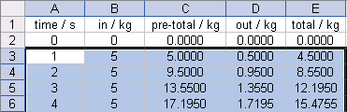
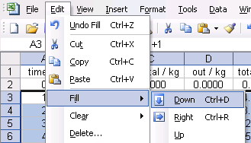
Topic 8: Energy production
8.2 – Thermal energy transfer
A simple Excel global warming model
EXAMPLE: Create a spreadsheet to determine what the mass will be when the aquarium reaches equilibrium and how many seconds it will take.
SOLUTION:
•Highlight cells A3 through E3 all the way down to about row 100.
•Then select Edit→Fill →Down (or Ctrl+D) to copy down all of the formulas to each cell for all 100 rows.
Notes:
© 2006 By Timothy K. Lund

Slide 71
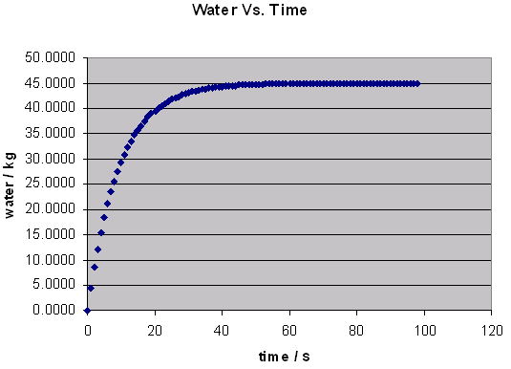
Topic 8: Energy production
8.2 – Thermal energy transfer
A simple Excel global warming model
EXAMPLE: Create a spreadsheet to determine what the mass will be when the aquarium reaches equilibrium and how many seconds it will take.
SOLUTION:
•Finally, make a graph or read the spreadsheet:
•The graph shows that the mass of water will be 45 kg at equilibrium.
•This will occur after about 60 seconds.
equilibrium
Notes:
© 2006 By Timothy K. Lund

