Slide 1
Topic 8: Energy production
8.1 – Energy sources
Essential idea: The constant need for new energy sources implies decisions that may have a serious effect on the environment. The finite quantity of fossil fuels and their implication in global warming has led to the development of alternative sources of energy. This continues to be an area of rapidly changing technological innovation.
Notes:
© 2006 By Timothy K. Lund

Slide 2
Topic 8: Energy production
8.1 – Energy sources
Nature of science: Risks and problem-solving: Since early times mankind understood the vital role of harnessing energy and large-scale production of electricity has impacted all levels of society. Processes where energy is transformed require holistic approaches that involve many areas of knowledge. Research and development of alternative energy sources has lacked support in some countries for economic and political reasons. Scientists, however, have continued to collaborate and share new technologies that can reduce our dependence on non-renewable energy sources.
Notes:
© 2006 By Timothy K. Lund

Slide 3
Topic 8: Energy production
8.1 – Energy sources
Understandings:
• Specific energy and energy density of fuel sources
• Sankey diagrams
• Primary energy sources
• Electricity as a secondary and versatile form of energy
• Renewable and non-renewable energy sources
Notes:
© 2006 By Timothy K. Lund

Slide 4
Topic 8: Energy production
8.1 – Energy sources
Applications and skills:
• Solving specific energy and energy density problems
• Sketching and interpreting Sankey diagrams
• Describing the basic features of fossil fuel power stations, nuclear power stations, wind generators, pumped storage hydroelectric systems and solar power cells
• Solving problems relevant to energy transformations in the context of these generating systems
• Discussing safety issues and risks associated with the production of nuclear power
• Describing the differences between photovoltaic cells and solar heating panels
Notes:
© 2006 By Timothy K. Lund

Slide 5
Topic 8: Energy production
8.1 – Energy sources
Guidance:
• Specific energy has units of J kg⁻¹; energy density has units of J m⁻³
• The description of the basic features of nuclear power stations must include the use of control rods, moderators and heat exchangers
• Derivation of the wind generator equation is not required but an awareness of relevant assumptions and limitations is required
• Students are expected to be aware of new and developing technologies which may become important during the life of this guide
Notes:
© 2006 By Timothy K. Lund

Slide 6
Topic 8: Energy production
8.1 – Energy sources
Data booklet reference:
• Power = energy / time
• Power = (1/2) Aρv³
Utilization:
• Generators for electrical production and engines for motion have revolutionized the world (see Physics sub-topics 5.4 and 11.2)
• The engineering behind alternative energy sources is influenced by different areas of physics (see Physics sub-topics 3.2, 5.4 and B.2)
• Energy density (see Chemistry sub-topic C.1)
• Carbon recycling (see Biology sub-topic 4.3)
Notes:
© 2006 By Timothy K. Lund

Slide 7
Topic 8: Energy production
8.1 – Energy sources
Aims:
• Aim 4: the production of power involves many different scientific disciplines and requires the evaluation and synthesis of scientific information
• Aim 8: the production of energy has wide economic, environmental, moral and ethical dimensions
Notes:
© 2006 By Timothy K. Lund

Slide 8
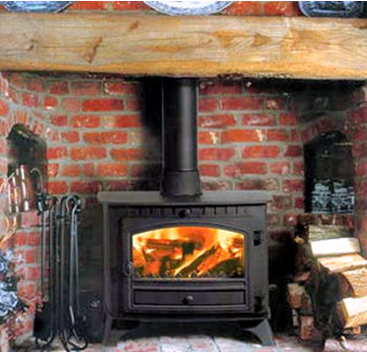
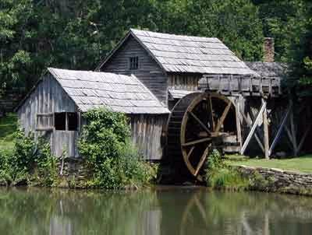
Topic 8: Energy production
8.1 – Energy sources
Primary energy sources
•A primary energy source is an energy source, such as coal, wind, oil, gas, or water, which is used directly by the consumer.
EXAMPLE: A wood-burning stove or a furnace convert the chemical energy in wood or natural gas to heat, through burning. The heat is used directly.
EXAMPLE: A windmill or waterwheel can directly convert the kinetic energy of the wind or water into mechanical motion of wheels to grind wheat grain into flour.
Notes:
© 2006 By Timothy K. Lund

Slide 9
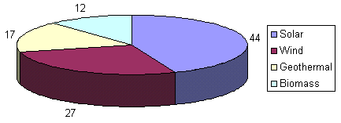

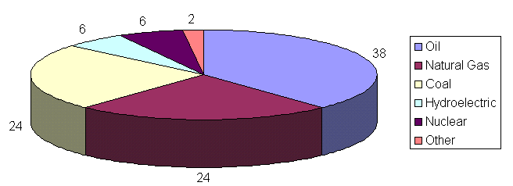
Topic 8: Energy production
8.1 – Energy sources
Primary energy sources
•You should have a good idea of these percentages, from memory.
Fossil fuels
CO₂
Notes:
© 2006 By Timothy K. Lund

Slide 10
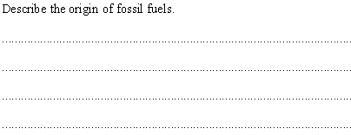
Topic 8: Energy production
8.1 – Energy sources
Primary energy sources
PRACTICE:
•Sun makes biomass through photosynthesis.
•Biomass gathers and grows over time.
•Biomass buried under great pressure and heat.
•Biomass becomes coal, oil and natural gas over eons.
•Coal, oil and natural gas are extracted.
•Coal, oil and natural gas are used as fuels.
Notes:
© 2006 By Timothy K. Lund

Slide 11
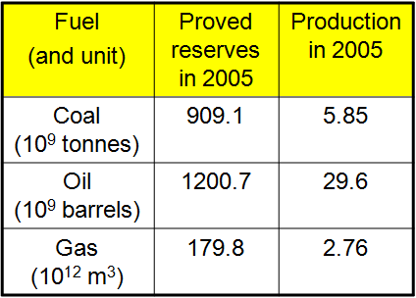
Topic 8: Energy production
8.1 – Energy sources
Primary energy sources
PRACTICE: Proved reserves are resources that we are sure we can obtain. Production means actual reserves that have been obtained and placed on the market. Use the table to estimate how long oil reserves might last.
SOLUTION: Expectancy = Reserves / Production
= 1200.7×10⁹ / 29.6×10⁹
= 40.6 years.
•This is an estimate because both numbers are subject to yearly change.
Notes:
© 2006 By Timothy K. Lund

Slide 12
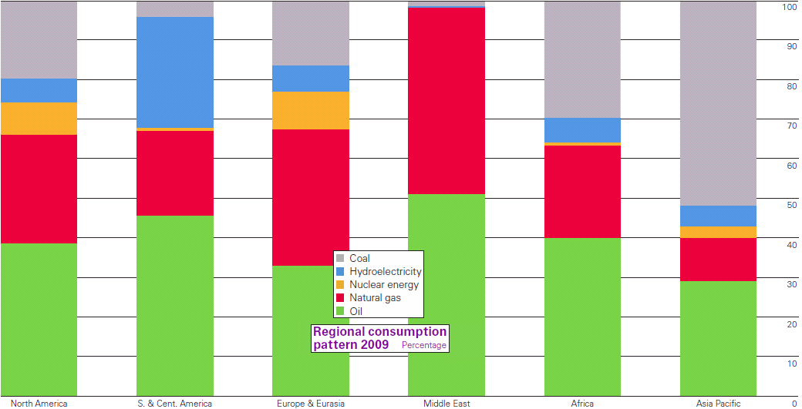
Topic 8: Energy production
8.1 – Energy sources
Primary energy sources
Notes:
© 2006 By Timothy K. Lund

Slide 13
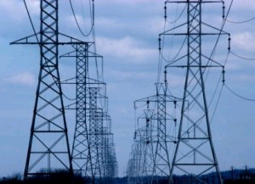
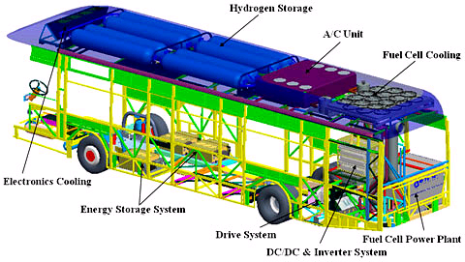
Topic 8: Energy production
8.1 – Energy sources
Secondary energy sources
•A secondary energy source is an energy source, such as electricity or hydrogen, which has been transformed from a primary energy source before use by the consumer.
EXAMPLE: Electricity is by far the most common of the secondary energy sources because of its convenience in both use and transport.
EXAMPLE: Hydrogen is a growing secondary energy source, and is being developed because its consumption produces only water as a by-product.
Notes:
© 2006 By Timothy K. Lund

Slide 14
Topic 8: Energy production
8.1 – Energy sources
Specific energy and energy density of fuel sources
•Specific energy E_{SP} is how much energy (J) you can get per unit mass (kg) from a fuel. Its units are J kg⁻¹.
•Energy density E_{D} is how much energy (J) you can get per unit volume (m³). Its units are J m⁻³.
EXAMPLE: Fission of each uranium-235 produces 3.5×10⁻¹¹ J of energy. The density of U-235 is 1.8×10⁴ kg m⁻³. Calculate the E_{SP} and the E_{D} of U-235.
SOLUTION:
(a) m = (235 u)(1.661×10⁻²⁷ kg u⁻¹) = 3.90×10⁻²⁵ kg.
E_{SP} = 3.5×10⁻¹¹ J / 3.90×10⁻²⁵ kg = 9.0×10¹³ J kg⁻¹.
(b) E_{D} = (9.0×10¹³ J kg⁻¹)(1.8×10⁴ kg m⁻³)
= 1.6×10¹⁸ J m⁻³.
Notes:
© 2006 By Timothy K. Lund

Slide 15
Topic 8: Energy production
8.1 – Energy sources
Specific energy and energy density of fuel sources
•Most of our energy comes from fuels. Here is the energy yield of various fuels:
Fuel
Fuel Type
Specific energy (MJ / kg)
Protons
Nuclear
300,000,000
Uranium-235
Nuclear
90,000,000
Petrol
Fossil
46.9
Diesel
Fossil
45.8
Biodiesel
Fossil
42.2
Crude Oil
Fossil
41.9
Coal
Fossil
32.5
Sugar
Fossil
17.0
Wood
Fossil
17.0
Cow Dung
Fossil
15.5
Household Waste
Fossil
10.0
Notes:
© 2006 By Timothy K. Lund

Slide 16

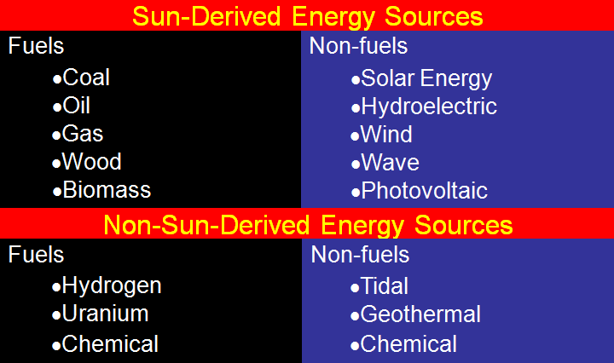


Topic 8: Energy production
8.1 – Energy sources
Renewable and non-renewable energy sources
•Renewable resources can be replaced in a reasonable amount of time (or are not depleted).
Notes:
© 2006 By Timothy K. Lund

Slide 17


Topic 8: Energy production
8.1 – Energy sources
Renewable and non-renewable energy sources
•Renewable energy is better than non-renewable because it will not run out.
•Oil and gas are better than coal because they burn more efficiently and produce less CO₂.
•Coal is cheaper and more plentiful than gas and oil.
•Nuclear power does not produce CO₂.
•Hydroelectric systems are useful to have in a grid because they can be used to store extra energy.
•Burning biomass alleviates landfills.
•Nuclear waste lasts for thousands of years.
•Wind turbines and photovoltaic cells depend on the weather conditions and have small output.
Notes:
© 2006 By Timothy K. Lund

Slide 18
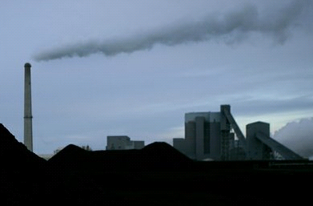
Topic 8: Energy production
8.1 – Energy sources
Solving specific energy and energy density problems
EXAMPLE: Coal has a specific energy of 32.5 MJ/ kg. If a city has a coal-fired power plant that needs to produce 30.0 MW of power, with an efficiency of 25%, how many kilograms of coal are needed daily?
SOLUTION:
0.25 = 30.0 MW / input → input = 120 MW
But 1 day = 24×3600 s = 86400 s so that
input = (120 MJs⁻¹)(86400 s) = 10368000 MJ.
input = (10368000 MJ)(1 kg / 32.5 MJ) = 320000 kg.
efficiency = output / input
efficiency
Notes:
© 2006 By Timothy K. Lund

Slide 19
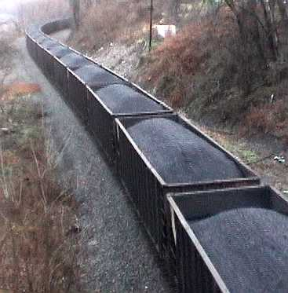
Topic 8: Energy production
8.1 – Energy sources
Solving specific energy and energy density problems
PRACTICE:
If coal is transported in rail cars having a capacity of 1.5 metric tons, how many cars per day must supply the power plant of the previous example?
SOLUTION:
•From the previous example we calculated that we need 320000 kg of coal per day.
•Since a metric ton is 1000 kg, we have
(320000 kg ) / (1.5 × 1000 kg / car)
or 213 cars d⁻¹!
Notes:
© 2006 By Timothy K. Lund

Slide 20
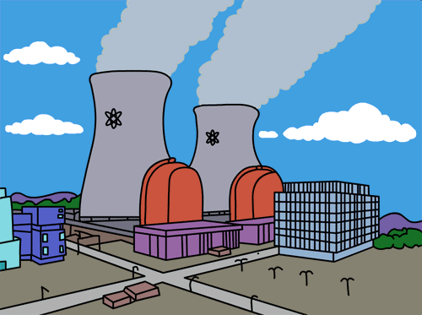
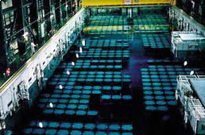
Topic 8: Energy production
8.1 – Energy sources
Solving specific energy and energy density problems
PRACTICE:
If a nuclear power plant powered by uranium-235 has the same output and the same efficiency as the coal-fired plant of the previous example, how many kilograms of nuclear fuel will it burn per day? Per year?
SOLUTION:
•From the previous example we calculated that we need 10368000 MJ of energy per day.
•Thus
(10368000 MJ) / (1 kg / 90000000 MJ)
or 0.1152 kg d⁻¹! This is 42 kg y⁻¹.
Notes:
© 2006 By Timothy K. Lund

Slide 21
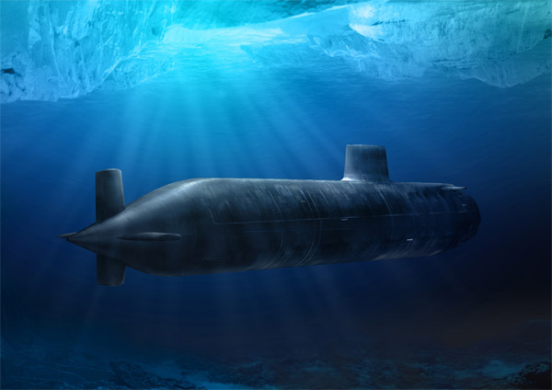
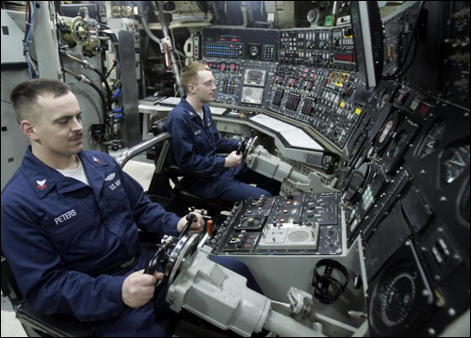
Topic 8: Energy production
8.1 – Energy sources
Solving specific energy and energy density problems
PRACTICE:
Explain why it is advantageous to have a submarine which is nuclear powered, as opposed to diesel.
SOLUTION:
•There are two main reasons:
(1) Nuclear reactors don’t use oxygen, so the sub can stay under water for months at a time.
(2) Nuclear fuel is extremely compact for the amount of energy it contains. Thus the sub can cruise far before refill.
Notes:
© 2006 By Timothy K. Lund

Slide 22

Topic 8: Energy production
8.1 – Energy sources
Sankey diagrams
•Continuous conversion of energy into work requires a cyclical process and the transfer of energy from the system.
•If you've ever camped out you've probably used a campfire in these two obvious ways:
- for cooking, and for warmth.
•In both cases:
(1) It is the heat released during combustion (a chemical reaction) that is used.
(2) The heat is used directly.
(3) Some heat is lost to the environment or wasted.
Notes:
© 2006 By Timothy K. Lund

Slide 23


Topic 8: Energy production
8.1 – Energy sources
Sankey diagrams
•Continuous conversion of energy into work requires a cyclical process and the transfer of energy from the system.
•If you want to convert the heat to useful work, some sort of engine must be designed.
•For example, the potential energy of a hot air balloon can be changed with heat…
•And to make an electricity-producing engine…
•Once the water is used up, the balloon must cool down, descend, and refill its water supply.
•Then it can repeat the motion in a cyclical process that will keep producing electricity.
Notes:
© 2006 By Timothy K. Lund

Slide 24
Topic 8: Energy production
8.1 – Energy sources
Sankey diagrams
PRACTICE:
In the balloon-water electricity engine name all of the energy conversions that occur.
SOLUTION:
1 - Coal (or wood) becomes heat.
2 - Heat expands air in balloon to decrease its density.
3 - Buoyant force causes balloon to rise, increasing potential energy of the water.
4 - Falling water converts potential to kinetic energy.
5 - Moving water collides with fan blades and imparts kinetic energy to them.
6 - Moving fan blades generate electricity.
Notes:
© 2006 By Timothy K. Lund

Slide 25
Topic 8: Energy production
8.1 – Energy sources
Sankey diagrams
PRACTICE:
In the balloon-water electricity engine name all of the energy losses that occur.
SOLUTION:
1 - Coal loses heat to air outside balloon.
2 - Hot balloon loses heat to outside air.
3 - Excess hot air escapes bottom of balloon.
4 - Falling water heats up air as it falls.
5 - Falling water continues past blades colliding with the ground.
6 - Internal friction of fan shaft impedes rotation.
7 - Internal resistance of wiring generates I ²R heat loss.
Notes:
© 2006 By Timothy K. Lund

Slide 26

Topic 8: Energy production
8.1 – Energy sources
Sankey diagrams
•The second law of thermodynamics states that although it is possible to convert mechanical energy completely into thermal energy, it is NOT possible to convert all heat energy into mechanical energy.
•The balloon example demonstrates the second part of the law: Much energy is lost or wasted.
•And the example of kicking the block shown next demonstrates the first part:
•All of the block’s kinetic energy became friction heat.
•Obviously, this heat cannot ever be used to give the block back its original kinetic energy!
•This loss of energy during conversion from one form to another is called energy degradation.
Notes:
© 2006 By Timothy K. Lund

Slide 27
Topic 8: Energy production
8.1 – Energy sources
Sankey diagrams
•Energy degradation in systems can be shown with an energy flow diagram called a Sankey diagram.
•For the hot-air balloon example we have the following Sankey diagram:
•The degraded energy is represented by the yellow bent arrows, and shows energy lost by the system.
CHEMICAL ENERGY
POTENTIAL ENERGY
KINETIC ENERGY
ELECTRICAL ENERGY
Notes:
© 2006 By Timothy K. Lund

Slide 28
Topic 8: Energy production
8.1 – Energy sources
Sankey diagrams
•Sankey diagrams show the efficiency of each energy conversion.
•Suppose the actual energy values are as shown:
•The efficiency of a conversion is given by
•For example, the efficiency of the first energy conversion (chemical to potential) is
efficiency = 80 MJ / 100 MJ = 0.80 or 80%.
CHEMICAL ENERGY
POTENTIAL ENERGY
KINETIC ENERGY
ELECTRICAL ENERGY
70 MJ
50 MJ
80 MJ
100 MJ
efficiency = output / input
efficiency
Notes:
© 2006 By Timothy K. Lund

Slide 29
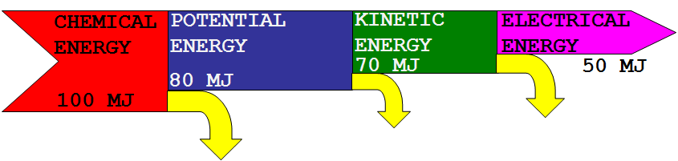
Topic 8: Energy production
8.1 – Energy sources
Sankey diagrams
EXAMPLE:
Find the energy values for each of the degradations in the Sankey diagram.
SOLUTION:
•From conservation of energy we see that at each interface, the energy in must equal the energy out.
10 MJ
20 MJ
20 MJ
FYI
•What is the overall efficiency of this engine?
Notes:
© 2006 By Timothy K. Lund

Slide 30
Topic 8: Energy production
8.1 – Energy sources
Sankey diagrams
EXAMPLE:
•Efficiencies for various “machines” are shown in the table.
Machine
Efficiency (%)
Steam Locomotive
5 to 10
Human Muscle
20 to 25
Automobile
less than 25
Compressor
80
Electric Motor
70 to 95
Notes:
© 2006 By Timothy K. Lund

Slide 31

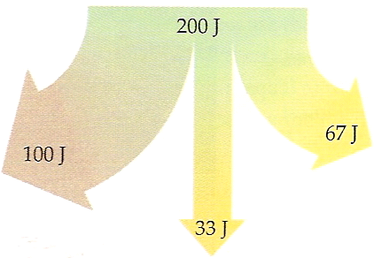



Topic 8: Energy production
8.1 – Energy sources
Sankey diagrams
EXAMPLE: To give you an idea of why living things are so inefficient, consider the caterpillar that eats leaves.
•Note how the total leaf energy is used:
What is the caterpillar’s overall efficiency?
SOLUTION:
•Adding to the caterpillar biomass of the world is the desired outcome. Thus
efficiency = 33 J / 200 J
= 17%
Notes:
© 2006 By Timothy K. Lund

Slide 32
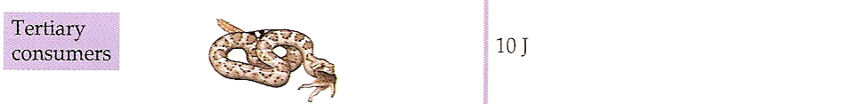
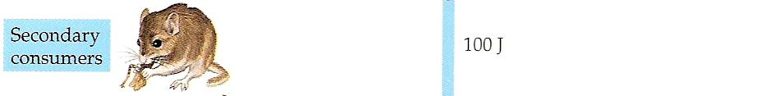


Topic 8: Energy production
8.1 – Energy sources
Sankey diagrams
EXAMPLE: In the bigger picture, energy is degraded in an ecosystem.
Note that in each stage 90% of the stored energy is lost to the environment!
Notes:
© 2006 By Timothy K. Lund

Slide 33
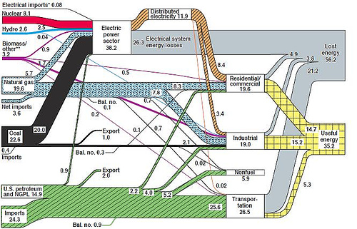
Energy diagram for the US.
Energy flows from left to right.
Notes:
© 2006 By Timothy K. Lund

Slide 34
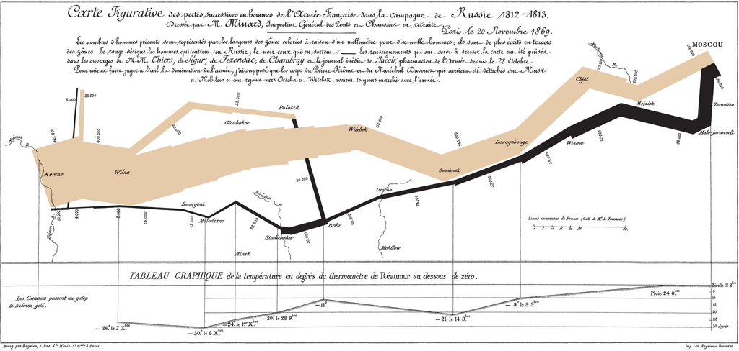
Charles Minard's 1869 Sankey diagram showing the number of men in Napoleon’s 1812 Russian campaign army, their movements, as well as the temperature they encountered on the return path. Lithograph, 62 x 30 cm.
1812 Overture on YouTube
Notes:
© 2006 By Timothy K. Lund

Slide 35
Topic 8: Energy production
8.1 – Energy sources
Electricity as a secondary and versatile form of energy
•Electricity is one of the most useable forms of (secondary) energy we have because it is so easily transportable and distributed.
•You may recall that moving electrons produce a magnetic field.
•It turns out that the process is symmetric: A moving magnetic field produces moving electrons (an electromotive force).
•Essentially, an electromotive force (emf) is a voltage that can drive an electrical current.
ammeter
0
-
+
Notes:
© 2006 By Timothy K. Lund

Slide 36
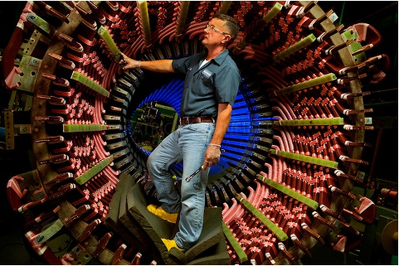
Topic 8: Energy production
8.1 – Energy sources
Electricity as a secondary and versatile form of energy
•The wire coils in a generator experience reversing magnetic fields as they rotate through action of a turbine of some sort, usually driven by a primary energy source.
•This changing field produces the emf.
•This emf drives the charges and creates a current.
•Note how the direction of the current keeps alternating.
•This is why your current at home is alternating current (AC).
B-Field
Electrons
Wire
Notes:
© 2006 By Timothy K. Lund

Slide 37
Topic 8: Energy production
8.1 – Energy sources
Describing fossil fuel power stations
•The most common way to generate electrical power is the coal-burning power plant.
•Chemical energy in coal is released by burning.
•Heat boils water.
•Steam rotates a turbine.
•The turbine turns a coil of wire in a magnetic field.
•Electrical power is produced.
Turbine
Generator
Coal
Condenser
Boiler
Notes:
© 2006 By Timothy K. Lund

Slide 38
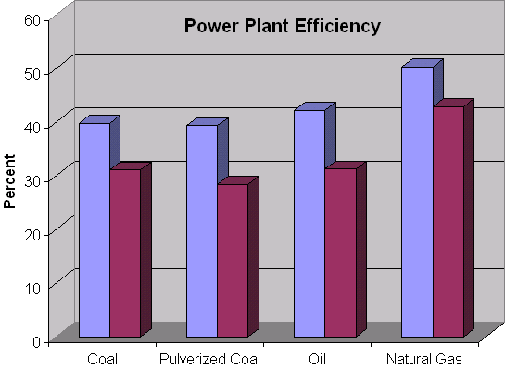
Topic 8: Energy production
8.1 – Energy sources
Describing fossil fuel power stations – Coal/oil-burning
exhaust gas
BOILER
friction
STEAM TURBINE
GENERATOR
COAL
CONDENSER
cold water
wasted heat
CHEMICAL ENERGY
HOT STEAM
KINETIC
ELECTRICITY
friction
exhaust gas
wasted heat
40% efficient
Notes:
© 2006 By Timothy K. Lund

Slide 39
Topic 8: Energy production
8.1 – Energy sources
Describing fossil fuel power stations – Gas-burning
exhaust gas
BOILER
friction
GAS
STEAM TURBINE
GENERATOR
GENERATOR
friction
GAS TURBINE
CONDENSER
cold water
wasted heat
friction
CHEMICAL ENERGY
ELECTRICITY
HOT STEAM
KINETIC
ELECTRICITY
friction
wasted heat
50% efficient
exhaust
Notes:
© 2006 By Timothy K. Lund

Slide 40
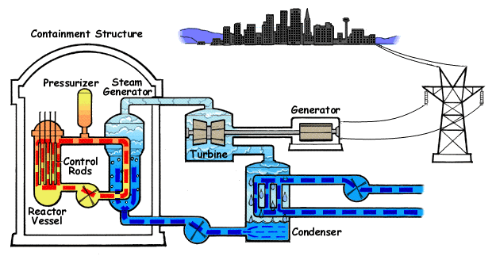






Topic 8: Energy production
8.1 – Energy sources
Describing nuclear power stations
•Nuclear power stations are the same as fossil fuel stations, from the turbine on down.
⇒ Heat
⇒ Kinetic
⇒ Electrical
Notes:
© 2006 By Timothy K. Lund

Slide 41

Topic 8: Energy production
8.1 – Energy sources
Solving problems relevant to energy transformations
EXAMPLE: Create a Sankey diagram for a typical nuclear reactor: Because of the difficulty of enrichment, include that energy in the diagram.
SOLUTION:
ENERGY USED IN PROCESSING FUEL
ENERGY IN URANIUM ORE
ENERGY IN ENRICHED URANIUM
ELECTRICAL ENERGY
ENERGY REMAINING IN SPENT FUEL
HEAT LOSS
Notes:
© 2006 By Timothy K. Lund

Slide 42
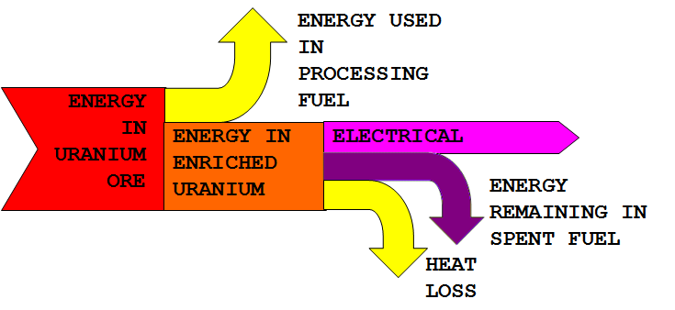
Topic 8: Energy production
8.1 – Energy sources
Solving problems relevant to energy transformations
PRACTICE:
What transformations were not shown in the previous Sankey diagram?
SOLUTION:
•Between ENERGY IN ENRICHED URANIUM and ELECTRICAL there should be HOT STEAM and KINETIC.
•From HOT STEAM and KINETIC there should be a HEAT LOSS and FRICTION.
Notes:
© 2006 By Timothy K. Lund

Slide 43
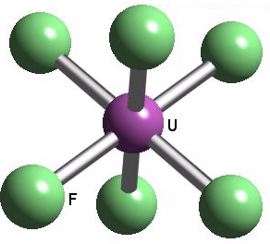
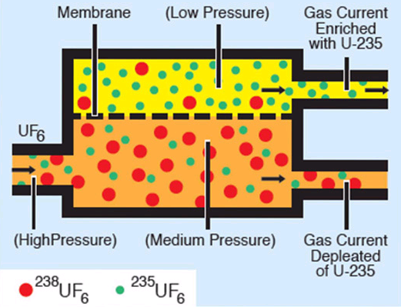
Topic 8: Energy production
8.1 – Energy sources
Describing nuclear power stations
•To work properly, a reactor needs a higher proportion of the U-235 isotope of uranium than occurs naturally.
•One slow and expensive means of enrichment for uranium is called gaseous diffusion.
•Uranium is purified and combined with fluorine to produce a gas called uranium hexafluoride UF₆.
•The different isotopes of uranium will lead to slightly different UF₆ masses.
•The process of diffusion uses many stages of membrane filters.
Notes:
© 2006 By Timothy K. Lund

Slide 44
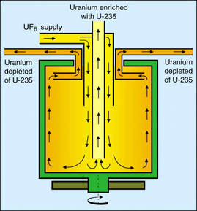
Topic 8: Energy production
8.1 – Energy sources
Describing nuclear power stations
•To work properly, a reactor needs a higher proportion of the U-235 isotope of uranium than occurs naturally.
•Another slow and expensive means of enrichment for uranium is called centrifuging.
•Centrifuging spins the UF₆ gas and the heavier isotopes are decanted while the lighter ones are sent to further stages.
FYI
•Because of the energy expenditure of the enrichment process, it is often included in the Sankey diagram.
Notes:
© 2006 By Timothy K. Lund

Slide 45
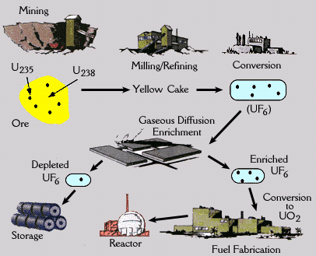
Topic 8: Energy production
8.1 – Energy sources
Describing nuclear power stations
Notes:
© 2006 By Timothy K. Lund

Slide 46
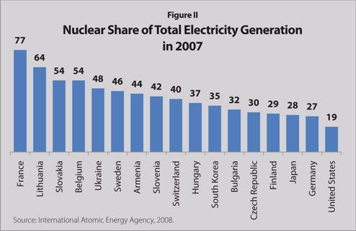
Topic 8: Energy production
8.1 – Energy sources
Primary energy sources
Notes:
© 2006 By Timothy K. Lund

Slide 47






Topic 8: Energy production
8.1 – Energy sources
Describing nuclear power stations
•Nuclear fission is the splitting of a large nucleus into two smaller (daughter) nuclei.
•An example of fission is
•In the animation, ²³⁵U is hit by a neutron, and capturing it, becomes excited and unstable:
•It quickly splits into two smaller daughter nuclei, and two neutrons, each of which can split another nucleus of ²³⁵U.
²³⁵U + ¹n → (²³⁶U*) → ¹⁴⁰Xe + ⁹⁴Sr + 2(¹n)
⁹² ⁰ ⁹² ⁵⁴ ³⁸ ⁰
⁹⁴Sr
¹⁴⁰Xe
Notes:
© 2006 By Timothy K. Lund

Slide 48
Topic 8: Energy production
8.1 – Energy sources
Describing nuclear power stations
•Note that the splitting was triggered by a single neutron that had just the right energy to excite the nucleus.
•Note also that during the split, two more neutrons were released.
•If each of these neutrons splits subsequent nuclei, we have what is called a chain reaction.
²³⁵U + ¹n → (²³⁶U*) → ¹⁴⁰Xe + ⁹⁴Sr + 2(¹n)
⁹² ⁰ ⁹² ⁵⁴ ³⁸ ⁰
1
2
Primary
4
Secondary
8
Tertiary
Exponential Growth
Notes:
© 2006 By Timothy K. Lund

Slide 49
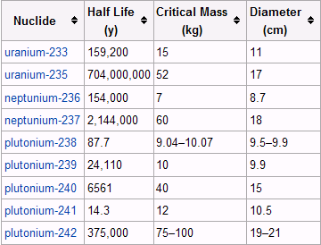
Topic 8: Energy production
8.1 – Energy sources
Describing nuclear power stations
•We call the minimum mass of a fissionable material which will sustain the fission process by itself the critical mass.
Note that ²³⁸U is not even in this list.
This is why we must enrich naturally-occurring uranium for reactor usage.
Notes:
© 2006 By Timothy K. Lund

Slide 50
Topic 8: Energy production
8.1 – Energy sources
Describing nuclear power stations
•In a nuclear reactor, a controlled nuclear reaction is desired so that we merely sustain the reaction without growing it.
•In a nuclear bomb, an uncontrolled nuclear reaction is desired so that we have an immense and very rapid energy release.
Half of the product neutrons are absorbed by the control rods
controlled
Few of the product neutrons are absorbed
uncontrolled
Notes:
© 2006 By Timothy K. Lund

Slide 51
Topic 8: Energy production
8.1 – Energy sources
Describing nuclear power stations
•Recall that a typical fission of ²³⁵U will produce two (and sometimes 3) product neutrons.
•These neutrons have a wide range of kinetic energies E_{K}.
•If the E_{K} value of a neutron is too high, it can pass through a ²³⁵U nucleus without causing it to split.
•If the E_{K} value is too small, it will just bounce off of the ²³⁵U nucleus without exciting it at all.
too slow
too fast
Notes:
© 2006 By Timothy K. Lund

Slide 52
Topic 8: Energy production
8.1 – Energy sources
Describing nuclear power stations
•Most of the neutrons produced in a reactor are fast neutrons, unable to split the ²³⁵U nucleus.
•These fast neutrons will eventually be captured by ²³⁸U, or they will leave the surface of the fuel rod, without sustaining the fission reaction.
•Moderators such as graphite, light water and heavy water slow down these fast neutrons to about 0.02 eV so that they can contribute to the fission process.
1-2 MeV average
0
5
10
Neutron energy / MeV
fuel rod
moderator
moderator
moderator
moderator
Notes:
© 2006 By Timothy K. Lund

Slide 53
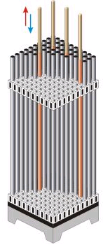
Topic 8: Energy production
8.1 – Energy sources
Describing nuclear power stations
•In order to shut down, start up, and change the reaction rate in a reactor, neutron-absorbing control rods are used.
•Retracting the control rods will increase the reaction rate.
•Inserting the control rods will decrease the reaction rate.
•Control rods are made of cadmium or boron steel.
moderator
moderator
moderator
moderator
Notes:
© 2006 By Timothy K. Lund

Slide 54
Topic 8: Energy production
8.1 – Energy sources
Describing nuclear power stations
•The whole purpose of the reactor core is to produce heat through fission.
•The fuel rods, moderator and control rods are all surrounded by water, or some other thermal absorber that can be circulated.
•Some reactors use liquid sodium!
•The extremely hot water from the reactor core is sent to the heat exchanger which acts like the boiler in a fossil fuel power plant.
moderator
moderator
moderator
moderator
Notes:
© 2006 By Timothy K. Lund

Slide 55
Topic 8: Energy production
8.1 – Energy sources
Describing nuclear power stations
•The heat exchanger extracts heat from the circulating reactor coolant and makes steam to run the turbine.
turbine
generator
control rods
heat exchanger
cooling tower
condenser
Notes:
© 2006 By Timothy K. Lund

Slide 56
Topic 8: Energy production
8.1 – Energy sources
Discussing nuclear safety issues and risks
•There are three isolated water circulation zones whose purpose is to protect the environment from radioactivity.
Zone 1: Reactor coolant
Zone 2: Heat exchanger
Zone 3: Cooling tower
Notes:
© 2006 By Timothy K. Lund

Slide 57
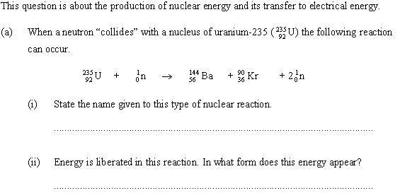
Topic 8: Energy production
8.1 – Energy sources
Solving problems relevant to energy transformations
•This is a fission reaction.
•Heat and some kinetic energy of the product neutrons.
Notes:
© 2006 By Timothy K. Lund

Slide 58

Topic 8: Energy production
8.1 – Energy sources
Solving problems relevant to energy transformations
•Looking at the reaction we see that one neutron initiates one fission…
but each reaction produces two neutrons.
•Thus the fission process can produce a self-sustaining chain reaction.
Notes:
© 2006 By Timothy K. Lund

Slide 59
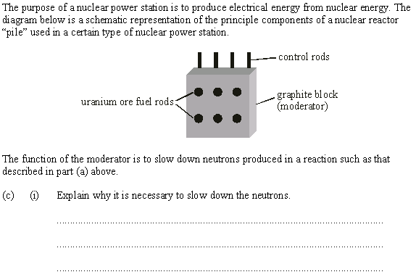
Topic 8: Energy production
8.1 – Energy sources
Solving problems relevant to energy transformations
•Product neutrons are too fast to cause fissioning.
•The moderator slows them down to the right speed.
Notes:
© 2006 By Timothy K. Lund

Slide 60
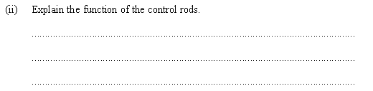
Topic 8: Energy production
8.1 – Energy sources
Solving problems relevant to energy transformations
•The control rods absorb neutrons produced by fission.
•This allows a reactor to just maintain its reaction rate at the self-sustaining level, rather than becoming a dangerous chain reaction.
Notes:
© 2006 By Timothy K. Lund

Slide 61
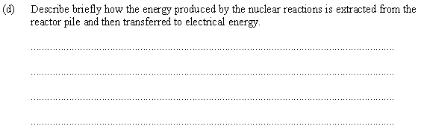
Topic 8: Energy production
8.1 – Energy sources
Solving problems relevant to energy transformations
•Reactor coolant from the pile is circulated through a heat exchanger.
•The heat exchanger heats up water to boiling to run a steam turbine.
•The steam turbine turns a generator to produce electricity.
Notes:
© 2006 By Timothy K. Lund

Slide 62
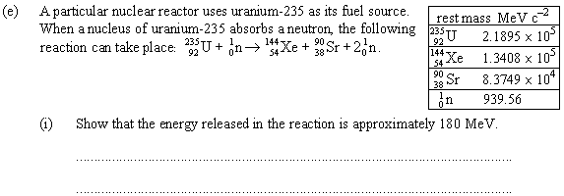
Topic 8: Energy production
8.1 – Energy sources
Solving problems relevant to energy transformations
•The reactants: U-235 and 1n:
218950 + 940 = 219890 MeV.
•The products: Xe-144, Sr 90 and 2n:
134080 + 83749 + 2(940) = 219709 MeV.
•The mass defect is 219890 – 219709 = 181 MeV.
(This is the energy released through mass loss according to E = mc²).
Notes:
© 2006 By Timothy K. Lund

Slide 63
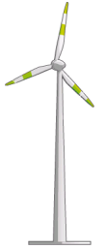
Topic 8: Energy production
8.1 – Energy sources
Describing wind generators
•Heated land air becomes less dense, and rises.
•Cooler air then fills the low pressure left behind.
•A convection current forms.
•Wind turbines can use the wind to make electricity.
Air Falls
Air Rises
Convection Current
Partial Vacuum
Low Pressure
Land (c is small)
Wind Turbine
Heats/cools QUICKLY
Water (c is big)
Heats/cools SLOWLY
Notes:
© 2006 By Timothy K. Lund

Slide 64
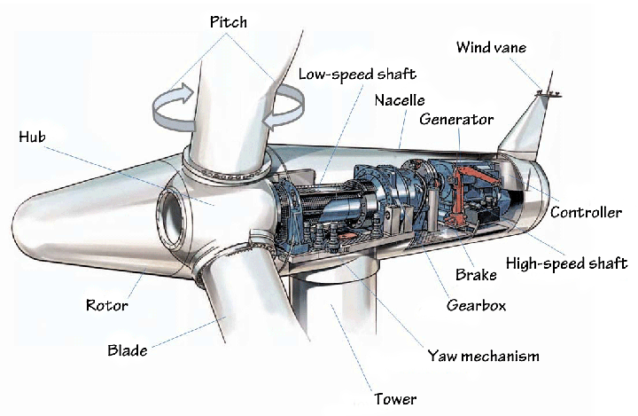
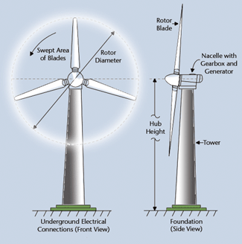
Topic 8: Energy production
8.1 – Energy sources
Describing wind generators
•The most obvious features of a wind generator are the rotor blades.
•The nacelle contains a gearbox, and a generator.
Notes:
© 2006 By Timothy K. Lund

Slide 65
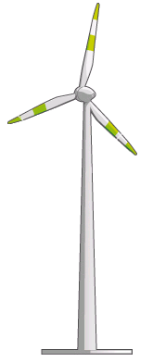
Topic 8: Energy production
8.1 – Energy sources
Solving problems relevant to energy transformations
EXAMPLE: Determine the power that may be delivered by a wind generator, assuming that the wind kinetic energy is completely converted into mechanical energy.
SOLUTION:Assume a rotor blade radius of r.
•The volume of air that moves through the blades in a time t is given by V = Ad = Avt, where v is the speed of the air and A = πr².
•The mass m is thus m = ρV = ρAvt.
•E_{K} = (1/2)mv² = (1/2)ρAvtv² = (1/2)ρAv³t.
•Power is E_{K} / t so that
d = vt
r
where A = πr ²
power = (1/ 2)Aρv³
wind generator
Notes:
© 2006 By Timothy K. Lund

Slide 66
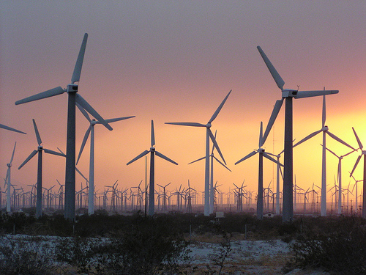
Topic 8: Energy production
8.1 – Energy sources
Solving problems relevant to energy transformations
PRACTICE: Since the air is still moving after passing through the rotor area, obviously not all of the kinetic energy can be used. The maximum theoretical efficiency of a wind turbine is about 60%. Given a turbine having a blade length of 12 m, a wind speed of 15 ms⁻¹ and an efficiency of 45%, find the power output. The density of air is ρ = 1.2 kg m⁻³.
SOLUTION:
A = πr ² = π(12²) = 452 m².
Power = (0.45)(1/2)Aρv³
= (0.45)(1/2)×452×1.2×15³
= 411885 W
= 410 kW.
Notes:
© 2006 By Timothy K. Lund

Slide 67

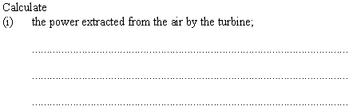
Topic 8: Energy production
8.1 – Energy sources
Solving problems relevant to energy transformations
•A = πr² = π(7.5²) = 177.
•Power_{in} = (1/2)Aρv³ = (1/2)(177)(1.2)9³ = 77420
•Power_{thru} = (1/2)Aρv³ = (1/2)(177)(2.2)5³ = 24338
•Power_{ext} = power_{in} - power_{thru}
•Power_{ext} = 77420 – 24338 = 53082 W = 53 kW.
Notes:
© 2006 By Timothy K. Lund

Slide 68

Topic 8: Energy production
8.1 – Energy sources
Solving problems relevant to energy transformations
•P_{out} = (efficiency)P_{extracted}
•P_{out} = (0.72)(53 kW) = 38 kW
Notes:
© 2006 By Timothy K. Lund

Slide 69

Topic 8: Energy production
8.1 – Energy sources
Solving problems relevant to energy transformations
•Power is proportional to v³.
•The wind speed had doubled (from 6 to 12 m s⁻¹).
•Thus the power should increase by 2³ = 8 times.
•Output will now be 8(5 kW) = 40 kW.
Notes:
© 2006 By Timothy K. Lund

Slide 70
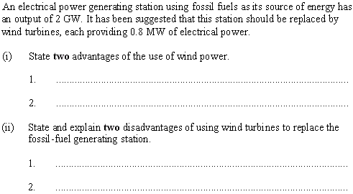
Topic 8: Energy production
8.1 – Energy sources
Solving problems relevant to energy transformations
•Wind power doesn’t produce greenhouse gas.
•Wind power is a renewable resource.
•Wind depends on the weather.
•2 GW / 0.8 MW = 2500 turbines required!
Notes:
© 2006 By Timothy K. Lund

Slide 71
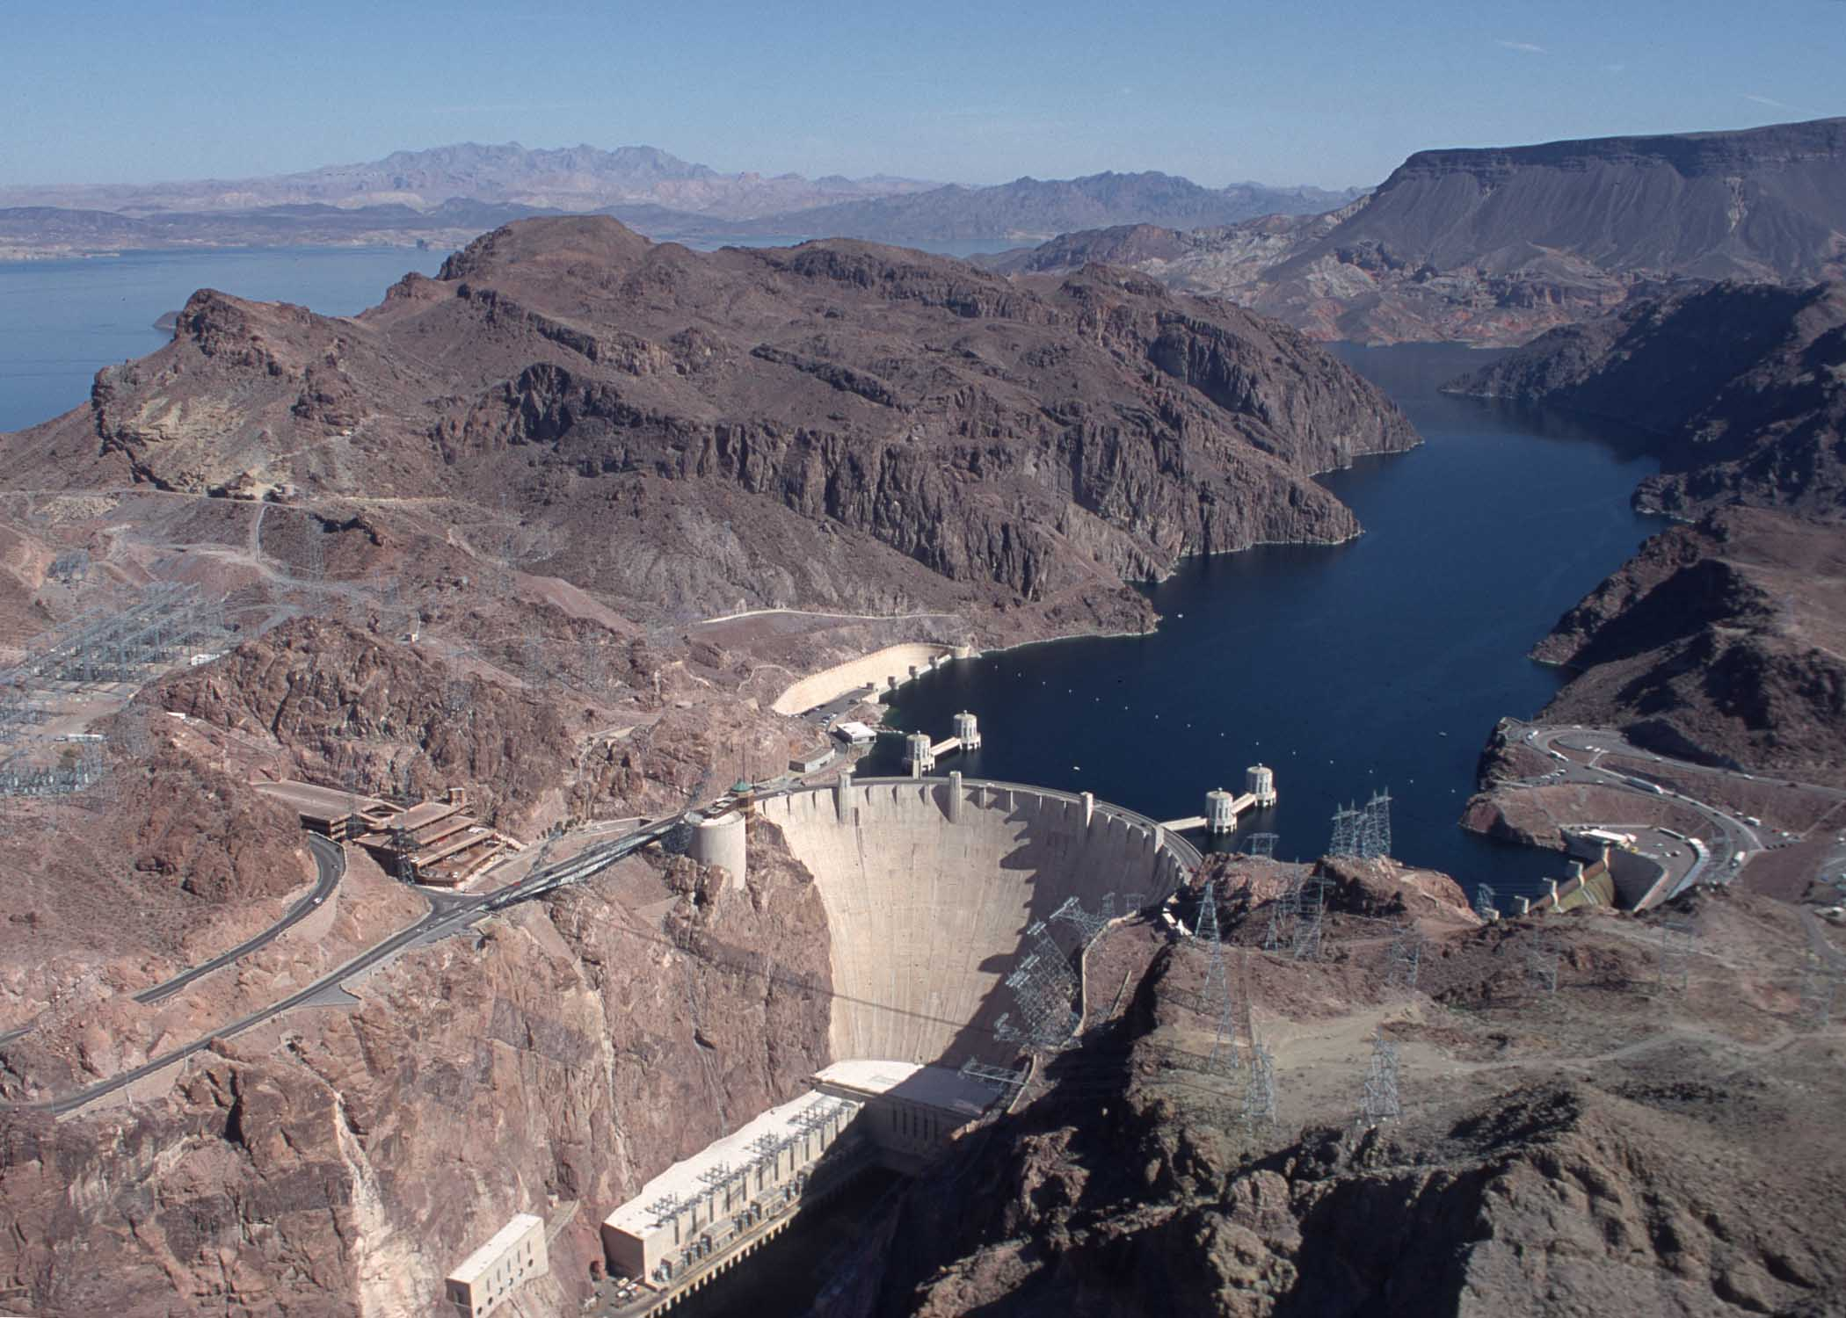

Topic 8: Energy production
8.1 – Energy sources
Describing hydroelectric systems
•We can divide hydroelectric power production into two groups:
•Sun-derived uses sun-driven potential energy.
•Moon-derived uses tidal-driven potential energy.
Hoover Dam: 1.5×10⁹ W
Rance Tidal Barrage: 2.4×10⁸ W
Notes:
© 2006 By Timothy K. Lund

Slide 72

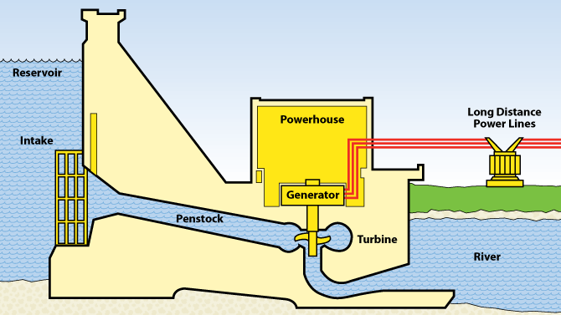
Topic 8: Energy production
8.1 – Energy sources
Describing hydroelectric systems – sun-driven
•A typical hydroelectric dam:
•Sun-driven evaporation and rainfall place water at a high potential energy.
•During times of less energy demand, excess power plant electricity can be used to pump water back up into the reservoir for later use.
•This is called the pumped storage scheme.
FYI
•If electrical supply and demand differ by 5%, a blackout occurs. Pumped storage alleviates this.
Notes:
© 2006 By Timothy K. Lund

Slide 73

Topic 8: Energy production
8.1 – Energy sources
Describing hydroelectric systems – tide-driven
•A typical tidal barrage:
•The turbine can be driven both ways during a tidal cycle.
Ocean side
Estuary side
Notes:
© 2006 By Timothy K. Lund

Slide 74
Topic 8: Energy production
8.1 – Energy sources
Solving problems relevant to energy transformations
•In the sun- or tide-driven scheme there is a conversion of the potential energy of the water into the kinetic energy of a turbine and thus to electricity.
ENERGY IN SUNLIGHT /OR TIDE
POTENTIAL ENERGY IN RESERVOIR
KINETIC ENERGY OF TURBINE
ELECTRICITY
FRICTION
FRICTION
EVAPORATION FROM RESERVOIR
Notes:
© 2006 By Timothy K. Lund

Slide 75
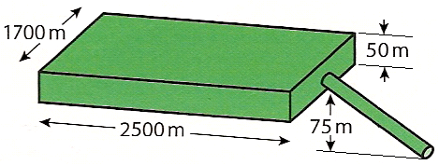
Topic 8: Energy production
8.1 – Energy sources
Solving problems relevant to energy transformations
PRACTICE: A reservoir for a hydroelectric dam is shown.
(a) Calculate the potential energy yield.
SOLUTION:
•The total volume of water is
V = 1700(2500)(50) = 2.125×10⁸ m³.
•The mass of the water is
m = ρV = (1000 kg m⁻³)(2.125×10⁸ m³) = 2.125×10¹¹ kg.
•The average water height is h = 75 + 50 / 2 = 100 m.
•The potential energy yield will then be
E_{P} = mgh = (2.125×10¹¹)(10)(100) = 2.125×10¹⁴ J.
Notes:
© 2006 By Timothy K. Lund

Slide 76
Topic 8: Energy production
8.1 – Energy sources
Solving problems relevant to energy transformations
PRACTICE: A reservoir for a hydroelectric dam is shown.
(b) If the water flow rate is 25 m³ per second, what is the power provided by the moving water?
SOLUTION:
•Each cubic meter has a mass of 1000 kg.
•Thus each second m = 25(1000) = 25000 kg falls.
•Thus each second the reservoir relinquishes
E_{P} = mgh = (25000)(10)(100) = 2.5×10⁷ J.
•Since power is measured in W (or J s⁻¹) the power provided is 2.5×10⁷ W = 25 MW.
Average height is 100 m.
Notes:
© 2006 By Timothy K. Lund

Slide 77
Topic 8: Energy production
8.1 – Energy sources
Solving problems relevant to energy transformations
PRACTICE: A reservoir for a hydroelectric dam is shown.
(c) If the water is not replenished, how long can this reservoir produce power at this rate?
SOLUTION:
•The total volume of water is
V = 1700(2500)(50) = 2.125×10⁸ m³.
•The volume flow rate is 25 m³ s⁻¹.
•Thus the time is given by
t = (2.125×10⁸ m³) / (25 m³ s⁻¹)
= 8.5×10⁶ s = 2361 h = 100 d.
Notes:
© 2006 By Timothy K. Lund

Slide 78
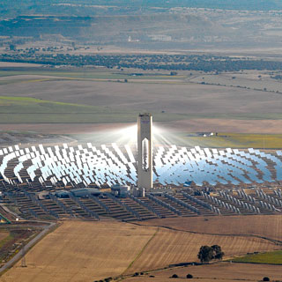
Topic 8: Energy production
8.1 – Energy sources
Describing solar energy systems
•The energy of the sun produced the fossil fuels.
•Hydroelectric dams operate using sun-lifted water.
•Wind turbines use sun-driven wind currents.
•In a sense, all of these energy sources are indirectly due to the sun.
•When we speak of solar power it is in the direct sense, meaning energy gotten directly from the sun's rays.
•The two direct solar energy devices we will discuss are solar heating panels and photovoltaic cells.
Notes:
© 2006 By Timothy K. Lund

Slide 79
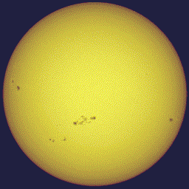
Topic 8: Energy production
8.1 – Energy sources
Describing solar energy systems
PRACTICE:
The sun radiates energy at a rate of 3.90×10²⁶ W. What is the rate at which energy from the sun reaches earth if our orbital radius is 1.5×10¹¹ m?
SOLUTION:
•The surface area of a sphere is A = 4πr².
•Recall that intensity is the rate at which energy is being gained per unit area. Thus
or I = P/ [4πr²] = 3.90×10²⁶ / [4π(1.5×10¹¹)²]
I = 1380 W m⁻².
•This is 1380 J/s per m².
intensity = power / A
intensity
Notes:
© 2006 By Timothy K. Lund

Slide 80

Topic 8: Energy production
8.1 – Energy sources
Describing solar energy systems
PRACTICE:
Explain why the solar intensity is different for different parts of the earth.
SOLUTION:
•The following diagram shows how the same intensity is spread out over more area the higher the latitude.
1380 W/m²
Notes:
© 2006 By Timothy K. Lund

Slide 81

Topic 8: Energy production
8.1 – Energy sources
Solving problems relevant to energy transformations
•The intensity also varies with the season, which is due to the tilt of Earth.
Notes:
© 2006 By Timothy K. Lund

Slide 82


Topic 8: Energy production
8.1 – Energy sources
Describing solar energy systems – photovoltaic cells
•The photovoltaic cell converts sunlight directly into electricity.
•The cell is made of crystalline silicon (a semiconductor) doped with phosphorus and boron impurities.
N-type silicon
P-type silicon
Notes:
© 2006 By Timothy K. Lund

Slide 83
Topic 8: Energy production
8.1 – Energy sources
Solving problems relevant to energy transformations
EXAMPLE: A photovoltaic cell has an area of 1.00 cm² and an efficiency of 10.5%.
(a) If the cell is placed in a position where the sun's intensity is I = 1250 W m⁻², what is the power output of the cell?
SOLUTION:
A = (1 cm²)(1 m / 100 cm)² = 0.0001 m².
P_{IN} / A = I so P_{IN} = IA = 1250(0.0001) = 0.125 W.
•The cell is only 10.5% efficient so that
P_{OUT} = 0.105P_{IN}= 0.105(.125) = 0.0131 W.
Notes:
© 2006 By Timothy K. Lund

Slide 84
Topic 8: Energy production
8.1 – Energy sources
Solving problems relevant to energy transformations
EXAMPLE: A photovoltaic cell has an area of 1.00 cm² and an efficiency of 10.5%.
(b) If the cell is rated at 0.500 V, what is its current output?
(c) If ten of these cells are placed in series, what will the voltage and the current be?
SOLUTION:
(b) P = IV so that I = P/ V = 0.0131/.5 = 0.0262 A.
(c) In series the voltage increases.
In series the current stays the same.
Thus V = 10(0.500) = 5.00 V and I = 0.0262 A.
Notes:
© 2006 By Timothy K. Lund

Slide 85
Topic 8: Energy production
8.1 – Energy sources
Solving problems relevant to energy transformations
EXAMPLE: A photovoltaic cell has an area of 1.00 cm² and an efficiency of 10.5%.
(d) If ten of these cells are placed in parallel, what will the voltage and the current be?
SOLUTION:
(d) In parallel the voltage stays the same.
In parallel the current increases.
Thus V = 0.500 V and I = (10)(0.0262) = 0.262 A.
Notes:
© 2006 By Timothy K. Lund

Slide 86

Topic 8: Energy production
8.1 – Energy sources
Solving problems relevant to energy transformations
EXAMPLE: A photovoltaic cell has an area of 1.00 cm² and an efficiency of 10.5%.
(e) How many cells would you need to operate a 100 W circuit?
SOLUTION:
(e) P_{out} = 0.0131 W/ cell. Thus
(100 W) / (0.0131 W/ cell) = 7630 cells!
FYI
•Obviously, a solar-powered calculator doesn’t need as much power to operate!
Notes:
© 2006 By Timothy K. Lund

Slide 87

Topic 8: Energy production
8.1 – Energy sources
Solving problems relevant to energy transformations
•Efficiency = P_{out} / P_{in} so that
•P_{in} = P_{out} / Efficiency = 47×10⁻³ / 0.08 = 0.5875 W.
•Thus I = P_{in} / A = 0.5875 W / 6.5×10⁻⁴ m²
I = 900 W m⁻² = 0.90 kW m⁻².
Notes:
© 2006 By Timothy K. Lund

Slide 88

Topic 8: Energy production
8.1 – Energy sources
Solving problems relevant to energy transformations
•Cloud cover variation is one reason.
•Season is another reason.
FYI
•Do NOT use latitude as a reason for this question.
•The question specifically states that it is concerned with only a particular region having a variation, so its latitude does not change.
Notes:
© 2006 By Timothy K. Lund

Slide 89
Topic 8: Energy production
8.1 – Energy sources
Solving problems relevant to energy transformations
PRACTICE: Draw a Sankey diagram for a photovoltaic cell having an efficiency of 18%.
•Note the approximate proportions.
•Perhaps, like the nuclear reactor, we could also show the energy needed to process the materials that go into making a photovoltaic cell.
ENERGY IN INCIDENT SUNLIGHT
USEABLE ELECTRICITY
WASTED HEAT
Notes:
© 2006 By Timothy K. Lund

Slide 90
Topic 8: Energy production
8.1 – Energy sources
Describing solar energy systems – heating panels
•The heating panel converts sunlight directly into heat.
•The slower the water is circulated, the hotter it can get.
sunlight
glass
insulation
black absorber
cold water in
water pipe
hot water out
Notes:
© 2006 By Timothy K. Lund

Slide 91

Topic 8: Energy production
8.1 – Energy sources
Solving problems relevant to energy transformations
•Because of the tilt of Earth’s axis southern exposures get more sun in the northern hemisphere, and northern exposures get more sun in the southern hemisphere.
Notes:
© 2006 By Timothy K. Lund

Slide 92

Topic 8: Energy production
8.1 – Energy sources
Solving problems relevant to energy transformations
•From Topic 3 the energy needed for ∆T = 25 K is
Q = mc∆T = 140(4200)(25) = 1.47×10⁷ J.
•But P_{OUT} = Q / t = 1.47×10⁷ J / (6 h)(3600 s / h)
so that P_{out} = 681 W.
•Since Efficiency = P_{OUT} / P_{IN} = 0.35 then
P_{IN} = P_{OUT} / Eff. = 681/0.35 = 1944 W.
•From I = P_{IN} / A we get A = P_{IN} / I so that
A = 1944 / 840 = 2.3 m².
Notes:
© 2006 By Timothy K. Lund

