Slide 1
Topic 5: Electricity and magnetism
5.2 – Heating effect of electric currents
Essential idea: One of the earliest uses for electricity was to produce light and heat. This technology continues to have a major impact on the lives of people around the world.
Nature of science: Although Ohm and Barlow published their findings on the nature of electric current around the same time, little credence was given to Ohm. Barlow’s incorrect law was not initially criticized or investigated. This is a reflection of the nature of academia of the time with physics in Germany being largely non-mathematical and Barlow held in high respect in England. It indicates the need for the publication and peer review of research findings in recognized scientific journals.
Notes:
© 2014 By Timothy K. Lund

Slide 2
Topic 5: Electricity and magnetism
5.2 – Heating effect of electric currents
Understandings:
• Circuit diagrams
• Kirchhoff’s circuit laws
• Heating effect of current and its consequences
• Resistance expressed as R = V / I
• Ohm’s law
• Resistivity R = ρL / A
• Power dissipation
Notes:
2
© 2014 By Timothy K. Lund

Slide 3
Topic 5: Electricity and magnetism
5.2 – Heating effect of electric currents
Applications and skills:
• Drawing and interpreting circuit diagrams
• Identifying ohmic and non-ohmic conductors through a consideration of the V / I characteristic graph
• Solving problems involving potential difference, current, charge, Kirchhoff’s circuit laws, power, resistance and resistivity
• Investigating combinations of resistors in parallel and series circuits
• Describing ideal and non-ideal ammeters and voltmeters
• Describing practical uses of potential divider circuits, including the advantages of a potential divider over a series resistor in controlling a simple circuit
Notes:
3
© 2014 By Timothy K. Lund

Slide 4
Topic 5: Electricity and magnetism
5.2 – Heating effect of electric currents
Applications and skills:
• Investigating one or more of the factors that affect resistivity experimentally
Guidance:
• The filament lamp should be described as a non-ohmic device; a metal wire at a constant temperature is an ohmic device
• The use of non-ideal voltmeters is confined to voltmeters with a constant but finite resistance
• The use of non-ideal ammeters is confined to ammeters with a constant but non-zero resistance
• Application of Kirchhoff’s circuit laws will be limited to circuits with a maximum number of two source-carrying loops
Notes:
4
© 2014 By Timothy K. Lund

Slide 5
Topic 5: Electricity and magnetism
5.2 – Heating effect of electric currents
Data booklet reference:
• Kirchhoff’s circuit laws:
ΣV = 0 (loop)
ΣI = 0 (junction);
• R = V / I
• P = VI = I ²R = V ²/ R
• R_{total} = R₁ + R₂ + …
• 1 / R_{total} = 1 / R₁ + 1 / R₂ + …
• ρ = RA / L
Notes:
5
© 2014 By Timothy K. Lund

Slide 6
Topic 5: Electricity and magnetism
5.2 – Heating effect of electric currents
International-mindedness:
• A set of universal symbols is needed so that physicists in different cultures can readily communicate ideas in science and engineering
Theory of knowledge:
• Sense perception in early electrical investigations was key to classifying the effect of various power sources, however this is fraught with possible irreversible consequences for the scientists involved. Can we still ethically and safely use sense perception in science research?
Notes:
6
© 2014 By Timothy K. Lund

Slide 7
Topic 5: Electricity and magnetism
5.2 – Heating effect of electric currents
Utilization:
• Although there are nearly limitless ways that we use electrical circuits, heating and lighting are two of the most widespread
• Sensitive devices can employ detectors capable of measuring small variations in potential difference and/or current, requiring carefully planned circuits and high precision components
Notes:
7
© 2014 By Timothy K. Lund

Slide 8
Topic 5: Electricity and magnetism
5.2 – Heating effect of electric currents
Aims:
• Aim 2: electrical theory and its approach to macro and micro effects characterizes much of the physical approach taken in the analysis of the universe
• Aim 3: electrical techniques, both practical and theoretical, provide a relatively simple opportunity for students to develop a feeling for the arguments of physics
• Aim 6: experiments could include (but are not limited to): use of a hot-wire ammeter as an historically important device; comparison of resistivity of a variety of conductors such as a wire at constant temperature, a filament lamp, or a graphite pencil;
Notes:
8
© 2014 By Timothy K. Lund

Slide 9
Topic 5: Electricity and magnetism
5.2 – Heating effect of electric currents
Aims:
• Aim 6: determination of thickness of a pencil mark on paper; investigation of ohmic and non-ohmic conductor characteristics; using a resistive wire wound and taped around the reservoir of a thermometer to relate wire resistance to current in the wire and temperature of wire
• Aim 7: there are many software and online options for constructing simple and complex circuits quickly to investigate the effect of using different components within a circuit
Notes:
9
© 2014 By Timothy K. Lund

Slide 10
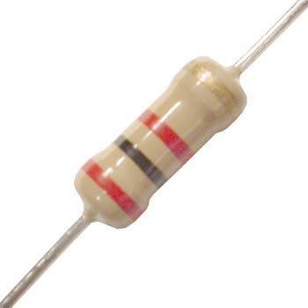
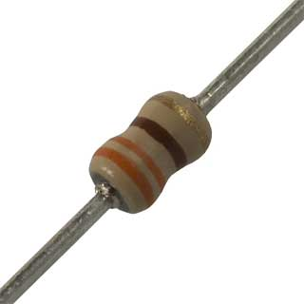
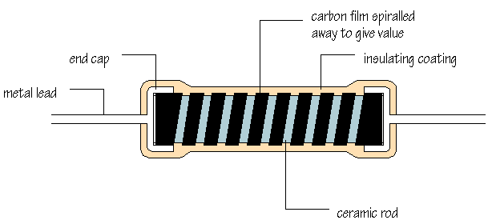
Topic 5: Electricity and magnetism
5.2 – Heating effect of electric currents
Resistance
•If you have ever looked inside an electronic device you have no doubt seen what a resistor looks like.
•A resistor’s working part is usually made of carbon, which is a semiconductor.
•The less carbon there is, the harder it is for current to flow through the resistor.
•As the animation shows, carbon is spiraled away to cut down the cross-sectional area, thereby increasing the resistance to whatever value is desired.
Notes:
10
© 2006 By Timothy K. Lund

Slide 11
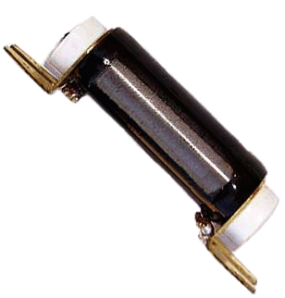
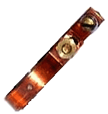
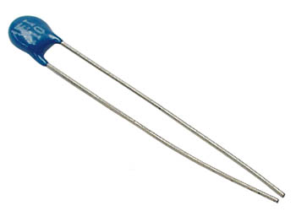
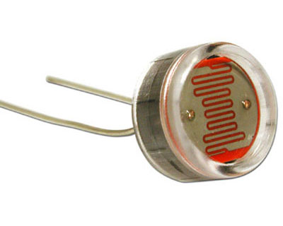
Topic 5: Electricity and magnetism
5.2 – Heating effect of electric currents
Resistance
•Some very precise resistors are made of wire and are called wire-wound resistors.
•And some resistors can be made to vary their resistance by tapping them at various places. These are called variable resistors and potentiometers.
•Thermistors are temperature- dependent resistors, changing their resistance in response to their temperature.
•Light-dependent resistors (LDRs) change their resistance in response to light intensity.
Notes:
11
© 2006 By Timothy K. Lund

Slide 12
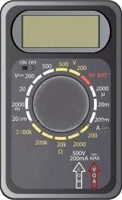
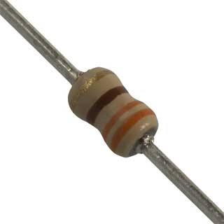

Topic 5: Electricity and magnetism
5.2 – Heating effect of electric currents
Resistance
•Electrical resistance R is a measure of how hard it is for current to flow through a material. Resistance is measured in ohms (Ω) using an ohm-meter.
0.L
This resistor has a resistance of 330.4 Ω.
0.0
330.4
FYI
•A reading of 0.L on an ohmeter means “overload”. The resistance is too high to record with the meter.
Notes:
12
© 2006 By Timothy K. Lund

Slide 13


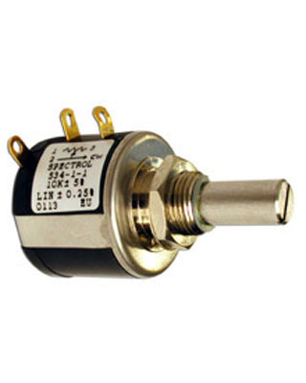

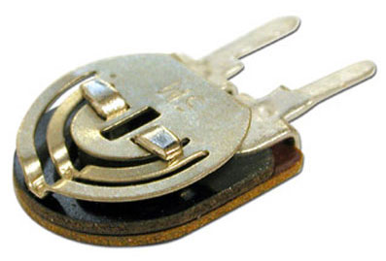
Topic 5: Electricity and magnetism
5.2 – Heating effect of electric currents
Resistance
•The different types of resistors have different schematic symbols.
fixed-value resistor
2 leads
potentiometer
3 leads
variable resistor
2 leads
Notes:
13
© 2006 By Timothy K. Lund

Slide 14


Topic 5: Electricity and magnetism
5.2 – Heating effect of electric currents
Resistance
•The different types of resistors have different schematic symbols.
light-dependent resistor (LDR)
thermister
2 leads
2 leads
As temperature increases resistance decreases
As brightness increases resistance decreases
Notes:
14
© 2006 By Timothy K. Lund

Slide 15
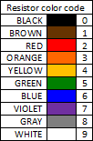
Topic 5: Electricity and magnetism
5.2 – Heating effect of electric currents
Resistance
•The resistance R of a material is the ratio of the potential difference V across the material to the current I flowing through the material.
•The units from the formula are (V A⁻¹) which are called ohms (Ω).
R = V / I
electric resistance
PRACTICE:
A fixed resistor has a current of 18.2 mA when it has a 6.0 V potential difference across it. What is its resistance?
SOLUTION:
• R = V / I = 6.0 / 18.2×10⁻³ = 330 Ω.
Orange = 3
Orange = 3
Brown = 1
Last color is number of zeros.
Notes:
15
© 2006 By Timothy K. Lund

Slide 16
Topic 5: Electricity and magnetism
5.2 – Heating effect of electric currents
Resistance
•To understand electrical resistance, consider two identical milk shakes.
•In the first experiment the straws have the same diameter, but different lengths.
•In the second experiment the straws have the same length, but different diameters.
•Note that R ∝ L / A.
Resistance is a measure of how hard it is to pass something through a material.
R ∝ L
R ∝ 1 / A
Notes:
16
© 2006 By Timothy K. Lund

Slide 17
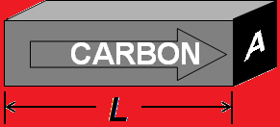
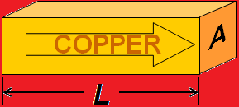
Topic 5: Electricity and magnetism
5.2 – Heating effect of electric currents
Resistance
•Of course conductors and resistors are not hollow like straws. And instead of milk shake current we have electrical current.
•Even through solids R ∝ L / A.
•But R also depends on the material through which the electricity is flowing.
•For example the exact same size of copper will have much less resistance than the carbon.
•With the proportionality constant ρ we have equality:
R = ρL / A or ρ = RA / L
resistance equation
Notes:
17
© 2006 By Timothy K. Lund

Slide 18
Topic 5: Electricity and magnetism
5.2 – Heating effect of electric currents
Resistance
•The Greek ρ is the resistivity of the particular material the resistor is made from. It is measured in Ωm.
Resistivities and Temperature Coefficients for Various Materials at 20°C
Material
ρ (Ω⋅m)
α (C° ⁻¹)
Material
ρ (Ω⋅m)
α (C° ⁻¹)
Conductors
Semiconductors
Aluminum
2.82×10⁻⁸
4.29×10⁻³
Carbon
3600×10⁻⁸
-5.0×10⁻⁴
Copper
1.70×10⁻⁸
6.80×10⁻³
Germanium
4.6×10⁻¹
-5.0×10⁻²
Iron
10×10⁻⁸
6.51×10⁻³
Silicon
2.5×10²
-7.0×10⁻²
Mercury
98.4×10⁻⁸
0.89×10⁻³
Nichrome
100×10⁻⁸
0.40×10⁻³
Nonconductors
Nickel
7.8×10⁻⁸
6.0×10⁻³
Glass
10¹²
Platinum
10×10⁻⁸
3.93×10⁻³
Rubber
10¹⁵
Silver
1.59×10⁻⁸
6.1×10⁻³
Wood
10¹⁰
Tungsten
5.6×10⁻⁸
4.5×10⁻³
Notes:
18
© 2006 By Timothy K. Lund

Slide 19
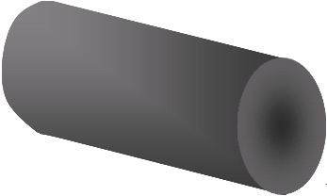
Topic 5: Electricity and magnetism
5.2 – Heating effect of electric currents
Resistance
•Note that resistance depends on temperature. The IBO does not require us to explore this facet of resistivity.
PRACTICE: What is the resistance of a 0.00200 meter long carbon core resistor having a core diameter of 0.000100 m? Assume the temperature is 20 °C.
•r = d / 2 = 0.0001 / 2 = 0.00005 m.
•A = πr² = π(0.00005)² = 7.854×10⁻⁹ m².
•From the table ρ = 3600×10⁻⁸ Ω m.
R = ρL / A
= (3600×10⁻⁸)(0.002) / 7.854×10⁻⁹ = 9.17 Ω.
A
L
Notes:
19
© 2006 By Timothy K. Lund

Slide 20
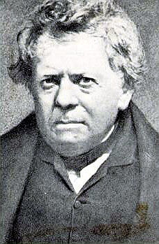
Topic 5: Electricity and magnetism
5.2 – Heating effect of electric currents
Ohm’s law
•The German Ohm studied resistance of materials in the 1800s and in 1826 stated:
“Provided the temperature is kept constant, the resistance of very many materials is constant over a wide range of applied potential differences, and therefore the potential difference is proportional to the current.”
•In formula form Ohm’s law looks like this:
V ∝ I
or V / I = CONST
or V = IR
Ohm’s law
FYI
•Ohm’s law applies to components with constant R.
Notes:
20
© 2006 By Timothy K. Lund

Slide 21
Topic 5: Electricity and magnetism
5.2 – Heating effect of electric currents
Ohm’s law – ohmic and non-ohmic behavior
•A material is considered ohmic if it behaves according to Ohm’s law. In other words the resistance stays constant as the voltage changes.
EXAMPLE: Label appropriate V-I graphs with the following labels: ohmic, non-ohmic, R increasing, R decreasing, R constant.
SOLUTION:
•First label the resistance dependence.
•R = V / I so R is just the slope of the V vs. I graph.
•Ohm’s law states the R is constant. Thus only one graph is ohmic.
V
V
V
non-ohmic
R⎯
R↓
non-ohmic
R↑
ohmic
I
I
I
Notes:
21
© 2006 By Timothy K. Lund

Slide 22
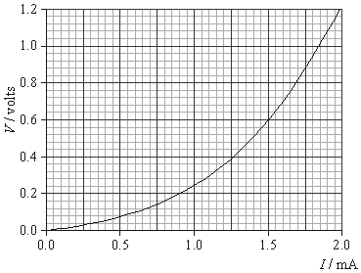
Topic 5: Electricity and magnetism
5.2 – Heating effect of electric currents
Ohm’s law – ohmic and non-ohmic behavior
EXAMPLE: The graph shows the applied voltage V vs. resulting current I through a tungsten filament lamp.
Find R when I = 0.5 mA and 1.5 mA. Is this filament ohmic or non-ohmic?
SOLUTION:
•At 0.5 mA: V = 0.08 V
R = V / I = 0.08 / 0.5×10⁻³ = 160 Ω.
•At 1.5 mA: V = 0.6 V
R = V / I = 0.6 / 1.5×10⁻³ = 400 Ω.
Since R is not constant the filament is non-ohmic.
Notes:
22
© 2006 By Timothy K. Lund

Slide 23
Topic 5: Electricity and magnetism
5.2 – Heating effect of electric currents
Ohm’s law – ohmic and non-ohmic behavior
EXAMPLE: The graph shows the applied voltage V vs. resulting current I through a tungsten filament lamp.
Explain why a lamp filament might be non-ohmic.
SOLUTION:
•The temperature coefficient for tungsten is positive, typical for conductors.
•Therefore, the hotter the filament the higher R.
•But the more current, the hotter a lamp filament burns.
•Thus, the bigger the I the bigger the R.
Material
ρ (Ω⋅m)
α (C° ⁻¹)
Tungsten
5.6×10⁻⁸
4.5×10⁻³
Notes:
23
© 2006 By Timothy K. Lund

Slide 24
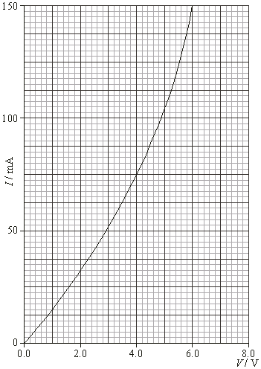
Topic 5: Electricity and magnetism
5.2 – Heating effect of electric currents
Ohm’s law – ohmic and non-ohmic behavior
EXAMPLE: The I-V characteristic is shown for a non-ohmic compo- nent. Sketch in the I-V character- istic for a 40 Ω ohmic component in the range of 0.0 V to 6.0 V.
SOLUTION:
•”Ohmic” means V = IR and R is constant (and the graph is linear).
•Thus V = I×40 or I = V / 40.
•If V = 0, I = 0 / 40 = 0.0.
•If V = 6, I = 6 / 40 = 0.15 A.
•But 0.15 A = 150 mA.
Notes:
24
© 2006 By Timothy K. Lund

Slide 25
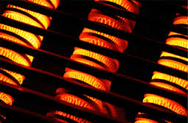
Topic 5: Electricity and magnetism
5.2 – Heating effect of electric currents
Power dissipation
•Recall that power is the rate at which work is being done. Thus P = W / t.
•From Topic 5.1 we learned that W = qV.
•Thus
P = W / t
P = qV / t
P = (q / t)V
P = IV.
FYI
•This power represents the energy per unit time delivered to, or consumed by, an electrical component having a current I and a potential difference V.
Notes:
25
© 2006 By Timothy K. Lund

Slide 26
Topic 5: Electricity and magnetism
5.2 – Heating effect of electric currents
Power dissipation
PRACTICE: Use the definition of resistance R = V / I. together with the one we just derived (P = VI) to derive the following two formulas:
(a) P = I ²R
(b) P = V ²/ R.
SOLUTION:
(a) From R = V / I we get V = IR.
P = IV = I ( IR ) = I ²R.
(b) From R = V / I we get I = V / R.
P = IV = (V / R) (V) = V ²/ R.
P = VI = I ²R = V ²/ R
electrical power
Notes:
26
© 2006 By Timothy K. Lund

Slide 27
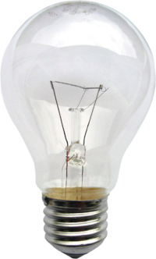
Topic 5: Electricity and magnetism
5.2 – Heating effect of electric currents
Power dissipation
PRACTICE:
The graph shows the V-I characteristics of a tungsten filament lamp.
What is its power consumption at I = 0.5 mA and at I = 1.5 mA?
SOLUTION:
•At 0.5 mA, V = 0.08 V.
•P = IV = (0.5×10⁻³)(0.08) = 4.0×10⁻⁵ W.
•At 1.5 mA, V = 0.6 V.
•P = IV = (1.5×10⁻³)(0.6) = 9.0×10⁻⁴ W.
Notes:
27
© 2006 By Timothy K. Lund

Slide 28
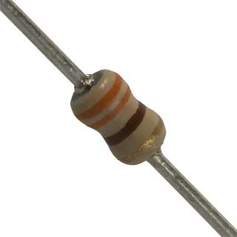
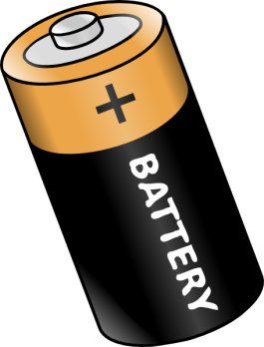
Topic 5: Electricity and magnetism
5.2 – Heating effect of electric currents
Electric circuits
•An electric circuit is a set of conductors (like wires) and components (like resistors, lights, etc.) connected to an electrical voltage source (like a cell or a battery) in such a way that current can flow in complete loops.
•Here are two circuits consisting of cells, resistors, and wires.
•Note current flowing from (+) to (-) in each circuit.
triple-loop circuit
single-loop circuit
solder joints
Notes:
© 2006 By Timothy K. Lund

Slide 29


Topic 5: Electricity and magnetism
5.2 – Heating effect of electric currents
Circuit diagrams
•A complete circuit will always contain a cell or a battery.
•The schematic diagram of a cell is this:
•A battery is just a group of cells connected in series:
•If each cell is 1.5 V, then the battery above is 3(1.5) = 4.5 V. What is the voltage of your calculator battery?
•A fixed-value resistor looks like this:
•The schematic of a fixed-value resistor looks like this:
this is really a cell…
this is a battery…
this is the same battery…
this is a resistor…
Notes:
© 2006 By Timothy K. Lund

Slide 30


Topic 5: Electricity and magnetism
5.2 – Heating effect of electric currents
Drawing and interpreting circuit diagrams
EXAMPLE: Draw schematic diagrams of each of the following circuits:
SOLUTION:
Notes:
© 2006 By Timothy K. Lund

Slide 31
Topic 5: Electricity and magnetism
5.2 – Heating effect of electric currents
Investigating combinations of resistors in series
•Resistors can be connected to one another in series, which means one after the other.
•Note that there is only one current I and that I is the same for all series components.
•Conservation of energy tells us qε = qV₁ + qV₂ + qV₃.
•Thus ε = IR₁ + IR₂ + IR₃ from Ohm’s law V = IR
ε = I(R₁ + R₂ + R₃) factoring out I
ε = I(R), where R = R₁ + R₂ + R₃.
R₁
R₂
R₃
ε
R = R₁ + R₂ + …
equivalent resistance in series
Notes:
© 2006 By Timothy K. Lund

Slide 32
Topic 5: Electricity and magnetism
5.2 – Heating effect of electric currents
Investigating combinations of resistors in series
R₁
R₂
R₃
EXAMPLE: Three resistors of 330 Ω each are connected to a 6.0 V battery in series as shown.
(a) What is the circuit’s equivalent resistance?
(b) What is the current in the circuit?
SOLUTION:
(a) In series, R = R₁ + R₂ + R₃ so that
R = 330 + 330 + 330 = 990 Ω.
(b) Since the voltage on the entire circuit is 6.0 V, and since the total resistance is 990 Ω, from Ohm’s law we have I = V / R = 6 / 990 = 0.0061 A.
ε
Notes:
© 2006 By Timothy K. Lund

Slide 33
Topic 5: Electricity and magnetism
5.2 – Heating effect of electric currents
Investigating combinations of resistors in series
R₁
R₂
R₃
EXAMPLE: Three resistors of 330 Ω each are connected to a 6.0 V battery in series as shown.
(c) What is the voltage on each resistor?
SOLUTION:
(c) The current I we just found is the same everywhere. Thus each resistor has a current of I = 0.0061 A.
•From Ohm’s law, each resistor has a voltage given by V = IR = (0.0061)(330) = 2.0 V.
ε
FYI
•In series the V’s are different if the R’s are different.
Notes:
© 2006 By Timothy K. Lund

Slide 34
Topic 5: Electricity and magnetism
5.2 – Heating effect of electric currents
Investigating combinations of resistors in parallel
•Resistors can also be in parallel.
•In this circuit each resistor is connected directly to the cell.
•Thus each resistor has the same voltage V and V is the same for all parallel components.
•We can then write ε = V₁ = V₂ = V₃ ≡ V.
•But there are three currents I₁, I₂, and I₃.
•Since the total current I passes through the cell we see that I = I₁ + I₂ + I₃.
•If R is the equivalent or total resistance of the three resistors, then I = I₁ + I₂ + I₃ becomes
ε / R = V₁ / R₁ + V₂ / R₂ + V₃ / R₃ Ohm’s law I = V / R
R₁
R₂
R₃
ε
Notes:
© 2006 By Timothy K. Lund

Slide 35
Topic 5: Electricity and magnetism
5.2 – Heating effect of electric currents
Investigating combinations of resistors in parallel
•Resistors can also be in parallel.
•In this circuit each resistor is connected directly to the cell.
•Thus each resistor has the same voltage V and V is the same for all parallel components.
•From ε = V₁ = V₂ = V₃ ≡ V
and ε / R = V₁ / R₁ + V₂ / R₂ + V₃ / R₃,
we get V / R = V / R₁ + V / R₂ + V / R₃.
•Thus the equivalent resistance R is given by
R₁
R₂
R₃
ε
1 / R = 1 / R₁ + 1 / R₂ + …
equivalent resistance in parallel
Notes:
© 2006 By Timothy K. Lund

Slide 36
Topic 5: Electricity and magnetism
5.2 – Heating effect of electric currents
Investigating combinations of resistors in parallel
EXAMPLE: Three resistors of 330 Ω each are connected to a 6.0 V cell in parallel as shown.
(a) What is the circuit’s resistance?
(b) What is the voltage on each resistor?
SOLUTION:
(a) In parallel, 1 / R = 1 / R₁ + 1 / R₂ + 1 / R₃ so that
1 / R = 1 / 330 + 1 / 330 + 1 / 330 = 0.00909.
Thus R = 1 / 0.00909 = 110 Ω.
(b) The voltage on each resistor is 6.0 V, since the resistors are in parallel. (Each resistor is clearly directly connected to the battery).
R₁
R₂
R₃
ε
Notes:
© 2006 By Timothy K. Lund

Slide 37
Topic 5: Electricity and magnetism
5.2 – Heating effect of electric currents
Investigating combinations of resistors in parallel
EXAMPLE: Three resistors of 330 Ω each are connected to a 6.0 V cell in parallel as shown.
(c) What is the current in each resistor?
SOLUTION:
(c) Using Ohm’s law (I = V / R):
I₁ = V₁ / R₁ = 6 / 330 = 0.018 A.
I₂ = V₂ / R₂ = 6 / 330 = 0.018 A.
I₃ = V₃ / R₃ = 6 / 330 = 0.018 A.
R₁
R₂
R₃
ε
FYI
•In parallel the I’s are different if the R’s are different.
Notes:
© 2006 By Timothy K. Lund

Slide 38
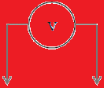

Topic 5: Electricity and magnetism
5.2 – Heating effect of electric currents
Circuit diagrams - voltmeters are connected in parallel
PRACTICE: Draw a schematic diagram for this circuit:
SOLUTION:
1.06
FYI
•Be sure to position the voltmeter across the desired resistor in parallel.
Notes:
© 2006 By Timothy K. Lund

Slide 39
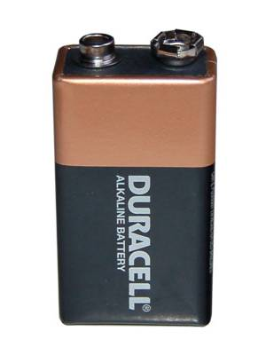
Topic 5: Electricity and magnetism
5.2 – Heating effect of electric currents
tenths place
Circuit diagrams - voltmeters are connected in parallel
EXAMPLE:
A battery’s voltage is measured as shown.
(a) What is the uncertainty in it’s measurement?
SOLUTION:
•For digital devices always use the place value of the least significant digit as your raw uncertainty.
•For this voltmeter the voltage is measured to the tenths place so we give the raw uncertainty a value of ∆V = ±0.1 V.
09.4
00.0
Notes:
39
© 2006 By Timothy K. Lund

Slide 40
Topic 5: Electricity and magnetism
5.2 – Heating effect of electric currents
Circuit diagrams - voltmeters are connected in parallel
EXAMPLE:
A battery’s voltage is measured as shown.
(b) What is the fractional error in this measurement?
SOLUTION: Fractional error is just ΔV / V. For this particular measurement we then have
ΔV / V = 0.1 / 9.4 = 0.011 (or 1.1%).
09.4
FYI
•When using a voltmeter the red lead is placed at the point of highest potential.
Notes:
40
© 2006 By Timothy K. Lund

Slide 41
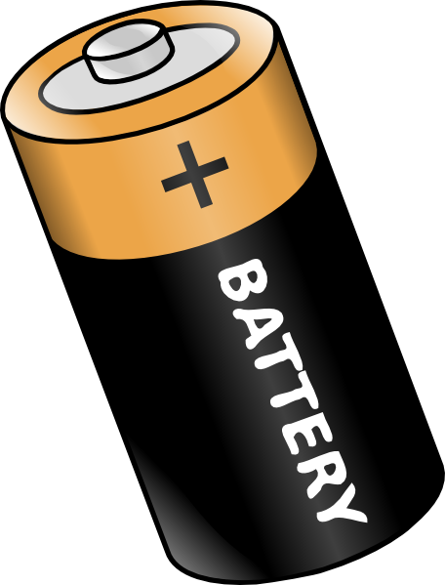
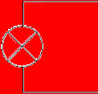
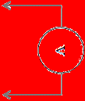

Topic 5: Electricity and magnetism
5.2 – Heating effect of electric currents
Circuit diagrams - voltmeters are connected in parallel
•Consider the simple circuit of battery, lamp, and wire.
•To measure the voltage of the circuit we merely connect the voltmeter while the circuit is in operation.
01.6
00.0
voltmeter
lamp
cell
in parallel
Notes:
41
© 2006 By Timothy K. Lund

Slide 42


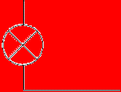
Topic 5: Electricity and magnetism
5.2 – Heating effect of electric currents
Circuit diagrams - ammeters are connected in series
•To measure the current of the circuit we must break the circuit and insert the ammeter so that it intercepts all of the electrons that normally travel through the circuit.
00.2
00.0
ammeter
in series
lamp
cell
Notes:
42
© 2006 By Timothy K. Lund

Slide 43

Topic 5: Electricity and magnetism
5.2 – Heating effect of electric currents
the circuit must be temporarily broken to insert the ammeter
Circuit diagrams - ammeters are connected in series
PRACTICE: Draw a schematic diagram for this circuit:
SOLUTION:
.003
FYI
•Be sure to position the ammeter between the desired resistors in series.
Notes:
© 2006 By Timothy K. Lund

Slide 44
Topic 5: Electricity and magnetism
5.2 – Heating effect of electric currents
Circuit diagrams
PRACTICE: Draw a schematic diagram for this circuit:
SOLUTION:
FYI
•This circuit is a combination series-parallel. In a later slide you will learn how to find the equivalent resistance of the combo circuit.
Notes:
© 2006 By Timothy K. Lund

Slide 45
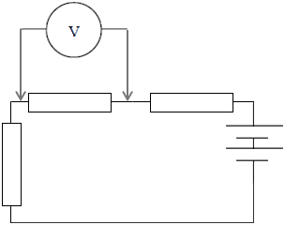
Topic 5: Electricity and magnetism
5.2 – Heating effect of electric currents
Ideal voltmeters - ∞ Ω resistance
•Voltmeters are connected in parallel.
•The voltmeter reads the voltage of only the component it is in parallel with.
•The green current represents the amount of current the battery needs to supply to the voltmeter in order to make it register.
•The red current is the amount of current the battery supplies to the original circuit.
•In order to NOT ALTER the original properties of the circuit, ideal voltmeters have extremely high resistance (∞ Ω) to minimize the green current.
Notes:
© 2006 By Timothy K. Lund

Slide 46
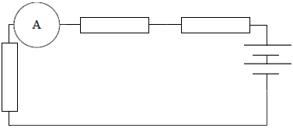
Topic 5: Electricity and magnetism
5.2 – Heating effect of electric currents
Ideal ammeters - 0 Ω resistance
•Ammeters are connected in series.
•The ammeter is supposed to read the current of the original circuit.
•In order to NOT ALTER the original properties of the circuit, ideal ammeters have extremely low resistance (0 Ω) to minimize the effect on the red current.
Notes:
© 2006 By Timothy K. Lund

Slide 47
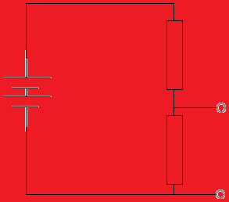

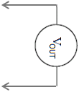
Topic 5: Electricity and magnetism
5.2 – Heating effect of electric currents
Potential divider circuits
•Consider a battery of ε = 6 V. Suppose we have a light bulb that can only use three volts. How do we obtain 3 V from a 6 V battery?
•A potential divider is a circuit made of two (or more) series resistors that allows us to tap off any voltage we want that is less than the battery voltage.
•The input voltage is the emf of the battery.
•The output voltage is the voltage drop across R₂.
•Since the resistors are in series R = R₁ + R₂.
potential divider
R₁
R₂
Notes:
© 2006 By Timothy K. Lund

Slide 48
Topic 5: Electricity and magnetism
5.2 – Heating effect of electric currents
Potential divider circuits
•Consider a battery of ε = 6 V. Suppose we have a light bulb that can only use three volts. How do we obtain 3 V from a 6 V battery?
•From Ohm’s law the current I of the divider is given by I = V_{IN} / R = V_{IN} / (R₁ + R₂).
•But V_{OUT} = V₂ = IR₂ so that
V_{OUT} = IR₂
= R₂×V_{IN} / (R₁ + R₂).
potential divider
R₁
R₂
V_{OUT} = V_{IN} [ R₂ / (R₁ + R₂) ]
potential divider
Notes:
© 2006 By Timothy K. Lund

Slide 49
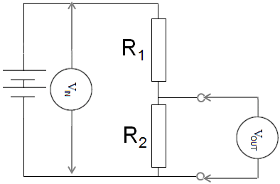
Topic 5: Electricity and magnetism
5.2 – Heating effect of electric currents
Potential divider circuits
PRACTICE:
Find the output voltage if the battery has an emf of 9.0 V, R₁ is a 2200 Ω resistor, and R₂ is a 330 Ω resistor.
SOLUTION:
•Use V_{OUT} = V_{IN} [ R₂ / (R₁ + R₂) ]
V_{OUT} = 9 [ 330 / (2200 + 330) ]
V_{OUT} = 9 [ 330 / 2530 ] = 1.2 V.
FYI
•The bigger R₂ is in comparison to R₁, the closer V_{OUT} is in proportion to the total voltage.
Notes:
© 2006 By Timothy K. Lund

Slide 50
Topic 5: Electricity and magnetism
5.2 – Heating effect of electric currents
Potential divider circuits
PRACTICE:
Find the value of R₂ if the battery has an emf of 9.0 V, R₁ is a 2200 Ω resistor, and we want an output voltage of 6 V.
SOLUTION:
•Use the formula V_{OUT} = V_{IN} [ R₂ / (R₁ + R₂) ]. Thus
6 = 9 [ R₂ / (2200 + R₂) ]
6(2200 + R₂) = 9R₂
13200 + 6R₂ = 9R₂
13200 = 3R₂
R₂ = 4400 Ω
Notes:
© 2006 By Timothy K. Lund

Slide 51
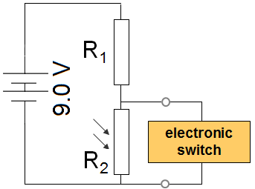
Topic 5: Electricity and magnetism
5.2 – Heating effect of electric currents
Potential divider circuits
PRACTICE: A light-dependent resistor (LDR) has R = 25 Ω in bright light and R = 22000 Ω in low light. An electronic switch will turn on a light when its p.d. is above 7.0 V. What should the value of R₁ be?
SOLUTION: Use V_{OUT} = V_{IN} [ R₂ / (R₁ + R₂) ]. Thus
7 = 9 [ 22000 / (R₁ + 22000) ]
7(R₁ + 22000) = 9(22000)
7R₁ + 154000 = 198000
7R₁ = 44000
R₁ = 6300 Ω (6286)
Notes:
© 2006 By Timothy K. Lund

Slide 52
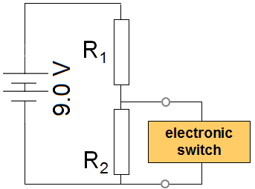
Topic 5: Electricity and magnetism
5.2 – Heating effect of electric currents
Potential divider circuits
PRACTICE: A thermistor has a resistance of 250 Ω when it is in the heat of a fire and a resistance of 65000 Ω when at room temperature. An electronic switch will turn on a sprinkler system when its p.d. is above 7.0 V.
(a) Should the thermistor be R₁ or R₂?
SOLUTION:
•Because we want a high voltage at a high temperature, and because the thermistor’s resistance decreases with temperature, it should be placed at the R₁ position.
Notes:
© 2006 By Timothy K. Lund

Slide 53
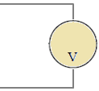

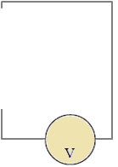
Topic 5: Electricity and magnetism
5.2 – Heating effect of electric currents
Potential divider circuits
PRACTICE: A thermistor has a resistance of 250 Ω when it is in the heat of a fire and a resistance of 65000 Ω when at room temperature. An electronic switch will turn on a sprinkler system when its p.d. is above 7.0 V.
(b) What should R₂ be?
SOLUTION: In fire the thermistor is R₁ = 250 Ω.
7 = 9 [ R₂ / (250 + R₂) ]
7(250 + R₂) = 9R₂
1750 + 7R₂ = 9R₂ → R₂ = 880 Ω (875)
Notes:
© 2006 By Timothy K. Lund

Slide 54
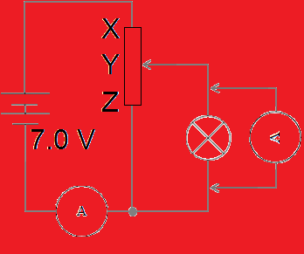
Topic 5: Electricity and magnetism
5.2 – Heating effect of electric currents
Potential divider circuits
PRACTICE: A filament lamp is rated at “4.0 V, 0.80 W” on its package. The potentiometer has a resistance from X to Z of 24 Ω and has linear variation.
(a) Sketch the variation of the p.d. V vs. the current I for a typical filament lamp. Is it ohmic?
SOLUTION: Since the temperature increases with the current, so does the resistance.
•But from V = IR we see that R = V / I, which is the slope.
•Thus the slope should increase with I.
ohmic means linear
V
non-ohmic
I
Notes:
© 2006 By Timothy K. Lund

Slide 55
Topic 5: Electricity and magnetism
5.2 – Heating effect of electric currents
Potential divider circuits
R₁
PRACTICE: A filament lamp is rated at “4.0 V, 0.80 W” on its package. The potentiometer has a resistance from X to Z of 24 Ω and has linear variation.
(b) The potentiometer is adjusted so that the meter shows 4.0 V. Will it’s contact be above Y, below Y, or exactly on Y?
SOLUTION: The circuit is acting like a potential divider with R₁ being the resistance between X and Y and R₂ being the resistance between Y and Z.
•Since we need V_{OUT} = 4 V, and since V_{IN} = 6 V, the contact must be adjusted above the Y.
R₂
Notes:
© 2006 By Timothy K. Lund

Slide 56
Topic 5: Electricity and magnetism
5.2 – Heating effect of electric currents
Potential divider circuits
R₁
PRACTICE: A filament lamp is rated at “4.0 V, 0.80 W” on its package. The potentiometer has a resistance from X to Z of 24 Ω and has linear variation.
(c) The potentiometer is adjusted so that the meter shows 4.0 V. What are the current and the resistance of the lamp at this instant?
SOLUTION: P = 0.80 W and V = 4.0 V.
•From P = IV we get 0.8 = I(4) so that I = 0.20 A.
•From V = IR we get 4 = 0.2R so that R = 20. Ω.
•You could also use P = I ²R for this last one.
R₂
Notes:
© 2006 By Timothy K. Lund

Slide 57
Topic 5: Electricity and magnetism
5.2 – Heating effect of electric currents
Potential divider circuits
R₁
PRACTICE: A filament lamp is rated at “4.0 V, 0.80 W” on its package. The potentiometer has a resistance from X to Z of 24 Ω and has linear variation.
(d) The potentiometer is adjusted so that the meter shows 4.0 V. What is the resistance of the Y-Z portion of the potentiometer?
SOLUTION: Let R₁ = X to Y and R₂ = Y to Z resistance.
•Then R₁ + R₂ = 24 so that R₁ = 24 – R₂.
•From V_{OUT} = V_{IN} [ R₂ / (R₁ + R₂) ] we get
4 = 7 [ R₂ / (24 – R₂ + R₂) ]
R₂
→ R₂ = 14 Ω (13.71).
Notes:
© 2006 By Timothy K. Lund

Slide 58
Topic 5: Electricity and magnetism
5.2 – Heating effect of electric currents
Potential divider circuits
R₁
PRACTICE: A filament lamp is rated at “4.0 V, 0.80 W” on its package. The potentiometer has a resistance from X to Z of 24 Ω and has linear variation.
(e) The potentiometer is adjusted so that the meter shows 4.0 V. What is the current in the Y-Z portion of the potentiometer?
SOLUTION:
•V₂ = 4.0 V because it is in parallel with the lamp.
I₂ = V₂ / R₂
= 4 / 13.71 = 0.29 A
R₂
Notes:
© 2006 By Timothy K. Lund

Slide 59
Topic 5: Electricity and magnetism
5.2 – Heating effect of electric currents
Potential divider circuits
R₁
PRACTICE: A filament lamp is rated at “4.0 V, 0.80 W” on its package. The potentiometer has a resistance from X to Z of 24 Ω and has linear variation.
(f) The potentiometer is adjusted so that the meter shows 4.0 V. What is the current in the ammeter?
SOLUTION: The battery supplies two currents.
•The red current is 0.29 A because it is the I₂ we just calculated in (e).
•The green current is 0.20 A found in (c).
•The ammeter has both so I = 0.29 + 0.20 = 0.49 A.
R₂
Notes:
© 2006 By Timothy K. Lund

Slide 60
Topic 5: Electricity and magnetism
5.2 – Heating effect of electric currents
Solving problems involving circuits
PRACTICE: A battery is connected to a 25-W lamp as shown.
What is the lamp’s resistance?
SOLUTION:
Suppose we connect a voltmeter to the circuit.
•We know P = 25 W.
•We know V = 1.4 V.
•From P = V ² / R we get
•R = V ²/ P = 1.4 ² / 25 = 0.078 Ω.
01.4
00.0
Notes:
60
© 2006 By Timothy K. Lund

Slide 61
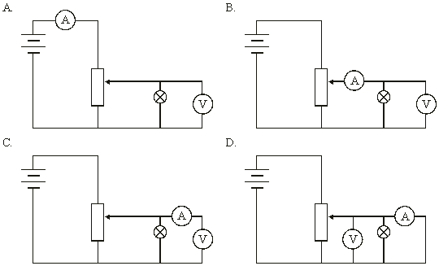
Topic 5: Electricity and magnetism
5.2 – Heating effect of electric currents
Solving problems involving circuits
PRACTICE: Which circuit shows the correct setup to find the V-I characteristics of a filament lamp?
SOLUTION:
•The voltmeter must be in parallel with the lamp.
•It IS, in ALL cases.
•The ammeter must be in series with the lamp and must read only the lamp’s current.
•The correct response is B.
two currents
lamp current
no currents
short circuit!
Notes:
© 2006 By Timothy K. Lund

Slide 62
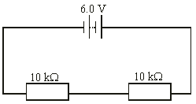
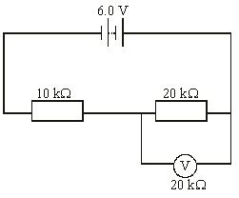
Topic 5: Electricity and magnetism
5.2 – Heating effect of electric currents
equivalent ckt
Solving problems involving circuits
PRACTICE: A non-ideal voltmeter is used to measure the p.d. of the 20 kΩ resistor as shown. What will its reading be?
SOLUTION: There are two currents in the circuit because the voltmeter does not have a high enough resistance to prevent the green one from flowing.
•The 20 kΩ resistor is in parallel with the 20 kΩ so that
1 / R = 1 / 20000 + 1 / 20000 = 2 / 20000.
R = 20000 / 2 = 10 kΩ.
•But then we have two 10 kΩ resistors in series and each takes half the battery voltage, or 3 V.
Notes:
© 2006 By Timothy K. Lund

Slide 63
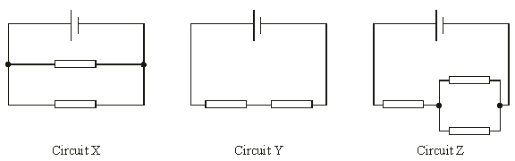
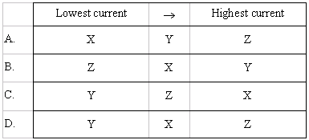
Topic 5: Electricity and magnetism
5.2 – Heating effect of electric currents
Solving problems involving circuits
PRACTICE: All three circuits use the same resistors and the same cells.
Which one of the following shows the correct ranking for the currents passing through the cells?
SOLUTION: The bigger the R the smaller the I.
Highest I
Lowest I
Middle I
1.5R
0.5R
2R
R
0.5R
parallel
series
combo
Notes:
© 2006 By Timothy K. Lund

Slide 64
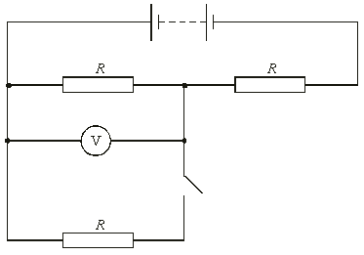
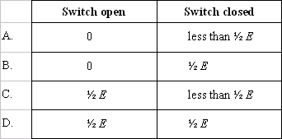
Topic 5: Electricity and magnetism
5.2 – Heating effect of electric currents
Solving problems involving circuits
E
PRACTICE: The voltmeter has infinite resistance.
What are the readings on the voltmeter when the switch is open and closed?
SOLUTION:
•With the switch open the green R is not part of the circuit. Red and orange split the battery emf.
•With the switch closed the red and green are in parallel and are (1/2)R.
Notes:
© 2006 By Timothy K. Lund

Slide 65
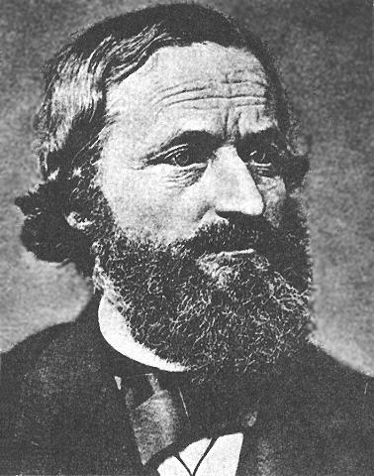
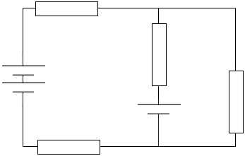
Topic 5: Electricity and magnetism
5.2 – Heating effect of electric currents
Kirchhoff’s rules – junction, branch, and loop
•”Solving” a circuit consists of finding the voltages and currents of all of its components.
•Consider the following circuit containing a few batteries and resistors:
•A junction is a point in a circuit where three or more wires are connected together.
•A branch is all the wire and all the components connecting one junction to another.
•A loop is all the wire and all the components in a complete circle.
Snoop Dog Kirchhoff
Notes:
65
© 2006 By Timothy K. Lund

Slide 66
Topic 5: Electricity and magnetism
5.2 – Heating effect of electric currents
Kirchhoff’s rules – the rule for current I
•”Solving” a circuit consists of finding the voltages and currents of all of its components.
•STEP 1: Assign a current to each branch.
•If you have a good idea which way it flows, choose that direction.
•If you don’t, an arbitrary direction will do just fine.
I₁
I₃
FYI
•If a current turns out to have a negative solution, you will interpret that as meaning that it flows in the opposite direction.
I₂
Notes:
66
© 2006 By Timothy K. Lund

Slide 67
Topic 5: Electricity and magnetism
5.2 – Heating effect of electric currents
Kirchhoff’s rules – the rule for current I
•”Solving” a circuit consists of finding the voltages and currents of all of its components.
•If a current enters a junction it is a “gain” and is assigned a POSITIVE value. If a current leaves a junction it is a “loss” and is assigned a NEGATIVE value.
•For the TOP junction, I₁ and I₃ are both POSITIVE and I₂ is NEGATIVE.
•For the BOTTOM junction, I₁ and I₃ are both NEGATIVE and I₂ is POSITIVE.
I₁
I₃
I₂
Notes:
67
© 2006 By Timothy K. Lund

Slide 68
Topic 5: Electricity and magnetism
5.2 – Heating effect of electric currents
Kirchhoff’s rules – the rule for current I
•”Solving” a circuit consists of finding the voltages and currents of all of its components.
•From conservation of charge the sum of the currents at each junction is zero.
•STEP 2: Use Kirchhoff’s rule for I for each junction.
•Each JUNCTION yields its own equation:
TOP: I₁ – I₂ + I₃ = 0.
BOTTOM: I₂ – I₁ – I₃ = 0.
ΣI = 0 (junction)
Kirchhoff’s rule for I
I₁
I₃
I₂
Notes:
68
© 2006 By Timothy K. Lund

Slide 69
Topic 5: Electricity and magnetism
5.2 – Heating effect of electric currents
Kirchhoff’s rules – the rule for voltage V
•”Solving” a circuit consists of finding the voltages and currents of all of its components.
•Give each resistor a voltage V and each cell or battery an emf ε.
•Cells and batteries increase the energy of the current, resistors decrease the energy.
•Since the energy is qV (or qε), if we sum up all the energy gains and losses in each LOOP we must get zero.
•We can go either CW or CCW – it doesn’t matter.
V₂
I₁
I₃
V₄
ε₁
ε₂
V₃
V₁
I₂
Notes:
69
© 2006 By Timothy K. Lund

Slide 70
Topic 5: Electricity and magnetism
5.2 – Heating effect of electric currents
Kirchhoff’s rules – the rule for voltage V
•”Solving” a circuit consists of finding the voltages and currents of all of its components.
•If our loop goes in the direction of the branch current assigned earlier, the resistor energy change is negative.
•If our loop goes against the branch current, the sign is reversed for the resistor.
•For our loop we see that we have –qV₁ and –qV₂ and –qV₄.
V₂
I₁
I₃
V₄
negative
positive
ε₁
ε₂
V₃
V₁
I₂
Notes:
70
© 2006 By Timothy K. Lund

Slide 71

Topic 5: Electricity and magnetism
5.2 – Heating effect of electric currents
Kirchhoff’s rules – the rule for voltage V
•”Solving” a circuit consists of finding the voltages and currents of all of its components.
•If our loop goes through a cell from negative to positive, the cell energy change is positive.
•If our loop goes from positive to negative through a cell the energy change is negative.
•For our loop we see that we have +qε₁ and –qε₂.
V₂
I₁
I₃
V₄
ε₁
positive
negative
V₃
ε₂
V₁
I₂
Notes:
71
© 2006 By Timothy K. Lund

Slide 72
Topic 5: Electricity and magnetism
5.2 – Heating effect of electric currents
Kirchhoff’s rules – the rule for voltage V
•”Solving” a circuit consists of finding the voltages and currents of all of its components.
•From conservation of energy the sum of the voltages in each loop is zero.
•STEP 3: Use Kirchhoff’s rule for V for each loop.
•For our loop we have
–V₁ + ε₁ + –V₂ + –V₄ + –ε₂ = 0.
ΣV = 0 (loop)
Kirchhoff’s rule for V
V₂
I₁
I₃
V₄
ε₁
ε₂
V₃
FYI
•The qs all cancel.
V₁
I₂
Notes:
72
© 2006 By Timothy K. Lund

Slide 73
Topic 5: Electricity and magnetism
5.2 – Heating effect of electric currents
Kirchhoff’s rules – the rule for voltage V
•”Solving” a circuit consists of finding the voltages and currents of all of its components.
•From conservation of energy the sum of the voltages in each loop is zero.
ΣV = 0 (loop)
Kirchhoff’s rule for V
PRACTICE: Using the voltage rule write the equation for the other loop.
SOLUTION:
–ε₂ + –V₃ + –V₄ = 0.
I₁
V₂
I₃
V₄
ε₁
ε₂
V₃
negative
negative
V₁
I₂
Notes:
73
© 2006 By Timothy K. Lund

Slide 74
Topic 5: Electricity and magnetism
5.2 – Heating effect of electric currents
Kirchhoff’s rules – solving the circuit
EXAMPLE: Suppose each of the resistors is R = 2.0 Ω, and the emfs are ε₁ = 12 V and ε₂ = 6.0 V. Find the voltages and the currents of the circuit.
SOLUTION: Use Ohm’s law: V = IR for the resistors.
•From the rule for I we have I₁ – I₂ + I₃ = 0.
•From the rule for V we have
–V₁ + –V₂ + –V₄ + ε₁ + – ε₂ = 0,
– ε₂ – V₃ – V₄ = 0.
•From Ohm’s law we have
–2I₁ + –2I₁ + –2I₂ + 12 + –6 = 0
– 6 – 2I₃ – 2I₂ = 0.
V₂
I₁
I₃
V₄
ε₁
ε₂
V₃
V₁
I₂
Notes:
74
© 2006 By Timothy K. Lund

Slide 75
Topic 5: Electricity and magnetism
5.2 – Heating effect of electric currents
Kirchhoff’s rules – solving the circuit
EXAMPLE: Suppose each of the resistors is R = 2.0 Ω, and the emfs are ε₁ = 12 V and ε₂ = 6.0 V. Find the voltages and the currents of the circuit.
SOLUTION:
•We now have three equations in I.
I₁ – I₂ + I₃ = 0 → I₃ = I₂ – I₁.
–2I₁ + –2I₁ + –2I₂ + 12 + –6 = 0
→ 6 = 4I₁ + 2I₂ → 3 = 2I₁ + I₂.
– 6 – 2I₃ – 2I₂ = 0
→ 6 = -2I₂ + -2I₃ → 3 = -I₂ + -I₃.
V₂
I₁
I₃
V₄
ε₁
ε₂
V₃
V₁
I₂
Notes:
75
© 2006 By Timothy K. Lund

Slide 76
Topic 5: Electricity and magnetism
5.2 – Heating effect of electric currents
Kirchhoff’s rules – solving the circuit
EXAMPLE: Suppose each of the resistors is R = 2.0 Ω, and the emfs are ε₁ = 12 V and ε₂ = 6.0 V. Find the voltages and the currents of the circuit.
SOLUTION:
•Now eliminate variables one by one.
(1) I₃ = I₂ – I₁. (2) 3 = 2I₁ + I₂. (3) 3 = -I₂ + -I₃.
•(1) into (3) eliminates I₃:
3 = -I₂ + - (I₂ – I₁) or 3 = -2I₂ + I₁.
•Then I₁ = 3 + 2I₂.
•Placing into (2) yields
3 = 2(3 + 2I₂) + I₂ so that
3 = 6 + 4I₂ + I₂ → I₂ = -0.6 A.
V₂
I₁
I₃
V₄
ε₁
ε₂
V₃
V₁
I₂
Notes:
76
© 2006 By Timothy K. Lund

Slide 77
Topic 5: Electricity and magnetism
5.2 – Heating effect of electric currents
Kirchhoff’s rules – solving the circuit
EXAMPLE: Suppose each of the resistors is R = 2.0 Ω, and the emfs are ε₁ = 12 V and ε₂ = 6.0 V. Find the voltages and the currents of the circuit.
SOLUTION:
•Once you have one, you have them all by substitution:
(1) I₃ = I₂ – I₁. (2) 3 = 2I₁ + I₂. (3) 3 = -I₂ + -I₃.
•Putting I₂ = -0.6 A into (2) yields
3 = 2I₁ + -0.6 → I₁ = 1.8 A.
•Putting I₁ and I₂ into (1) yields
I₃ = -0.6 – 1.8 = -2.4 A.
•Since I₂ and I₃ are negative, we chose the wrong directions.
V₂
I₁
I₃
V₄
ε₁
ε₂
V₃
V₁
I₂
Notes:
77
© 2006 By Timothy K. Lund

Slide 78
Topic 5: Electricity and magnetism
5.2 – Heating effect of electric currents
Kirchhoff’s rules – solving the circuit
EXAMPLE: Suppose each of the resistors is R = 2.0 Ω, and the emfs are ε₁ = 12 V and ε₂ = 6.0 V. Find the voltages and the currents of the circuit.
SOLUTION:
•Finally, we can redraw our currents:
•From Ohm’s law we calculate our resistor voltages:
V₁ = 1.8(2) = 3.6 V.
V₂ = 1.8(2) = 3.6 V.
V₃ = 2.4(2) = 4.8 V.
V₄ = 0.6(2) = 1.2 V.
•Use both of Kirchhoff’s rules to check junctions and loops.
3.6 V
2.4 A
1.8 A
V₂
V₄
1.2 V
12 V
0.6 A
4.8 V
V₃
6 V
3.6 V
V₁
Notes:
78
© 2006 By Timothy K. Lund

