Slide 1
Topic 5: Electricity and magnetism
5.1 – Electric fields
Essential idea: When charges move an electric current is created.
Nature of science: Modeling: Electrical theory demonstrates the scientific thought involved in the development of a microscopic model (behavior of charge carriers) from macroscopic observation. The historical development and refinement of these scientific ideas when the microscopic properties were unknown and unobservable is testament to the deep thinking shown by the scientists of the time.
Notes:
© 2014 By Timothy K. Lund

Slide 2
Topic 5: Electricity and magnetism
5.1 – Electric fields
Understandings:
• Charge
• Electric field
• Coulomb’s law
• Electric current
• Direct current (dc)
• Potential difference
Notes:
2
© 2014 By Timothy K. Lund

Slide 3
Topic 5: Electricity and magnetism
5.1 – Electric fields
Applications and skills:
• Identifying two forms of charge and the direction of the forces between them
• Solving problems involving electric fields and Coulomb’s law
• Calculating work done in an electric field in both Joules and electronvolts
• Identifying sign and nature of charge carriers in a metal
• Identifying drift speed of charge carriers
• Solving problems using the drift speed equation
• Solving problems involving current, potential difference and charge
Notes:
3
© 2014 By Timothy K. Lund

Slide 4
Topic 5: Electricity and magnetism
5.1 – Electric fields
Guidance:
• Students will be expected to apply Coulomb’s law for a range of permittivity values
Data booklet reference:
• I = Δq / Δt
• F = kq₁q₂ / r²
• k = 1 / [4πε₀]
• V = W / q
• E = F / q
• I = nAvq
Notes:
4
© 2014 By Timothy K. Lund

Slide 5
Topic 5: Electricity and magnetism
5.1 – Electric fields
International-mindedness:
• Electricity and its benefits have an unparalleled power to transform society
Theory of knowledge:
• Early scientists identified positive charges as the charge carriers in metals, however the discovery of the electron led to the introduction of “conventional” current direction. Was this a suitable solution to a major shift in thinking? What role do paradigm shifts play in the progression of scientific knowledge?
Notes:
5
© 2014 By Timothy K. Lund

Slide 6
Topic 5: Electricity and magnetism
5.1 – Electric fields
Utilization:
• Transferring energy from one place to another (see Chemistry option C and Physics topic 11)
• Impact on the environment from electricity generation (see Physics topic 8 and Chemistry option sub-topic C2)
• The comparison between the treatment of electric fields and gravitational fields (see Physics topic 10)
Notes:
6
© 2014 By Timothy K. Lund

Slide 7
Topic 5: Electricity and magnetism
5.1 – Electric fields
Aims:
• Aim 2: electrical theory lies at the heart of much modern science and engineering
• Aim 3: advances in electrical theory have brought immense change to all societies
• Aim 6: experiments could include (but are not limited to): demonstrations showing the effect of an electric field (eg. using semolina); simulations involving the placement of one or more point charges and determining the resultant field
• Aim 7: use of computer simulations would enable students to measure microscopic interactions that are typically very difficult in a school laboratory situation
Notes:
7
© 2014 By Timothy K. Lund

Slide 8
Topic 5: Electricity and magnetism
5.1 – Electric fields
Charge
•In a simplified atomic model, electrons orbit about a central nucleus:
•As long as the number of electrons equals the number of protons, an atom is neutral.
•If an electron is removed from an atom, the atom has a net (+) charge and becomes a positive ion.
•If an electron is added to an atom, the atom has a net (-) charge and is called a negative ion.
Proton (+)
Neutron (0)
Electron (-)
NEGATIVE ION
POSITIVE ION
N E U T R A L
N E U T R A L
HYDROGEN
BERYLLIUM
Notes:
© 2006 By Timothy K. Lund

Slide 9
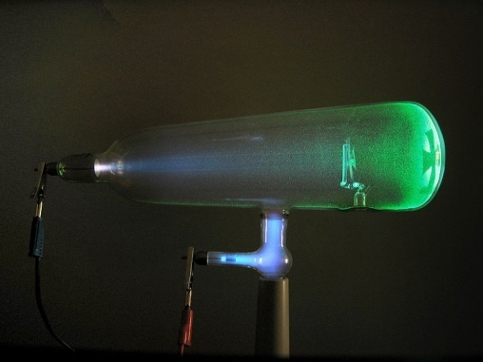
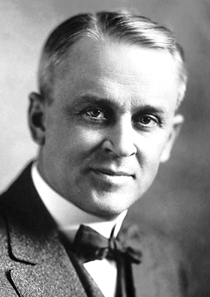
Topic 5: Electricity and magnetism
5.1 – Electric fields
Charge – the elementary charge e
•Although we like to consider the charge of an electron -1 and the charge of a proton +1, it turns out the actual charge of each is given in terms of the elementary charge e.
•Sir William Crookes used his cathode ray tube to demonstrate the electrons were negatively charged.
•Physicists Robert Millikan and Harvey Fletcher performed the famous oil-drop experiment to determine the actual value of the charge of an electron in 1909.
1e = 1.60×10⁻¹⁹ C
the elementary charge
Notes:
© 2006 By Timothy K. Lund

Slide 10

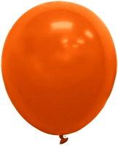
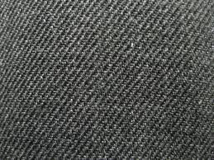

Topic 5: Electricity and magnetism
5.1 – Electric fields
Charge
•A simple experiment can demonstrate not only the “creation” of charges, but a simple force rule.
•If we rub a rubber balloon on a piece of wool, the balloon strips electrons from the wool, and captures them.
•Thus the wool becomes (+) and the balloon (-).
Notes:
© 2006 By Timothy K. Lund

Slide 11
Topic 5: Electricity and magnetism
5.1 – Electric fields
Charge – the charge law
•We find that the green and the orange balloons repel each other.
•We find that the wool samples repel each other.
•We can thus state that like charges repel.
Notes:
© 2006 By Timothy K. Lund

Slide 12
Topic 5: Electricity and magnetism
5.1 – Electric fields
Charge – the charge law
•We also find that the balloons are attracted to the wool samples, any way we combine them.
•We can thus state that unlike charges attract.
Notes:
© 2006 By Timothy K. Lund

Slide 13
Topic 5: Electricity and magnetism
5.1 – Electric fields
Charge – the charge law
•The previous slides tell us then that there are two types of charge: positive and negative.
•And that like charges repel and unlike charges attract.
FYI
It is well to state here that the charge law is a model that represents some sort of behavior involving a physical property called “charge.”
We use (+) and (-) to represent these properties only because they are convenient and familiar to us.
In Topic 7 we will learn of another type of charge called color charge. A 3-color model will be used then.
Notes:
© 2006 By Timothy K. Lund

Slide 14
Topic 5: Electricity and magnetism
5.1 – Electric fields
Charge – the conservation of charge
•If you compare the original balloon-wool sample pairings you will see that for every (-) transferred to the balloon, there is exactly one (+) left behind on the wool.
•Careful observation shows us that there are 15 (+) charges on the wool, and 15 (-) charges on the balloon for a total (or net) charge of ZERO.
•Given that neither the wool nor the balloon had any net charge before the rubbing process, we see that we have created NO NET CHARGE during the rubbing process.
Notes:
© 2006 By Timothy K. Lund

Slide 15
Topic 5: Electricity and magnetism
5.1 – Electric fields
Charge – the conservation of charge
•This leads us to another conservation law. The law of conservation of charge states that charge can be neither created nor destroyed.
•Obviously charge can be transferred from one object to another.
•Thus we can build up a negative charge on a balloon, but only at the expense of leaving behind an equal positive charge on a wool sweater.
FYI
Conservation of charge is never violated, as we will see when we talk of nuclear and particle physics, whereas conservation of mass is sometimes violated.
Notes:
© 2006 By Timothy K. Lund

Slide 16
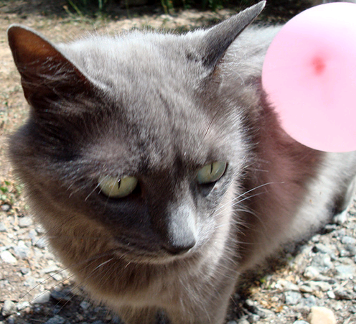
Topic 5: Electricity and magnetism
5.1 – Electric fields
Charge – the conservation of charge
PRACTICE: A cat’s fur, like your hair, acts just like wool when you rub a balloon on it. A balloon has picked up -150 μC of charge from Albert. The resulting opposite charges of balloon and Albert cause the balloon to stick.
How many electrons have been transferred?
(b) What is the charge on Albert?
SOLUTION: Use 1 e⁻ = -1.60×10⁻¹⁹ C so…
(a) n = (-150×10⁻⁶ C)(1 e⁻ / -1.60×10⁻¹⁹ C) = 9.4×10¹⁴ e⁻.
(b) Conservation of charge tells us that
q_{Albert} = +150 μC.
Notes:
© 2006 By Timothy K. Lund

Slide 17
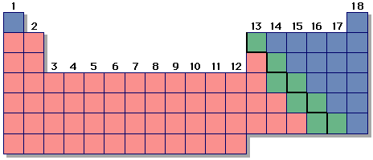
Topic 5: Electricity and magnetism
5.1 – Electric fields
Charge – conductors and nonconductors
•Materials can be divided into three categories:
(1) Conductors - which easily transport electrons without trying to capture or impede them,
(2) Nonconductors or insulators - which capture or impede electrons, and
(3) Semiconductors - which lie between conductors and insulators.
•Roughly speaking, metals are good conductors, nonmetals are good insulators, and metalloids are good semiconductors.
Notes:
© 2006 By Timothy K. Lund

Slide 18
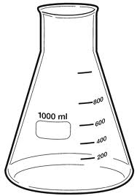
Topic 5: Electricity and magnetism
5.1 – Electric fields
Charge – detection using an electroscope
EXAMPLE: An electroscope is a primitive instrument that can be used to detect electrical charge.
•A glass Erlenmeyer flask has a rubber stopper with a hole in it. Both the rubber stopper and the glass are insulators.
•A conductor is passed through a hole.
•At the outside end of the conductor is a conducting ball.
•On the inside end of the conductor is a very thin and flexible gold leaf that hangs under its own weight. Gold is also a conductor.
Notes:
© 2006 By Timothy K. Lund

Slide 19
Topic 5: Electricity and magnetism
5.1 – Electric fields
Charge – detection using an electroscope
EXAMPLE: An electroscope is a primitive instrument that can be used to detect electrical charge.
•The idea is that you can place a charge on the ball, and the conductors of the scope will allow the charge to spread out, all the way to the gold leaf.
•When the charge reaches the leaf, since each leaf has some of the original charge, the leaves will repel.
•When the leaves repel you can tell, because they spread out from one another.
Notes:
© 2006 By Timothy K. Lund

Slide 20
Topic 5: Electricity and magnetism
5.1 – Electric fields
Charge – detection using an electroscope
PRACTICE: Consider the three electroscopes shown.
Which one has the greatest charge in the leaves?
Which one has the least?
Can you tell whether the charge is (+) or (-)? Why?
SOLUTION:
•The last one has the most charge, the middle one the least.
•You cannot tell the sign of the charge since (-)(-) will repel, but so will (+)(+).
Notes:
© 2006 By Timothy K. Lund

Slide 21
Topic 5: Electricity and magnetism
5.1 – Electric fields
Charge – detection using an electroscope
PRACTICE: Explain: A charged wand is brought near an uncharged electroscope without touching it. While the wand is near, the leaves spread apart.
SOLUTION:
•The ball and the leaves are conductors and they are connected to each other.
•The wand’s charge repels like charges in the ball.
•The like charges in the ball travel as far as they can to the leaves.
•The leaves now temporarily hold like charges and thus they repel each other.
before and after
during
Notes:
© 2006 By Timothy K. Lund

Slide 22
Topic 5: Electricity and magnetism
5.1 – Electric fields
Electric current
•Electric current I is the time rate ∆t at which charge ∆q moves past a particular point in a circuit.
•From the formula it should be clear that current is measured in Coulombs per second (C s⁻¹) which is called an Ampere (A).
I = ∆q / ∆t
or I = q / t
electric current
PRACTICE: Many houses have 20-amp(ere) service. How many electrons per second is this?
SOLUTION:
•20 A is 20 C (per s) so we only need to know how many electrons are in 20 C.
(20 C)(1 e⁻ / 1.6×10⁻¹⁹ C) = 1.3×10²⁰ e⁻.
Notes:
© 2006 By Timothy K. Lund

Slide 23
Topic 5: Electricity and magnetism
5.1 – Electric fields
Electric current
•Electric current I is the time rate ∆t at which charge ∆q moves past a particular point in a circuit.
•A simple model may help clarify current flow.
•Think of conductors as “pipes” that hold electrons.
•The chemical cell pushes an electron out of the (-) side. This electron in turn pushes the next, and so on, because like charges repel.
•This “electromotive force” is transfered simultaneously to every charge in the circuit.
Notes:
© 2006 By Timothy K. Lund

Slide 24
Topic 5: Electricity and magnetism
5.1 – Electric fields
Electric current
•Electric current I is the time rate ∆t at which charge ∆q moves past a particular point in a circuit.
EXAMPLE: Suppose each (-) represents an electron. Find the current in electrons per second and then convert it to amperes.
SOLUTION: Choose a reference and start a timer.
•The rate is about 7 electrons each 12 s or I = 7/12 = 0.58 e⁻ s⁻¹.
•I = (0.58 e⁻ s⁻¹)(1.6×10⁻¹⁹ C/1 e⁻) = 9.3×10⁻²⁰ A.
Notes:
© 2006 By Timothy K. Lund

Slide 25
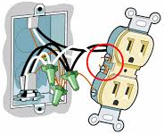
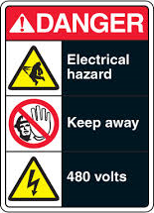
Topic 5: Electricity and magnetism
5.1 – Electric fields
Electric current
EXAMPLE: Explain why when a wire is cut current stops everywhere and does not “leak” into the air.
SOLUTION:
•Freeing an e⁻ from a conductor takes a lot of energy.
•This is why you don’t get electrocuted by e⁻ jumping off of nearby conductors like outlets (unless the voltage is very high).
•This is also why when you cut the wire e⁻ do not leak out into the surrounding environment.
•Finally, if the chain is broken the push stops, so the current stops everywhere.
Notes:
© 2006 By Timothy K. Lund

Slide 26
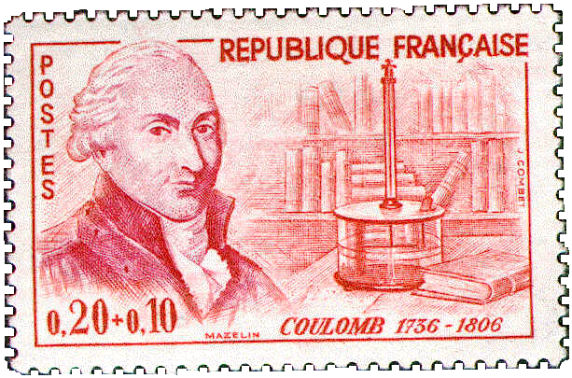
Topic 5: Electricity and magnetism
5.1 – Electric fields
Coulomb’s law
•Charles-Augustin de Coulomb studied charge, and discovered an inverse square law for the electric force F between two point charges q₁ and q₂ separated by distance r :
•k is called Coulomb’s constant. Beware. There is another constant that is designated k called Boltzmann’s constant used in thermodynamics.
•There is an alternate form of Coulomb’s law:
F = kq₁q₂ / r ²
Coulomb’s law
where k = 8.99×10⁹ N m² C⁻²
F = (1/[4πε₀])q₁q₂ / r ²
Coulomb’s law
where ε₀ = 8.85×10⁻¹² C² N⁻¹ m⁻²
Notes:
© 2014 By Timothy K. Lund

Slide 27
Topic 5: Electricity and magnetism
5.1 – Electric fields
Coulomb’s law
PRACTICE: Show that the numeric value of 1/[4πε₀] equals the numeric value of k.
SOLUTION:
•We know that k = 8.99×10⁹.
•We know that ε₀ = 8.85×10⁻¹².
•Then 1/[4πε₀] = 1 / [4π×8.85×10⁻¹²] = 8.99×10⁹ = k.
FYI
Either F = kq₁q₂ / r ² or F = (1/[4πε₀])q₁q₂ / r ² can be used. It is your choice. The first is easiest, though.
In Topic 6 we will discover that the gravitational force is also an inverse square law.
Notes:
© 2014 By Timothy K. Lund

Slide 28
Topic 5: Electricity and magnetism
5.1 – Electric fields
Coulomb’s law
PRACTICE:
Find the Coulomb force between two electrons located 1.0 cm apart.
SOLUTION:
•Note r = 1.0 cm = 0.010 m.
•Note q₁ = e = 1.60×10⁻¹⁹ C.
•Note q₂ = e = 1.60×10⁻¹⁹ C.
•From F = kq₁q₂ / r ²
F = 8.99×10⁹×(1.60×10⁻¹⁹)² / 0.010²
= 2.30×10⁻²⁴ N.
•Since like charges repel the electrons repel.
Notes:
© 2014 By Timothy K. Lund

Slide 29
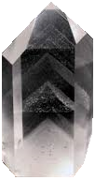
Topic 5: Electricity and magnetism
5.1 – Electric fields
Coulomb’s law - permittivity
PRACTICE: The ε₀ in Coulomb’s law F = (1/[4πε₀])q₁q₂ / r ² is called the permittivity of free space. In general, different materials have different permittivities ε, and Coulomb’s law has a more general form: F = (1/[4πε])q₁q₂ / r ². If the two electrons are embedded in a chunk of quartz, having a permittivity of 12ε₀, what will the Coulomb force be between them if they are 1.0 cm apart?
SOLUTION:
F = (1/[4πε])q₁q₂ / r ²
= (1/[4π×12×8.85×10⁻¹²]) (1.60×10⁻¹⁹)² / 0.010²
= 1.92×10⁻²⁵ N.
Notes:
© 2014 By Timothy K. Lund

Slide 30
Topic 5: Electricity and magnetism
5.1 – Electric fields
Coulomb’s law – extended distribution
•We can use integral calculus to prove that a spherically symmetric shell of charge Q acts as if all of its charge is located at its center.
•Thus Coulomb’s law works not only for point charges, which have no radii, but for any spherical distribution of charge at any radius.
•Be very clear that r is the distance between the centers of the charges.
Q
q
r
Notes:
© 2014 By Timothy K. Lund

Slide 31
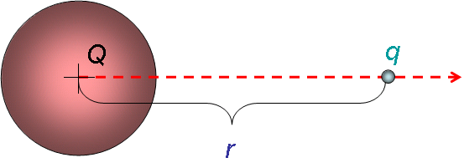
Topic 5: Electricity and magnetism
5.1 – Electric fields
Coulomb’s law – extended distribution
EXAMPLE: A conducting sphere of radius 0.10 m holds an electric charge of Q = ⁺125 μC. A charge q = -5.0 μC is located 0.30 m from the surface of Q. Find the electric force between the two charges.
SOLUTION:
•Use F = kQq / r ², where r is the distance between the centers of the charges.
•Then r = 0.10 + 0.30 = 0.40 m. Thus
F = kQq / r ²
= 8.99×10⁹×125×10⁻⁶× ⁻5.0×10⁻⁶ / 0.40 ²
= ⁻35 N.
Notes:
© 2014 By Timothy K. Lund

Slide 32
Topic 5: Electricity and magnetism
5.1 – Electric fields
Electric field - definition
•Suppose a charge q is located a distance r from a another charge Q.
•We define the electric field strength E as the force per unit charge acting on q due to the presence of Q.
•The units are Newtons per Coulomb (N C⁻¹).
E = F / q
electric field strength
PRACTICE: Find the electric field strength 1.0 cm from an electron.
SOLUTION: We have already found the Coulomb force between two electrons located 1.0 cm apart. We just divide our previous answer by one of the charges:
•Then E = F / q = 2.3×10⁻²⁴ / 1.6×10⁻¹⁹ = 1.4×10⁻⁵ N C⁻¹.
Notes:
© 2014 By Timothy K. Lund

Slide 33
Topic 5: Electricity and magnetism
5.1 – Electric fields
Electric field – definition
EXAMPLE: Let q be a small charge located a distance r from a larger charge Q. Find the electric field strength due to Q at a distance r from the center of Q.
SOLUTION: Use E = F / q and F = kQq / r ².
•From E = F / q we have Eq = F.
•And from Coulomb’s law we can write
Eq = F = kQq / r ²
Eq = kQq / r ²
•Thus the electric field strength is given by
E = kQ / r ²
electric field strength at a distance r from the center of a charge Q
Notes:
© 2014 By Timothy K. Lund

Slide 34
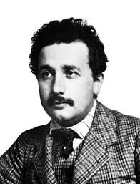
Topic 5: Electricity and magnetism
5.1 – Electric fields
Electric field – the field model
•In 1905 Albert Einstein published his Special Theory of Relativity, which placed an upper bound on the speed anything in the universe could reach.
•According to relativity, nothing can travel faster than the speed of light c = 3.00×10⁸ ms⁻¹.
•Thus the “Coulomb force signal” cannot propagate faster than the speed of light.
•Since the electric force was thought to be an action-at-a-distance force, a significant problem arose with the advent of relativity which required a paradigm shift from action-at-a-distance to the new idea of field.
Notes:
© 2014 By Timothy K. Lund

Slide 35
Topic 5: Electricity and magnetism
5.1 – Electric fields
Electric field – the field model
•In the action-at-a-distance model, if the Coulomb force signal cannot propagate faster than the speed of light, electrons trapped in orbits about nuclei cannot instantaneously feel the Coulomb force, and thus cannot instantaneously adjust their motion on time to remain in a circular orbit.
•Since electrons in orbit around nuclei do not spiral away, a new model called the field model was developed which theorized that the space surrounding a nucleus is distorted by its charge in such a way that the electron “knows” how to act.
Notes:
© 2014 By Timothy K. Lund

Slide 36
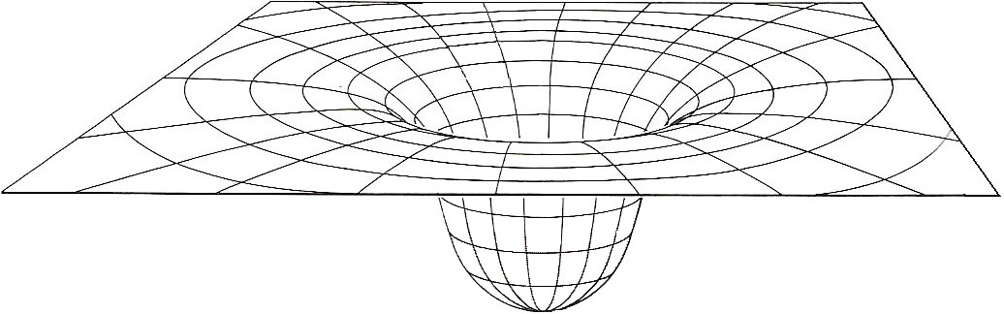
Topic 5: Electricity and magnetism
5.1 – Electric fields
Electric field – the field model
•In the field model the charge Q distorts its surrounding space.
•Then the electrons know which way to curve in their orbits, not by knowing where Q is, but by knowing the local curvature of their immediate environment.
Q
Notes:
© 2014 By Timothy K. Lund

Slide 37
Topic 5: Electricity and magnetism
5.1 – Electric fields
Electric field – test charges
•In order to explore the electric field in the surrounding a charge we use tiny POSITIVE test charges.
PRACTICE: Observe the test charges as they are released. What is the sign of Q?
SOLUTION: Q is attracting the test charges
and test charges are (+), so Q must be (-).
q₁
q₂
E₁
E₂
Q
Notes:
© 2006 By Timothy K. Lund

Slide 38
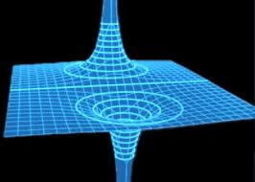
Topic 5: Electricity and magnetism
5.1 – Electric fields
Electric field – test charges
PRACTICE: Observe the test charge as it is released. What is the sign of Q?
SOLUTION:
•Q is repelling the test charge and since test charges are by definition (+), Q must also be (+).
Q
Notes:
© 2006 By Timothy K. Lund

Slide 39
Topic 5: Electricity and magnetism
5.1 – Electric fields
Electric field – test charges
• By “placing” a series of test charges about a negative charge, we can map out its electric field:
Q
FYI
•The field arrows of the inner ring are longer than the field arrows of the outer ring and all field arrows point to the centerline.
Notes:
© 2006 By Timothy K. Lund

Slide 40
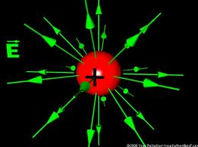
Topic 5: Electricity and magnetism
5.1 – Electric fields
Electric field – sketching
PRACTICE: We can simplify our drawings of electric fields by using top views and using rays. Which field is that of the…
(a) Largest negative charge?
(b) Largest positive charge?
(c) Smallest negative charge?
(d) Smallest positive charge?
SOLUTION: The larger the charge, the more concentrated the field.
•Lines show the direction a positive test charge will go.
•Outward is (+) charge, inward (-).
D
A
A
B
C
E
D
C
E
F
Notes:
© 2006 By Timothy K. Lund

Slide 41
Topic 5: Electricity and magnetism
5.1 – Electric fields
Solving problems involving electric fields
EXAMPLE: Two charges of -0.225 C each are located at opposite corners of a square having a side length of 645 m. Find the electric field vector at
the center of the square, and
(b) one of the unoccupied corners.
SOLUTION: Start by making a sketch.
The opposing fields cancel so E = 0.
(b) The two fields are at right angles.
E₁ = (8.99×10⁹)(-0.225) / 645 ² = -4860 NC⁻¹
E₂ = (8.99×10⁹)(-0.225) / 645 ² = -4860 NC⁻¹
E² = E₁² + E₂² = 2(4860)² = 47239200 →E = 6870 NC⁻¹.
q₁
E₂
(b)
E₁
s
(a)
q₂
s
E₁+E₂
E₁
E₂
sum points to center of square
(↓).
(←).
Notes:
© 2006 By Timothy K. Lund

Slide 42

Topic 5: Electricity and magnetism
5.1 – Electric fields
Solving problems involving electric fields
PRACTICE:
Two stationary charges are shown. At which point is the electric field strength the greatest?
SOLUTION:
•Sketch in the field due to each charge at each point.
•Fields diminish as 1 / r².
•Fields point away from (+) and toward (-).
•The only place the fields add is point B.
Notes:
© 2006 By Timothy K. Lund

Slide 43
Topic 5: Electricity and magnetism
5.1 – Electric fields
Solving problems involving electric fields
PRACTICE: An isolated metal sphere of radius 1.5 cm has a charge of -15 nC placed on it.
(a) Sketch in the electric field lines outside the sphere.
(b) Find the electric field strength at the surface of the sphere.
SOLUTION:
(a) Field lines point towards (-) charge.
(b) The field equation works as if all of the charge is at the center of the spherical distribution.
  E = kQ / r ²
= (8.99×10⁹)(15×10⁻⁹) / 0.015² = 6.0×10⁵ NC⁻¹.
(-)
Notes:
© 2006 By Timothy K. Lund

Slide 44
Topic 5: Electricity and magnetism
5.1 – Electric fields
Solving problems involving electric fields
PRACTICE: An isolated metal sphere of radius 1.5 cm has a charge of -15 nC placed on it.
(c) An electron is placed on the outside surface of the sphere and released. What is its initial acceleration?
SOLUTION:
(c) The electron feels force F = Eq so that
F = Ee = (6.0×10⁵)(1.6×10⁻¹⁹) = 9.6×10⁻¹⁴ N.
But F = ma so that
a = F / m
= (9.6×10⁻¹⁴) / (9.11×10⁻³¹) = 1.1×10¹⁷ m s⁻².
(-)
Notes:
© 2006 By Timothy K. Lund

Slide 45
Topic 5: Electricity and magnetism
5.1 – Electric fields
Electric monopoles and dipoles
•Because there are two types of electric charge, electric fields can have field lines pointing inward AND outward.
•A single charge is called a monopole.
MONOPOLES
Negative sphere of charge
Positive sphere of charge
Notes:
© 2006 By Timothy K. Lund

Slide 46
Topic 5: Electricity and magnetism
5.1 – Electric fields
Electric monopoles and dipoles
•If two opposite electric monopoles are near enough to each other their field lines interact as shown here:
(-) MONOPOLE
(+) MONOPOLE
DIPOLE
Notes:
© 2006 By Timothy K. Lund

Slide 47
Topic 5: Electricity and magnetism
5.1 – Electric fields
Solving problems involving electric fields
EXAMPLE: Suppose test charges are placed at points A and B in the electric field of the dipole, as shown. Trace their paths when released.
SOLUTION:
•Just remember: Test charges travel with the field arrows and on the field lines.
A
B
Notes:
© 2006 By Timothy K. Lund

Slide 48
Topic 5: Electricity and magnetism
5.1 – Electric fields
Solving problems involving electric fields
PRACTICE: Suppose small negative charges are placed at points A and B in the electric field of the dipole, as shown. Trace their paths when released.
SOLUTION:
•Just remember: (-) charges travel against the field arrows and on the field lines.
A
B
Notes:
© 2006 By Timothy K. Lund

Slide 49
Topic 5: Electricity and magnetism
5.1 – Electric fields
Solving problems involving electric fields
PRACTICE: If the charge on a 25 cm radius metal sphere is +150 μC, calculate
(a) the electric field strength at the surface.
(b) the field strength 25 cm from the surface.
(c) the force on a -0.75 μC charge placed 25 cm from the surface.
SOLUTION: Use E = kQ / r², and for (c) use E = F / q.
(a) E = kQ / r²
= (8.99×10⁹)(150×10⁻⁶) / 0.25 ² = 2.2×10⁷ NC⁻¹.
(b) E = (8.99×10⁹)(150×10⁻⁶) / 0.50 ² = 5.4×10⁶ NC⁻¹.
(c) F = Eq = (5.4×10⁶)(-0.75×10⁻⁶) = -4.0 N.
The minus sign means it is an attractive force.
Notes:
© 2006 By Timothy K. Lund

Slide 50
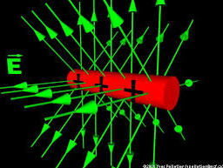
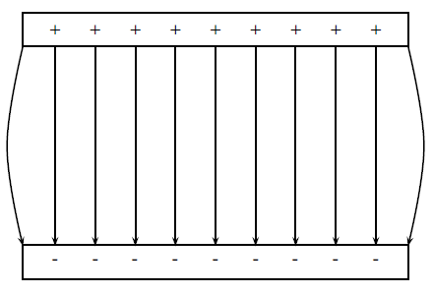
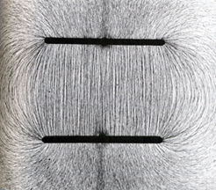
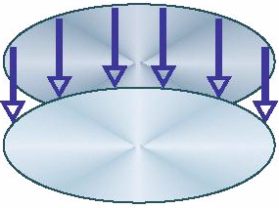
Topic 5: Electricity and magnetism
5.1 – Electric fields
Electric field – between parallel plates
EXAMPLE: If we take two parallel plates of metal and give them equal and opposite charge, what does the electric field look like between the plates?
SOLUTION: Just remember: Field lines point away from (+) charge and toward (-) charge.
(+)
E
(-)
Notes:
© 2006 By Timothy K. Lund

Slide 51
Topic 5: Electricity and magnetism
5.1 – Electric fields
Electric field – between parallel plates
PRACTICE: Justify the statement “the electric field strength is uniform between two parallel plates.”
SOLUTION:
•Sketch the electric field lines between two parallel plates.
•Now demonstrate that the electric field lines have equal density everywhere between the plates.
Notes:
© 2006 By Timothy K. Lund

Slide 52
Topic 5: Electricity and magnetism
5.1 – Electric fields
Electric field – between parallel plates
PRACTICE: The uniform electric field strength inside the parallel plates is 275 N C⁻¹. A ⁺12 μC charge having a mass of 0.25 grams is placed in the field at A and released.
(a) What is the electric force acting on the charge?
(b) What is the weight of the charge?
SOLUTION:
(a) F = Eq = (275)(12×10⁻⁶) = 0.0033 N.
(b) Change grams to kg by jumping 3 places left:
F = mg = (0.00025)(9.8) = 0.0025 N.
0.025 m
E
A
Notes:
© 2006 By Timothy K. Lund

Slide 53
Topic 5: Electricity and magnetism
5.1 – Electric fields
Electric field – between parallel plates
PRACTICE: The uniform electric field strength inside the parallel plates is 275 N C⁻¹. A ⁺12 μC charge having a mass of 0.25 grams is placed in the field at A and released.
(c) What is the acceleration of the charge?
SOLUTION: Use F_{net} = ma.
The electric force is trying to make the charge go up, and the weight is trying to make it go down. Thus
F_{net} = 0.0033 - 0.0025 = 0.0008 N.
F_{net} = ma
0.0008 = 0.00025a → a = 3.2 m s⁻² ( ↑).
0.025 m
E
A
Notes:
© 2006 By Timothy K. Lund

Slide 54
Topic 5: Electricity and magnetism
5.1 – Electric fields
Potential difference
•Because electric charges experience the electric force, when one charge is moved in the vicinity of another, work W is done (recall that work is a force times a displacement).
•We define the potential difference V between two points A and B as the amount of work W done per unit charge in moving a point charge from A to B.
•Note that the units of V are JC⁻¹ which are volts V.
Q
q
A
B
V = W / q
potential difference
Notes:
© 2006 By Timothy K. Lund

Slide 55
Topic 5: Electricity and magnetism
5.1 – Electric fields
Potential difference
PRACTICE: A charge of q = ⁺15.0 μC is moved from point A, having a voltage (potential) of 25.0 V to point B, having a voltage (potential) of 18.0 V.
(a) What is the potential difference undergone by the charge?
(b) What is the work done in moving the charge from A to B?
SOLUTION:
(a) V = V_{B} – V_{A} = 18.0 – 25.0 = ⁻7.0 V.
(b) W = qV = 15.0×10⁻⁶×⁻7.0 = ⁻1.1 ×10⁻⁴ J.
A
B
q
FYI
•Many books use ΔV instead of V.
Notes:
© 2006 By Timothy K. Lund

Slide 56
Topic 5: Electricity and magnetism
5.1 – Electric fields
Potential difference – the electronvolt
•When speaking of energies of individual charges (like electrons in atoms), rather than large groups of charges (like currents through wire), Joules are too large and awkward.
•We define the electronvolt eV as the work done when an elementary charge e is moved through a potential difference V.
•From W = qV we see that
1 eV = eV = (1.60×10⁻¹⁹ C)(1 V) = 1.60×10⁻¹⁹ J.
1 eV = 1.60×10⁻¹⁹ J
electronvolt conversion
FYI •We will use electronvolts exclusively in Topic 7 when we study atomic physics.
Notes:
© 2006 By Timothy K. Lund

Slide 57
Topic 5: Electricity and magnetism
5.1 – Electric fields
Potential difference – the electronvolt
PRACTICE: An electron is moved from Point A, having a voltage (potential) of 25.0 V, to Point B, having a voltage (potential) of 18.0 V.
(a) What is the work done (in eV and in J) on the electron by the external force during the displacement?
SOLUTION:
•Use W = q(V_{B} – V_{A}). Then
W = -e(18.0 V – 25.0 V) = 7.0 eV.
7.0 eV (1.60×10⁻¹⁹ J / eV) = 1.12 ×10⁻¹⁸ J.
A
B
q
FYI
•Since the electron is more attracted to A than B, we have stored this energy as potential energy.
Notes:
© 2006 By Timothy K. Lund

Slide 58
Topic 5: Electricity and magnetism
5.1 – Electric fields
Potential difference – the electronvolt
PRACTICE: An electron is moved from Point A, having a voltage (potential) of 25.0 V, to Point B, having a voltage (potential) of 18.0 V.
(b) If the electron is released from Point B, what is its speed when it reaches Point A?
SOLUTION: Use ΔE_{K} + ΔE_{P} = 0 with ΔE_{P} = ⁻1.12 ×10⁻¹⁸.
ΔE_{K} = ⁻ΔE_{P}
(1/2)mv² – (1/2)mu² = ⁻(⁻1.12 ×10⁻¹⁸)
(1/2)mv² – (1/2)m0² = 1.12 ×10⁻¹⁸
(1/2)(9.11×10⁻³¹)v² = 1.12 ×10⁻¹⁸
v ² = 2.45×10¹²
v = 1.57×10⁶ ms⁻¹.
A
B
q
Notes:
© 2006 By Timothy K. Lund

Slide 59
Topic 5: Electricity and magnetism
5.1 – Electric fields
Potential difference – path independence
EXAMPLE: A charge of q = ⁺15.0 μC is moved from point A, having a voltage (potential) of 25.0 V to point B, having a voltage (potential) of 18.0 V, in three different ways. What is the work done in each case?
SOLUTION:
•The work is independent of the path because the electric force is a conservative force.
•W = qV = 15.0×10⁻⁶× ⁻7.0 = ⁻1.1 ×10⁻⁴ J. Same for all.
A
B
FYI
•We will find out in Topic 6 that gravity is also a conservative force.
Notes:
© 2006 By Timothy K. Lund

Slide 60

Topic 5: Electricity and magnetism
5.1 – Electric fields
Potential difference – between parallel plates
PRACTICE: Two parallel plates with plate separation d are charged up to a potential difference of V simply by connecting a battery (shown) to them. The electric field between the plates is E. A positive charge q is moved from A to B.
(a) How much work is done in moving q through the distance d?
(b) Find the potential difference V across the plates.
SOLUTION: Use W = Fd cos θ, F = Eq, and W = qV.
(a) W = Fd cos 0° = (Eq)d.
(b) qV = Eqd → V = Ed.
A
d
E
B
Notes:
© 2006 By Timothy K. Lund

Slide 61
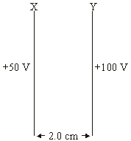
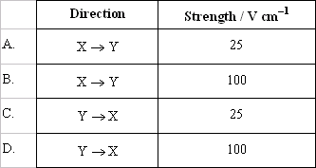
Topic 5: Electricity and magnetism
5.1 – Electric fields
Potential difference – between parallel plates
PRACTICE: Two parallel plates with plate separation 2.0 cm are charged up to the potential difference shown. Which one of the following shows the correct direction and strength of the resulting electric field?
SOLUTION:
•Since the greater positive is plate Y, the electric field lines point from Y → X.
•From V = Ed we see that
E = V / d
= (100 – 50) / 2
= 25 V cm⁻¹.
Notes:
© 2006 By Timothy K. Lund

Slide 62
Topic 5: Electricity and magnetism
5.1 – Electric fields
Identifying sign and nature of charge carriers in a metal
•In 1916 conclusive proof that the charge carriers in a metal are electrons (-) was obtained by Tolman and Stewart.
•Assuming the charge carriers in a conductor are free to move, if a conductor is suddenly accelerated, the electrons would “pool” at the trailing side due to inertia, and a potential difference measured by a voltmeter would be set up between the ends.
a
Notes:
© 2006 By Timothy K. Lund

Slide 63
Topic 5: Electricity and magnetism
5.1 – Electric fields
Drift velocity
•In a metal, free electrons move very rapidly, but collide constantly with the atoms in the crystalline lattice structure of the metal.
•Note that through any cross-section of the conductor, the net current is zero.
FYI
•Thus, although the electrons have a very high velocity, the net result at the macroscopic level is that there is no net electron migration.
Notes:
© 2006 By Timothy K. Lund

Slide 64
Topic 5: Electricity and magnetism
5.1 – Electric fields
Drift velocity
•If we place that same portion of conductor under the influence of a potential difference, we have a slow drifting of the velocities toward the lower potential:
•Note that the net current is NOT zero in this case.
•The electrons still have a high velocity, but this time the net migration is in the direction of the lower potential.
•The speed of this net migration is called the drift velocity.
ΔV
Notes:
© 2006 By Timothy K. Lund

Slide 65

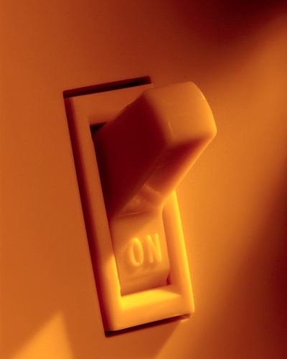
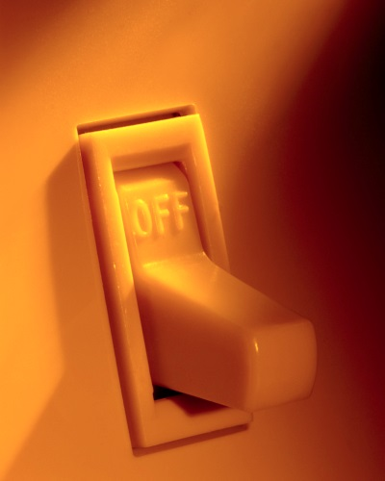
Topic 5: Electricity and magnetism
5.1 – Electric fields
Drift velocity
PRACTICE: Suppose the drift velocity is 0.0025 ms⁻¹ for your house wiring. If the wire between your light switch and your light bulb is 6.5 meters, how long does it take an electron to travel from the switch to the bulb?
SOLUTION: Use v = d / t we get t = d / v. Thus
t = d / v = 6.5 / 0.0025 = 2600 s = 43.33 min!
PRACTICE:
Why does the bulb turn on instantly?
SOLUTION:
Recall the charge in a tube model: all of the electrons begin moving at the same time through the whole circuit.
Notes:
© 2006 By Timothy K. Lund

Slide 66
Topic 5: Electricity and magnetism
5.1 – Electric fields
Drift velocity
•If we know the number n of free charges q per unit volume in a conductor, known as the number density, and the cross sectional area A of the conductor, and the drift velocity v of the charges, the current I is
I = nAvq
current vs. drift velocity
PRACTICE: Suppose the current in a 2.5 mm diameter copper wire is 1.5 A and the number density of the free electrons is 5.0×10²⁶ m⁻³. Find the drift velocity.
SOLUTION: Use I = nAvq, where A = πd ²/ 4.
A = πd ²/ 4 = π(2.5×10⁻³) ²/ 4 = 4.91×10⁻⁶ m².
v = I / [nAq]
= 1.5 / [5.0×10²⁶×4.91×10⁻⁶×1.6×10⁻¹⁹ ] = 0.0038 ms⁻¹.
Notes:
© 2006 By Timothy K. Lund

Slide 67
Topic 5: Electricity and magnetism
5.1 – Electric fields
Drift velocity
EXAMPLE: Derive the equation for drift velocity used in the previous practice problem.
SOLUTION:
•Through any time interval Δt, only the charges ΔQ between the two black cross-sections will provide the current I.
•The volume containing the charge ΔQ is V = AvΔt.
•Thus ΔQ = nVq = nAvΔtq.
•Finally, I = ΔQ / Δt = nAvq.
v Δt
ΔQ
A
v
Notes:
© 2006 By Timothy K. Lund

