Slide 1
Topic 12: Quantum & nuclear physics - AHL
12.1 – The interaction of matter with radiation
Topic 12.1 is an extension of Topics 7.1 and 7.2.
Essential idea: The microscopic quantum world offers a range of phenomena whose interpretation and explanation require new ideas and concepts not found in the classical world.
Nature of science: (1) Observations: Much of the work towards a quantum theory of atoms was guided by the need to explain the observed patterns in atomic spectra. The first quantum model of matter is the Bohr model for hydrogen. (2) Paradigm shift: The acceptance of the wave–particle duality paradox for light and particles required scientists in many fields to view research from new perspectives.
Notes:
© 2015 by Timothy K. Lund

Slide 2
Topic 12: Quantum & nuclear physics - AHL
12.1 – The interaction of matter with radiation
Understandings:
• Photons
• The photoelectric effect
• Matter waves
• Pair production and pair annihilation
• Quantization of angular momentum in the Bohr model for hydrogen
• The wave function
• The uncertainty principle for energy and time and position and momentum
• Tunneling, potential barrier and factors affecting tunneling probability
Notes:
© 2015 by Timothy K. Lund

Slide 3
Topic 12: Quantum & nuclear physics - AHL
12.1 – The interaction of matter with radiation
Applications and skills:
• Discussing the photoelectric effect experiment and explaining which features of the experiment cannot be explained by the classical wave theory of light
• Solving photoelectric problems both graphically and algebraically
• Discussing experimental evidence for matter waves, including an experiment in which the wave nature of electrons is evident
• Stating order of magnitude estimates from the uncertainty principle
Notes:
© 2015 by Timothy K. Lund

Slide 4
Topic 12: Quantum & nuclear physics - AHL
12.1 – The interaction of matter with radiation
Guidance:
• The order of magnitude estimates from the uncertainty principle may include (but is not limited to) estimates of the energy of the ground state of an atom, the impossibility of an electron existing within a nucleus, and the lifetime of an electron in an excited energy state
• Tunneling is to be treated qualitatively using the idea of continuity of wave functions
Notes:
© 2015 by Timothy K. Lund

Slide 5
Topic 12: Quantum & nuclear physics - AHL
12.1 – The interaction of matter with radiation
Data booklet reference:
• E = hf
• E_{max} = hf – φ
• E = – (13.6 / n²) eV
• mvr = nh / (2π)
• P(r) = | ψ |² ΔV
• Δx Δp ≥ h / (4π)
• ΔE Δt ≥ h / (4π)
Theory of knowledge:
• The duality of matter and tunneling are cases where the laws of classical physics are violated. To what extent have advances in technology enabled paradigm shifts in science?
Notes:
© 2015 by Timothy K. Lund

Slide 6
Topic 12: Quantum & nuclear physics - AHL
12.1 – The interaction of matter with radiation
Utilization:
• The electron microscope and the tunneling electron microscope rely on the findings from studies in quantum physics
• Probability is treated in a mathematical sense in Mathematical studies SL sub-topics 3.6–3.7
Notes:
© 2015 by Timothy K. Lund

Slide 7
Topic 12: Quantum & nuclear physics - AHL
12.1 – The interaction of matter with radiation
Aims:
• Aim 1: study of quantum phenomena introduces students to an exciting new world that is not experienced at the macroscopic level. The study of tunneling is a novel phenomenon not observed in macroscopic physics.
• Aim 6: the photoelectric effect can be investigated using LEDs
• Aim 9: the Bohr model is very successful with hydrogen but not of any use for other elements
Notes:
© 2015 by Timothy K. Lund

Slide 8
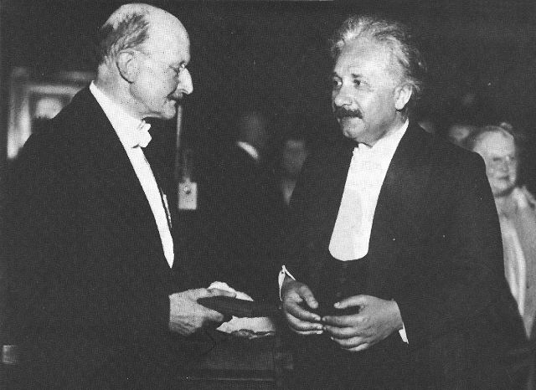
Topic 12: Quantum & nuclear physics - AHL
12.1 – The interaction of matter with radiation
The quantum nature of radiation
•Back in the very early 1900s physicists thought that within a few years everything having to do with physics would be discovered and the “book of physics” would be complete.
•This “book of physics” has come to be known as classical physics and consists of particles and mechanics on the one hand, and wave theory on the other.
•Two men who spearheaded the physics revolution which we now call modern physics were Max Planck and Albert Einstein.
Notes:
© 2015 by Timothy K. Lund

Slide 9
Topic 12: Quantum & nuclear physics - AHL
12.1 – The interaction of matter with radiation
The quantum nature of radiation
•To understand Planck’s contribution to modern physics we revisit black- body radiation and its characteristic curves:
•Recall Wien’s displace- ment law which gives the relationship between the wavelength and intensity for different temperatures.
visible radiation
UV radiation
IR radiation
Intensity
1000
2000
3000
4000
5000
Wavelength (nm)
λ_{max}T = 2.90×10⁻³ m⋅K
Wien’s displacement law
FYI •Note that the intensity becomes zero for very long and very short wavelengths of light.
Notes:
© 2015 by Timothy K. Lund

Slide 10
Topic 12: Quantum & nuclear physics - AHL
12.1 – The interaction of matter with radiation
The quantum nature of radiation
•Blackbody radiation gave Planck the first inkling that things were not as they should be.
•As far as classical wave theory goes, thermal radiation is caused by electric charge acceleration near the surface of an object.
e⁻
visible radiation
UV radiation
IR radiation
Intensity
1000
2000
3000
4000
5000
Wavelength (nm)
FYI
•Recall that moving electric charges produce magnetic fields. Accelerated electric charges produce electromagnetic radiation, including visible light.
Notes:
© 2015 by Timothy K. Lund

Slide 11
Topic 12: Quantum & nuclear physics - AHL
12.1 – The interaction of matter with radiation
The quantum nature of radiation
•According to classical wave theory, the intensity vs. wavelength curve should look like the dashed line:
•For long wavelengths the predicted and observed curves match up well.
•But for small wavelengths, classical theory fails.
visible radiation
UV radiation
IR radiation
Intensity
1000
2000
3000
4000
5000
Wavelength (nm)
FYI
•The failure of classical wave theory with experimental observation of blackbody radiation was called the ultraviolet catastrophe.
Notes:
© 2015 by Timothy K. Lund

Slide 12
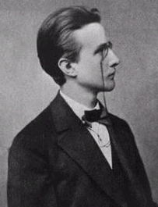
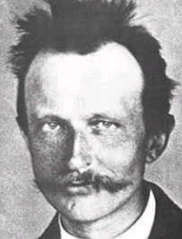
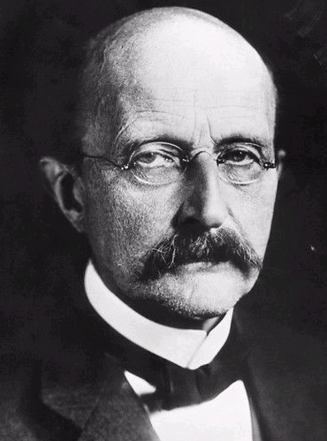
Topic 12: Quantum & nuclear physics - AHL
12.1 – The interaction of matter with radiation
The quantum nature of radiation
•In 1900, the UV catastrophe led German physicist Max Planck to reexamine blackbody radiation.
•Planck discovered that the failure of classical theory was in assuming that energy could take on any value (in other words, that it was continuous).
•Planck hypothesized that if thermal oscillators could only vibrate at specific frequencies delivering packets of energy he called quanta, then the ultraviolet catastrophe was resolved.
1876
1938
1901
e⁻
E_{n} = nhf, for n = 1,2,3,...
Planck’s hypothesis
Planck’s constant h = 6.63×10⁻³⁴ J s.
Notes:
© 2015 by Timothy K. Lund

Slide 13
Topic 12: Quantum & nuclear physics - AHL
12.1 – The interaction of matter with radiation
The quantum nature of radiation
EXAMPLE: Using Planck’s hypothesis show that the energy E of a single quanta with frequency f is given by E = hc / λ. Find the energy contained in a single quantum of light having a wavelength of 500. nm.
SOLUTION:
•From classical wave theory v = λf.
•But for light, v = c, the speed of light.
•Thus f = c / λ and we have E = hf = hc / λ.
•For light having a wavelength of 500. nm we have
E = hc / λ = (6.63×10⁻³⁴)(3.00×10⁸) / (500.×10⁻⁹)
= 3.98×10⁻¹⁹ J.
E = hc / λ
Planck’s hypothesis
Notes:
© 2015 by Timothy K. Lund

Slide 14

Topic 12: Quantum & nuclear physics - AHL
12.1 – The interaction of matter with radiation
The quantum nature of radiation
•According to Planck's hypothesis, thermal oscillators can only absorb or emit light in chunks which are whole-number multiples of E.
•Max Planck received the Nobel Prize in 1918 for his quantum hypothesis, which was used successfully to unravel other problems that could not be explained classically.
•The world could no longer be viewed as a continuous entity – rather, it was seen to be grainy.
FYI
•The Nobel Prize amount for 2012 was 1.2 million USD at the time of its announcement.
Notes:
© 2015 by Timothy K. Lund

Slide 15
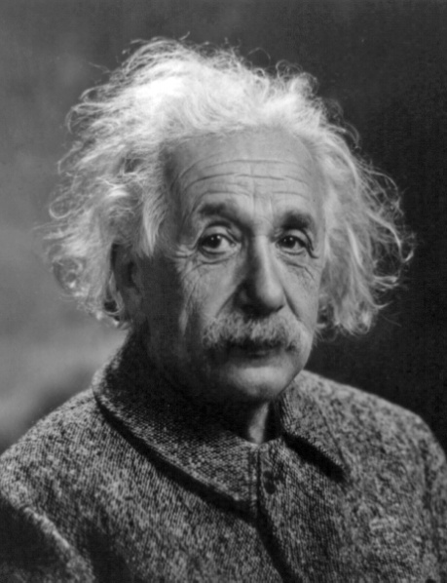
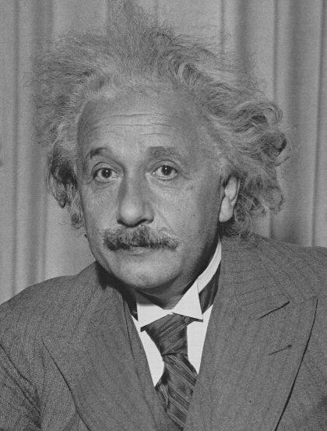
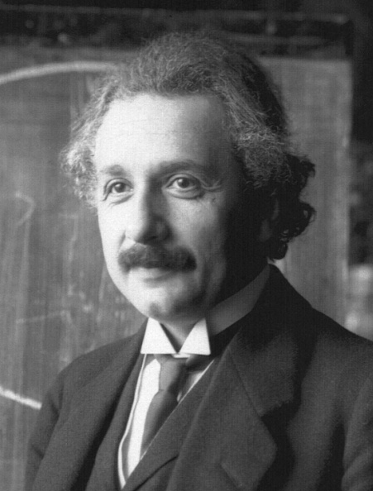
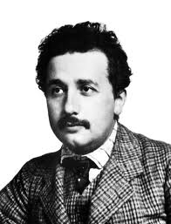
Topic 12: Quantum & nuclear physics - AHL
12.1 – The interaction of matter with radiation
The photoelectric effect
•In the early 1900s Albert Einstein conducted experiments in which he irradiated photosensitive metals with light of different frequencies and intensities.
•In 1905 he published a paper on the photoelectric effect, in which he postulated that energy quantization is also a fundamental property of electromagnetic waves (including visible light and heat).
•He called the energy packet a photon, and postulated that light acted like a particle as well as a wave.
1921
1932
1945
1895
Notes:
© 2015 by Timothy K. Lund

Slide 16



Topic 12: Quantum & nuclear physics - AHL
12.1 – The interaction of matter with radiation
The photoelectric effect
•Certain metals are photosensitive - meaning that when they are struck by radiant energy, they emit electrons from their surface.
•In order for this to happen, the light must have done work on the electrons.
FYI
•Perhaps the best-known example of an application using photosensitive metals is the XeroxTM machine.
•Light reflects off of a document causing a charge on the photosensitive drum in proportion to the color and intensity of the light reflected.
Photosensitive metal
Notes:
© 2015 by Timothy K. Lund

Slide 17
Topic 12: Quantum & nuclear physics - AHL
12.1 – The interaction of matter with radiation
The photoelectric effect
•Einstein enhanced the photoelectric effect by placing a plate opposite and applying a potential difference:
•The positive plate attracts the photo- electrons whereas the negative plate repels them.
•From the reading on the ammeter he could determine the current of the photoelectrons.
+
-
A
Notes:
© 2015 by Timothy K. Lund

Slide 18
Topic 12: Quantum & nuclear physics - AHL
12.1 – The interaction of matter with radiation
The photoelectric effect
•If he reversed the polarity of the plates, Einstein found that he could adjust the voltage until the photocurrent stopped.
•The top plate now repels the photoelectrons whereas the bottom plate attracts them back.
•The ammeter now reads zero because there is no longer a photocurrent.
+
-
A
Notes:
© 2015 by Timothy K. Lund

Slide 19

Topic 12: Quantum & nuclear physics - AHL
12.1 – The interaction of matter with radiation
phototube
The photoelectric effect
•The experimental setup is shown:
•Monochromatic light of fixed intensity is shined into the tube, creating a photocurrent I_{p}.
•Note the reversed polarity of the plates and the potential divider that is used to adjust the voltage.
•I_{p} remains constant for all positive p.d.’s.
•Not until we reach a p.d. of zero, and start reversing the polarity, do we see a response:
I_{p}
V
A
+
-
I_{p}
-V₀
V
Notes:
© 2015 by Timothy K. Lund

Slide 20
Topic 12: Quantum & nuclear physics - AHL
12.1 – The interaction of matter with radiation
phototube
The photoelectric effect
•We call the voltage –V₀ at which I_{p} becomes zero the cutoff voltage.
•Einstein discovered that if the intensity were increased, even though I_{p} increased substantially, the cutoff voltage remained V₀.
I_{p}
V
A
FYI •Classical theory predicts that increased intensity should produce higher I_{p}.
•But classical theory also predicts that the cutoff voltage should change when it obviously doesn’t.
+
-
I_{p}
E X P E C T E D
N O T E X P E C T E D
-V₀
V
Notes:
© 2015 by Timothy K. Lund

Slide 21
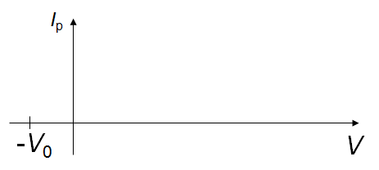
Topic 12: Quantum & nuclear physics - AHL
12.1 – The interaction of matter with radiation
The photoelectric effect
•Einstein also discovered that if the frequency of the light delivering the photons increased, so did the cutoff voltage.
•Einstein noted that if the frequency of the light was low enough, no matter how intense the light no photocurrent was observed. He termed this minimum frequency needed to produce a photocurrent the cutoff frequency.
•And finally, he observed that even if the intensity was extremely low, the photocurrent would begin immediately.
Notes:
© 2015 by Timothy K. Lund

Slide 22





Topic 12: Quantum & nuclear physics - AHL
12.1 – The interaction of matter with radiation
The photoelectric effect
EXAMPLE: Complete the table…
The photoelectric effect and classical wave theory compared…
Characteristics observed in the photoelectric effect. | Classical Wave Theory OK?
I_{p} is proportional to the light’s intensity.
I_{p} is zero for low enough cutoff frequency f₀ regardless of the intensity of the light.
I_{p} is observed immediately even with a low intensity of light above the cutoff frequency f₀.
E_{K} is independent of intensity of light.
E_{K} is dependent on frequency of light.
Notes:
© 2015 by Timothy K. Lund

Slide 23
Topic 12: Quantum & nuclear physics - AHL
12.1 – The interaction of matter with radiation
The photoelectric effect
•Einstein found that if he treated light as if it were a stream of particles instead of a wave that his theory could predict all of the observed results of the photoelectric effect.
•The light particle (photon) has the same energy as Planck’s quantum of thermal oscillation:
•Einstein defined a work function φ which was the minimum amount of energy needed to “knock” an electron from the metal. A photon having a frequency at least as great as the cutoff frequency f₀ was needed.
E = hf = hc / λ
energy of a photon
φ = hf₀
the work function
Notes:
© 2015 by Timothy K. Lund

Slide 24
Topic 12: Quantum & nuclear physics - AHL
12.1 – The interaction of matter with radiation
The photoelectric effect
•If an electron was freed by the incoming photon having energy E = hf, and if it had more energy than the work function, the electron would have a maximum kinetic energy in the amount of
•Putting it all together into a single formula:
E_{K,max} = hf – φ = eV
maximum E_{K}
hf = hf₀ + eV
photoelectric effect
hf = φ + E_{max}
Energy left for motion of electron
Energy to free electron from metal
Energy of incoming photon
Notes:
© 2015 by Timothy K. Lund

Slide 25
Topic 12: Quantum & nuclear physics - AHL
12.1 – The interaction of matter with radiation
The photoelectric effect
PRACTICE: A photosensitive metal has a work function of 5.5 eV. Find the minimum frequency f₀ of light needed to free an electron from its surface.
SOLUTION:
•Use hf₀ = φ:
•Then
(6.63×10⁻³⁴)f₀ = (5.5 eV)(1.6×10⁻¹⁹ J / eV)
f₀ = 1.3×10¹⁵ Hz.
FYI
•The excess energy in an incoming photon having a frequency greater than f₀ will be given to the electron in the form of kinetic energy.
Notes:
© 2015 by Timothy K. Lund

Slide 26
Topic 12: Quantum & nuclear physics - AHL
12.1 – The interaction of matter with radiation
The photoelectric effect
PRACTICE: A photosensitive metal has a work function of 5.5 eV. Find the maximum kinetic energy of an electron freed by a photon having a frequency of 2.5×10¹⁵ Hz.
SOLUTION: Use hf = φ + E_{max}.
•First find the total energy hf :
hf = (6.63×10⁻³⁴)(2.5×10¹⁵) = 1.658×10⁻¹⁸ J.
•Then convert the work function φ into Joules:
φ = (5.5 eV)(1.6×10⁻¹⁹ J / eV) = 8.8×10⁻¹⁹ J.
•Then from hf = φ + E_{max} we get
E_{max} = hf – φ
= 1.658×10⁻¹⁸ – 8.8×10⁻¹⁹
= 7.8×10⁻¹⁹ J.
Notes:
© 2015 by Timothy K. Lund

Slide 27
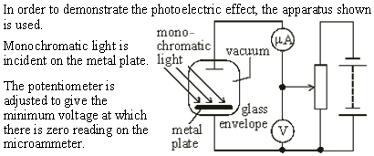
Topic 12: Quantum & nuclear physics - AHL
12.1 – The interaction of matter with radiation
The photoelectric effect
•We are at the cutoff voltage for this particular frequency. Even at an increased intensity there will be no photocurrent.
Notes:
© 2015 by Timothy K. Lund

Slide 28
Topic 12: Quantum & nuclear physics - AHL
12.1 – The interaction of matter with radiation
The photoelectric effect
•A higher frequency will result in a nonzero photocurrent since a higher cutoff voltage is now required to stop the electrons.
Notes:
© 2015 by Timothy K. Lund

Slide 29
Topic 12: Quantum & nuclear physics - AHL
12.1 – The interaction of matter with radiation
The photoelectric effect
•Use E = φ + E_{K}.
•The photon energy is equal to the work function plus the energy of the emitted electron.
Notes:
© 2015 by Timothy K. Lund

Slide 30
Topic 12: Quantum & nuclear physics - AHL
12.1 – The interaction of matter with radiation
The photoelectric effect
•Use E = φ + eV.
•E = hc/λ = (6.63×10⁻³⁴)(3×10⁸) / 540×10⁻⁹ = 3.7×10⁻¹⁹ J.
•Then E = (3.7×10⁻¹⁹ J)(1 eV / 1.6×10⁻¹⁹ J) = 2.3 eV.
•Finally 2.3 eV = φ + 1.9 eV, so that φ = 0.4 eV.
Notes:
© 2015 by Timothy K. Lund

Slide 31
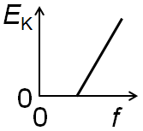
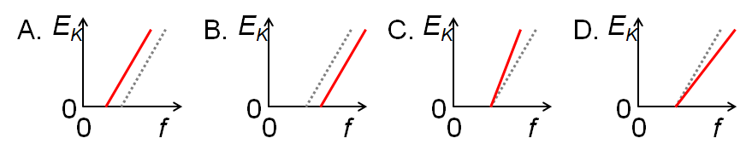
Topic 12: Quantum & nuclear physics - AHL
12.1 – The interaction of matter with radiation
The photoelectric effect
PRACTICE: The graph shows the variation with frequency f in the kinetic energy E_{K} of photo- electrons emitted from a metal surface S. Which one of the following graphs shows the variation for a metal having a higher work function?
SOLUTION: Use hf = φ + E_{max}.
•Then E_{max} = hf – φ which shows a slope of h…
and a y-intercept of – φ.
•Because φ is bigger the intercept is lower:
Notes:
© 2015 by Timothy K. Lund

Slide 32
Topic 12: Quantum & nuclear physics - AHL
12.1 – The interaction of matter with radiation
The wave nature of matter
•The last section described how light, which in classical physics is a wave, was discovered to have particle-like properties.
•Recall that a photon was a discrete packet or quantum of energy (like a particle) having an associated frequency (like a wave). Thus
is really a statement of the wave-particle duality of light.
•Because of the remarkable symmetries observed in nature, in 1924 the French physicist Louis de Broglie proposed that just as light exhibited a wave-particle duality, so should matter.
E = hf = hc / λ
energy of a photon
Notes:
© 2015 by Timothy K. Lund

Slide 33
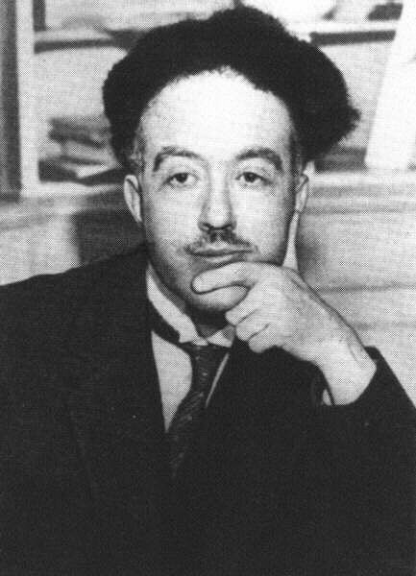
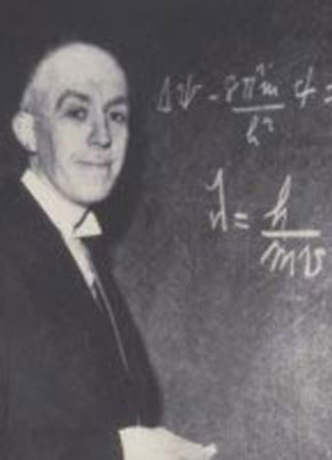
Topic 12: Quantum & nuclear physics - AHL
12.1 – The interaction of matter with radiation
The de Broglie hypothesis
•The de Broglie hypothesis is given in the statement
“Any particle having a momentum p will have a wave associated with it having a wavelength λ of h / p.”
•In formulaic form we have:
•With de Broglie’s hypothesis the particle-wave duality of matter was established.
λ = h / p = h / (mv)
de Broglie hypothesis
FYI
•At first, de Broglie's hypothesis was poo-pooed by the status quo. But then it began to yield fruitful results...
Notes:
© 2015 by Timothy K. Lund

Slide 34
Topic 12: Quantum & nuclear physics - AHL
12.1 – The interaction of matter with radiation
The de Broglie hypothesis
PRACTICE: An electron is accelerated from rest through a potential difference of 100 V. What is its expected de Broglie wavelength?
SOLUTION: We need the velocity, which comes from E_{K} = eV, and then we will use λ = h / p = h / (mv).
•From E_{K} = eV,
eV = (1.6×10⁻¹⁹)(100) = 1.6×10⁻¹⁷ J
1.6×10⁻¹⁷ = (1/2)mv ² = (1/2)(9.11×10⁻³¹)v ²
so that v = 5.9×10⁶ m s⁻¹.
•Then λ = h / p = h / (mv)
= (6.63×10⁻³⁴) / (9.11×10⁻³¹×5.9×10⁶)
= 1.2×10⁻¹⁰ m.
•This is about the diameter of an atom.
Notes:
© 2015 by Timothy K. Lund

Slide 35
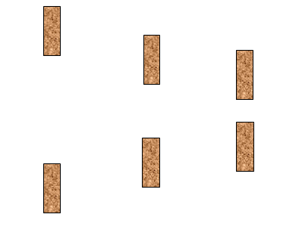
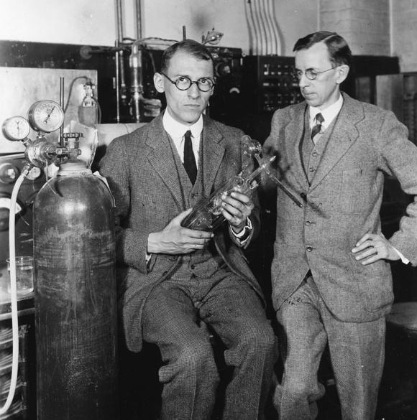
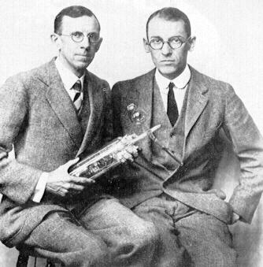
Topic 12: Quantum & nuclear physics - AHL
12.1 – The interaction of matter with radiation
The de Broglie hypothesis
•Recall that diffraction of a wave will occur if the aperture of a hole is comparable to the wavelength of the incident wave.
•In 1924 Davisson and Germer performed an experiment which showed that a stream of electrons in fact exhibit wave properties according to the de Broglie hypothesis.
b
b
b
b = 2λ
b = 6λ
b = 12λ
FYI
•For small apertures crystals can be used. Crystalline nickel has lattice plane separation of 0.215 nm.
Notes:
© 2015 by Timothy K. Lund

Slide 36
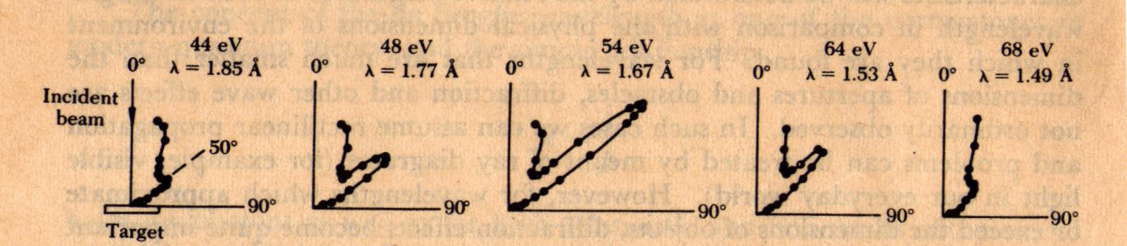
Topic 12: Quantum & nuclear physics - AHL
12.1 – The interaction of matter with radiation
The de Broglie hypothesis
•By varying the voltage and hence the velocity (and hence the de Broglie wavelength) their data showed that diffraction of an electron beam actually occurred in accordance with de Broglie!
b
b
b
b = 2λ
b = 6λ
b = 12λ
Notes:
© 2015 by Timothy K. Lund

Slide 37
Topic 12: Quantum & nuclear physics - AHL
12.1 – The interaction of matter with radiation
The de Broglie hypothesis
PRACTICE: A particle has an energy E and an associated de Broglie wavelength λ. The energy E is proportional to
A. λ⁻² B. λ⁻¹ C. λ D. λ²
SOLUTION:
•Since λ = h / (mv) then v = h / (mλ). Then
E_{K} = (1/2)mv ²
= (1/2)mh² / (m²λ²)
= h² / (2mλ²)
•Therefore E_{K} ∝ λ⁻².
Notes:
© 2015 by Timothy K. Lund

Slide 38

Topic 12: Quantum & nuclear physics - AHL
12.1 – The interaction of matter with radiation
The de Broglie hypothesis
Notes:
© 2015 by Timothy K. Lund

Slide 39
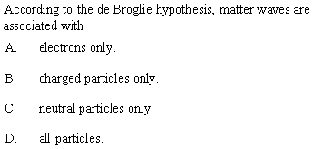
Topic 12: Quantum & nuclear physics - AHL
12.1 – The interaction of matter with radiation
The de Broglie hypothesis
Notes:
© 2015 by Timothy K. Lund

Slide 40
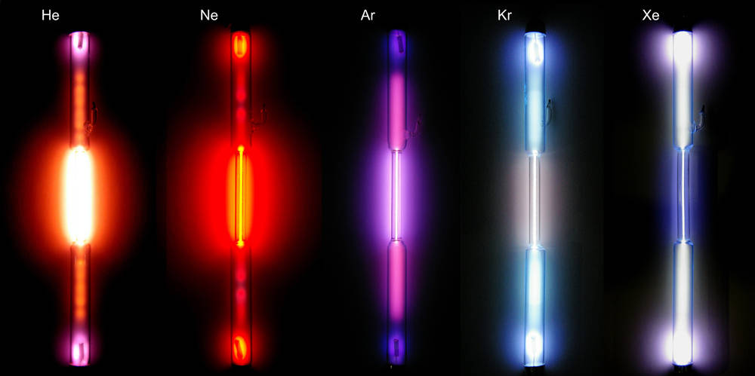
Topic 12: Quantum & nuclear physics - AHL
12.1 – The interaction of matter with radiation
Atomic spectra and atomic energy states – review
•When a low-pressure gas in a tube is subjected to a voltage the gas ionizes and emits light. (See Topic 7.1).
Notes:
© 2015 by Timothy K. Lund

Slide 41

Topic 12: Quantum & nuclear physics - AHL
12.1 – The interaction of matter with radiation
Atomic spectra and atomic energy states – review
•We can analyze that light by looking at it through a spectroscope.
•A spectroscope acts similar to a prism in that it separates the incident light into its constituent wavelengths.
•For example, heated barium gas will produce an emission spectrum that looks like this:
4000 4500 5000 5500 6000 6500 7000 7500
FYI
• Heating a gas and observing its light is how we produce and observe atomic spectra.
Notes:
© 2015 by Timothy K. Lund

Slide 42



Topic 12: Quantum & nuclear physics - AHL
12.1 – The interaction of matter with radiation
Atomic spectra and atomic energy states – review
•The fact that the emission spectrum is discontinuous tells us that atomic energy states are quantized.
continuous spectrum
light source
absorption spectrum
light source
cool gas X
emission spectrum
hot gas X
compare…
discontinuous!
Notes:
© 2015 by Timothy K. Lund

Slide 43
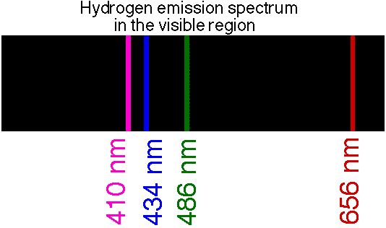
Topic 12: Quantum & nuclear physics - AHL
12.1 – The interaction of matter with radiation
Atomic spectra and atomic energy states – review
PRACTICE: Which one of the following provides direct evidence for the existence of discrete energy levels in an atom?
A. The continuous spectrum of the light emitted by a white hot metal.
B. The line emission spectrum of a gas at low pressure.
C. The emission of gamma radiation from radioactive atoms.
D. The ionization of gas atoms when bombarded by alpha particles.
SOLUTION:
•Dude, just pay attention!
Notes:
© 2015 by Timothy K. Lund

Slide 44
Topic 12: Quantum & nuclear physics - AHL
12.1 – The interaction of matter with radiation
Atomic spectra and atomic energy states – review
•Now we know that light energy is carried by a particle called a photon.
•If a photon of just the right energy strikes a hydrogen atom, it is absorbed by the atom and stored by virtue of the electron jumping to a new energy level:
•The electron jumped from the n = 1 state to the n = 3 state.
•We say the atom is excited.
7
6
5
4
3
2
1
Notes:
© 2015 by Timothy K. Lund

Slide 45
Topic 12: Quantum & nuclear physics - AHL
12.1 – The interaction of matter with radiation
Atomic spectra and atomic energy states – review
•When the atom de-excites the electron jumps back down to a lower energy level.
•When it does, it emits a photon of just the right energy to account for the atom’s energy loss during the electron’s orbital drop.
•The electron jumped from the n = 3 state to the n = 2 state.
•We say the atom is de-excited, but not quite in its lowest, or ground state.
7
6
5
4
3
2
1
Notes:
© 2015 by Timothy K. Lund

Slide 46
Topic 12: Quantum & nuclear physics - AHL
12.1 – The interaction of matter with radiation
Atomic spectra and atomic energy states – review
PRACTICE: A spectroscopic examination of glowing hydrogen shows the presence of a 434 nm blue emission line.
(a) What is its frequency?
SOLUTION:
•Use λf = c with c = 3.00×10⁸ ms⁻¹ and λ = 434×10⁻⁹ m:
(434×10⁻⁹)f = 3.00×10⁸
f = 3.00×10⁸ / 434×10⁻⁹
= 6.91×10¹⁴ Hz.
Notes:
© 2015 by Timothy K. Lund

Slide 47
Topic 12: Quantum & nuclear physics - AHL
12.1 – The interaction of matter with radiation
Atomic spectra and atomic energy states – review
PRACTICE: A spectroscopic examination of glowing hydrogen shows the presence of a 434 nm blue emission line.
(b) What is the energy (in J and eV) of each of its blue-light photons?
SOLUTION: Use E = hf:
E = (6.63×10⁻³⁴)(6.91×10¹⁴)
= 4.58×10⁻¹⁹ J.
= (4.58×10⁻¹⁹ J)(1 eV / 4.58×10⁻¹⁹ J)
= 2.86 eV.
Notes:
© 2015 by Timothy K. Lund

Slide 48
Topic 12: Quantum & nuclear physics - AHL
12.1 – The interaction of matter with radiation
Atomic spectra and atomic energy states – review
PRACTICE: A spectroscopic examination of glowing hydrogen shows the presence of a 434 nm blue emission line.
What are the energy levels associated with this photon?
SOLUTION:
•Because it is visible use the Balmer Series with ΔE = ⁻2.86 eV.
•Note that
E₂ – E₅ = ⁻3.40 – ⁻0.544
= ⁻2.86 eV.
•Thus the electron jumped from n = 5 to n = 2.
n = ∞
0.00 eV
n = 5
-0.544 eV
n = 4
-0.850 eV
n = 3
-1.51 eV
Paschen
n = 2
-3.40 eV
Balmer
n = 1
-13.6 eV
Lyman
Notes:
© 2015 by Timothy K. Lund

Slide 49
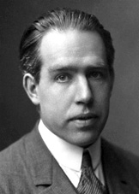
Topic 12: Quantum & nuclear physics - AHL
12.1 – The interaction of matter with radiation
The Bohr model of the hydrogen atom
•The Danish physicist Niels Bohr sought to understand why the hydrogen atom had discrete energy levels.
•He began by looking at the energies of an electron in “orbit” around a proton.
E = E_{K} + E_{P}
= (1/2)mv ² + ( – ke² / r )
•Since the electron is held in UCM by the electric force, we also have the relationship
F = ke² / r ² = mv ² / r → mv ² = ke² / r.
•Thus
E = ke² / (2r) – 2ke² / (2r) = – (1/2)ke² / r.
Notes:
© 2015 by Timothy K. Lund

Slide 50
Topic 12: Quantum & nuclear physics - AHL
12.1 – The interaction of matter with radiation
The Bohr model of the hydrogen atom
•So far Bohr had not done anything we wouldn’t have done. But he went one creative step further: He assumed that the angular momentum L = mvr of the electron was quantized.
•Bohr further assumed that L could only be integral numbers n of the basic quantity h / (2π). Hence
mvr = L = nh / (2π).
•Squaring both sides we see that
m²v²r² = n²h² / (4π²) → mv² = n²h² / (4π²mr ²).
•From the previous slide mv ² = ke² / r so that
ke² / r = n²h² / (4π²mr ²) → r_{n} = n²h² / (4π²ke²m) .
Notes:
© 2015 by Timothy K. Lund

Slide 51
Topic 12: Quantum & nuclear physics - AHL
12.1 – The interaction of matter with radiation
The Bohr model of the hydrogen atom
•The last formula tells us that only certain electronic radii are allowed in the hydrogen atom!
r_{n} = n²h² / (4π²ke²m) n = 1,2,3,…
hydrogen radii
PRACTICE: Calculate the radius of a hydrogen atom in its ground state (n = 1).
SOLUTION:
r₁ = 1²h² / (4π²ke²m)
= 5.31×10⁻¹¹ m.
(6.63×10⁻³⁴)²
4π²×8.99×10⁹×(1.60×10⁻¹⁹)²×9.11 ×10⁻³¹
=
r_{n} = (5.31×10⁻¹¹ m) n² n = 1,2,3,…
hydrogen radii
Notes:
© 2015 by Timothy K. Lund

Slide 52
Topic 12: Quantum & nuclear physics - AHL
12.1 – The interaction of matter with radiation
The Bohr model of the hydrogen atom
r_{n} = n²h² / (4π²ke²m) n = 1,2,3,…
hydrogen radii
PRACTICE: Given E = – (1/2)ke² / r_{n} , show that
SOLUTION:
E_{n} = – (1/2)ke² / r_{n}
= – (1/2)ke²×4π²ke²m / n²h²
= – 2π²k²e⁴m / n²h²
= – (2.1668×10⁻¹⁸ J)( 1 eV / 1.60×10⁻¹⁹ ) / n²
= –13.6 / n² eV.
E_{n} = –13.6 / n² ( E in eV )
hydrogen energy levels
2π²(8.99×10⁹)²(1.60×10⁻¹⁹)⁴(9.11×10⁻³¹ )
(6.63×10⁻³⁴)² n ²
= –
Notes:
© 2015 by Timothy K. Lund

Slide 53
Topic 12: Quantum & nuclear physics - AHL
12.1 – The interaction of matter with radiation
The Bohr model of the hydrogen atom
E_{n} = –13.6 / n² ( E in eV )
hydrogen energy levels
PRACTICE: Find E₁ through E₅ and compare them to the table to the right:
SOLUTION: E_{n} = –13.6 / n² eV.
E₁ = –13.6 / 1² = - 13.6 eV.
E₂ = –13.6 / 2² = - 3.40 eV.
E₃ = –13.6 / 3² = - 1.51 eV.
E₄ = –13.6 / 4² = - 0.850 eV.
E₅ = –13.6 / 5² = - 0.544 eV.
•They match the table perfectly!
n = ∞
0.00 eV
n = 5
-0.544 eV
n = 4
-0.850 eV
n = 3
-1.51 eV
Paschen
n = 2
-3.40 eV
Balmer
n = 1
-13.6 eV
Lyman
Notes:
© 2015 by Timothy K. Lund

Slide 54
Topic 12: Quantum & nuclear physics - AHL
12.1 – The interaction of matter with radiation
The Schrödinger model of the hydrogen atom
EXAMPLE: Suppose an electron confined in a 1D box whose length is L oscillates so that it’s de Broglie wave has end nodes.
(a) Show that the allowed de Broglie wavelengths of the electron are given by λ = 2L / n, where n = 1,2,3,….
SOLUTION:
•For n = 1 we see that (1/2)λ = L or λ = 2L / 1.
•For n = 2 we see that (2/2)λ = L or λ = 2L / 2.
•For n = 3 we see that (3/2)λ = L or λ = 2L / 3.
•For any n we see that λ = 2L / n.
•Note that these are the resonant frequencies.
L
Notes:
© 2015 by Timothy K. Lund

Slide 55
Topic 12: Quantum & nuclear physics - AHL
12.1 – The interaction of matter with radiation
The Schrödinger model of the hydrogen atom
EXAMPLE: Suppose an electron confined in a 1D box whose length is L oscillates so that it’s de Broglie wave has end nodes.
(b) Show that the allowed de Broglie kinetic energies are given by E_{K} = n²h²/ ( 8mL² ), where n = 1,2,3,….
SOLUTION: Use λ = h / p = h / (mv).
•From λ = h / (mv) we get
λ = 2L / n = h / (mv) so that v = nh / (2mL).
•From E_{K} = (1/2)mv ² we get
E_{K} = (1/2)mv ² = (1/2)m·n²h²/ (4m²L²)
E_{K} = n²h²/ ( 8mL² ).
L
Notes:
© 2015 by Timothy K. Lund

Slide 56
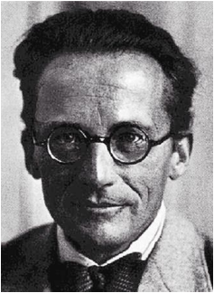
Topic 12: Quantum & nuclear physics - AHL
12.1 – The interaction of matter with radiation
The Schrödinger model of the hydrogen atom
•In 1926 Austrian physicist Erwin Schrödinger argued that since electrons must exhibit wavelike properties, in order to exist in a bound orbit in a hydrogen atom a whole number of the electron's wavelength must fit precisely in the circumference of that orbit to form a standing wave.
Thus:
•Note that nλ = 2πr_{n}.
•But from de Broglie we have λ = h / mv.
•Thus nh / mv = 2πr_{n} so that v = nh / (2πr_{n}m).
3
2
1
2πr₁
2πr₂
2πr₃
Notes:
© 2015 by Timothy K. Lund

Slide 57
Topic 12: Quantum & nuclear physics- AHL
12.1 – The interaction of matter with radiation
The Schrödinger model of the hydrogen atom
PRACTICE: Show that the kinetic energy of an electron at a radius r_{n} in an atom is given by
E_{K} = n²h² / (8mπ²r_{n}²).
SOLUTION:
•Use E_{K} = (1/2)mv² and v = nh / (2πr_{n}m).
E_{K} = (1/2)mv²
= (1/2)mn²h² / (2πr_{n}m)²
= (1/2)mn²h² / (4π²r_{n}²m²)
= n²h² / (8π²r_{n}²m)
= n²h² / (8mπ²r_{n}²)
FYI
•The IBO expects you to derive the ‘electron in a box’ formula, but not this one.
Notes:
© 2015 by Timothy K. Lund

Slide 58
Topic 12: Quantum & nuclear physics- AHL
12.1 – The interaction of matter with radiation
The wave function
•Integrating the math of waves with the math of particles through the conservation of energy, Schrödinger developed a wave equation that looked like this:
•Three things to note about the wave equation:
1) It is built around the conservation of mechanical energy: E = E_{K} + E_{P}.
2) There is a wavefunction ψ which describes both the particle and the wave properties of matter simultaneously.
3) The probability “cloud” (P-cloud) shows where the electron has the highest probability of being.
Schrödinger’s wave equation
(E_{K} + E_{P})ψ = Eψ
High P
Low P
L
Notes:
© 2015 by Timothy K. Lund

Slide 59
Topic 12: Quantum & nuclear physics- AHL
12.1 – The interaction of matter with radiation
The wave function
•The wave equation (E_{K} + E_{P})ψ = Eψ has a form that looks like this for the hydrogen atom:
•Compare the highlighted region with the allowed E_{K} of the “electron in a box” E_{K} = n²h² / (8mL²), or the hydrogen atom: E_{K} = n²h² / (8mπ²r_{n}²).
•Just as ax² + bx = c has solutions, so does the Schrödinger equation. Instead of x we use ψ.
•The major differences between the equation in x and the Schrödinger model is that the model is a differential equation and the wavefunction ψ is a function in 3D: ψ = ψ (r, θ, t).
n²h²
8π²m
d²ψ
dr²
Schrödinger’s wave equation in 1D
–
+ 2π²mv²r²ψ = Eψ
Notes:
© 2015 by Timothy K. Lund

Slide 60
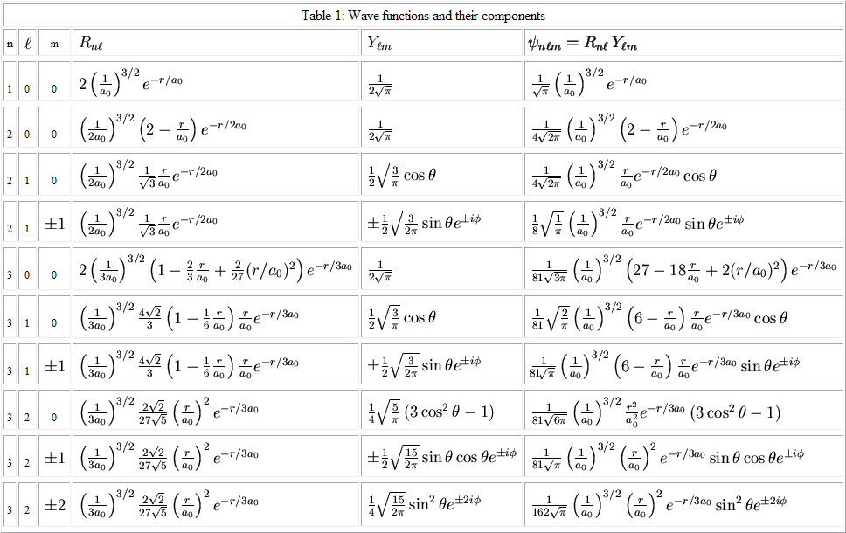
P(r, θ, t) = | ψ(r, θ, t) |² ΔV
probability P of the electron being located at radius r.
potential difference
wave function
Notes:
© 2015 by Timothy K. Lund

Slide 61
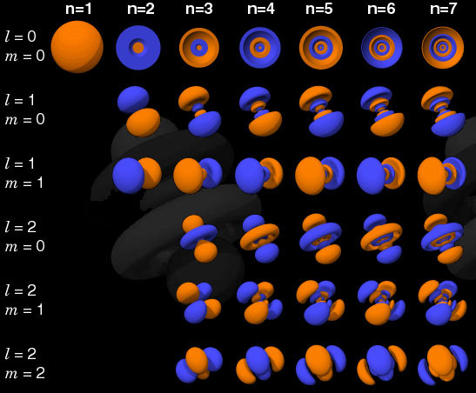
P(r, θ, t) = | ψ(r, θ, t) |² ΔV
Notes:
© 2015 by Timothy K. Lund

Slide 62
Topic 12: Quantum & nuclear physics- AHL
12.1 – The interaction of matter with radiation
Tunneling
•Schrödinger imagined a particle to be a wave packet:
•We can imagine the particle to be trapped within a potential well.
•If we imagine that this particle is, say, an alpha particle within the nucleus of an atom, the strong force defines the height of the well.
•As long as the alpha particle’s potential is less than ΔV (if its energy E is less than E = eΔV ) it appears that the alpha particle cannot get out of the nucleus.
ΔV
Notes:
© 2015 by Timothy K. Lund

Slide 63

Topic 12: Quantum & nuclear physics- AHL
12.1 – The interaction of matter with radiation
Tunneling
•In region A (within the nucleus) the particle oscillates as a standing wave, exactly like the electron in a box.
•In region B the waveform of the particle drops off exponentially. The bigger the mass m of the trapped particle, the bigger the width w of the barrier, and the bigger the potential difference ΔV between the barrier wall and the trapped particle, the more rapid the exponential drop of the waveform.
•In region C the waveform’s exponential drop continues until it is infinitesimally small (it approaches zero).
C
B
A
B
C
Notes:
63
© 2015 by Timothy K. Lund

Slide 64
Topic 12: Quantum & nuclear physics- AHL
12.1 – The interaction of matter with radiation
Tunneling
•The wavefunction ψ is the combined waveforms of the particle in each of the three regions.
•The probability function P(r) = | ψ |² ΔV tells us the probability of finding the particle at any position r.
•The probability of the particle existing outside the potential well is extremely small, but it is not zero.
•Thus on rare occasions, the alpha can “escape”!
•This is what radioactive decay is!
•And this barrier penetration is called tunneling.
C
B
A
B
C
r
Notes:
64
© 2015 by Timothy K. Lund

Slide 65
Topic 12: Quantum & nuclear physics- AHL
12.1 – The interaction of matter with radiation
Tunneling
•It turns out that P ∝ exp(– w mqΔV ).
•Thus we see that the smaller the charge q and the smaller the mass m the easier it is for a particle to tunnel. Hence beta decay (e⁺, e⁻, m_{e} ) is “more probable” than alpha decay (2e⁺, 4m_{p}).
•Surprisingly, this quantum mechanical phenomenon has applications in the technical world in the form of the tunnel diode (a rapid electronic switch) and the scanning tunneling microscope with which we can actually observe atoms in crystals!
C
B
A
B
C
r
Notes:
65
© 2015 by Timothy K. Lund

Slide 66
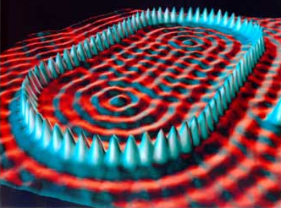
A stadium shaped corral made by iron atoms on a copper surface.
Courtesy: IBM Research, Almaden Research Center.
Notes:
66
© 2015 by Timothy K. Lund

Slide 67
Topic 12: Quantum & nuclear physics - AHL
12.1 – The interaction of matter with radiation
The Heisenberg uncertainty principle
•Suppose you want to know the position and the velocity of an electron.
•In order to detect the electron you have to make contact with it in what we call an "observation."
•The least intrusive means of observation would be to “bounce” a photon off of it and observe the results to determine its position.
•And if you bounced a second photon off of it and measured the time between the two "returns" you could determine the velocity of the electron.
•You could send out the two photons closer and closer together and find out, to any degree of accuracy, the electron's position and velocity.
Notes:
© 2015 by Timothy K. Lund

Slide 68
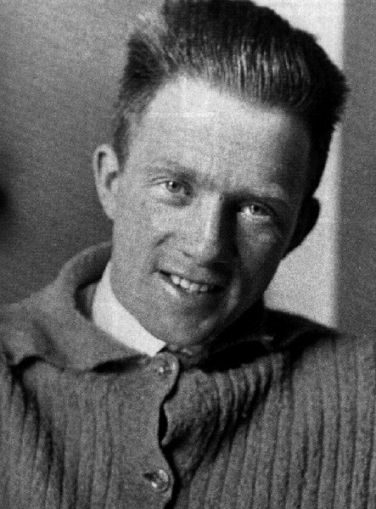

Topic 12: Quantum & nuclear physics - AHL
12.1 – The interaction of matter with radiation
The Heisenberg uncertainty principle
•And then along came German physicist Werner Heisenberg, who in 1927 stated the Heisenberg uncertainty principle:
“ It is impossible to know simultaneously an object's exact position and momentum. "
•The uncertainty principle comes in two forms that look like this:
Δx Δp ≥ h / 4π (momentum form)
Heisenberg uncertainty principle
ΔE Δt ≥ h / 4π (energy form)
FYI
•The energy form tells us that for very short time intervals, energy conservation can be violated!
Notes:
© 2015 by Timothy K. Lund

Slide 69
Topic 12: Quantum & nuclear physics - AHL
12.1 – The interaction of matter with radiation
The Heisenberg uncertainty principle
•The “Δ” stands for “uncertainty in” and the uncertainties are not related to the equipment used to make the measurements.
•Perfect equipment would still result in Δx Δp = h / 4π (or ΔE Δt = h / 4π).
•The first equation says that if you know a particle’s position to a high degree of precision, then its momentum has a high uncertainty (and vice versa).
•Einstein, one of the leaders in the quantum revolution, never came to accept this as a final body of thought. He believed a new and better theory would replace it…
Δx Δp ≥ h / 4π (momentum form)
Heisenberg uncertainty principle
ΔE Δt ≥ h / 4π (energy form)
Notes:
© 2015 by Timothy K. Lund

Slide 70
Topic 12: Quantum & nuclear physics - AHL
12.1 – The interaction of matter with radiation
The Heisenberg uncertainty principle
•To try to understand the uncertainty principle, imagine we have a stationary electron. Then p_{e} = 0 (p_{e} = m_{e}v_{e}).
•But to “observe” its position we must “light it up” with at least one photon:
•From conservation of momentum we see that
P₀ = P_{f}
m_{e}(0) + –p_{γ} = m_{e}v_{e} + p_{γ}
– 2p_{γ} = p_{e}.
•Thus we see that the very act of observing the electron causes its momentum to change!
•Obviously for large objects like baseballs, the change in momentum from a photon would be quite small.
e⁻
Notes:
© 2015 by Timothy K. Lund

Slide 71
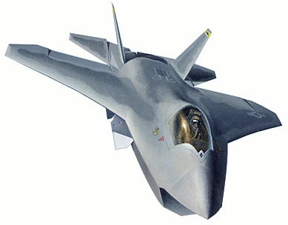

Topic 12: Quantum & nuclear physics - AHL
12.1 – The interaction of matter with radiation
The Heisenberg uncertainty principle
EXAMPLE: An electron and a jet fighter are observed to have equal speeds of 500. m s⁻¹, accurate to within ±0.0200%. What is the minimum uncertainty in the position of each if the mass of the jet is 1.00 metric ton?
SOLUTION: First find the uncertainty in v:
•Δv = 0.000200(500.) = 0.100 m s⁻¹.
•From Heisenberg Δx = h / (4π Δp) = h / (4πm Δv).
•For the jet
Δx = 6.63×10⁻³⁴/ (4π×1000×0.100) = 5.28×10⁻³⁷ m.
•For the electron
Δx = 6.63×10⁻³⁴/ (4π×9.11×10⁻³¹×0.100) = 5.79×10⁻⁴ m.
•This is 0.6 mm!
Notes:
© 2015 by Timothy K. Lund

Slide 72

Topic 12: Quantum & nuclear physics - AHL
12.1 – The interaction of matter with radiation
The Heisenberg uncertainty principle
EXAMPLE: An electron in an excited state has a lifetime of 1.00×10⁻⁸ seconds before it de-excites.
(a) What is the minimum uncertainty in the energy of the photon emitted on de-excitation?
(b) What is the magnitude in the broadening of the frequency of the spectral line?
SOLUTION:
(a) Use the energy form of Heisenberg:
Thus ΔE Δt = h / 4π so that ΔE = h / (4π Δt), and
ΔE = 6.63×10⁻³⁴ / (4π×1.00×10⁻⁸) = 5.28×10⁻²⁷ J.
(b) Use E = hf which becomes ΔE = h Δf.
Δf = ΔE / h = 5.28×10⁻²⁷/ 6.63×10⁻³⁴ = 7.96×10⁶ Hz.
Notes:
© 2015 by Timothy K. Lund

Slide 73
Topic 12: Quantum & nuclear physics - AHL
12.1 – The interaction of matter with radiation
Heisenberg uncertainty – optional “derivation”
•Recall from Topic 9.2 that a single-slit having a width of b will diffract a wave having a wavelength of λ through an angle θ according to θ = λ / b.
•Now imagine projecting a beam of electrons through a hole of width b:
•The uncertainty in the position Δx of an electron in the beam is given by Δx = b / 2.
•The beam has electrons moving horizontally with a momentum p, but because of diffraction, the electrons can deviate from the horizontal by θ. Thus there is an uncertainty in momentum Δp shown in the diagram:
θ
Δp
b
Δx
p
Notes:
73
© 2015 by Timothy K. Lund

Slide 74
Topic 12: Quantum & nuclear physics - AHL
12.1 – The interaction of matter with radiation
Heisenberg uncertainty – optional “derivation”
•We have the following:
•θ = λ / b.
•Δx = b / 2 → b = 2 Δx.
•And from the purple triangle we have, for small θ, Δp / p ≈ θ. Thus
Δp / p ≈ θ
Δp / p ≈ λ / b
Δp / p ≈ λ / (2 Δx)
Δx Δp ≈ (p / 2) λ
Δx Δp ≈ (p / 2) (h / p) Why?
Δx Δp ≈ h / 2.
θ
Δp
b
Δx
p
Note that we are missing a factor of 2π. This is because we have simplified the derivation…
Notes:
74
© 2015 by Timothy K. Lund

Slide 75
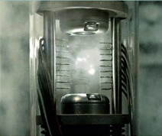
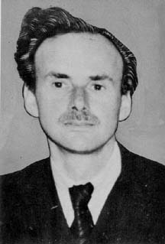
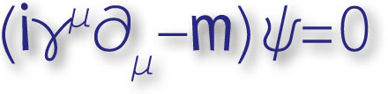
Topic 12: Quantum & nuclear physics - AHL
12.1 – The interaction of matter with radiation
Matter and antimatter
•Every particle has an antiparticle which has the same mass but all of its quantum numbers are the opposite.
•Thus an antiproton (p) has the same mass as a proton (p), but the opposite charge (-1).
•Thus an antielectron (e⁺ or e ) has the same mass as an electron but the opposite charge (+1).
Angels and Demons
Paul Dirac
FYI
•When matter meets antimatter both annihilate each other to become pure energy!
Notes:
© 2006 By Timothy K. Lund

Slide 76
Topic 12: Quantum & nuclear physics - AHL
12.1 – The interaction of matter with radiation
Pair production and annihilation
EXAMPLE: A proton and an antiproton are created from the void as allowed by the HUP. How much time do they exist before annihilating each other?
SOLUTION: A proton has a mass of 1.67×10⁻²⁷ kg.
•From ∆E = ∆mc² we can calculate the energy of a proton (or an antiproton) to be
∆E = (1.67×10⁻²⁷)(3.00×10⁸)² = 1.50×10⁻¹⁰ J.
•Since we need both p and p, the energy doubles.
•The energy form of the HUP, ∆E ∆t = h / 4π, yields
∆t = h / (4π ∆E)
= 6.63×10⁻³⁴ / (4π×2×1.50×10⁻¹⁰)
= 1.76×10⁻²⁵ s.
Notes:
© 2006 By Timothy K. Lund

Slide 77
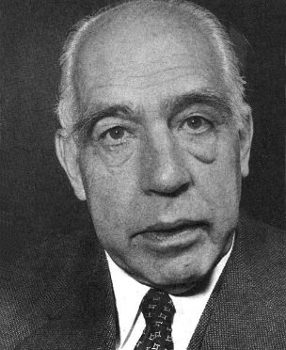

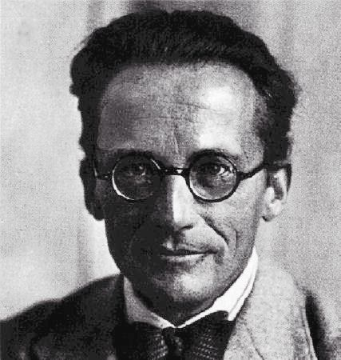

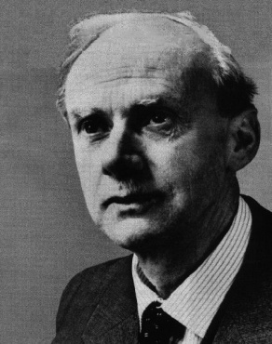
Topic 12: Quantum & nuclear physics - AHL
12.1 – The interaction of matter with radiation
THE QUANTUM REVOLUTION
Year
Physicist
Concept
Equation
1900
Planck
Energy Quanta
E = hf
1905
Einstein
Light Particles
hf = K_{max} + φ
1913
Bohr
Hydrogen Model
E_{n} = – 13.6 / n²
1924
de Broglie
Matter Waves
λ = h / p
1926
Schrödinger
Wave Mechanics
(E_{K} + E_{P})ψ = Eψ
1927
Heisenberg
Uncertainty Principle
Δx Δp ≥ h / 4π
1928
Dirac
Antimatter
hf ≥ 2m_{e}c²
Notes:
© 2015 by Timothy K. Lund

Slide 78
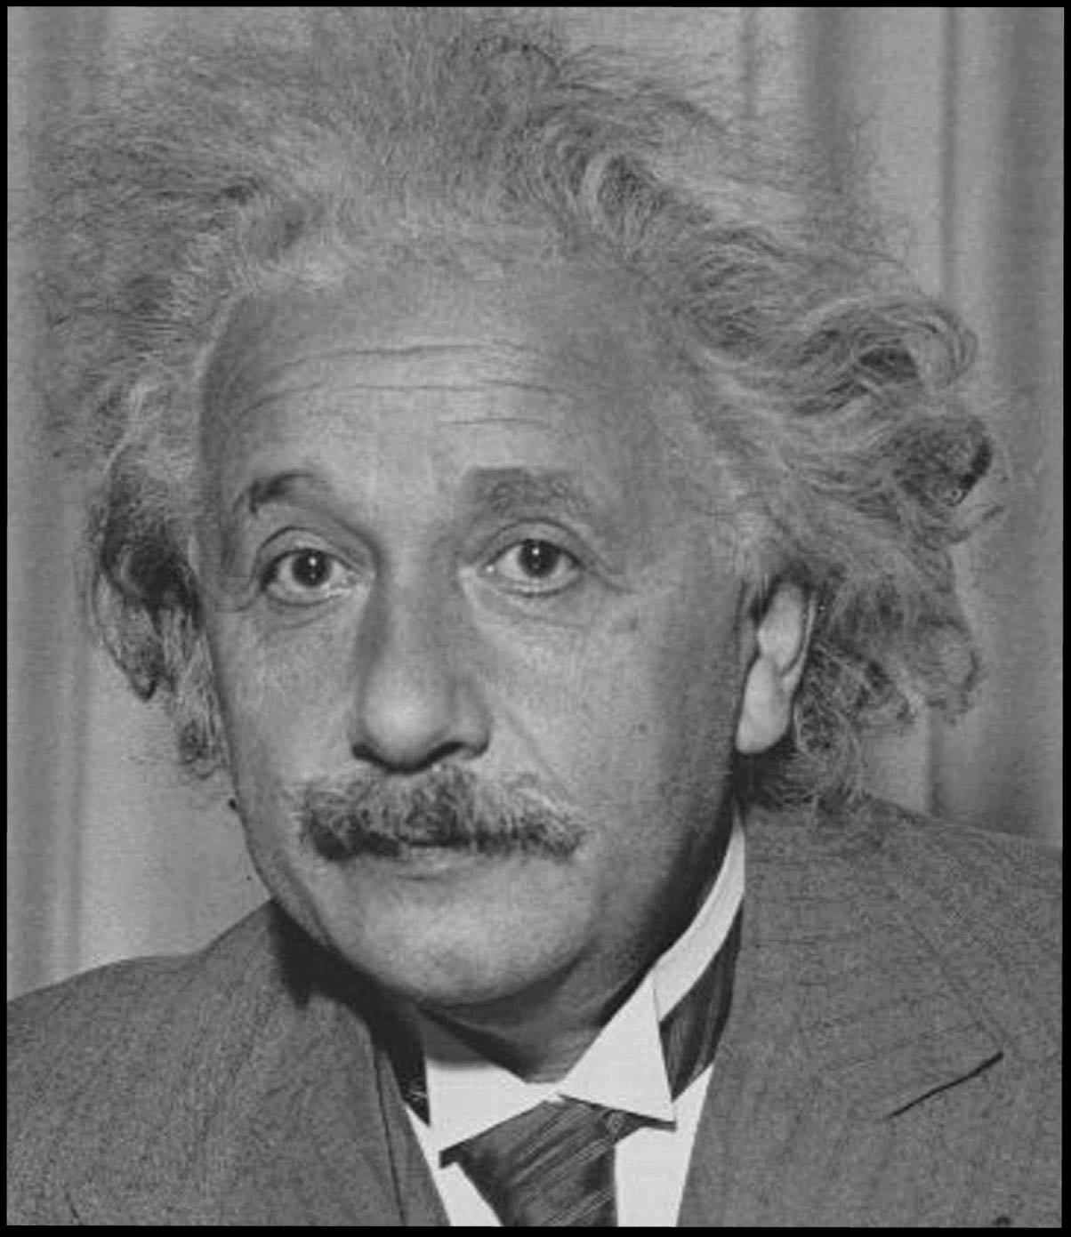
"The theory [quantum mechanics] yields much, but it hardly brings us close to the secrets of the Ancient One. In any case, I am convinced that He does not play dice."
"Yes, but my heart was not really in it."
-on his heading the German atomic bomb effort in WWII.
FYI: Heisenberg's uncertainty principle has not been disproved to date.
"It has never happened that a woman has slept with me and did not wish, as a consequence, to live with me all her life."
FYI: Einstein spent the rest of his life believing this. He tried to develop a grand unified field theory that would eliminate the need for quantum mechanics - and failed.
FYI: Schrodinger's statement has never been disproved, either!
Notes:
© 2015 by Timothy K. Lund

Slide 79
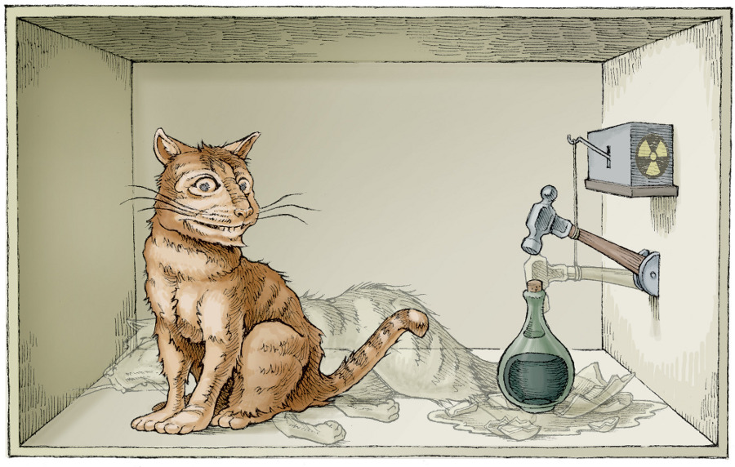

Schrödinger's Cat, Courtesy of Dean Tweed
Notes:
© 2015 by Timothy K. Lund

