Slide 1
Topic 11: Electromagnetic induction - AHL
11.2 – Power generation and transmission
Topic 11.2 is an extension of Topics 5.1, 5.4, 8.1 and 10.2.
Essential idea: Generation and transmission of alternating current (ac) electricity has transformed the world.
Nature of science: Bias: In the late 19th century Edison was a proponent of direct current electrical energy transmission while Westinghouse and Tesla favored alternating current transmission. The so called “battle of currents” had a significant impact on today’s society.
Notes:
© 2015 by Timothy K. Lund

Slide 2
Topic 11: Electromagnetic induction - AHL
11.2 – Power generation and transmission
Understandings:
• Alternating current (ac) generators
• Average power and root mean square (rms) values of current and voltage
• Transformers
• Diode bridges
• Half-wave and full-wave rectification
Notes:
2
© 2015 by Timothy K. Lund

Slide 3
Topic 11: Electromagnetic induction - AHL
11.2 – Power generation and transmission
Applications and skills:
• Explaining the operation of a basic ac generator, including the effect of changing the generator frequency
• Solving problems involving the average power in an ac circuit
• Solving problems involving step-up and step-down transformers
• Describing the use of transformers in ac electrical power distribution
• Investigating a diode bridge rectification circuit experimentally
• Qualitatively describing the effect of adding a capacitor to a diode bridge rectification circuit
Notes:
3
© 2015 by Timothy K. Lund

Slide 4
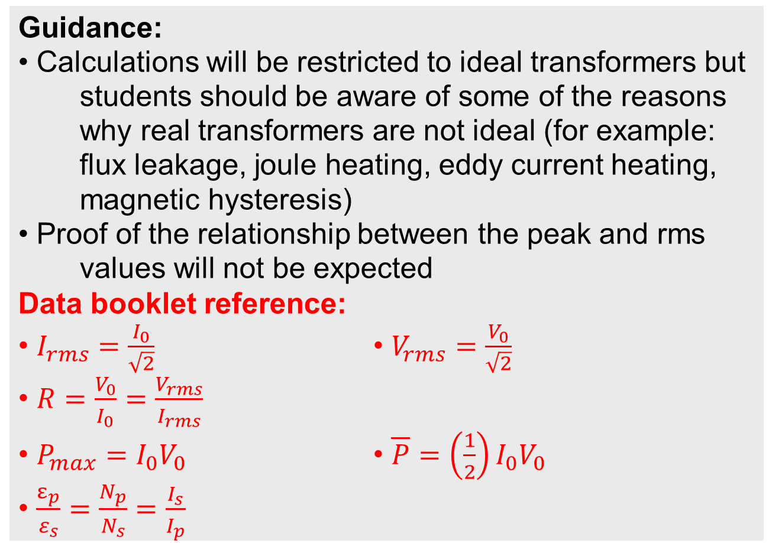
Topic 11: Electromagnetic induction - AHL
11.2 – Power generation and transmission
Guidance:
• Calculations will be restricted to ideal transformers but students should be aware of some of the reasons why real transformers are not ideal (for example: flux leakage, joule heating, eddy current heating, magnetic hysteresis)
• Proof of the relationship between the peak and rms values will not be expected
Data booklet reference:
• $I_{rms}=\frac{I_{0}}{\sqrt{2}}$ • $V_{rms}=\frac{V_{0}}{\sqrt{2}}$
• $R=\frac{V_{0}}{I_{0}}=\frac{V_{rms}}{I_{rms}}$
• $P_{max}=I_{0}V_{0}$ • $\overline{P}=\left(\frac{1}{2}\right)I_{0}V_{0}$
• $\frac{ε_{p}}{ε_{s}}=\frac{N_{p}}{N_{s}}=\frac{I_{s}}{I_{p}}$
Notes:
4
© 2015 by Timothy K. Lund

Slide 5
Topic 11: Electromagnetic induction - AHL
11.2 – Power generation and transmission
International-mindedness:
• The ability to maintain a reliable power grid has been the aim of all governments since the widespread use of electricity started
Theory of knowledge:
• There is continued debate of the effect of electromagnetic waves on the health of humans, especially children. Is it justifiable to make use of scientific advances even if we do not know what their long-term consequences may be?
Aims:
• Aim 6: experiments could include: construction of a basic ac generator; investigation of variation of input and output coils on a transformer; observing Wheatstone and Wien bridge circuits
Notes:
5
© 2015 by Timothy K. Lund

Slide 6
Topic 11: Electromagnetic induction - AHL
11.2 – Power generation and transmission
Aims:
• Aim 7: construction and observation of the adjustments made in very large electricity distribution systems is best carried out using computer-modeling software and websites
• Aim 9: power transmission is modeled using perfectly efficient systems but no such system truly exists. Although the model is imperfect, it renders the maximum power transmission. Recognition and ac-counting for the differences between the “perfect” system and the practical system is one of the main functions of professional scientists
Notes:
6
© 2015 by Timothy K. Lund

Slide 7
Topic 11: Electromagnetic induction - AHL
11.2 – Power generation and transmission
Alternating current (ac) generators
•Recall Faraday’s law:
•From the formula we see that there are three ways to increase the induced emf of a rotating coil:
(1) _______________________________________
(2) _______________________________________
(3) _______________________________________
Faraday’s law
FYI
•Recall that Φ = BA cos θ. Given the _________ magnetic field and ___________, B and A are _______. Thus the flux change ΔΦ will be due only to the change in the ___________.
Notes:
© 2015 by Timothy K. Lund

Slide 8
Topic 11: Electromagnetic induction - AHL
11.2 – Power generation and transmission
Alternating current (ac) generators
PRACTICE:
What is the effect of increasing the frequency of the generator on the induced emf?
SOLUTION:
Notes:
© 2015 by Timothy K. Lund

Slide 9
Topic 11: Electromagnetic induction - AHL
11.2 – Power generation and transmission
Alternating current (ac) generators
•Consider the rectangular loop of wire made to rotate in the fixed magnetic field shown:
•At this instant
Φ = BA cos 0º = BA.
•A bit later θ has changed:
Φ = BA cos 45º = 0.7BA.
•When θ = 90º:
Φ = BA cos 90º = 0.
•As θ continues to increase, the flux Φ becomes negative.
•A sinusoidal pattern emerges.
B
B
B
A
θ
θ
A
A
BA
Φ/ Wb
t / s
⁻BA
Notes:
© 2015 by Timothy K. Lund

Slide 10
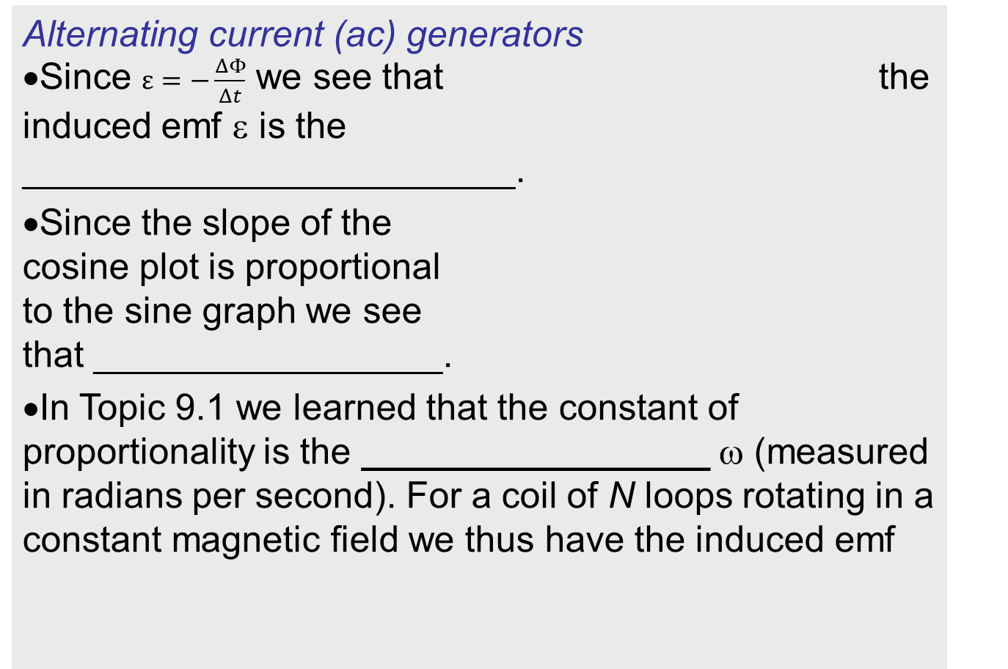
Topic 11: Electromagnetic induction - AHL
11.2 – Power generation and transmission
Alternating current (ac) generators
•Since $ε=−\frac{ΔΦ}{Δt}$ we see that the induced emf ε is the ________________________.
•Since the slope of the cosine plot is proportional to the sine graph we see that _________________.
•In Topic 9.1 we learned that the constant of proportionality is the _________________ ω (measured in radians per second). For a coil of N loops rotating in a constant magnetic field we thus have the induced emf
BA
Φ/ Wb
t / s
⁻BA
ε₀
ε / V
t / s
⁻ε₀
ε = NBAω sin ωt
induced emf (rotating coil, N loops, constant B-field)
(ω = angular frequency)
Notes:
© 2015 by Timothy K. Lund

Slide 11
Topic 11: Electromagnetic induction - AHL
11.2 – Power generation and transmission
Alternating current (ac) generators
ε = NBAω sin ωt
induced emf (rotating coil, N loops, constant B-field)
(ω = angular frequency)
EXAMPLE: A 250-turn coil of wire has dimensions 2.5 cm by 3.2 cm. It is rotating at a frequency of 60 Hz in a constant magnetic field having a strength of 1.5 T.
(a) What is its peak voltage ε₀?
(b) What is the time dependence of its emf?
SOLUTION: Recall that ω = 2πf = 2π(60) = 120π.
(a) A =
ε₀ =
(b) ε =
Notes:
© 2015 by Timothy K. Lund

Slide 12
Topic 11: Electromagnetic induction - AHL
11.2 – Power generation and transmission
Alternating current (ac) generators
EXAMPLE: Rewrite the generator induced emf formula in terms of frequency f, rather than angular frequency ω.
SOLUTION: Since ω = 2πf we have
ε = NBAω sin ωt
ε = 2πfNBA sin 2πft
ε = ε₀ sin 2πft
ε = NBAω sin ωt
induced emf (rotating coil, N loops, constant B-field)
ε = 2πfNBA sin 2πft
ε = ε₀ sin 2πft
ε₀ = _______
FYI
•ε₀ = _________ clearly shows that increasing the frequency increases the induced emf of the coil.
Notes:
© 2015 by Timothy K. Lund

Slide 13

Topic 11: Electromagnetic induction - AHL
11.2 – Power generation and transmission
Alternating current (ac) generators
EXAMPLE: Here is a simplified one-loop generator:
•Some mechanical means makes the coil rotate (say a steam turbine or paddle wheels).
•The alternating current is picked up by brushes riding on two conducting rings that each touch only one end of the coil, as shown.
Output voltage
N
S
FYI •The schematic representation of an AC voltage supply or generator is .
Notes:
© 2015 by Timothy K. Lund

Slide 14
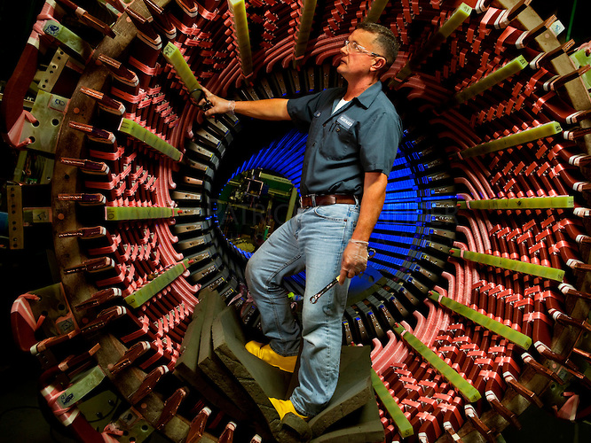
Massive windings for a nuclear power plant generator.
Notes:
© 2015 by Timothy K. Lund

Slide 15
Topic 11: Electromagnetic induction - AHL
11.2 – Power generation and transmission
Root mean square (rms) values of current and voltage
•The voltage produced by North American power plants is marketed as ___ AC, but if you were to record the voltage over time you would discover that it _____________________________.
•The value that is marketed is essentially sort of an “average” voltage value.
•The problem with finding the usual average of a sinusoidal function is that it is ______!
170
ε / V
y / s
⁻170
(+) and (-) areas cancel.
170
(+)
(+)
ε / V
t / s
(-)
(-)
⁻170
Notes:
© 2015 by Timothy K. Lund

Slide 16

Topic 11: Electromagnetic induction - AHL
11.2 – Power generation and transmission
Root mean square (rms) values of current and voltage
•The way to find the average of a regularly alternating voltage is called the ____________ __________.
•What we do is find the area under the squared value of the sinusoidal voltage so that no cancellation occurs!
•Consider the dashed line located at $\frac{ε_{0}^{2}}{2}$:
•Visualize the lobes above the dashed line filling in the troughs below.
ε₀
ε / V
t / s
⁻ε₀
ε₀²
ε₀²
2
0
t / s
Notes:
© 2015 by Timothy K. Lund

Slide 17
Topic 11: Electromagnetic induction - AHL
11.2 – Power generation and transmission
Root mean square (rms) values of current and voltage
•The AC rms values are equivalent to the constant DC values that would dissipate the same power.
EXAMPLE: Find the rms voltage for the “triangular” wave shown:
SOLUTION: There are equal (+) and (-) areas and the straight- forward average is zero. So use the rms for a single period T:
Notes:
© 2015 by Timothy K. Lund

Slide 18
Topic 11: Electromagnetic induction - AHL
11.2 – Power generation and transmission
Root mean square (rms) values of current and voltage
•The AC rms values are equivalent to the constant DC values that would dissipate the same power.
•We then define the root mean square value of an alternating voltage V_{rms} as
•A current that is set up by an alternating voltage will likewise be _____________. Similarly, we define the root mean square value of an alternating current I_{rms} as
•Think of rms values as the AC equivalent of a DC circuit in regards to power dissipation.
root mean square (rms) of an alternating voltage
(V₀ = peak voltage)
root mean square (rms) of an alternating current
(I₀ = peak current)
Notes:
© 2015 by Timothy K. Lund

Slide 19

Topic 11: Electromagnetic induction - AHL
11.2 – Power generation and transmission
Root mean square (rms) values of current and voltage
PRACTICE: “Mains” (outlet) electricity in the UK is rated at 220 V. This is an rms value. Find the peak voltage from a UK outlet.
SOLUTION:
FYI
•Travelers bring voltage converters along for their personal appliances.
Notes:
© 2015 by Timothy K. Lund

Slide 20
Topic 11: Electromagnetic induction - AHL
11.2 – Power generation and transmission
Root mean square (rms) values of current and voltage
•Recall the power formulas for DC (shown here):
•The whole reason for using the rms values for AC current and voltage is this:
-____________________________________________ _______ (and peak current); rather, _______________ ___________________, since they are an average.
electrical power (DC)
electrical power (AC)
PRACTICE: Show that for an AC circuit P = (1/2)V₀I₀.
SOLUTION:
Notes:
© 2015 by Timothy K. Lund

Slide 21
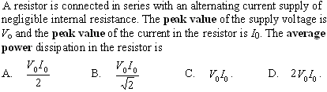
Topic 11: Electromagnetic induction - AHL
11.2 – Power generation and transmission
Root mean square (rms) values of current and voltage
Notes:
© 2015 by Timothy K. Lund

Slide 22

Topic 11: Electromagnetic induction - AHL
11.2 – Power generation and transmission
Root mean square (rms) values of current and voltage
•This is a straight-forward definition of rms current.
Notes:
© 2015 by Timothy K. Lund

Slide 23
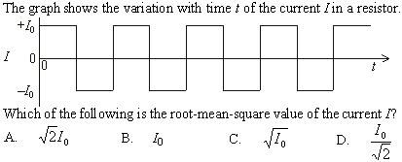
Topic 11: Electromagnetic induction - AHL
11.2 – Power generation and transmission
Root mean square (rms) values of current and voltage
Notes:
© 2015 by Timothy K. Lund

Slide 24

Topic 11: Electromagnetic induction - AHL
11.2 – Power generation and transmission
Alternating current (ac) generators
ε = NBAω sin ωt
induced emf (rotating coil, N loops, constant B-field)
ε = 2πfNBA sin 2πft
ε = ε₀ sin 2πft
ε₀ = 2πfNBA
Notes:
© 2015 by Timothy K. Lund

Slide 25
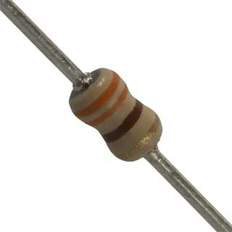
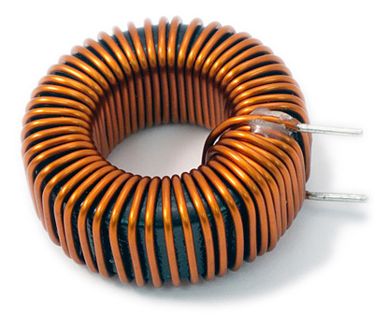
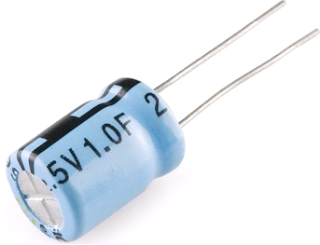
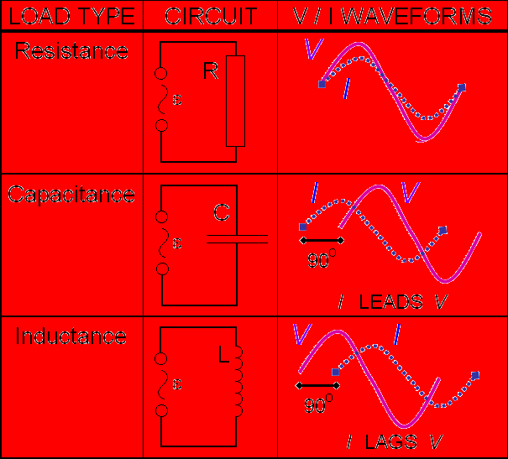
Topic 11: Electromagnetic induction - AHL
11.2 – Power generation and transmission
Solve AC circuit problems for ohmic resistors
•If a resistor is connected to an AC supply, the following relationship holds:
•This relationship shows that I andV are ________________ _______ and _____________..
•This may seem an obvious relationship but in AC circuits there are components called ________ and _______ which change the phase relationship between I and V.
V_{rms} = I_{rms}R V₀ = I₀R
ac circuits and resistors
consumes energy
stores E-field
stores B-field
Notes:
© 2015 by Timothy K. Lund

Slide 26

Topic 11: Electromagnetic induction - AHL
11.2 – Power generation and transmission
Solve AC circuit problems for ohmic resistors
Notes:
© 2015 by Timothy K. Lund

Slide 27
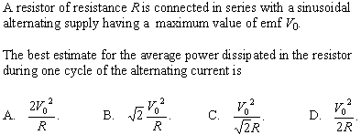
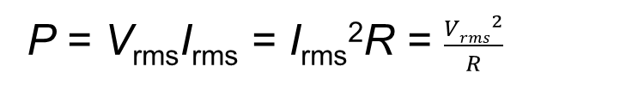
Topic 11: Electromagnetic induction - AHL
11.2 – Power generation and transmission
Solve AC circuit problems for ohmic resistors
P = V_{rms}I_{rms} = I_{rms}²R = $\frac{{Vrms}^{2}}{R}$
electrical power (AC)
Notes:
© 2015 by Timothy K. Lund

Slide 28

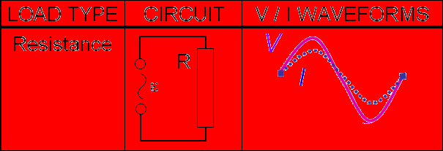
Topic 11: Electromagnetic induction - AHL
11.2 – Power generation and transmission
Solve AC circuit problems for ohmic resistors
EXAMPLE: A 60-Hz generator which produces an induced emf having a maximum value of ε₀ = 140 V is connected to a resistor of 28 Ω as shown. Find the equation of the current I as a function of time.
SOLUTION: For a resistance circuit, I and V are in phase.
•FromV₀ = I₀R we have
V₀ = I₀R →
•From I = I₀ sin 2πft we have
I =
=
Notes:
© 2015 by Timothy K. Lund

Slide 29
Topic 11: Electromagnetic induction - AHL
11.2 – Power generation and transmission
Transformers
•A ___________ is a device that changes a higher AC voltage to a lower one (called a _____________________) or from a lower AC voltage to a higher one (called a ______ ___________________).
•Here is how it works: The input coil, called the ______ _______, is wrapped around ____________as shown:
•Then the output coil, called the __________________, is wrapped around the same ____________, but with a different number of loops.
•Observe _________ to determine the transformer type.
INPUT
OUTPUT
primary
secondary
step down transformer
primary
secondary
step up transformer
Notes:
© 2015 by Timothy K. Lund

Slide 30

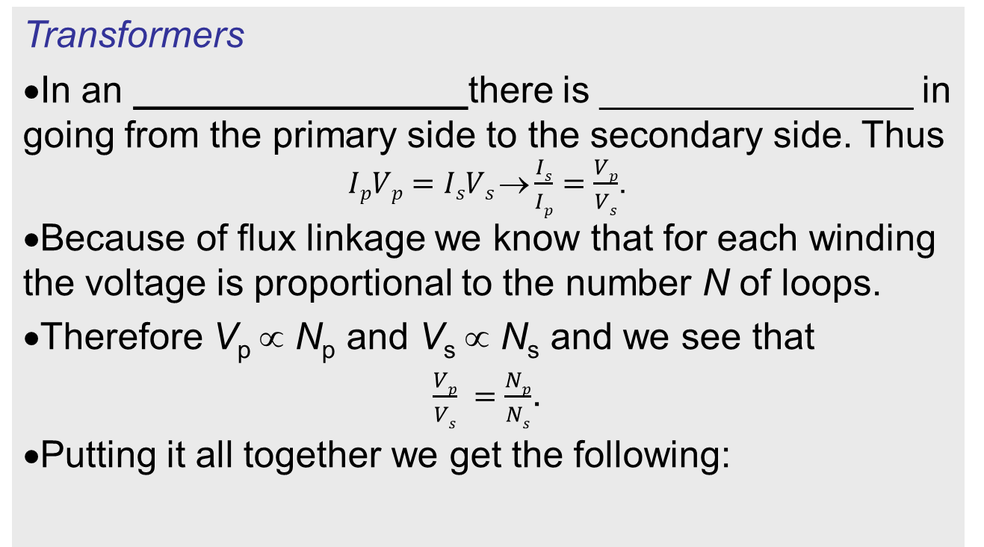
Topic 11: Electromagnetic induction - AHL
11.2 – Power generation and transmission
Transformers
•In an ________________there is _______________ in going from the primary side to the secondary side. Thus
$IpVp=IsVs →\frac{Is}{Ip}=\frac{Vp}{Vs}$.
•Because of flux linkage we know that for each winding the voltage is proportional to the number N of loops.
•Therefore V_{p} ∝ N_{p} and V_{s} ∝ N_{s} and we see that
$\frac{Vp}{Vs} =\frac{Np}{Ns}$.
•Putting it all together we get the following:
ideal transformer
FYI
•The schematic representation of an ideal transformer is shown here:
Notes:
© 2015 by Timothy K. Lund

Slide 31
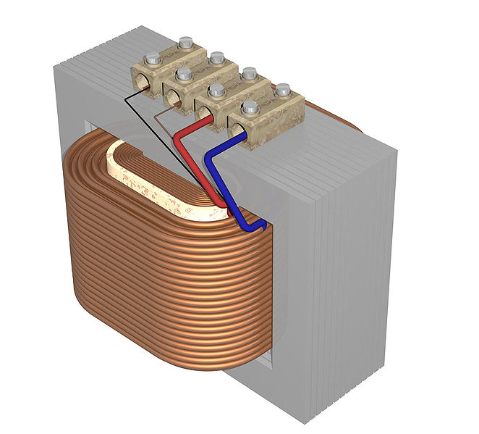
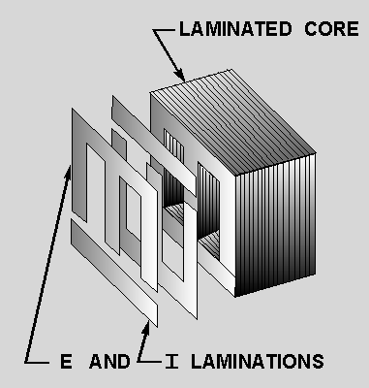
Topic 11: Electromagnetic induction - AHL
11.2 – Power generation and transmission
Transformers – real
EXAMPLE:
•To enhance the ___________ between the primary and secondary coils, transformers are constructed using an _____________.
•The primary and secondary coils are often concentric:
•The iron core of a transformer is ___________ (layered and insulated from other layers) to reduce the _____________ and hysteresis current energy losses.
COIL 1
COIL 2
Notes:
© 2015 by Timothy K. Lund

Slide 32
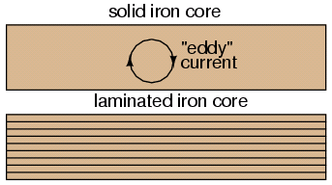
Topic 11: Electromagnetic induction - AHL
11.2 – Power generation and transmission
Transformers – real
•For real transformers there are ______________ and hysteresis currents, both of which are created by Faraday’s law due to the magnetic flux change that is naturally a part of AC circuits. Both of these currents produce P = I ²R _____________.
•Hysteresis losses (I_{hyst} ∝ f ) are less significant than eddy losses (I_{eddy} ∝ f ² ).
•____________________________ _____________________________.
•The laminations are insulated from one another, thereby eliminating any complete loops to make a circuit.
•Furthermore, each layer has E and I laminations.
Notes:
© 2015 by Timothy K. Lund

Slide 33
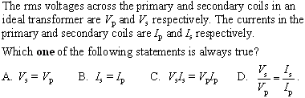
Topic 11: Electromagnetic induction - AHL
11.2 – Power generation and transmission
Solve problems involving ideal transformers
Notes:
© 2015 by Timothy K. Lund

Slide 34
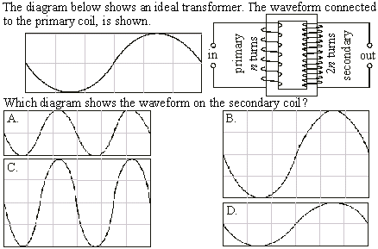
Topic 11: Electromagnetic induction - AHL
11.2 – Power generation and transmission
Solve problems involving ideal transformers
Notes:
© 2015 by Timothy K. Lund

Slide 35
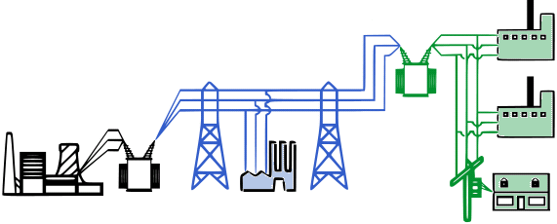










Topic 11: Electromagnetic induction - AHL
11.2 – Power generation and transmission
Transformers in AC electrical power distribution
•Observe the simplified electrical grid:
FYI
•Power is lost as heat during transformer step-up and -down of the voltage due to eddy currents (I_{eddy} ∝ f ²).
•Power is lost as heat in the lines during the current transmission due to internal resistance (P = I ²R).
Notes:
© 2015 by Timothy K. Lund

Slide 36
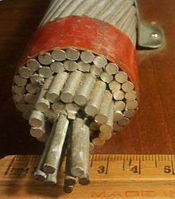
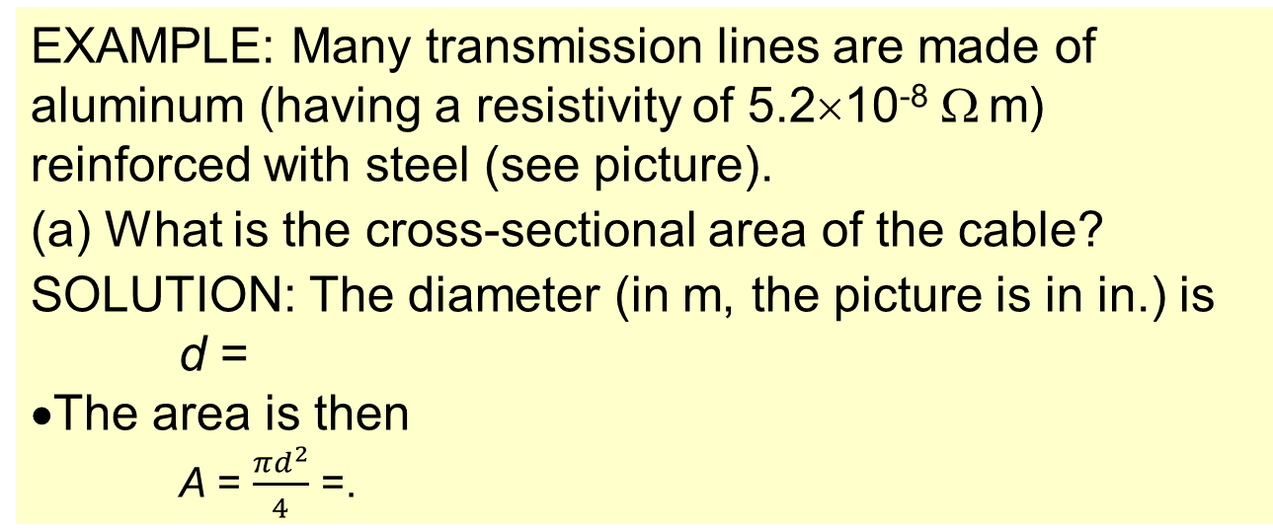
Topic 11: Electromagnetic induction - AHL
11.2 – Power generation and transmission
Solve problems involving power transmission
•For ________________, the gauge of wire is determined in a trade-off between the cost of large-diameter (low resistance) wire, and the cost of power lost due to low-diameter (high resistance) wire.
EXAMPLE: Many transmission lines are made of aluminum (having a resistivity of 5.2×10⁻⁸ Ω m) reinforced with steel (see picture).
(a) What is the cross-sectional area of the cable?
SOLUTION: The diameter (in m, the picture is in in.) is
d =
•The area is then
A = $\frac{πd^{2}}{4}$ =.
Notes:
© 2015 by Timothy K. Lund

Slide 37
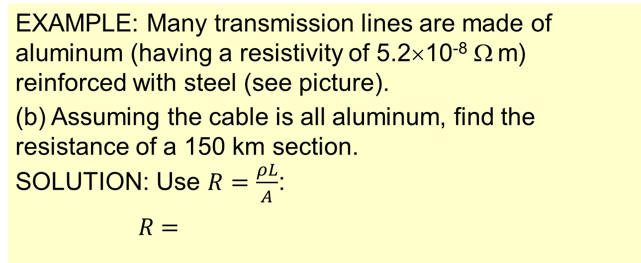
Topic 11: Electromagnetic induction - AHL
11.2 – Power generation and transmission
Solve problems involving power transmission
•For transmission lines, the gauge of wire is determined in a trade-off between the cost of large-diameter (low resistance) wire, and the cost of power lost due to low-diameter (high resistance) wire.
EXAMPLE: Many transmission lines are made of aluminum (having a resistivity of 5.2×10⁻⁸ Ω m) reinforced with steel (see picture).
(b) Assuming the cable is all aluminum, find the resistance of a 150 km section.
SOLUTION: Use $R=\frac{ρL}{A}$:
$R =$
Notes:
© 2015 by Timothy K. Lund

Slide 38
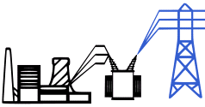
Topic 11: Electromagnetic induction - AHL
11.2 – Power generation and transmission
Solve problems involving power transmission
•Transmission heat loss is determined by _______.
•Since the resistance R of the transmission cable is fixed once its diameter has been chosen, the only other way to ______________ is to ____________________ _________________________.
•Since P = VI, if we want to ___________ we can do so if we ____________, thus maintaining the power P that is to be delivered.
•This is the idea behind the use of the ________ ______________ at the generation side of the power grid.
Notes:
© 2015 by Timothy K. Lund

Slide 39
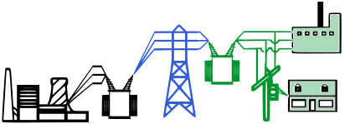
Topic 11: Electromagnetic induction - AHL
11.2 – Power generation and transmission
Solve problems involving power transmission
•Since the high voltage used for transmission is very dangerous, at the end of the transmission it is brought back down to a safer level through the use of a ______________________.
Notes:
© 2015 by Timothy K. Lund

Slide 40
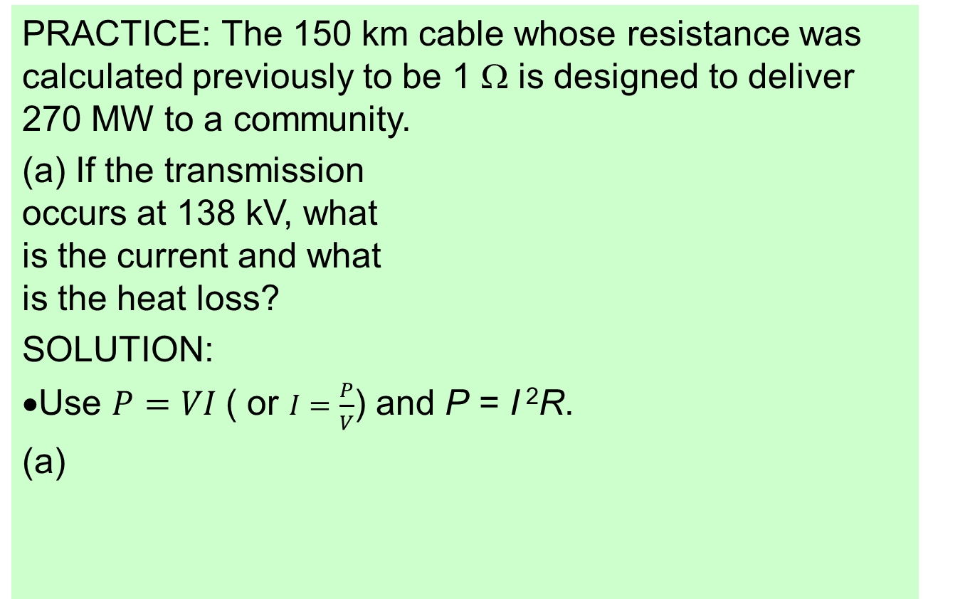
Topic 11: Electromagnetic induction - AHL
11.2 – Power generation and transmission
Solve problems involving power transmission
PRACTICE: The 150 km cable whose resistance was calculated previously to be 1 Ω is designed to deliver 270 MW to a community.
(a) If the transmission occurs at 138 kV, what is the current and what is the heat loss?
SOLUTION:
•Use $P=VI$( or $I=\frac{P}{V}$) and P = I ²R.
(a)
Notes:
© 2015 by Timothy K. Lund

Slide 41
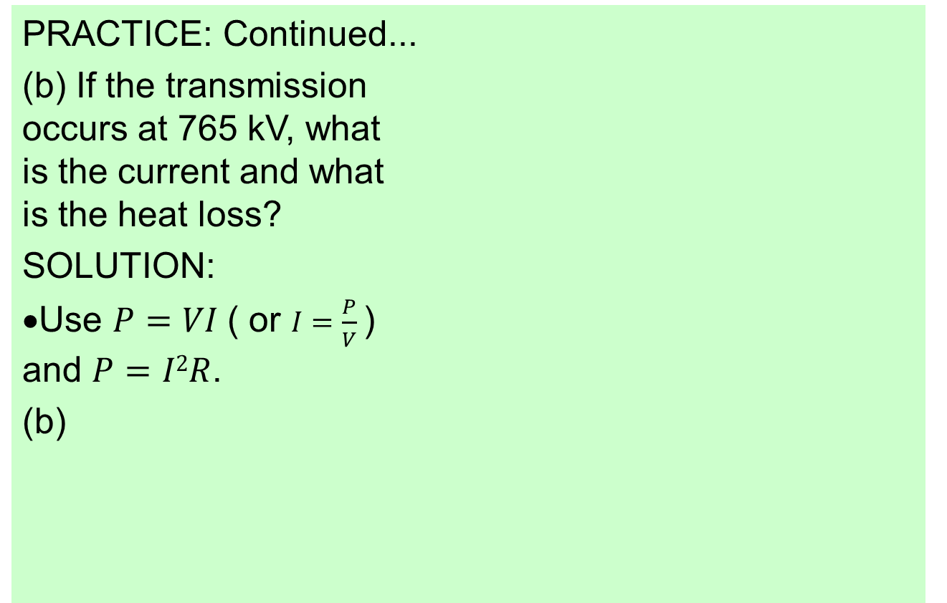
Topic 11: Electromagnetic induction - AHL
11.2 – Power generation and transmission
Solve problems involving power transmission
PRACTICE: Continued...
(b) If the transmission occurs at 765 kV, what is the current and what is the heat loss?
SOLUTION:
•Use $P=VI$( or $I=\frac{P}{V}$) and $P=I2R$.
(b)
Notes:
© 2015 by Timothy K. Lund

Slide 42
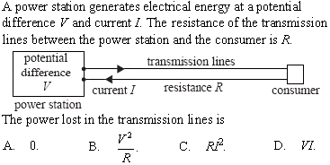
Topic 11: Electromagnetic induction - AHL
11.2 – Power generation and transmission
Solve problems involving power transmission
Notes:
© 2015 by Timothy K. Lund

Slide 43
Topic 11: Electromagnetic induction - AHL
11.2 – Power generation and transmission
The effect of electromagnetic waves on human health
•The frequency of transmitted and home-used power is about 60 Hz, which is considered to be an extremely low frequency (ELF).
•The photons emitted by such ELF radiation are not energetic enough to ionize living cells, and thus cannot harm cells via ionization in the ways that alpha, beta and gamma rays can.
•The alternating field, however, can set up small alternating currents in the body. This is because there are both ions and polarized molecules in cellular structures which can respond to alternating electromagnetic fields according to Faraday’s law.
Notes:
© 2015 by Timothy K. Lund

Slide 44
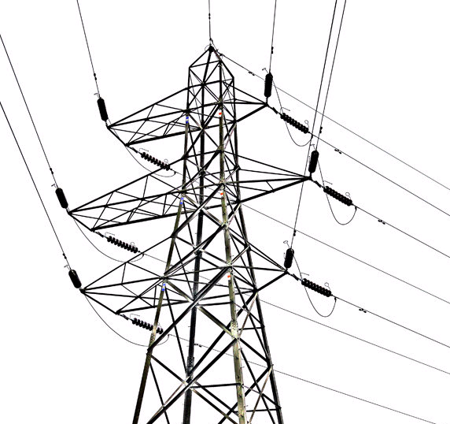
Topic 11: Electromagnetic induction - AHL
11.2 – Power generation and transmission
The effect of electromagnetic waves on human health
•Many studies have shown that ELF fields do not harm genetic material.
•Studies on the effect of ELF-induced currents in living cells are inconclusive, however.
•Read the article Power lines link to cancer to see evidence that induced currents may increase the incidence of childhood leukemia.
•Another obvious risk is danger of electrocution.
Notes:
© 2015 by Timothy K. Lund

Slide 45
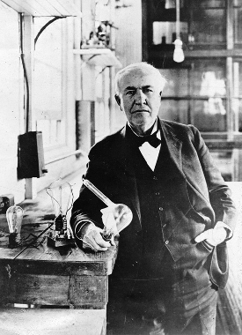
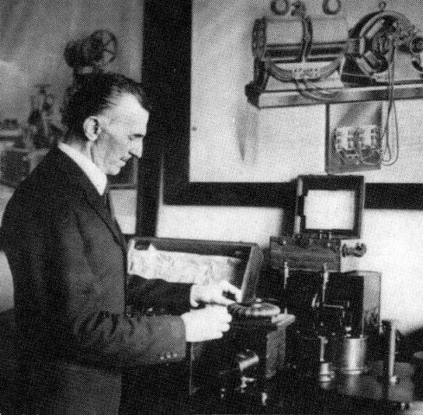
Topic 11: Electromagnetic induction - AHL
11.2 – Power generation and transmission
The AC vs. DC argument
•When electricity became available for distribution to households, various arguments as to which form it should be transmitted in were put forth by Edison (DC), Westinghouse (AC), and Tesla (AC).
•Power transmission today is exclusively AC.
•Given that AC can be stepped up and down via transformers (and DC can’t), we can see why it is preferable to DC for transmission.
•It is also easier to produce AC in quantity.
•However, most of the electronic devices we use today are of the DC variety. Thus there must be a means to convert AC to DC within these devices.
Notes:
© 2015 by Timothy K. Lund

Slide 46

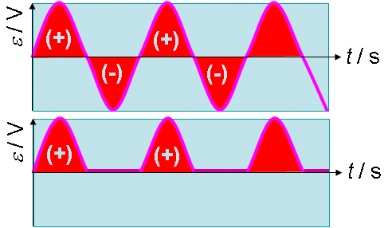
Topic 11: Electromagnetic induction - AHL
11.2 – Power generation and transmission
The diode bridge rectifier
•A ______ is a semiconductor that ________________ _________________. Its schematic symbol shows the direction of the conventional (+) current flow.
•Thus, if we supply an _________ to the diode, ____________________ of the alternating input will be allowed to _______ __________.
•The conversion from AC to DC is called ____________.
•This particular example is called a ________________ because we only “harvest” half the electrical energy.
AC INPUT
DC OUTPUT
Notes:
© 2015 by Timothy K. Lund

Slide 47
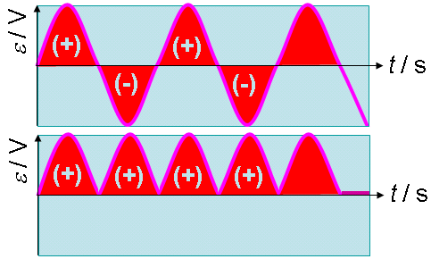
Topic 11: Electromagnetic induction - AHL
11.2 – Power generation and transmission
The diode bridge rectifier
•If we are clever, we can construct a ___________ ________________ using four diodes and a resistor, as shown:
•Now if we supply an AC input to the diode “bridge” there will always be a path for a lobe to make it through and produce a DC voltage drop across the load resistor.
DC OUTPUT
AC INPUT
DC OUTPUT
Notes:
© 2015 by Timothy K. Lund

Slide 48
Topic 11: Electromagnetic induction - AHL
11.2 – Power generation and transmission
(+)
The diode bridge rectifier
•Here is how it works:
•At the instant shown, let us say that the left terminal of the AC supply is (+) and the right terminal is (–).
•The (+) flows with the diode arrow, and the (–) flows against the diode arrow:
•Now suppose the polarity switches at the supply terminals:
•Note that no matter what the polarity of the supply terminals, the top output will be (+) and the bottom output will be (–). Thus we have DC at the output.
DC OUTPUT
(–)
Notes:
© 2015 by Timothy K. Lund

Slide 49

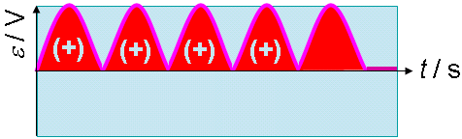
Topic 11: Electromagnetic induction - AHL
11.2 – Power generation and transmission
(+)
The diode bridge rectifier
•Because the full-wave rectifier simply converts negative lobes to positive ones, the voltage is _______ ____________.
•Note that although it is DC, it ________________twice each period.
•This _________________ for most electronic devices.
•Luckily, this problem can be corrected simply by adding a large-valued _________ across the output. Its storage capacity “smooths” out the resulting waveform.
(–)
Notes:
© 2015 by Timothy K. Lund

