Slide 1
Topic 10: Fields - AHL
10.2 – Fields at work
Topic 10.2 is an extension of Topics 5.1, 6.1 and 6.2.
This subtopic has a lot of stuff in it. Sometimes the IBO organizes their stuff that way. Live with it!
Essential idea: Similar approaches can be taken in analyzing electrical and gravitational potential problems.
Nature of science: Communication of scientific explanations: The ability to apply field theory to the unobservable (charges) and the massively scaled (motion of satellites) required scientists to develop new ways to investigate, analyze and report findings to a general public used to scientific discoveries based on tangible and discernible evidence.
Notes:
© 2015 by Timothy K. Lund

Slide 2
Topic 10: Fields - AHL
10.2 – Fields at work
Understandings:
• Potential and potential energy
• Potential gradient
• Potential difference
• Escape speed
• Orbital motion, orbital speed and orbital energy
• Forces and inverse-square law behavior
Notes:
2
© 2015 by Timothy K. Lund

Slide 3
Topic 10: Fields - AHL
10.2 – Fields at work
Applications and skills:
• Determining the potential energy of a point mass and the potential energy of a point charge
• Solving problems involving potential energy
• Determining the potential inside a charged sphere
• Solving problems involving the speed required for an object to go into orbit around a planet and for an object to escape the gravitational field of a planet
• Solving problems involving orbital energy of charged particles in circular orbital motion and masses in circular orbital motion
• Solving problems involving forces on charges and masses in radial and uniform fields
Notes:
3
© 2015 by Timothy K. Lund

Slide 4
Topic 10: Fields - AHL
10.2 – Fields at work
Guidance:
• Orbital motion of a satellite around a planet is restricted to a consideration of circular orbits (links to 6.1 and 6.2)
• Both uniform and radial fields need to be considered
• Students should recognize that lines of force can be two-dimensional representations of three-dimensional fields
• Students should assume that the electric field everywhere between parallel plates is uniform with edge effects occurring beyond the limits of the plates.
Notes:
4
© 2015 by Timothy K. Lund

Slide 5
Topic 10: Fields - AHL
10.2 – Fields at work
Data booklet reference:
GRAVITATIONAL FIELD ELECTROSTATIC FIELD
• V_{g} = –GM / r V_{e} = kq / r
• g = –∆V_{g} / ∆r E = –∆V_{e} / ∆r
• E_{P} = mV_{g} = – GMm / r E_{P} = qV_{e} = kq₁q₂ / r
• F_{G} = –GMm / r ² F_{E} = kq₁q₂ / r ²
• v_{esc} = 2GM / r
• v_{orbit} = GM / r
Notes:
5
© 2015 by Timothy K. Lund

Slide 6
Topic 10: Fields - AHL
10.2 – Fields at work
Utilization:
• The global positioning system depends on complete understanding of satellite motion
• Geostationary / polar satellites
• The acceleration of charged particles in particle accelerators and in many medical imaging devices depends on the presence of electric fields (see Physics option sub-topic C.4)
Notes:
6
© 2015 by Timothy K. Lund

Slide 7
Topic 10: Fields - AHL
10.2 – Fields at work
Aims:
• Aim 2: Newton’s law of gravitation and Coulomb’s law form part of the structure known as “classical physics”. This body of knowledge has provided the methods and tools of analysis up to the advent of the theory of relativity and the quantum theory.
• Aim 4: the theories of gravitation and electrostatic interactions allows for a great synthesis in the description of a large number of phenomena
Notes:
7
© 2015 by Timothy K. Lund

Slide 8
Note that E_{P} is negative. This means that E_{P} is greatest at r = ∞, when E_{P} = 0.
Topic 10: Fields - AHL
10.2 – Fields at work
Potential energy – gravitational
•Think of potential energy as the capacity to do work.
•And work is a force F times a displacement d.
•Recall the gravitational force from Newton:
•If we multiply the above force by a distance r we get
W = Fd cos θ
(θ is angle between F and d)
work definition
F_{G} = –Gm₁m₂ / r ²
universal law of gravitation
where G = 6.67×10⁻¹¹ N m² kg⁻²
E_{P} = –GMm / r
gravitational potential energy
where G = 6.67×10⁻¹¹ N m² kg⁻²
FYI
•The actual proof is beyond the scope of this course.
•Note, in particular, the minus sign.
Notes:
© 2015 By Timothy K. Lund

Slide 9
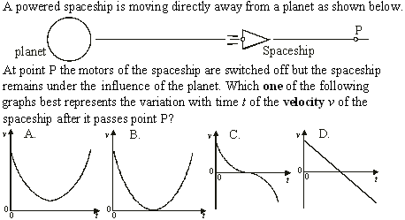
•Use F_{G} = GMm / r ².
Topic 10: Fields - AHL
10.2 – Fields at work
•Recall that a is the slope of the v vs. t graph.
Potential energy – gravitational
•The ship MUST slow down and reverse (v becomes – ).
•The force varies as 1 / r ² so that a is NOT linear.
Notes:
© 2015 By Timothy K. Lund

Slide 10
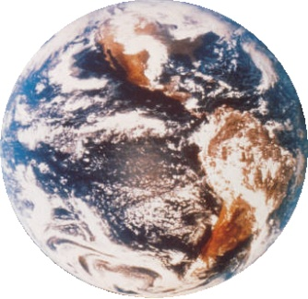
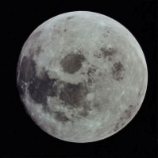
Note that E_{P} is negative. Note also that E_{P} = 0 when r = ∞.
Topic 10: Fields - AHL
10.2 – Fields at work
Potential energy – gravitational
E_{P} = –GMm / r
gravitational potential energy
where G = 6.67×10⁻¹¹ N m² kg⁻²
EXAMPLE: Find the gravitational potential energy stored in the Earth-Moon system.
SOLUTION: Use E_{P} = –GMm / r.
E_{P} = –GMm / r
= –(6.67×10⁻¹¹)(5.98×10²⁴)(7.36×10²²) / 3.82×10⁸
= -7.68×10²⁸ J.
M = 5.98×10²⁴ kg
m = 7.36×10²² kg
d = 3.82×10⁸ m
Notes:
© 2015 By Timothy K. Lund

Slide 11


Topic 10: Fields - AHL
10.2 – Fields at work
Potential energy – gravitational
•The previous formula is for large-scale gravitational fields (say, some distance from a planet).
•Recall the “local” formula for gravitational potential energy:
•The local formula treats y₀ as the arbitrary “zero value” of potential energy. The general formula treats r = ∞ as the “zero value”.
where g = 9.8 m s⁻²
local ∆E_{P}
∆E_{P} = mg ∆y
FYI
•The local formula works only for g = CONST, which is true as long as ∆y is relatively small (say, sea level to the top of Mt. Everest). For larger distances use ∆E_{P} = –GMm(1 / r_{f} – 1 / r₀).
Notes:
© 2015 By Timothy K. Lund

Slide 12
Note that E_{P} is negative. Note also that E_{P} = 0 when r = ∞.
Topic 10: Fields - AHL
10.2 – Fields at work
Potential – gravitational
•We now define gravitational potential as gravitational potential energy per unit mass:
•This is why it is called “potential”.
E_{P} = –GMm / r
gravitational potential energy
where G = 6.67×10⁻¹¹ N m² kg⁻²
∆V_{g} = ∆E_{P} / m
gravitational potential
V_{g} = –GM / r
FYI
•The units of ∆V_{g} and V_{g} are J kg⁻¹.
•Gravitational potential is the work done per unit mass done in moving a small mass from infinity to r. (Note that V = 0 at r = ∞.)
Notes:
© 2015 By Timothy K. Lund

Slide 13
Why was the change in potential positive?
Topic 10: Fields - AHL
10.2 – Fields at work
Potential – gravitational
∆V_{g} = ∆E_{P} / m
gravitational potential
V_{g} = –GM / r
EXAMPLE: Find the change in gravitational potential in moving from Earth’s surface to 5 Earth radii (from Earth’s center).
SOLUTION: M = 5.98×10²⁴ kg and r₁ = 6.37×10⁶ m.
•But then r₂ = 5(6.37×10⁶) = 3.19×10⁷ m. Thus
∆V_{g} = –GM( 1 / r₂ – 1 / r₁ )
= –GM( 1 / 3.19×10⁷ – 1 / 6.37×10⁶ )
= –GM(⁻1.26×10⁻⁷)
= –(6.67×10⁻¹¹)(5.98×10²⁴)(⁻1.26×10⁻⁷)
= ⁺5.01×10⁷ J kg⁻¹.
r₂
r₁
Notes:
© 2015 By Timothy K. Lund

Slide 14
Topic 10: Fields - AHL
10.2 – Fields at work
Potential and potential energy – gravitational
FYI
•A few words clarifying the gravitational potential energy and gravitational potential formulas are in order.
E_{P} = –GMm / r gravitational potential energy
V_{g} = –GM / r gravitational potential
•Be aware of the difference in name. Both have “gravitational potential” in them and can be confused during problem solving.
•Be aware of the minus sign in both formulas.
•The minus sign is there so that as you separate two masses, or move farther out in space, their values increase (as in the last example).
•Both values are zero when r becomes infinitely large.
Notes:
© 2015 By Timothy K. Lund

Slide 15
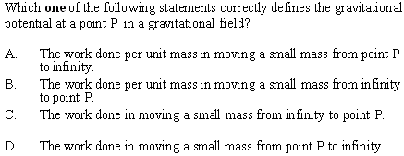
Topic 10: Fields - AHL
10.2 – Fields at work
Potential and potential energy – gravitational
•Be sure to know this definition.
•By the way, answer C is the official definition of the gravitational potential energy at a point P.
•Try not to mix up potential and potential energy.
Notes:
© 2015 By Timothy K. Lund

Slide 16
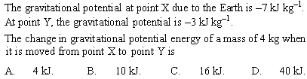
Topic 10: Fields - AHL
10.2 – Fields at work
Potential and potential energy – gravitational
•From ∆V_{g} = ∆E_{P} / m we have ∆E_{P} = m∆V_{g}.
•Thus ∆E_{P} = (4)( ⁻3k – ⁻7k) = 16 kJ.
Notes:
© 2015 By Timothy K. Lund

Slide 17
Topic 10: Fields - AHL
10.2 – Fields at work
Potential and potential energy – gravitational
•Gravitational potential is derived from gravitational potential energy and is thus a scalar. There is no need to worry about vectors.
EXAMPLE: Find the gravitational potential at the midpoint of the 2750-m radius circle of 125-kg masses shown.
SOLUTION: Potential is a scalar so it doesn’t matter how the masses are arranged on the circle. Only the distance matters.
•For each mass r = 2750 m. Each mass contributes V_{g} = –GM / r so that
V_{g} = –(6.67×10⁻¹¹)(125) / 2750 = -3.03×10⁻¹² J kg⁻¹.
•Thus V_{tot} = 4(-3.03×10⁻¹²) = -1.21×10⁻¹¹ J kg⁻¹.
r
Notes:
© 2015 By Timothy K. Lund

Slide 18
Does it matter what path the mass follows as it is brought in?
Topic 10: Fields - AHL
10.2 – Fields at work
NO. Why?
Potential and potential energy – gravitational
•Gravitational potential is derived from gravitational potential energy and is thus a scalar. There is no need to worry about vectors.
EXAMPLE: If a 365-kg mass is brought in from ∞ to the center of the circle of masses, how much potential energy will it have lost?
SOLUTION: ∆V_{g} = ∆E_{P} / m → ∆E_{P} = m ∆V_{g}.
∆E_{P} = m ∆V_{g}
= m (V_{g} – V_{g0})
= mV_{g}
= 365(-1.21×10⁻¹¹)
= -4.42×10⁻⁹ J.
r
0
FYI
•∆E_{P} = –W implies that the work done by gravity is +4.42×10⁻⁹ J. Why is W > 0?
Notes:
© 2015 By Timothy K. Lund

Slide 19
Topic 10: Fields - AHL
10.2 – Fields at work
Potential gradient – gravitational
•The gravitational potential gradient (GPG) is the change in gravitational potential per unit distance. Thus the GPG = ∆V_{g} / ∆r.
EXAMPLE: Find the GPG in moving from Earth’s surface to 5 radii from Earth’s center.
SOLUTION: In a previous slide we showed that ∆V_{g} = ⁺ 5.01×10⁷ J kg⁻¹.
•r₁ = 6.37×10⁶ m.
•r₂ = 5(6.37×10⁶) = 3.19×10⁷ m.
•∆r = r₂ – r₁ = 3.19×10⁷ – 6.37×10⁶ = 2.55×10⁷ m.
GPG = ∆V_{g} / ∆r
= 5.01×10⁷ / 2.55×10⁷ = 1.96 J kg⁻¹ m⁻¹.
r₂
r₁
Notes:
© 2015 By Timothy K. Lund

Slide 20
Topic 10: Fields - AHL
10.2 – Fields at work
Potential gradient – gravitational
•The gravitational potential gradient (GPG) is the change in gravitational potential per unit distance. Thus the GPG = ∆V_{g} / ∆r.
PRACTICE: Show that the units for the gravitational potential gradient are the units for acceleration.
SOLUTION:
•The units for ∆V_{g} are J kg⁻¹.
•The units for work are J, but since work is force times distance we have 1 J = 1 N m = 1 kg m s⁻² m.
•Therefore the units of ∆V_{g} are (kg m s⁻² m)kg⁻¹ or
[ ∆V_{g} ] = m² s⁻².
•Then the units of the GPG are
[ GPG ] = [ ∆V_{g} / ∆r ] = m² s⁻² / m = m s⁻².
Notes:
© 2015 By Timothy K. Lund

Slide 21
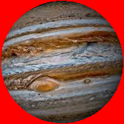
Topic 10: Fields - AHL
10.2 – Fields at work
Potential gradient – gravitational
•In Topic 10.1 we found that near Earth, g = –ΔV_{g} / Δy.
•The following potential gradient (which we will not prove) works at the planetary scale:
g = –∆V_{g} / ∆r
gravitational potential gradient
EXAMPLE: The gravitational potential in the vicinity of a planet changes from ⁻6.16×10⁷ J kg⁻¹ to ⁻6.12×10⁷ J kg⁻¹ in moving from 1.80×10⁸ m to 2.85×10⁸ m. What is the gravitational field strength in that region?
SOLUTION:
g = – ∆V_{g} / ∆r
g = –(⁻6.12×10⁷ – ⁻6.16×10⁷) / (2.85×10⁸ – 1.80×10⁸)
g = –4000000 / 105000000 = -0.0381 m s⁻².
Notes:
© 2015 By Timothy K. Lund

Slide 22
Topic 10: Fields - AHL
10.2 – Fields at work
Equipotential surfaces revisited – gravitational
•Recall that equipotential surfaces are imaginary surfaces at which the potential is the same.
•Since the gravitational potential for a point mass is given by V_{g} = –GM / r it is clear that the equipotential surfaces are at fixed radii and hence are concentric spheres:
m
equipotential surfaces
FYI
•Generally equipotential surfaces are drawn so that the ∆V_{g}s for consecutive surfaces are equal.
•Because V_{g} is inversely proportional to r, the consecutive rings get farther apart as we get farther from the mass.
Notes:
© 2015 By Timothy K. Lund

Slide 23
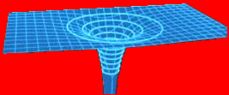
Topic 10: Fields - AHL
10.2 – Fields at work
Equipotential surfaces revisited – gravitational
•We know that for a point mass the gravitational field lines point inward.
•Thus the gravitational field lines are perpendicular to the equipotential surfaces.
•A 3D image of the same picture looks like this:
m
Notes:
© 2015 By Timothy K. Lund

Slide 24

Topic 10: Fields - AHL
10.2 – Fields at work
Equipotential surfaces and the potential gradient
EXAMPLE: Use the 3D view of the equipotential surface to interpret the gravitational potential gradient g = –∆V_{g} / ∆r.
SOLUTION: We can choose any direction for our r value, say the red line:
•Then g = –∆V_{g} / ∆y.
•This is just the gradient (slope) of the surface.
•Thus g is the (–) gradient of the equipotential surface.
∆r
∆V_{g}
Notes:
© 2015 By Timothy K. Lund

Slide 25
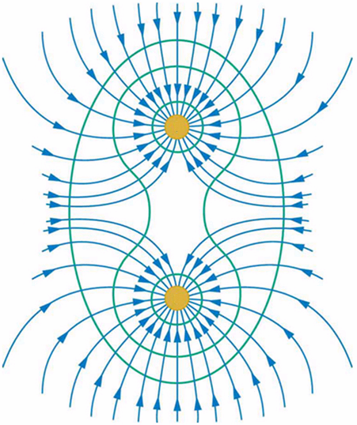
Topic 10: Fields - AHL
10.2 – Fields at work
Equipotential surfaces and the potential gradient
EXAMPLE: Sketch the gravitational field lines around two point masses.
SOLUTION: Remember that the gravitational field lines point inward, and that they are perpendicular to the equipotential surfaces.
m
m
Notes:
© 2015 By Timothy K. Lund

Slide 26
Topic 10: Fields - AHL
10.2 – Fields at work
Equipotential surfaces and the potential gradient
EXAMPLE: Use a 3D view of the equipotential surface of two point masses to illustrate that the gravitational potential gradient is zero somewhere in between the two masses.
SOLUTION:
•Remember that the gravitational potential gradient g = –∆V_{g} / ∆r is just the slope of the surface.
•The saddle point’s slope is zero. Thus g = 0 there.
saddle point
Notes:
© 2015 By Timothy K. Lund

Slide 27
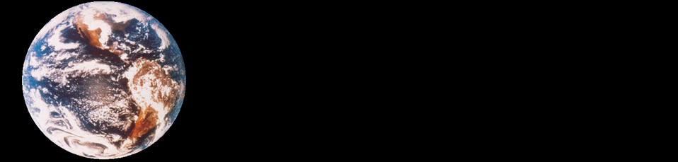
Topic 10: Fields - AHL
10.2 – Fields at work
Escape speed
•We define the escape speed to be the minimum speed an object needs to escape a planet’s gravitational pull.
•We can further define escape speed v_{esc} to be that minimum speed which will carry an object to infinity and bring it to rest there.
•Thus we see as r→∞ then v→0.
M
m
R
r = R
r = ∞
u = v_{esc}
v = 0
Notes:
© 2015 By Timothy K. Lund

Slide 28
Note that escape speed is independent of the mass that is actually escaping!
Topic 10: Fields - AHL
10.2 – Fields at work
Escape speed
•From the conservation of mechanical energy we have ∆E_{K} + ∆E_{P} = 0. Then
E_{K} – E_{K0} + E_{P} – E_{P0} = 0
(1/2)mv² – (1/2)mu² + ⁻GMm / r – ⁻GMm / r₀ = 0
(1/2)mv_{esc}² = GMm / R
0
0
v_{esc} = 2GM / R
escape speed
PRACTICE: Find the escape speed from Earth.
SOLUTION:
•M = 5.98×10²⁴ kg and R = 6.37×10⁶ m.
v_{esc}² = 2GM / R
= 2(6.67×10⁻¹¹)(5.98×10²⁴) / 6.37×10⁶
v_{esc} = 11200 ms⁻¹ (= 24900 mph!)
Notes:
© 20156 By Timothy K. Lund

Slide 29


Topic 10: Fields - AHL
10.2 – Fields at work
Orbital motion, orbital speed and orbital energy •Consider a baseball in circular orbit about Earth.
•Clearly the only force that is causing the ball to move in a circle is the gravitational force.
•Thus the gravitational force is the centripetal force for circular orbital motion.
EXAMPLE: A centripetal force causes a centripetal acceleration a_{c}. What are the two forms for a_{c}?
SOLUTION: Recall from Topic 6 that a_{c} = v² / r.
•Then from the relationship v = 2πr / T we see that
a_{c} = v² / r = (2πr / T)² / r = 4π²r² / (T ²r) = 4π²r / T ².
a_{c} = v² / r = 4π²r / T ²
centripetal acceleration
Notes:
© 2015 By Timothy K. Lund

Slide 30
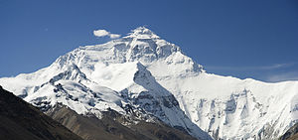

Topic 10: Fields - AHL
10.2 – Fields at work
Orbital motion, orbital speed and orbital energy
EXAMPLE: Suppose a 0.500-kg baseball is placed in a circular orbit around the earth at slightly higher than the tallest point, Mount Everest (8850 m). Given that the earth has a radius of R_{E} = 6400000 m, find the speed of the ball.
SOLUTION: r = 6408850 m.
•F_{c} is caused by the weight of the ball so that
F_{c} = mg = (0.5)(9.8) = 4.9 N.
•But F_{c} = mv² / r so that
4.9 = (0.5)v² / 6408850
v = 7925 m s⁻¹!
FYI
•We assumed that g = 9.8 ms⁻² at the top of Everest.
Notes:
© 2015 By Timothy K. Lund

Slide 31
Topic 10: Fields - AHL
10.2 – Fields at work
Orbital motion, orbital speed and orbital energy
PRACTICE: Find the period T of one complete orbit of the ball.
SOLUTION:
•r = 6408850 m.
•F_{c} = 4.9 N.
•F_{c} = ma_{c} = 0.5a_{c} so that a_{c} = 9.8.
•But a_{c} = 4π²r / T ² so that
T ² = 4π²r / a_{c}
T ² = 4π²(6408850) / 9.8
T = 5081 s = 84.7 min = 1.4 h.
Notes:
© 2015 By Timothy K. Lund

Slide 32
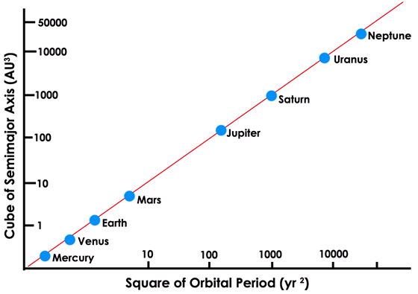
Topic 10: Fields - AHL
10.2 – Fields at work
Orbital motion, orbital speed and orbital energy
EXAMPLE: Show that for an object in a circular orbit about a body of mass M that T ² = (4π²/ GM)r³.
SOLUTION:
•In circular orbit F_{c} = ma_{c} and F_{c} = GMm / r².
•But a_{c} = 4π²r / T ². Then
ma_{c} = GMm / r²
4π²r / T ² = GM / r²
4π²r³ = GMT ²
T ² = [4π²/(GM)]r³
FYI
•The IBO expects you to be able to derive this relationship. It is known as Kepler’s 3rd law.
Notes:
© 2015 By Timothy K. Lund

Slide 33
Topic 10: Fields - AHL
10.2 – Fields at work
Orbital motion, orbital speed and orbital energy
PRACTICE: Using Kepler’s third law find the period T of one complete orbit of the baseball from the previous example.
SOLUTION: Use T ² = (4π² / GM)r³.
•r = 6408850 m.
•G = 6.67×10⁻¹¹ N m² kg⁻².
•M = 5.98×10²⁴ kg.
T ² = [ 4π² / GM ] r³
= [4π²/ (6.67×10⁻¹¹×5.98×10²⁴)](6408850)³
T = 5104 s = 85.0 min = 1.4 h.
FYI
•Note the slight discrepancy in the period (it was 5081 s before). How do you account for it?
Notes:
© 2015 By Timothy K. Lund

Slide 34
Topic 10: Fields - AHL
10.2 – Fields at work
Orbital motion, orbital speed and orbital energy
•An orbiting satellite has both kinetic energy and potential energy.
•The gravitational potential energy of an object of mass m in the gravitational field of Earth is E_{P} = –GMm / r, where M is the mass of the earth.
•As we learned in Topic 2, the kinetic energy of an object of mass m moving at speed v is E_{K} = (1/2)mv².
•Thus the total mechanical energy of an orbiting satellite of mass m is
E = E_{K} + E_{P}
total energy of an orbiting satellite
E = (1/2)mv² – GMm / r
Notes:
© 2015 By Timothy K. Lund

Slide 35
Topic 10: Fields - AHL
10.2 – Fields at work
Orbital motion, orbital speed and orbital energy
EXAMPLE: Show that the speed of an orbiting satellite having mass m at a distance r from the center of Earth (mass M) is v_{orbit} = GM / r.
SOLUTION:
•In circular orbit F_{c} = ma_{c} and F_{c} = F_{G} = GMm / r².
•But a_{c} = v² / r. Then
ma_{c} = GMm / r²
mv² / r = GMm / r²
v² = GM / r
v = GM / r
v_{orbit}= GM / r
speed of an orbiting satellite
Notes:
© 2015 By Timothy K. Lund

Slide 36
Topic 10: Fields - AHL
10.2 – Fields at work
Orbital motion, orbital speed and orbital energy
EXAMPLE: Show that the kinetic energy of an orbiting satellite having mass m at a distance r from the center of Earth (mass M) is E_{K} = GMm / (2r).
SOLUTION:
•In circular orbit F_{c} = ma_{c} and F_{c} = GMm / r².
•But a_{c} = v² / r. Then
ma_{c} = GMm / r²
mv² / r = GMm / r²
mv² = GMm / r
(1/2)mv² = GMm / (2r)
E_{K} = (1/2)mv² = GMm / (2r)
kinetic energy of an orbiting satellite
Notes:
© 2015 By Timothy K. Lund

Slide 37
Topic 10: Fields - AHL
10.2 – Fields at work
Orbital motion, orbital speed and orbital energy
EXAMPLE: Show that the total energy of an orbiting satellite at a distance r from the center of Earth is E = –GMm / (2r).
SOLUTION: From E = E_{K} + E_{P} and the expressions for E_{K} and E_{P} we have
E = E_{K} + E_{P}
E = GMm / (2r) – GMm / r
E = GMm / (2r) – 2GMm / (2r)
E = –GMm / (2r)
E = –GMm / (2r)
total energy of an orbiting satellite
E_{K} = GMm / (2r)
E_{P} = –GMm / r
FYI
•The IBO expects you to derive these relationships.
Notes:
© 2015 By Timothy K. Lund

Slide 38
Topic 10: Fields - AHL
10.2 – Fields at work
Orbital motion, orbital speed and orbital energy
E = –GMm / (2r)
total energy of an orbiting satellite
E_{K} = GMm / (2r)
E_{P} = –GMm / r
EXAMPLE: Graph the kinetic energy vs. the radius of orbit for a satellite of mass m about a planet of mass M and radius R.
SOLUTION: Use E_{K} = GMm / (2r). Note that E_{K} decreases with radius. It has a maximum value of E_{K} = GMm / (2R).
E_{K}
GMm
2R
r
R
2R
3R
4R
5R
Notes:
© 2015 By Timothy K. Lund

Slide 39
Topic 10: Fields - AHL
10.2 – Fields at work
Orbital motion, orbital speed and orbital energy
E = –GMm / (2r)
total energy of an orbiting satellite
E_{K} = GMm / (2r)
E_{P} = –GMm / r
EXAMPLE: Graph the potential energy vs. the radius of orbit for a satellite of mass m about a planet of mass M and radius R.
SOLUTION: Use E_{P} = –GMm / r. Note that E_{P} increases with radius. It becomes less negative.
R
2R
3R
4R
5R
r
GMm
R
-
E_{P}
Notes:
© 2015 By Timothy K. Lund

Slide 40
Thus a spacecraft must SLOW DOWN in order to reach a higher orbit!
Topic 10: Fields - AHL
10.2 – Fields at work
Orbital motion, orbital speed and orbital energy
E = –GMm / (2r)
total energy of an orbiting satellite
E_{K} = GMm / (2r)
E_{P} = –GMm / r
EXAMPLE: Graph the total energy E vs. the radius of orbit and include both E_{K} and E_{P}.
SOLUTION:
+
GMm
2R
R
2R
3R
4R
5R
E_{K}
r
E
GMm
2R
E_{P}
-
-
GMm
R
FYI
•Kinetic energy (thus v) DECREASES with radius.
Notes:
© 2015 By Timothy K. Lund

Slide 41


Topic 10: Fields - AHL
10.2 – Fields at work
Orbital motion and weightlessness
•Consider Dobson inside an elevator which is not moving…
•If he drops a ball, it will accelerate downward at 10 ms⁻² as expected.
PRACTICE: If the elevator is accelerating upward at 2 ms⁻², what does Dobson observe the dropped ball’s acceleration to be?
SOLUTION:
•Since the elevator is accelerating upward at 2 ms⁻² to meet the ball, and the ball is accelerating downward at 10 ms⁻², Dobson observes an acceleration of 12 ms⁻².
•If the elevator is accelerating downward at 2, he observes an acceleration of 8 ms⁻².
Notes:
© 2015 By Timothy K. Lund

Slide 42
Topic 10: Fields - AHL
10.2 – Fields at work
Orbital motion and weightlessness
PRACTICE: If the elevator is accelerating downward at 10 ms⁻², what does Dobson observe the dropped ball’s acceleration to be?
SOLUTION:
•He observes the acceleration of the ball to be zero!
•He thinks that the ball is “weightless!”
FYI
•The ball is NOT weightless, obviously. It is merely accelerating at the same rate as Dobson!
•This is what we mean by weightlessness in an orbiting spacecraft
Notes:
© 2015 By Timothy K. Lund

Slide 43
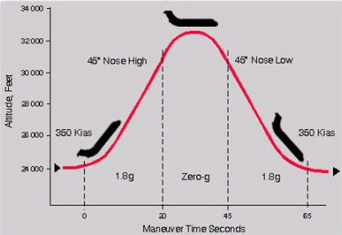
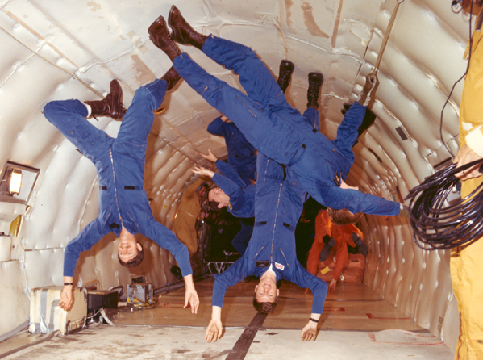
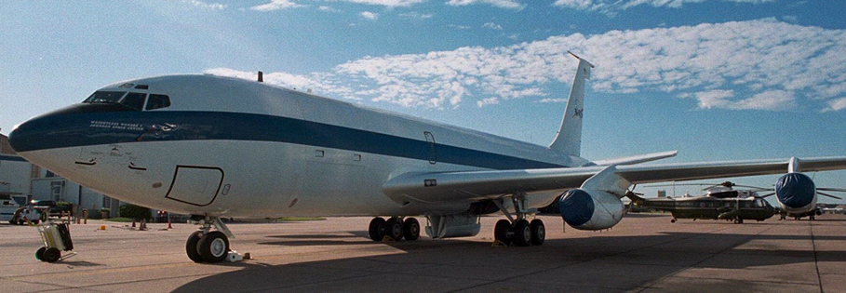
The “Vomit Comet”
Notes:
© 2015 By Timothy K. Lund

Slide 44
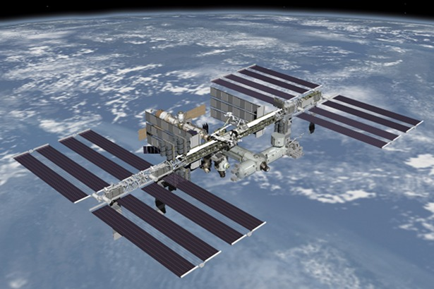
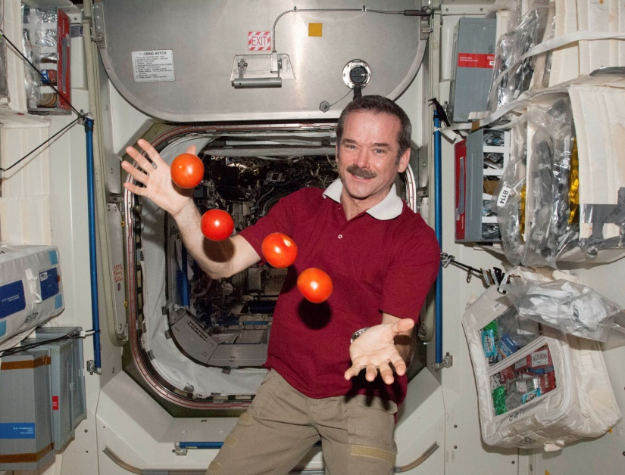
Topic 10: Fields - AHL
10.2 – Fields at work
Orbital motion and weightlessness
PRACTICE: We have all seen astronauts experiencing “weightlessness.” Explain why it only appears that they are weightless.
SOLUTION: The astronaut, the spacecraft, and the tomatoes, are all accelerating at a_{c} = g.
•They all fall together and appear to be weightless.
International Space Station
Notes:
© 2015 By Timothy K. Lund

Slide 45
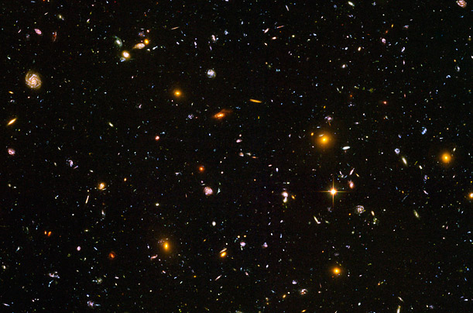
Topic 10: Fields - AHL
10.2 – Fields at work
Orbital motion and weightlessness
•Only in deep space – which is defined to be far, far away from all masses – will a mass be truly weightless.
•In deep space, the r in F_{G} = GMm / r ² is so large for
every m that F_{G}, the force of gravity, is for all intents and purposes, zero.
Notes:
© 2015 By Timothy K. Lund

Slide 46
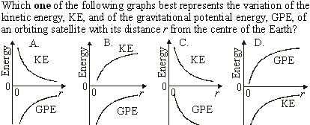
Topic 10: Fields - AHL
10.2 – Fields at work
Orbital motion, orbital speed and orbital energy
•KE is POSITIVE and decreasing.
•GPE is NEGATIVE and increasing (becoming less negative).
Notes:
© 2015 By Timothy K. Lund

Slide 47

Topic 10: Fields - AHL
10.2 – Fields at work
Orbital motion, orbital speed and orbital energy
•From Kepler’s 3rd law, T ² = [ 4π²/ (GM) ] r³.
•Thus r³ = [ GM / (4π²) ]T ².
•That is to say, r³ ∝ T ².
Notes:
© 2015 By Timothy K. Lund

Slide 48
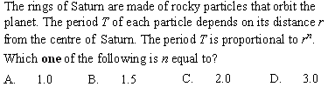
Topic 10: Fields - AHL
10.2 – Fields at work
Orbital motion, orbital speed and orbital energy
•From Kepler’s 3rd law T ² = [ 4π² / GM ]r³. Then
•T = { [ 4π²/GM ]r³ }^{1/2}
•T = [ 4π² / GM ]^{1/2}r ^{3/2}
•T ∝ r ^{3/2}.
Notes:
© 2015 By Timothy K. Lund

Slide 49
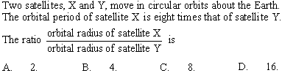
Topic 10: Fields - AHL
10.2 – Fields at work
Orbital motion, orbital speed and orbital energy
•From Kepler’s 3rd law T_{X}² = (4π² / GM)r_{X}³.
•From Kepler’s 3rd law T_{Y}² = (4π²/ GM)r_{Y}³.
• T_{X} = 8T_{Y} → T_{X}² = 64T_{Y}².
T_{X}² / T_{Y}² = (4π² / GM)r_{X}³ / [(4π² / GM)r_{Y}³]
64T_{Y}² / T_{Y}² = r_{X}³ / r_{Y}³
64 = (r_{X} / r_{Y})³
r_{X} / r_{Y} = 64^{1/3} = 4
Notes:
© 2015 By Timothy K. Lund

Slide 50

Topic 10: Fields - AHL
10.2 – Fields at work
Orbital motion, orbital speed and orbital energy
•Since the satellite is in uniform circular motion at a radius r and a speed v, it must be undergoing a centripetal acceleration.
•Since gravitational field strength g is the acceleration, g = v²/ r.
Notes:
© 2015 By Timothy K. Lund

Slide 51

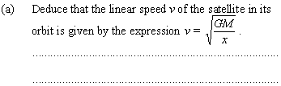
Topic 10: Fields - AHL
10.2 – Fields at work
Orbital motion, orbital speed and orbital energy
x
R
•F = mg = GMm / x² = mv²/ x.
•Thus v² = GM / x.
•Finally v = GM / x.
Notes:
© 2015 By Timothy K. Lund

Slide 52
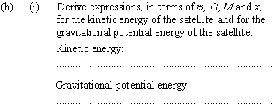
Topic 10: Fields - AHL
10.2 – Fields at work
Orbital motion, orbital speed and orbital energy
x
R
•From (a), v² = GM / x.
•But E_{K} = (1/2)mv².
•Thus E_{K} = (1/2)mv² = (1/2)m(GM / x) = GMm / (2x).
•E_{P} = mV and V = –GM / x.
•Then E_{P} = m(–GM / x) = –GMm / x.
Notes:
© 2015 By Timothy K. Lund

Slide 53
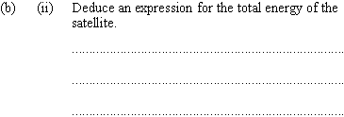
Topic 10: Fields - AHL
10.2 – Fields at work
Orbital motion, orbital speed and orbital energy
x
R
•E = E_{K} + E_{P}
•E = GMm / (2x) + –GMm / x [ from (b)(i) ]
•E = 1GMm / (2x) + ⁻2GMm / (2x)
•E = –GMm / (2x).
Notes:
© 2015 By Timothy K. Lund

Slide 54

Topic 10: Fields - AHL
10.2 – Fields at work
Orbital motion, orbital speed and orbital energy
x
R
•The satellite will begin to lose some of its mechanical energy in the form of heat.
Notes:
© 2015 By Timothy K. Lund

Slide 55
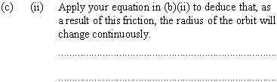
•Refer to E = –GMm / (2x) [ from (b)(ii) ].
Topic 10: Fields - AHL
10.2 – Fields at work
Orbital motion, orbital speed and orbital energy
x
R
•If E ↓, then x ↓ (to make E more negative).
•If r ↓ the atmosphere gets thicker and more resistive.
•Clearly the orbit will continue to decay (shrink).
Notes:
© 2015 By Timothy K. Lund

Slide 56


Topic 10: Fields - AHL
10.2 – Fields at work
Orbital motion, orbital speed and orbital energy
R₂
R₁
M₁
P
M₂
•It is the gravitational force between the two stars.
Notes:
© 2015 By Timothy K. Lund

Slide 57
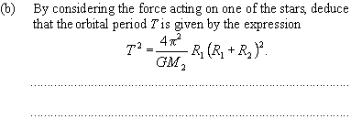
•F_{G} = GM₁M₂ / ( R₁+R₂ )².
Topic 10: Fields - AHL
10.2 – Fields at work
•M₁ experiences F_{c} = M₁v₁² / R₁.
•v₁ = 2πR₁ / T, v₁² = 4π²R₁²/ T ².
Orbital motion, orbital speed and orbital energy
R₂
R₁
M₁
P
M₂
•F_{c} = F_{G} →
M₁v₁² / R₁ = GM₁M₂ / ( R₁+R₂ )².
M₁[ 4π²R₁²/ T ² ] / R₁ = GM₁M₂ / ( R₁+R₂ )²
4π²R₁( R₁ + R₂ )² = GM₂T ²
4π²
GM₂
T ² = R₁( R₁+R₂ )².
Notes:
© 2015 By Timothy K. Lund

Slide 58

Topic 10: Fields - AHL
10.2 – Fields at work
Orbital motion, orbital speed and orbital energy
R₂
R₁
M₁
P
M₂
•From (b) T ² = [ 4π² / GM₂ ]R₁( R₁+R₂ )².
•From symmetry T ² = [ 4π² / GM₁ ]R₂( R₁+R₂ )². Thus
[ 4π² / GM₂ ]R₁( R₁+R₂ )² = [ 4π² / GM₁ ]R₂( R₁+R₂ )²
(1 / M₂)R₁ = (1 / M₁)R₂
M₁ / M₂ = R₂ / R₁
•Since R₂ > R₁, M₁ > M₂.
Notes:
© 2015 By Timothy K. Lund

Slide 59
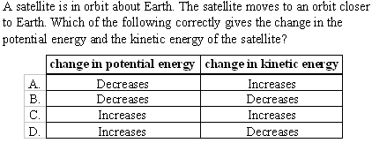
Topic 10: Fields - AHL
10.2 – Fields at work
Orbital motion, orbital speed and orbital energy
E = – GMm / (2r)
total energy of an orbiting satellite
E_{K} = GMm / (2r)
E_{P} = – GMm / r
•If r decreases E_{K} gets bigger.
•If r decreases E_{P} gets more negative (smaller).
Notes:
© 2015 By Timothy K. Lund

Slide 60

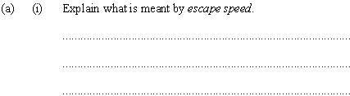
Topic 10: Fields - AHL
10.2 – Fields at work
Orbital motion, orbital speed and orbital energy
•Escape speed is the minimum speed needed to travel from the surface of a planet to infinity.
•It has the formula v_{esc}² = 2GM / R.
Notes:
© 2015 By Timothy K. Lund

Slide 61
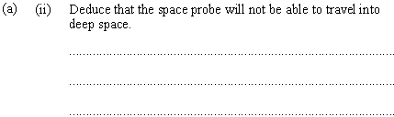
Topic 10: Fields - AHL
10.2 – Fields at work
Orbital motion, orbital speed and orbital energy
•To escape we need v_{esc}² = 2GM / R_{e}.
•The kinetic energy alone must then be E = (1/2)mv_{esc}² = (1/2)m(2GM / R_{e}) = GMm / R_{e}.
•This is to say, to escape E = 4GMm / (4R_{e}).
•Since we only have E = 3GMm / (4R_{e}) the probe will not make it into deep space.
Notes:
© 2015 By Timothy K. Lund

Slide 62
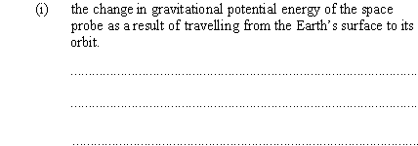
Topic 10: Fields - AHL
10.2 – Fields at work
Orbital motion, orbital speed and orbital energy
•Recall that E_{P} = –GMm / r.
•Thus ∆E_{P} = –GMm ( 1 / R – 1 / R_{e} ).
Notes:
© 2015 By Timothy K. Lund

Slide 63

Topic 10: Fields - AHL
10.2 – Fields at work
Orbital motion, orbital speed and orbital energy
•The probe is in circular motion so F_{c} = mv²/ R.
•But F_{G} = GMm / R² = F_{c}.
•Thus mv²/ R = GMm / R² or mv² = GMm / R.
•Finally E_{K} = (1/2)mv² = GMm / (2R).
Notes:
© 2015 By Timothy K. Lund

Slide 64

Topic 10: Fields - AHL
10.2 – Fields at work
Orbital motion, orbital speed and orbital energy
•The energy given to the probe is stored in potential and kinetic energy. Thus
∆E_{K} + ∆E_{P} = E
GMm / (2R) – GMm(1/ R – 1/ R_{e}) = 3GMm / (4R_{e})
1 / (2R) – 1 / R + 1 / R_{e} = 3 / (4R_{e})
1 / (4R_{e}) = 1 / (2R)
R = 2R_{e}.
Notes:
© 2015 By Timothy K. Lund

Slide 65
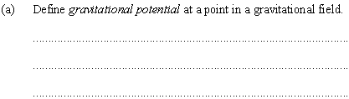
Topic 10: Fields - AHL
10.2 – Fields at work
Orbital motion, orbital speed and orbital energy
•It is the work done per unit mass by the gravitational field in bringing a small mass from infinity to that point.
•COMPARE: The work done by the gravitational field in bringing a small mass from infinity to that point is called the gravitational potential energy.
•The phrase only differs by omission of “per unit mass”.
Notes:
© 2015 By Timothy K. Lund

Slide 66
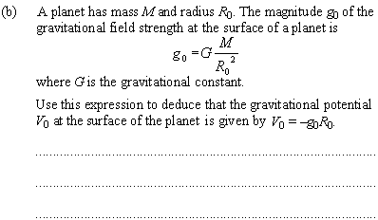
Topic 10: Fields - AHL
10.2 – Fields at work
Orbital motion, orbital speed and orbital energy
•V = –GM / r so that V₀ = – GM / R₀.
•But –g₀R₀ = –(GM / R₀²)R₀ = – GM / R₀
= V₀.
•Thus V₀ = – g₀R₀.
Notes:
© 2015 By Timothy K. Lund

Slide 67

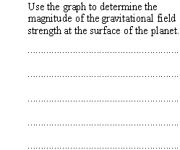
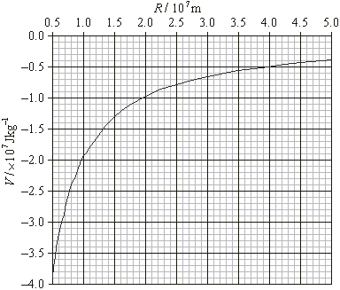
Topic 10: Fields - AHL
10.2 – Fields at work
Orbital motion, orbital speed and orbital energy
0.5×10⁷ = 5.0×10⁶ = R₀.
•At R₀ = 0.5×10⁷ clearly V₀ = -4.0×10⁷.
•From previous problem
g₀ = –V₀ / R₀
= – ⁻4.0×10⁷ / 0.5×10⁷
= 8.0 m s⁻².
Notes:
© 2015 By Timothy K. Lund

Slide 68

•This solution assumes probe is not in orbit but merely reaches altitude (and returns).
Topic 10: Fields - AHL
10.2 – Fields at work
Orbital motion, orbital speed and orbital energy
ΔV_{g} = (-0.8 - ⁻4.0)×10⁷ = 3.2×10⁷
0
∆E_{K} = – E_{P}
E_{K} – E_{K0} = – E_{P}
(1/2)mv² = ∆E_{P}
v² = 2 ∆E_{P} / m
v² = 2 ∆V_{g}
v² = 2(3.2×10⁷)
v = 8000 ms⁻¹.
Notes:
© 2015 By Timothy K. Lund

Slide 69
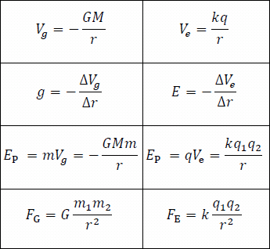
Topic 10: Fields - AHL
10.2 – Fields at work
Potential and potential energy – electrostatic
•You are probably asking yourself why we are spending so much time on fields.
•The reason is simple: Gravitational and electrostatic fields expose the symmetries in the physical world that are so intriguing to scientists.
FYI
•Both forces are governed by an inverse square law.
•Mass and charge are the corresponding physical quantities that create their fields in space.
•Potential and potential gradient are symmetric also.
Notes:
© 2015 By Timothy K. Lund

Slide 70
Topic 10: Fields - AHL
10.2 – Fields at work
Potential and potential energy – electrostatic
•Think of potential energy as the capacity to do work.
•And work is a force times a displacement.
•Recall the electrostatic force from Coulomb:
•If we multiply the above force by a distance r we get
W = Fd cos θ
(θ is angle between F and d)
work definition
F_{E} = kq₁q₂ / r ²
Coulombs law
where k = 8.99×10⁹ N m² C⁻²
E_{P} = kq₁q₂ / r
electrostatic potential energy
where k = 8.99×10⁹ N m² C⁻²
FYI
•The actual proof is beyond the scope of this course.
•You need integral calculus…
Notes:
© 2015 By Timothy K. Lund

Slide 71
Topic 10: Fields - AHL
10.2 – Fields at work
Potential and potential energy – electrostatic
•Since at r = ∞ the force is zero, we can dispense with the ∆E_{P}, just as we did with the gravitational force, and consider the potential energy E_{P} at each point in space as absolute.
E_{P} = kq₁q₂ / r
electrostatic potential energy
where k = 8.99×10⁹ N m² C⁻²
EXAMPLE: Find the electric potential energy between two protons located 3.0×10⁻¹⁰ meters apart.
SOLUTION: Use q₁ = q₂ = 1.60×10⁻¹⁹ C. Then
E_{P} = kq₁q₂ / r
= (8.99×10⁹)(1.60×10⁻¹⁹)² / 3.0×10⁻¹⁰
= 7.7×10⁻¹⁹ J.
Notes:
© 2015 By Timothy K. Lund

Slide 72
•Note that electrostatic E_{P} and the V_{e} don’t have (-) signs, as did the gravitational forms. Instead, they “inherit” their signs from the charges.
Topic 10: Fields - AHL
10.2 – Fields at work
Potential and potential energy – electrostatic
•The technical definition is: The work done by the electrostatic field in bringing a small charge from infinity to that point is called the electrostatic potential energy.
•We now define electrostatic potential V_{e} as electrostatic potential energy per unit charge:
∆V_{e} = ∆E_{P} / q
electrostatic potential
V_{e} = kq / r
FYI
•As we noted in the gravitational potential section of this slide show, you can now see why the potential is called that - it is derived from potential energy.
Notes:
© 2015 By Timothy K. Lund

Slide 73
Topic 10: Fields - AHL
10.2 – Fields at work
Potential and potential energy – electrostatic
PRACTICE: Find the electric potential at a point P located 4.5×10⁻¹⁰ m from a proton.
SOLUTION: q = 1.6×10⁻¹⁹ C so that
V_{e} = kq / r
= (8.99×10⁹)(1.6×10⁻¹⁹) / (4.5×10⁻¹⁰)
= 3.2 J C⁻¹ (which is 3.2 V)
PRACTICE: If we place an electron at P what will be the electric potential energy stored in the proton-electron combo?
SOLUTION: From ∆V_{e} = ∆E_{P} / q we see that
∆E_{P} = q∆V_{e}
= (-1.6×10⁻¹⁹)(3.2)
= 5.1×10⁻¹⁹ J (which is 3.2 eV)
Notes:
© 2015 By Timothy K. Lund

Slide 74
Topic 10: Fields - AHL
10.2 – Fields at work
Potential and potential energy – electrostatic
•Since electric potential is a scalar, finding the electric potential due to more than one point charge is a simple additive process.
r
EXAMPLE: Find the electric potential at the center of the circle of protons shown. The radius of the circle is the size of a small nucleus, or 3.0×10⁻¹⁵ m.
SOLUTION: Because potential is a scalar, it doesn’t matter how the charges are arranged on the circle.
•For each proton r = 3.0×10⁻¹⁵ m. Then each charge contributes V_{e} = kq / r so that
V_{e} = 4(9.0×10⁹)(1.6×10⁻¹⁹) / 3.0×10⁻¹⁵
= 1.9×10⁶ N C⁻¹ (or 1.9×10⁶ V).
Notes:
© 2015 By Timothy K. Lund

Slide 75
•Recall alpha decay, where alpha particles were released with energies of this order.
Topic 10: Fields - AHL
10.2 – Fields at work
Potential and potential energy – electrostatic
•Since electric potential is a scalar, finding the electric potential due to more than one point charge is a simple additive process.
r
EXAMPLE: Find the change in electric potential energy (in MeV) in moving a proton from infinity to the center of the previous nucleus.
SOLUTION: Use ∆V_{e} = ∆E_{P} / q and V∞ = 0:
∆E_{P} = q∆V_{e} = (1.6×10⁻¹⁹)(1.9×10⁶) = 3.0 ×10⁻¹³ J.
•Converting to eV we have
∆E_{P} = (3.0 ×10⁻¹³ J)(1 eV / 1.6 ×10⁻¹⁹ J)
= 1.9×10⁶ eV = 1.9 MeV.
FYI
•What is the significance of this number?
Notes:
© 2015 By Timothy K. Lund

Slide 76
Topic 10: Fields - AHL
10.2 – Fields at work
Potential gradient – electrostatic
•The electric potential gradient is the change in electric potential per unit distance. Thus the EPG = ∆V_{e} / ∆r.
•Recall the relationship between the gravitational potential gradient and the gravitational field strength g:
•Without proof we state that the relationship between the electric potential gradient and the electric field strength is the same:
g = –∆V_{g} / ∆r
gravitational potential gradient
E = –∆V_{e} / ∆r
electrostatic potential gradient
FYI
•In the US we speak of the gradient as the slope.
•In IB we use the term gradient exclusively.
Notes:
© 2015 By Timothy K. Lund

Slide 77
Topic 10: Fields - AHL
10.2 – Fields at work
Potential gradient – electrostatic
E = –∆V_{e} / ∆r
electrostatic potential gradient
PRACTICE: The electric potential in the vicinity of a charge changes from ⁻3.75 V to ⁻3.63 V in moving from r = 1.80×10⁻¹⁰ m to r = 2.85×10⁻¹⁰ m. What is the electric field strength in that region?
SOLUTION:
E = –∆V_{e} / ∆r
= –(⁻3.63 – ⁻3.75) / (2.85×10⁻¹⁰ – 1.80×10⁻¹⁰)
= -0.120 / 1.05×10⁻¹⁰ = -1.14×10⁹ V m⁻¹ (or N C⁻¹).
FYI
•Maybe it is a bit late for this reminder but be careful not to confuse the E for electric field strength for the E for energy!
Notes:
© 2015 By Timothy K. Lund

Slide 78
Topic 10: Fields - AHL
10.2 – Fields at work
Equipotential surfaces revisited – electrostatic
•Equipotential surfaces are imaginary surfaces at which the potential is the same.
•Since the electric potential for a point mass is given by V_{e} = kq / r it is clear that the equipotential surfaces are at fixed radii and hence are concentric spheres:
q
equipotential surfaces
FYI
•Generally equipotential surfaces are drawn so that the ∆V_{e}s for consecutive surfaces are equal.
•Because V_{e} is inversely proportional to r the consecutive rings get farther apart as we get farther from the mass.
Notes:
© 2015 By Timothy K. Lund

Slide 79
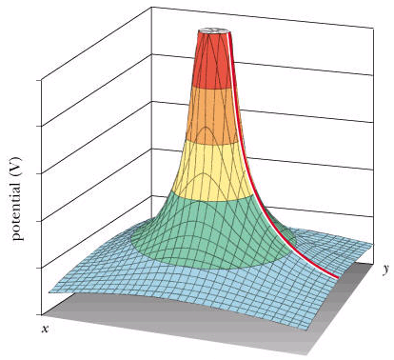
Topic 10: Fields - AHL
10.2 – Fields at work
Equipotential surfaces and the potential gradient
EXAMPLE: Use the 3D view of the equipotential surface surrounding a positive charge to interpret the electric potential gradient E = –∆V / ∆r.
SOLUTION: We can choose any direction for our r value, say the y-direction:
•Then E = –∆V / ∆y.
•This is just the gradient (slope) of the surface.
•Thus E is the (–) gradient of the equipotential surface.
Δy
ΔV_{e}
Notes:
© 2015 By Timothy K. Lund

Slide 80
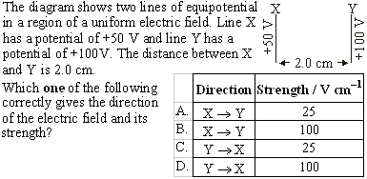
Topic 10: Fields - AHL
10.2 – Fields at work
Equipotential surfaces and the potential gradient
•The E-field points from more (+) to less (+).
•Use E = –∆V_{e} / ∆r and ignore the sign because we have already established direction:
•E = ∆V_{e} / ∆r = (100 V – 50 V) / 2 cm = 25 V cm⁻¹.
Notes:
© 2015 By Timothy K. Lund

Slide 81

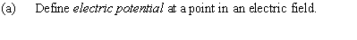
Topic 10: Fields - AHL
10.2 – Fields at work
Equipotential surfaces and the potential gradient
•Electric potential at a point P in space is the amount of work done per unit charge in bringing a charge from infinity to the point P.
•CONTRAST: Electric potential energy at a point P in space is the amount of work done in bringing a charge from infinity to the point P.
Notes:
© 2015 By Timothy K. Lund

Slide 82
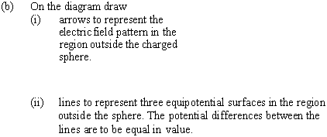
Topic 10: Fields - AHL
10.2 – Fields at work
Equipotential surfaces and the potential gradient
•The E-field points toward (-) charges.
•The E-field is ZERO inside a conductor.
•Perpendicular to E-field, and spreading.
Notes:
© 2015 By Timothy K. Lund

Slide 83
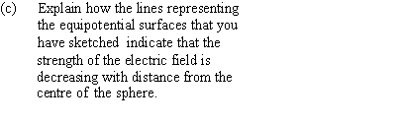
Topic 10: Fields - AHL
10.2 – Fields at work
Equipotential surfaces and the potential gradient
•From E = –∆V_{e} / ∆r we see that the bigger the separation between consecutive circles, the weaker the E-field.
•You can also tell directly from the concentration of the E-field lines.
Notes:
© 2015 By Timothy K. Lund

Slide 84
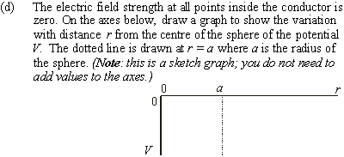
Topic 10: Fields - AHL
10.2 – Fields at work
Equipotential surfaces and the potential gradient
•V_{e} is ZERO inside a conductor.
kq / a
•V_{e} is biggest (–) when r = a. Thus V_{e} = kq / a.
•From V_{e} = kq / r we see that V is negative and it drops off as 1 / r.
Notes:
© 2015 By Timothy K. Lund

Slide 85
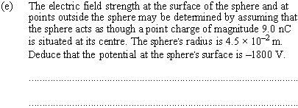
Topic 10: Fields - AHL
10.2 – Fields at work
Equipotential surfaces and the potential gradient
•V_{e} = kq / r
•V_{e} = (9.0×10⁹)(-9.0×10⁻⁹) / (4.5 ×10⁻²) = -1800 V.
Notes:
© 2015 By Timothy K. Lund

Slide 86
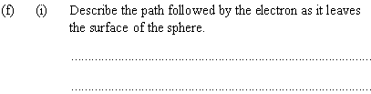
Topic 10: Fields - AHL
10.2 – Fields at work
Equipotential surfaces and the potential gradient
•It will accelerate away from the surface along a straight radial line.
•Its acceleration will drop off as 1 / r ² as it moves away from the sphere.
Notes:
© 2015 By Timothy K. Lund

Slide 87

Topic 10: Fields - AHL
10.2 – Fields at work
Equipotential surfaces and the potential gradient
•q = -1.6×10⁻¹⁹ C.
•V₀ = -1800 V.
•∆E_{P} = q∆V.
•V_{f} = kq / r = (9.0×10⁹)(-9.0×10⁻⁹) / (0.30) = -270 V.
• ∆E_{P} = q∆V = (-1.6×10⁻¹⁹)(-270 – ⁻1800) = -2.4×10⁻¹⁶ J.
• ∆E_{K} + ∆E_{P} = 0 → ∆E_{K} = - ∆E_{P} = 2.4×10⁻¹⁶ J.
0
• ∆E_{K} = E_{Kf} – E_{K0} = 2.4×10⁻¹⁶ J.
(1/2)mv² = 2.4×10⁻¹⁶.
(1/2)(9.11×10⁻³¹)v² = 2.4×10⁻¹⁶.
v = 2.3×10⁷ ms⁻¹.
Notes:
© 2015 By Timothy K. Lund

Slide 88
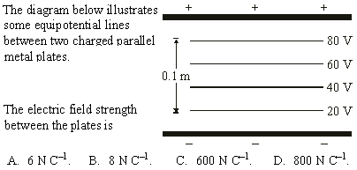
Topic 10: Fields - AHL
10.2 – Fields at work
Equipotential surfaces and the potential gradient
•|E| = ∆V_{e} / ∆r = (80 – 20) / 0.1 = 600.
Notes:
© 2015 By Timothy K. Lund

Slide 89
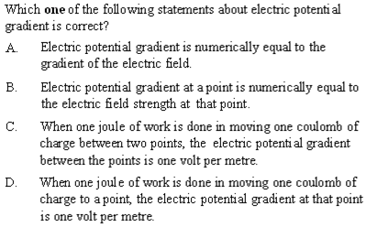
Topic 10: Fields - AHL
10.2 – Fields at work
Equipotential surfaces and the potential gradient
Notes:
© 2015 By Timothy K. Lund

Slide 90
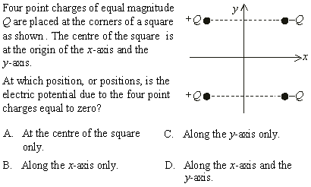
•At any point on the y-axis V_{e} = 0 since r is same and paired Qs are OPPOSITE.
Topic 10: Fields - AHL
10.2 – Fields at work
Equipotential surfaces and the potential gradient
•V_{e} = kQ / r
•On the x-axis V_{e} ≠ 0 since r is DIFFERENT for the paired Qs.
Notes:
© 2015 By Timothy K. Lund

