Slide 1
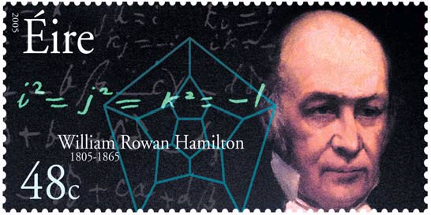
Topic 1: Measurement and uncertainties
1.3 – Vectors and scalars
Essential idea: Some quantities have direction and magnitude, others have magnitude only, and this understanding is the key to correct manipulation of quantities. This sub-topic will have broad applications across multiple fields within physics and other sciences.
Nature of science: Models: First mentioned explicitly in a scientific paper in 1846, scalars and vectors reflected the work of scientists and mathematicians across the globe for over 300 years on representing measurements in three- dimensional space.
Notes:
© 2006 By Timothy K. Lund

Slide 2
Topic 1: Measurement and uncertainties
1.3 – Vectors and scalars
Understandings:
• Vector and scalar quantities
• Combination and resolution of vectors
Applications and skills:
• Solving vector problems graphically and algebraically
Notes:
2
© 2006 By Timothy K. Lund

Slide 3
Topic 1: Measurement and uncertainties
1.3 – Vectors and scalars
Guidance:
• Resolution of vectors will be limited to two perpendicular directions
• Problems will be limited to addition and subtraction of vectors and the multiplication and division of vectors by scalars
Data booklet reference:
• A_{H} = A cos θ
• A_{V} = A sin θ
A_{V}
A
θ
A_{H}
Notes:
3
© 2006 By Timothy K. Lund

Slide 4
Topic 1: Measurement and uncertainties
1.3 – Vectors and scalars
International-mindedness:
• Vector notation forms the basis of mapping across the globe
Theory of knowledge:
• What is the nature of certainty and proof in mathematics?
Notes:
4
© 2006 By Timothy K. Lund

Slide 5
Topic 1: Measurement and uncertainties
1.3 – Vectors and scalars
Utilization:
• Navigation and surveying (see Geography SL/HL syllabus: Geographic skills)
• Force and field strength (see Physics sub-topics 2.2, 5.1, 6.1 and 10.1)
• Vectors (see Mathematics HL sub-topic 4.1; Mathematics SL sub-topic 4.1)
Aims:
• Aim 2 and 3: this is a fundamental aspect of scientific language that allows for spatial representation and manipulation of abstract concepts
Notes:
5
© 2006 By Timothy K. Lund

Slide 6
Topic 1: Measurement and uncertainties
1.3 – Vectors and scalars
Vector and scalar quantities
•A vector quantity is one which has a magnitude (size) and a spatial direction.
•A scalar quantity has only magnitude (size).
EXAMPLE: A force is a push or a pull, and is measured in newtons. Explain why it is a vector.
SOLUTION: Suppose Joe is pushing Bob with a force of 100 newtons to the north.
Then the magnitude of the force is 100 n.
The direction of the force is north.
Since the force has both magnitude and direction, it is a vector.
Notes:
© 2006 By Timothy K. Lund

Slide 7
Topic 1: Measurement and uncertainties
1.3 – Vectors and scalars
Vector and scalar quantities
•A vector quantity is one which has a magnitude (size) and a spatial direction.
•A scalar quantity has only magnitude (size).
EXAMPLE: Explain why time is a scalar.
SOLUTION: Suppose Joe times a foot race and the winner took 45 minutes to complete the race.
The magnitude of the time is 45 minutes.
But there is no direction associated with Joe’s stopwatch. The outcome is the same whether Joe’s watch is facing west or east. Time lacks any spatial direction. Thus time is a scalar.
Notes:
© 2006 By Timothy K. Lund

Slide 8
Topic 1: Measurement and uncertainties
1.3 – Vectors and scalars
Vector and scalar quantities
•A vector quantity is one which has a magnitude (size) and a spatial direction.
•A scalar quantity has only magnitude (size).
EXAMPLE: Give examples of scalars in physics.
SOLUTION:
Speed, distance, time, and mass are scalars. We will learn about them all later.
EXAMPLE: Give examples of vectors in physics.
SOLUTION:
Velocity, displacement, force, weight and acceleration are all vectors. We will learn about them all later.
Notes:
© 2006 By Timothy K. Lund

Slide 9
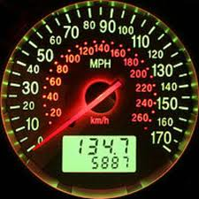
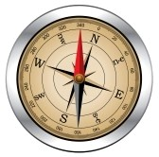
Topic 1: Measurement and uncertainties
1.3 – Vectors and scalars
Vector and scalar quantities
•Speed and velocity are examples of vectors you are already familiar with.
•Speed is what your speedometer reads (say 35 km h⁻¹) while you are in your car. It does not care what direction you are going. Speed is a scalar.
•Velocity is a speed in a particular direction (say 35 km h⁻¹ to the north). Velocity is a vector.
SCALAR
VECTOR
magnitude
magnitude
+
direction
Speed
Speed
Direction
Velocity
Notes:
© 2006 By Timothy K. Lund

Slide 10
Topic 1: Measurement and uncertainties
1.3 – Vectors and scalars
Vector and scalar quantities
•Suppose the following movement of a ball takes place in 5 seconds.
•Note that it traveled to the right for a total of 15 meters in 5 seconds. We say that the ball’s velocity is ⁺3 m/s (+15 m / 5 s). The (+) sign signifies it moved in the positive x-direction.
•Now consider the following motion that takes 4 seconds.
•Note that it traveled to the left for a total of 20 meters. In 4 seconds. We say that the ball’s velocity is - 5 m/s (–20 m / 4 s). The (–) sign signifies it moved in the negative x-direction.
x / m
x / m
Notes:
© 2006 By Timothy K. Lund

Slide 11
Topic 1: Measurement and uncertainties
1.3 – Vectors and scalars
Vector and scalar quantities
•It should be apparent that we can represent a vector as an arrow of scale length.
•There is no “requirement” that a vector must lie on either the x- or the y-axis. Indeed, a vector can point in any direction.
•Note that when the vector is at an angle, the sign is rendered meaningless.
x / m
v = +3 m s⁻¹
x / m
v = -4 m s⁻¹
v = 3 m s⁻¹
v = 4 m s⁻¹
Notes:
© 2006 By Timothy K. Lund

Slide 12
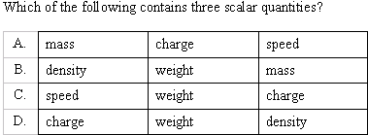
Topic 1: Measurement and uncertainties
1.3 – Vectors and scalars
Vector and scalar quantities
PRACTICE:
SOLUTION:
Weight is a vector.
Thus A is the answer by process of elimination.
Notes:
12
© 2006 By Timothy K. Lund

Slide 13
Topic 1: Measurement and uncertainties
1.3 – Vectors and scalars
Combination and resolution of vectors
•Consider two vectors drawn to scale: vector A and vector B.
•In print, vectors are designated in bold non-italicized print: A, B.
•When taking notes, place an arrow over your vector quantities, like this:
•Each vector has a tail, and a tip (the arrow end).
A
B
tip
tail
B
A
tip
tail
Notes:
© 2006 By Timothy K. Lund

Slide 14
Topic 1: Measurement and uncertainties
1.3 – Vectors and scalars
Combination and resolution of vectors
•Suppose we want to find the sum of the two vectors A + B.
•We take the second-named vector B, and translate it towards the first-named vector A, so that B’s TAIL connects to A’s TIP.
•The result of the sum, which we are calling the vector S (for sum), is gotten by drawing an arrow from the START of A to the FINISH of B.
tip
tail
B
A
tip
FINISH
A+B=S
START
tail
Notes:
© 2006 By Timothy K. Lund

Slide 15

Topic 1: Measurement and uncertainties
1.3 – Vectors and scalars
Combination and resolution of vectors
•As a more entertaining example of the same technique, let us embark on a treasure hunt.
Arrgh, matey. First, pace off the first vector A.
Then, pace off the second vector B.
And ye'll be findin' a treasure, aye!
Notes:
© 2006 By Timothy K. Lund

Slide 16

Topic 1: Measurement and uncertainties
1.3 – Vectors and scalars
Combination and resolution of vectors
•We can think of the sum A + B = S as the directions on a pirate map.
•We start by pacing off the vector A, and then we end by pacing off the vector B.
•S represents the shortest path to the treasure.
B
A
end
S
A
+
B
=
S
start
Notes:
© 2006 By Timothy K. Lund

Slide 17

Topic 1: Measurement and uncertainties
1.3 – Vectors and scalars
Combination and resolution of vectors
PRACTICE:
SOLUTION:
Resultant is another word for sum.
Draw the 7 N vector, then from its tip, draw a circle of radius 5 N:
Various choices for the 5 N vector are illustrated, together with their vector sum:
•The shortest possible vector is 2 N.
Notes:
17
© 2006 By Timothy K. Lund

Slide 18
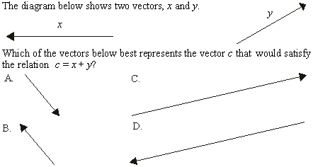
Topic 1: Measurement and uncertainties
1.3 – Vectors and scalars
Combination and resolution of vectors
SOLUTION:
Sketch the sum.
y
c = x + y
x
Notes:
18
© 2006 By Timothy K. Lund

Slide 19
Topic 1: Measurement and uncertainties
1.3 – Vectors and scalars
Combination and resolution of vectors
•Just as in algebra we learn that to subtract is the same as to add the opposite (5 – 8 = 5 + -8), we do the same with vectors.
•Thus A - B is the same as A + ⁻ B.
•All we have to do is know that the opposite of a vector is simply that same vector with its direction reversed.
⁻ B
B
the vector B
A + ⁻ B
A
⁻ B
the opposite of the vector B
Thus,
A
A - B =
+
⁻ B
Notes:
© 2006 By Timothy K. Lund

Slide 20
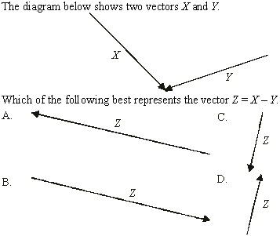
Topic 1: Measurement and uncertainties
1.3 – Vectors and scalars
Combination and resolution of vectors
SOLUTION:
•Sketch in the difference.
Z = X - Y
x
- y
Notes:
20
© 2006 By Timothy K. Lund

Slide 21
Topic 1: Measurement and uncertainties
1.3 – Vectors and scalars
Combination and resolution of vectors
•To multiply a vector by a scalar, increase its length in proportion to the scalar multiplier.
•Thus if A has a length of 3 m, then 2A has a length of 6 m.
•To divide a vector by a scalar, simply multiply by the reciprocal of the scalar.
•Thus if A has a length of 3 m, then A / 2 has a length of (1/2)A, or 1.5 m.
A
2A
A
A / 2
FYI
•In the case where the scalar has units, the units of the product will change. More later!
Notes:
© 2006 By Timothy K. Lund

Slide 22
Topic 1: Measurement and uncertainties
1.3 – Vectors and scalars
Combination and resolution of vectors
•Suppose we have a ball moving simultaneously in the x- and the y-direction along the diagonal as shown:
FYI
•The green balls are just the shadow of the red ball on each axis. Watch the animation repeatedly and observe how the shadows also have velocities.
y / m
x / m
Notes:
© 2006 By Timothy K. Lund

Slide 23
Topic 1: Measurement and uncertainties
1.3 – Vectors and scalars
Combination and resolution of vectors
•We can measure each side directly on our scale:
•Note that if we move the 9 m side to the right we complete a right triangle.
•Clearly, vectors at an angle can be broken down into the pieces represented by their shadows.
y / m
25 m
9 m
23.3 m
x / m
Notes:
© 2006 By Timothy K. Lund

Slide 24
Topic 1: Measurement and uncertainties
1.3 – Vectors and scalars
Combination and resolution of vectors
•Consider a generalized vector A as shown below.
•We can break the vector A down into its horizontal or x-component A_{x} and its vertical or y-component A_{y}.
•We can also sketch in an angle, and perhaps measure it with a protractor.
•In physics and most sciences we use the Greek letter θ (theta) to represent an angle.
•From Pythagoras we have
A² = A_{H}² + A_{V}².
A
vertical component
A_{V}
A_{V}
θ
A_{H}
horizontal component
Notes:
© 2006 By Timothy K. Lund

Slide 25
Topic 1: Measurement and uncertainties
1.3 – Vectors and scalars
Combination and resolution of vectors
•Recall the trigonometry of a right triangle:
opp
hyp
A_{V}
adj
hyp
A_{H}
opp
adj
A_{V}
sin θ = cos θ = tan θ =
A
A
A_{H}
A
hypotenuse
opposite
A_{V} = A sin θ
θ
s-o-h-c-a-h-t-o-a
adjacent
trigonometric ratios
A_{H} = A cos θ
EXAMPLE: What is sin 25° and what is cos 25°?
SOLUTION:
sin 25° = 0.4226
cos 25° = 0.9063
FYI
•Set your calculator to “deg” using your “mode” function.
Notes:
© 2006 By Timothy K. Lund

Slide 26
Topic 1: Measurement and uncertainties
1.3 – Vectors and scalars
Combination and resolution of vectors
EXAMPLE: A student walks 45 m on a staircase that rises at a 36° angle with respect to the horizontal (the x-axis). Find the x- and y-components of his journey.
SOLUTION: A picture helps.
A_{H} = A cos θ
= 45 cos 36° = 36 m
A_{V} = A sin θ
= 45 sin 36° = 26 m
A = 45 m
A_{V}
A_{V}
θ = 36°
A_{H}
FYI
•To resolve a vector means to break it down into its x- and y-components.
Notes:
© 2006 By Timothy K. Lund

