Slide 1
Topic 1: Measurement and uncertainties
1.1 – Measurements in physics
Essential idea:
Since 1948, the Système International d’Unités (SI) has been used as the preferred language of science and technology across the globe and reflects current best measurement practice.
Notes:
© 2006 By Timothy K. Lund

Slide 2
Topic 1: Measurement and uncertainties
1.1 – Measurements in physics
Nature of science:
Common terminology: Since the 18th century, scientists have sought to establish common systems of measurements to facilitate international collaboration across science disciplines and ensure replication and comparability of experiments.
Improvement in instrumentation: Improvement in instrumentation, such as using the transition of cesium-133 atoms for atomic clocks, has led to more refined definitions of standard units.
Certainty: Although scientists are perceived as working towards finding “exact” answers, there is unavoidable uncertainty in any measurement.
Notes:
2
© 2006 By Timothy K. Lund

Slide 3
Topic 1: Measurement and uncertainties
1.1 – Measurements in physics
Understandings:
• Fundamental and derived SI units
• Scientific notation and metric multipliers
• Significant figures
• Orders of magnitude
• Estimation
Notes:
3
© 2006 By Timothy K. Lund

Slide 4
Topic 1: Measurement and uncertainties
1.1 – Measurements in physics
Applications and skills:
• Using SI units in the correct format for all required measurements, final answers to calculations and presentation of raw and processed data
• Using scientific notation and metric multipliers
• Quoting and comparing ratios, values and approximations to the nearest order of magnitude
• Estimating quantities to an appropriate number of significant figures
Notes:
4
© 2006 By Timothy K. Lund

Slide 5
Topic 1: Measurement and uncertainties
1.1 – Measurements in physics
Guidance:
• SI unit usage and information can be found at the website of Bureau International des Poids et Mesures
• Students will not need to know the definition of SI units except where explicitly stated in the relevant topics
• Candela is not a required SI unit for this course
• Guidance on any use of non-SI units such as eV, MeV c⁻², Ly and pc will be provided in the relevant topics
International-mindedness:
• Scientific collaboration is able to be truly global without the restrictions of national borders or language due to the agreed standards for data representation
Notes:
5
© 2006 By Timothy K. Lund

Slide 6
Topic 1: Measurement and uncertainties
1.1 – Measurements in physics
Theory of knowledge:
• What has influenced the common language used in science? To what extent does having a common standard approach to measurement facilitate the sharing of knowledge in physics?
Utilization:
• This topic is able to be integrated into any topic taught at the start of the course and is important to all topics
• Students studying more than one group 4 subject will be able to use these skills across all subjects
Notes:
6
© 2006 By Timothy K. Lund

Slide 7
Topic 1: Measurement and uncertainties
1.1 – Measurements in physics
Aims:
• Aim 2 and 3: this is an essential area of knowledge that allows scientists to collaborate across the globe
• Aim 4 and 5: a common approach to expressing results of analysis, evaluation and synthesis of scientific information enables greater sharing and collaboration
Notes:
7
© 2006 By Timothy K. Lund

Slide 8
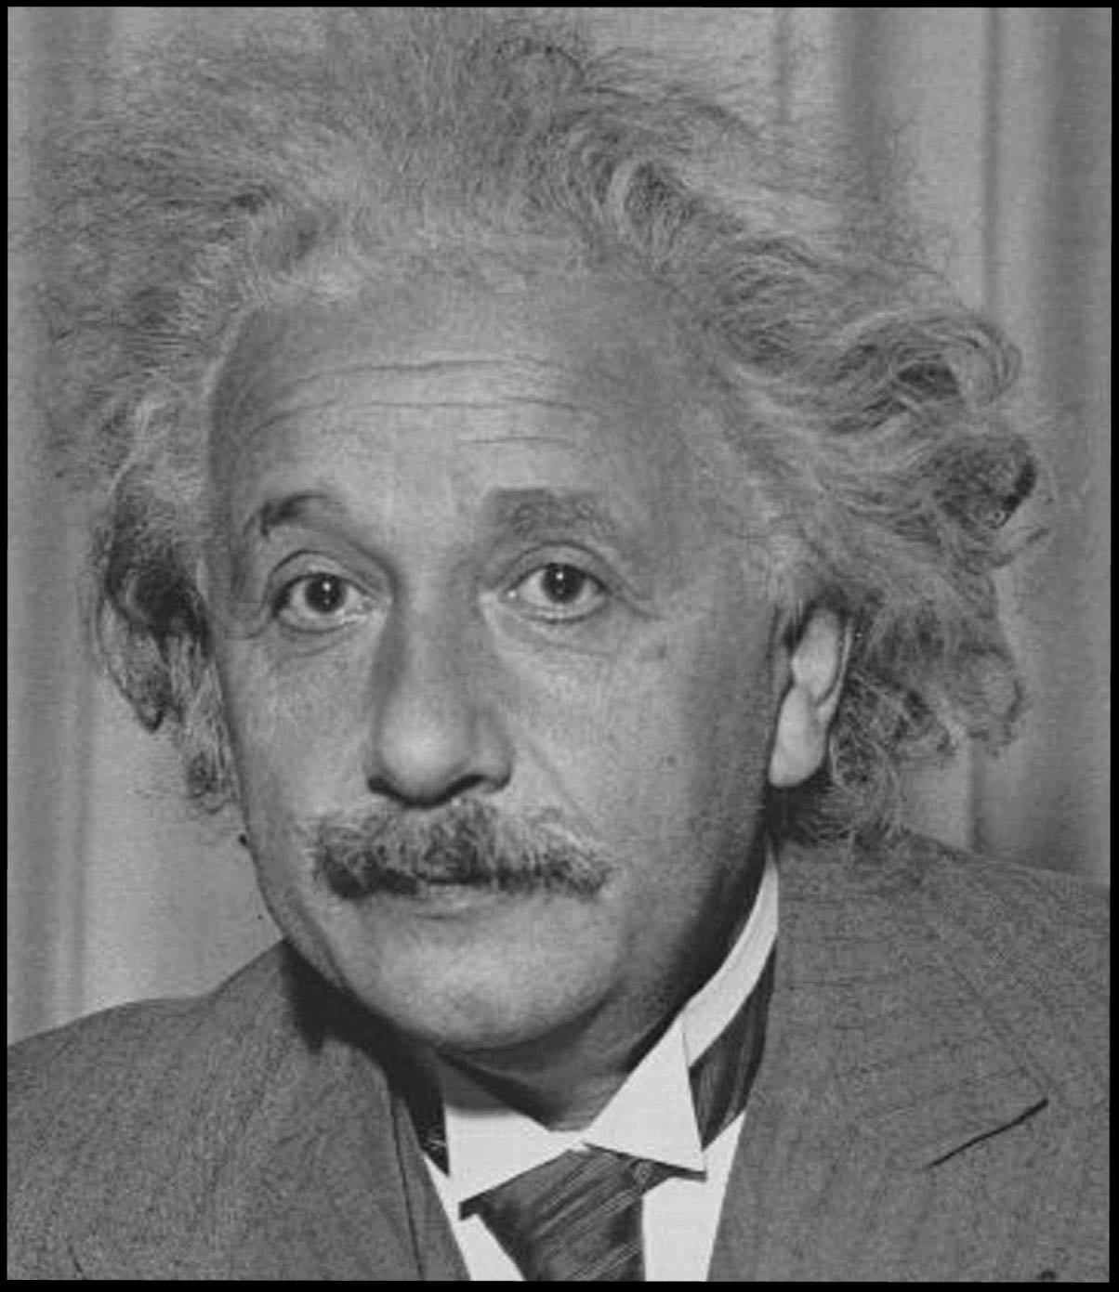
Topic 1: Measurement and uncertainties
1.1 – Measurements in physics
Physics has some of the most famous names in science.
If a poll were to be taken on who is the most famous scientist, many people would choose…
Albert Einstein
A PHYSICIST
Notes:
© 2006 By Timothy K. Lund

Slide 9
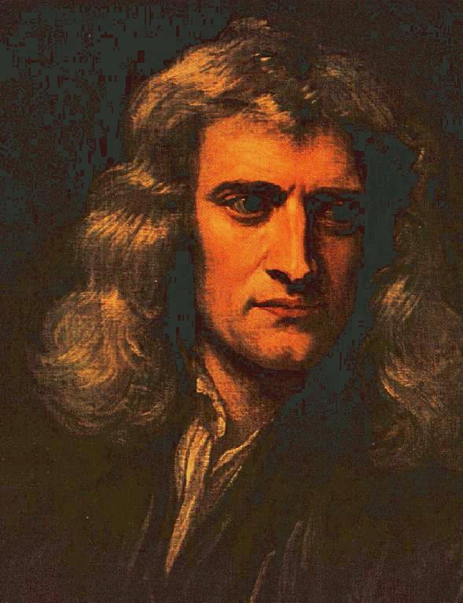
Topic 1: Measurement and uncertainties
1.1 – Measurements in physics
Physics has some of the most famous names in science.
If a poll were to be taken on who is the most famous scientist, other people might choose…
Isaac Newton
A PHYSICIST
Notes:
© 2006 By Timothy K. Lund

Slide 10
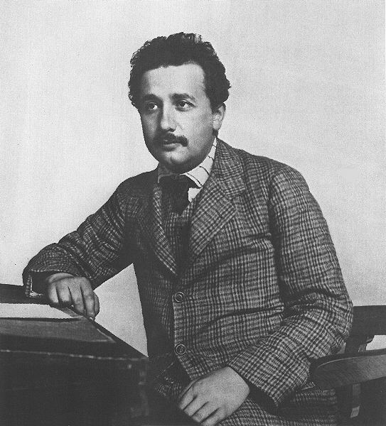
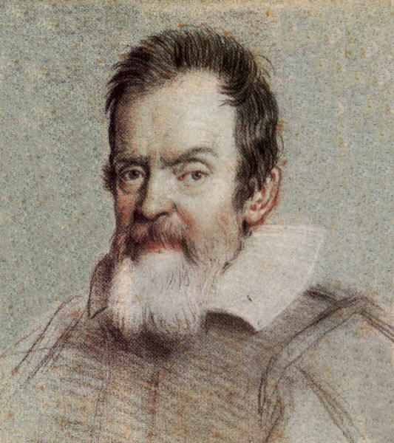
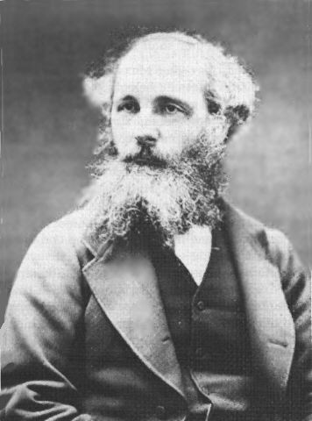
Topic 1: Measurement and uncertainties
1.1 – Measurements in physics
The physics we will study this year and next was pioneered by the following four individuals:
Other greats will be introduced when the time comes.
Einstein
Galileo
Relativity
Kinematics
Newton
Maxwell
Quantum physics
Calculus
Dynamics
Electrodynamics
Classical Physics
Notes:
© 2006 By Timothy K. Lund

Slide 11
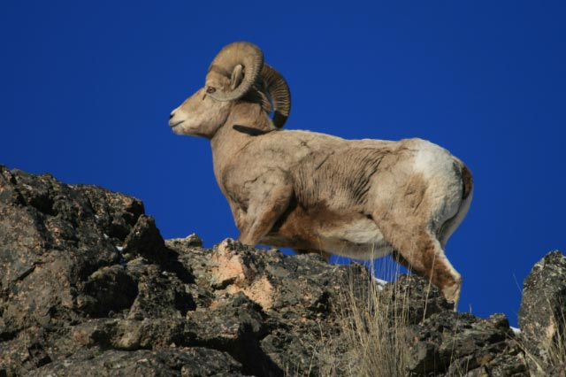
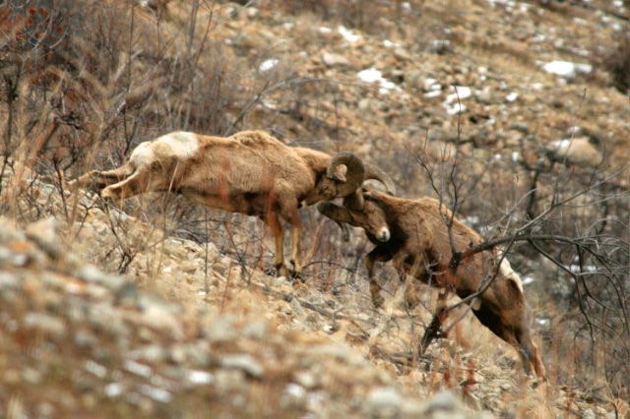
Topic 1: Measurement and uncertainties
1.1 – Measurements in physics
Physics is the study of forces, and matter’s reaction to them.
All of the sciences have examples of force:
In biology, we have the bighorn sheep:
N₁
F₂₁
Kilo pounds
f₁
F₁₂
N₂
W₁
f₂
W₂
Notes:
© 2006 By Timothy K. Lund

Slide 12
Topic 1: Measurement and uncertainties
1.1 – Measurements in physics
Physics is the study of forces, and matter’s reaction to them.
All of the sciences have examples of force:
In chemistry, we have the popping can:
pounds
Notes:
© 2006 By Timothy K. Lund

Slide 13
Topic 1: Measurement and uncertainties
1.1 – Measurements in physics
Physics is the study of forces, and matter’s reaction to them.
All of the sciences have examples of force:
In physics, we have the biggest forces of all:
Notes:
© 2006 By Timothy K. Lund

Slide 14
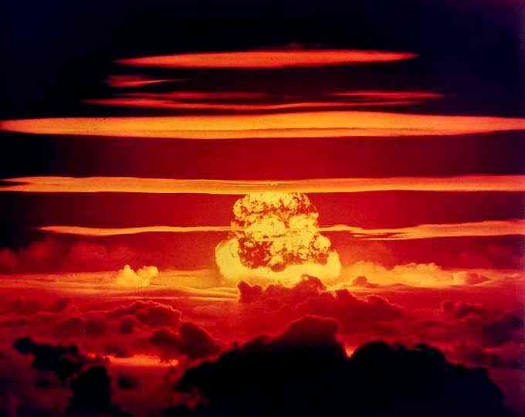
Dakota H-Bomb – 1 million tons of TNT
Notes:
© 2006 By Timothy K. Lund

Slide 15
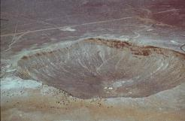
Meteor Crater - Arizona
100 Dakota H-Bombs
Notes:
© 2006 By Timothy K. Lund

Slide 16
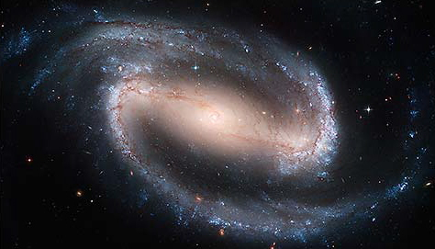
Topic 1: Measurement and uncertainties
1.1 – Measurements in physics
Physics is the study of the very small.
And the very large.
And everything in between.
Barred Spiral Galaxy NGC 1300
About 2 ×10²¹ meters in diameter
Notes:
© 2006 By Timothy K. Lund

Slide 17
Topic 1: Measurement and uncertainties
1.1 – Measurements in physics
Fundamental and derived SI units
•The fundamental units in the SI system are…
- mass - measured in kilograms (kg)
- length - measured in meters (m)
- time - measured in seconds (s)
- temperature - measured in Kelvin degrees (K)
- electric current - measured in amperes (A)
- luminosity - measured in candela (cd)
- mole - measured in moles (mol)
FYI
•In chemistry you will no doubt use the mole, the meter, the second, and probably the Kelvin.
•You will also use the gram. In physics we use the kilogram (meaning 1000 grams).
Notes:
© 2006 By Timothy K. Lund

Slide 18

Topic 1: Measurement and uncertainties
1.1 – Measurements in physics
FYI: Blue headings are assessment criteria put out by the IBO
Fundamental and derived SI units
PRACTICE:
SOLUTION:
•The correct answer is (D).
FYI: “Funky print” practice problems are drawn from old IB tests
FYI
•The body that has designed the IB course is called the IBO, short for International Baccalaureate Organization, headquartered in Geneva, Switzerland and Wales, England.
•The IBO expects you to memorize the fundamental units.
Notes:
18
© 2006 By Timothy K. Lund

Slide 19
Learning Intentions
You have already learned about…
  What is physics
  The 7 fundamental units
What you will learn about…
  Derived units
  Converting between units

Slide 20
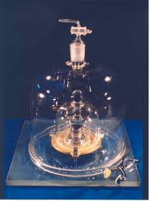
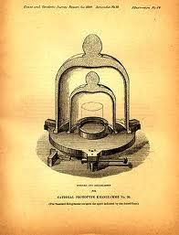
Topic 1: Measurement and uncertainties
1.1 – Measurements in physics
Fundamental and derived SI units
•The International Prototype of the Kilogram was sanctioned in 1889. Its form is a cylinder with diameter and height of about 39 mm. It is made of an alloy of 90 % platinum and 10 % iridium. The IPK has been conserved at the BIPM since 1889, initially with two official copies. Over the years, one official copy was replaced and four have been added.
FYI
•One meter is about a yard or three feet.
•One kilogram is about 2.2 pounds.
Notes:
© 2006 By Timothy K. Lund

Slide 21
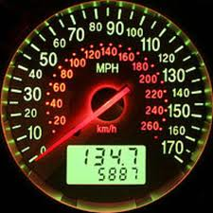
Topic 1: Measurement and uncertainties
1.1 – Measurements in physics
Fundamental and derived SI units
•Derived quantities have units that are combos of the fundamental units. For example
•Speed - measured in meters per second (m / s).
•Acceleration - measured in meters per second per second (m / s ²).
FYI
•SI stands for Système International and is a standard body of measurements.
•The SI system is pretty much the world standard in units.
Notes:
© 2006 By Timothy K. Lund

Slide 22
Topic 1: Measurement and uncertainties
1.1 – Measurements in physics
Fundamental and derived SI units
•In the sciences, you must be able to convert from one set of units (and prefixes) to another.
•We will use “multiplication by the well-chosen one”.
EXAMPLE: Suppose the rate of a car is 36 mph, and it travels for 4 seconds. What is the distance traveled in that time by the car?
SOLUTION:
Distance is rate times time, or d = rt.
FYI
•Sometimes “correct” units do not convey much meaning to us. See next example!
d = r · t
36 mi
1 h
× (4 s)
d =
d = 144 mi·s/h
Notes:
© 2006 By Timothy K. Lund

Slide 23
Topic 1: Measurement and uncertainties
1.1 – Measurements in physics
Fundamental and derived SI units
•In the sciences, you must be able to convert from one set of units (and prefixes) to another.
•We will use “multiplication by the well-chosen one”.
EXAMPLE: Convert 144 mi·s/h into units that we can understand.
SOLUTION:
Use well-chosen ones as multipliers.
144 mi·s
h
1 h
60 min
1 min
60 s
= 0.04 mi
d =
×
×
0.04 mi
1
5280 ft
mi
= 211.2 ft
×
Notes:
© 2006 By Timothy K. Lund

Slide 24
Topic 1: Measurement and uncertainties
1.1 – Measurements in physics
Fundamental and derived SI units
•You can use units to prove that equations are invalid.
EXAMPLE: Given that distance is measured in meters, time in seconds and acceleration in meters per second squared, show that the formula d = at does not work and thus is not valid.
SOLUTION: Start with the formula, then substitute the units on each side. Cancel to where you can easily compare left and right sides:
d = at
FYI
•The last line shows that the units are inconsistent on left and right.
•Thus the equation cannot be valid.
m =
m
s²
·s
m =
m
s
Notes:
© 2006 By Timothy K. Lund

Slide 25
Topic 1: Measurement and uncertainties
1.1 – Measurements in physics
Fundamental and derived SI units
•You can use units to prove that equations are invalid.
PRACTICE: Decide if the formulas are dimensionally consistent. The information you need is that v is measured in m/s, a is in m/s², x is in m and t is in s.
(a) v = at² (b) v² = 3ax (c) x = at²
Inconsistent Consistent Consistent
numbers don’t have units
FYI
•The process of substituting units into formulas to check for consistency is called dimensional analysis.
•DA can be used only to show the invalidity of a formula. Both (b) and (c) are consistent but neither is correct. They should be: v² = 2ax and x = (1/2)at².
Notes:
© 2006 By Timothy K. Lund

Slide 26
Topic 1: Measurement and uncertainties
1.1 – Measurements in physics
Scientific notation and metric multipliers
•We will be working with very large and very small numbers, so we will use the these prefixes:
Power of 10 Prefix Name Symbol
10 ⁻¹² pico p
10 ⁻⁹ nano n
10 ⁻⁶ micro µ
10 ⁻³ milli m
10 ⁻² centi c
10 ³ kilo k
10 ⁶ mega M
10 ⁹ giga G
10 ¹² tera T
Notes:
© 2006 By Timothy K. Lund

Slide 27
Topic 1: Measurement and uncertainties
1.1 – Measurements in physics
Scientific notation and metric multipliers
•Scientific notation (commonly referred to as "standard form") is a way of writing numbers that are too big or too small to be conveniently written in decimal form.
•A number in scientific notation is expressed as a×10^{b}, where a is a real number (called the coefficient, mantissa or significand) and b is an integer { … , -2, -1, 0, 1, 2, … }.
•We say that the number is normalized if 1 ≤ |a| < 10.
Notes:
27
© 2006 By Timothy K. Lund

Slide 28
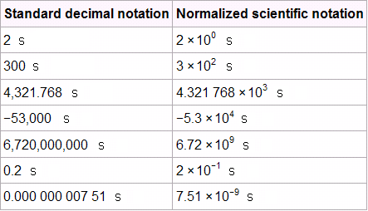
Topic 1: Measurement and uncertainties
1.1 – Measurements in physics
Scientific notation and metric multipliers
EXAMPLE: http://en.wikipedia.org/wiki/Scientific_notation#Normalized_notation
4.321768 ks
-53 ks
9.72 Gs
200 ms
7.51 ns
Notes:
28
© 2006 By Timothy K. Lund

Slide 29
Topic 1: Measurement and uncertainties
1.1 – Measurements in physics
Using SI units in the correct format
•In IB units are in “European” format rather than “American” format.
•The accepted presentation has no fraction slash.
•Instead, denominator units are written in the numerator with negative exponents. This is “SI standard.”
EXAMPLE: A car’s speed is measured as 40 km / h and its acceleration is measured as 1.5 m / s ². Rewrite the units in the accepted IB format.
SOLUTION: Denominator units just come to the numerator as negative exponents. Thus
40 km / h is written 40 km h ⁻¹.
•1.5 m / s ² is written 1.5 m s ⁻².
Notes:
© 2006 By Timothy K. Lund

Slide 30
Topic 1: Measurement and uncertainties
1.1 – Measurements in physics
Significant figures
•Error in measurement is expected because of the imperfect nature of our measuring devices.
•A typical meter stick has marks at every millimeter (10 ⁻³ m or 1/1000 m). Thus the best measurement you can get from a typical meter stick is to the nearest mm.
EXAMPLE: Consider the following line whose length we wish to measure. How long is it?
SOLUTION:
It is closer to 1.2 cm than 1.1 cm, so we say it measures 1.2 cm. The 1 and 2 are both significant.
0
1
1 cm
1 mm
Notes:
30
© 2006 By Timothy K. Lund

Slide 31
Topic 1: Measurement and uncertainties
1.1 – Measurements in physics
Significant figures
•We call the “1” in the measurement below the most significant digit. It represents the “main portion” of our measurement.
•We call the “2” in the measurement below the least significant digit.
EXAMPLE: Consider the following line whose length we wish to measure. How long is it?
SOLUTION:
It is closer to 1.2 cm than 1.1 cm, so we say it measures 1.2 cm.
0
1
1 cm
1 mm
Notes:
31
© 2006 By Timothy K. Lund

Slide 32
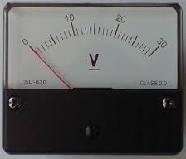
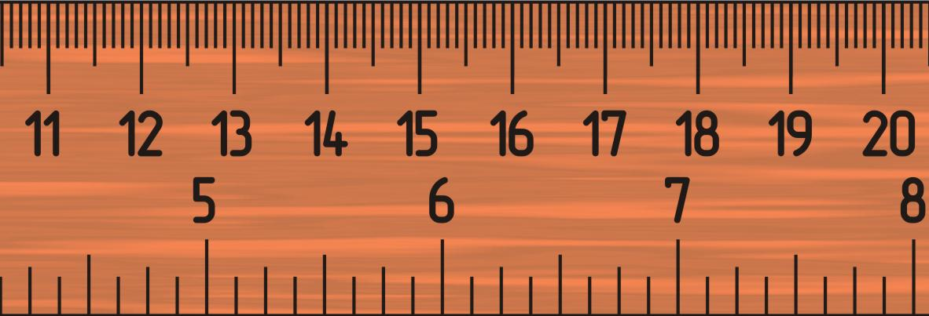
Topic 1: Measurement and uncertainties
1.1 – Measurements in physics
Significant figures
•A ruler is an analog measuring device.
•So is a meter with a needle.
•For good analog devices you can estimate the last digit.
•Thus, to say that the blue line is 1.17 cm or 1.18 cm long are both correct.
•The 1.1 part constitutes the two certain digits.
•The 7 (or 8) constitutes the uncertain digit.
0
1
Notes:
32
© 2006 By Timothy K. Lund

Slide 33
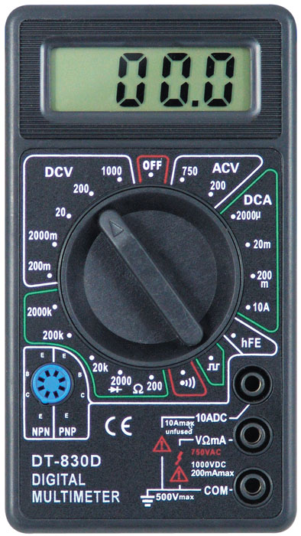
Topic 1: Measurement and uncertainties
1.1 – Measurements in physics
Significant figures
•A digital measuring device, on the other hand, is only “good” to the least significant digit’s place.
EXAMPLE:
•The meter shown here is only good to the nearest 0.1 V. There is NO estimation of another digit.
Notes:
33
© 2006 By Timothy K. Lund

Slide 34
Topic 1: Measurement and uncertainties
1.1 – Measurements in physics
Significant figures
•Significant figures are the reasonable number of digits that a measurement or calculation should have.
•For example, as illustrated before, a typical wooden meter stick has two significant figures.
•The number of significant figures in a calculation reflects the precision of the least precise of the measured values.
Notes:
34
© 2006 By Timothy K. Lund

Slide 35
Topic 1: Measurement and uncertainties
1.1 – Measurements in physics
Significant figures
(1) All non-zero digits are significant.
438 g
26.42 m
0.75 cm
3
4
2
(2) All zeros between non-zero digits are significant.
12060 m
900.43 cm
4
5
(3) Filler zeros to the left of an understood decimal place are not significant.
220 L
60 g
30. cm
2
1
2
(4) Filler zeros to the right of a decimal place are not significant.
0.006 L
0.08 g
1
1
(5) All non-filler zeros to the right of a decimal place are significant.
8.0 L
60.40 g
2
4
Notes:
35
© 2006 By Timothy K. Lund

Slide 36
Topic 1: Measurement and uncertainties
1.1 – Measurements in physics
Significant figures in calculations
  EXAMPLE CALCULATOR SIG. FIGS
  •Multiplication and division – round your answer to the same number of significant digits as the quantity with the fewest number of significant digits.
  (1.2 cm)(2 cm) 2.4 cm² 2 cm²
  π(2.75 cm)² 7.5625 cm² 7.56 cm²
  5.350 m/2.752 s 1.944040698 m/s 1.944 m/s
  (0.0075 N)(6 m) 0.045 Nm 0.04 Nm
  •Addition and subtraction – round your answer to the same number of decimal places as the quantity with the fewest number of decimal places.
  1.2 cm + 2 cm 3.2 cm 3 cm
  2000 m+2.1 m 2002.1 m 2000 m
  0.00530 m – 2.10 m -2.0947 m -2.09 m
Notes:
36
© 2006 By Timothy K. Lund

Slide 37
Topic 1: Measurement and uncertainties
1.1 – Measurements in physics
Estimating quantities to an appropriate number of significant figures
PRACTICE: How long is this line?
SOLUTION: Read the first two certain digits, then estimate the last uncertain one.
•The 1 and the 2 are the certain digits.
•The 8 (or 7) is the uncertain digit.
•It is about 1.28 cm (or maybe 1.27 cm) long.
0
1
1 cm
1 mm
Notes:
37
© 2006 By Timothy K. Lund

Slide 38
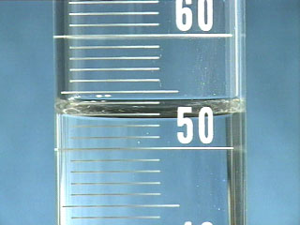
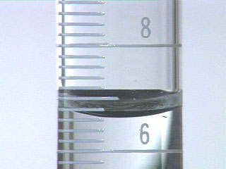
Topic 1: Measurement and uncertainties
1.1 – Measurements in physics
Estimating quantities to an appropriate number of significant figures
PRACTICE: What is the reading on each of the graduated cylinders? Which digits are uncertain.
(A) (B)
SOLUTION: Read to the bottom of the meniscus.
(A) reads 52.8 mL. The 8 is uncertain.
(B) Reads 6.62 mL. The 2 is uncertain.
Notes:
38
© 2006 By Timothy K. Lund

Slide 39
Topic 1: Measurement and uncertainties
1.1 – Measurements in physics
Orders of magnitude
Mass of universe 10 ⁵⁰ kg
Diameter of universe 10 ²⁵ m
Diameter of galaxy 10 ²¹ m
Age of universe 10 ¹⁸ s
Speed of light 10 ⁸ m s⁻¹
Diameter of atom 10 ⁻¹⁰ m
Diameter of nucleus 10 ⁻¹⁵ m
Diameter of quark 10 ⁻¹⁸ m
Mass of proton 10 ⁻²⁷ kg
Mass of quark 10 ⁻³⁰ kg
Mass of electron 10 ⁻³¹ kg
Planck length 10 ⁻³⁵ m
Notes:
39
© 2006 By Timothy K. Lund

Slide 40
Topic 1: Measurement and uncertainties
1.1 – Measurements in physics
Quoting and comparing ratios, values and approximations to the nearest order of magnitude
EXAMPLE: Given that the smallest length in the universe is the Planck length of 10 ⁻³⁵ meters and that the fastest speed in the universe is that of light at 10 ⁸ meters per second, find the smallest time interval in the universe.
SOLUTION:
Speed is distance divided by time (speed = d / t).
Using algebra we can write t = d / speed.
Substitution yields t = 10 ⁻³⁵ / 10 ⁸ = 10 ⁻⁴³ seconds.
Notes:
40
© 2006 By Timothy K. Lund

Slide 41
Topic 1: Measurement and uncertainties
1.1 – Measurements in physics
Quoting and comparing ratios, values and approximations to the nearest order of magnitude
EXAMPLE: Find the difference in order of magnitude of the mass of the universe to the mass of a quark.
SOLUTION:
Make a ratio (fraction) and simplify.
10 ⁵⁰ kilograms / 10 ⁻³⁰ kilograms = 10 ⁸⁰.
Note that the kilograms cancels leaving a unitless power of ten.
The answer is 80 orders of magnitude.
Notes:
41
© 2006 By Timothy K. Lund

Slide 42


Topic 1: Measurement and uncertainties
1.1 – Measurements in physics
Quoting and comparing ratios, values and approximations to the nearest order of magnitude
PRACTICE:
SOLUTION:
•Diameter of nucleus is 10 ⁻¹⁵ m.
•Diameter of atom is 10 ⁻¹⁰ m.
•Thus 10 ⁻¹⁵ m / 10 ⁻¹⁰ m = 10 ^{-15 – (-10)} = 10 ⁻⁵.
•The correct answer is (C).
Notes:
42
© 2006 By Timothy K. Lund

Slide 43

Topic 1: Measurement and uncertainties
1.1 – Measurements in physics
Quoting and comparing ratios, values and approximations to the nearest order of magnitude
PRACTICE:
SOLUTION:
•The “92” in ⁹²Sr means 92 nucleons.
•The mass of nucleons (protons and neutrons) is of the order of 10 ⁻²⁷ kg.
•92 is of the order of 10 ².
•Thus 10 ² × 10 ⁻²⁷ kg = 10 ⁻²⁵ kg.
•The correct answer is (B).
Notes:
43
© 2006 By Timothy K. Lund

Slide 44

Topic 1: Measurement and uncertainties
1.1 – Measurements in physics
Quoting and comparing ratios, values and approximations to the nearest order of magnitude
PRACTICE:
SOLUTION:
•V_{Earth} = 10 ¹² km³ = 10 ¹² × (10 ³) ³ = 10 ¹² ⁺ ⁹ = 10 ²¹ m³.
•V_{sand} = 1 mm³ = 10 ⁰ × (10 ⁻³) ³ = 10 ⁰ ⁻ ⁹ = 10 ⁻⁹ m³.
•N_{sand} = V_{Earth} / V_{sand} = 10 ²¹ / 10 ⁻⁹ = 10 ^{21 – (-9)} = 10³⁰.
•The correct answer is (D).
Notes:
44
© 2006 By Timothy K. Lund

Slide 45
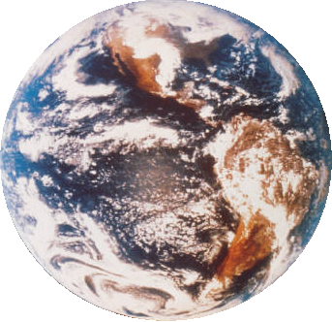
Topic 1: Measurement and uncertainties
1.1 – Measurements in physics
Estimation revisited
•Another form of estimation is to solve complex problems with the simplest math possible and obtain a ballpark figure as an answer.
•If at all possible, only powers of ten are used.
EXAMPLE: NY and LA are separated by about 3000 mi and three time zones. What is the circumference of Earth?
SOLUTION:
•Since 3000 mi = 3 TZ, 1000 mi = 1 TZ.
•There are 24 h in a day.
•Earth rotates once each day. Thus there are 24 TZ in one circumference, or 24×1000 mi = 24000 mi.
Notes:
45
© 2006 By Timothy K. Lund

Slide 46

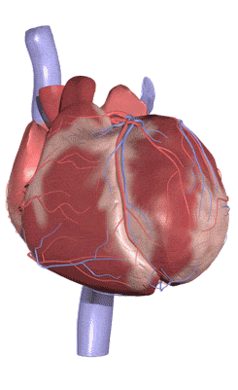
Topic 1: Measurement and uncertainties
1.1 – Measurements in physics
Quoting and comparing ratios, values and approximations to the nearest order of magnitude
PRACTICE:
SOLUTION: The human heart rate is about 75 beats per minute. This is between 10 ¹ (10) and 10 ² (100).
•But 1 hour is 60 min, which is also between 10 ¹ (10) and 10 ² (100).
•Then our answer is between 10 ¹ × 10 ¹ = 10 ² and 10 ² × 10 ² = 10 ⁴.
•The correct answer is (C).
Notes:
46
© 2006 By Timothy K. Lund

