Slide 1
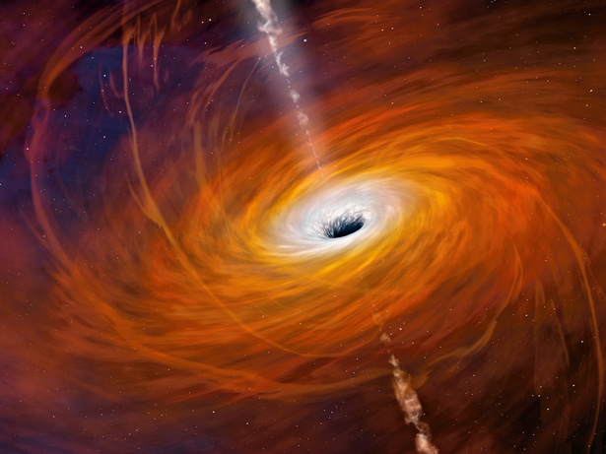
Further Cosmology

Slide 2
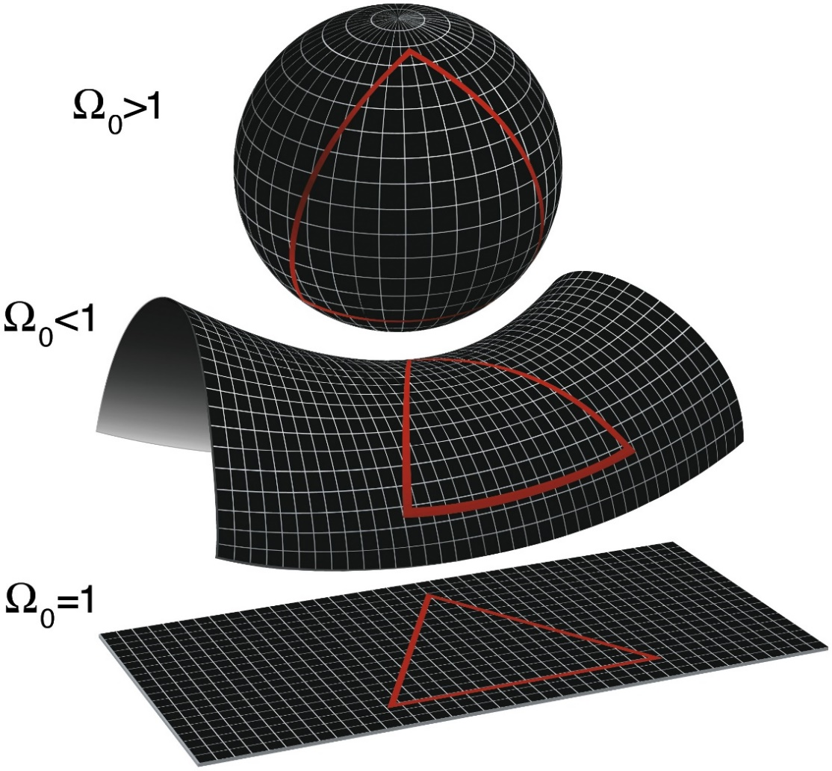
The Cosmological Principle
The fate of the universe is determined by the total mass in the universe
Three possible fates are generally proposed:
  _________________: will eventually __________ in on itself, resulting in a “_______________”
  _________________: _____________________. Gravity may slow the expansion, but does not stop it.
  _________________: Sort of in between – gravity __________________________________ but takes _______________________________.
http://wmap.gsfc.nasa.gov/media/990006/990006_2048.jpg

Slide 3
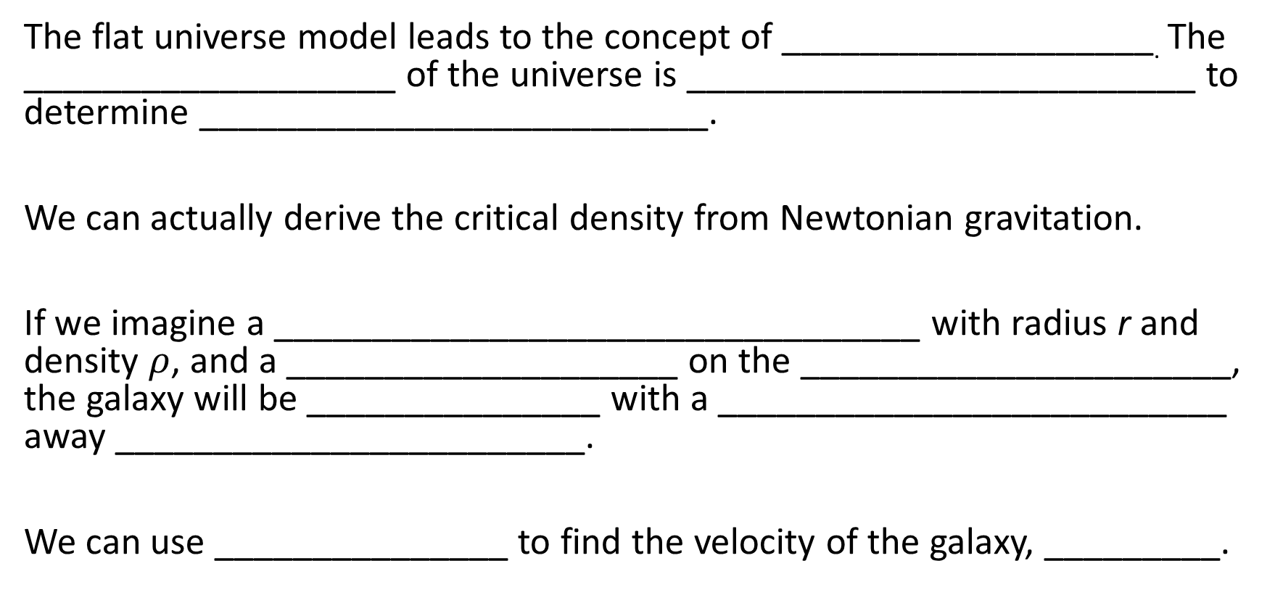
Critical Density
The flat universe model leads to the concept of ___________________. The ___________________ of the universe is __________________________ to determine __________________________.
We can actually derive the critical density from Newtonian gravitation.
If we imagine a _________________________________ with radius r and density $ρ$, and a ____________________ on the ______________________, the galaxy will be _______________ with a __________________________ away ________________________.
We can use _______________ to find the velocity of the galaxy, _________.

Slide 4
Deriving Critical Density
The total energy of the galaxy is:
Note that the ________________________________ for all objects separated by less than infinity.
We can use density and volume to find the mass of the gas sphere:
So,

Slide 5

Deriving Critical Density
The _________ of this equation is when the energy is perfectly balanced, making ______$.$
We can now simplify and solve for $ρ_{c}$:

Slide 6
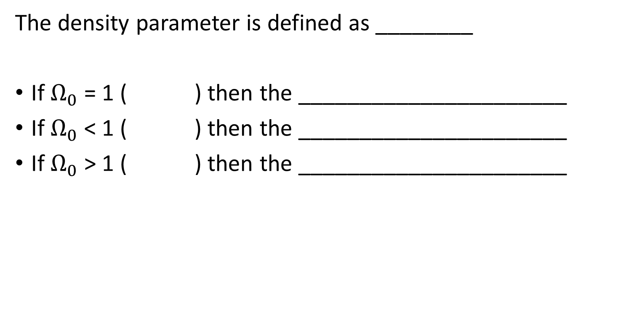
The Density Paramater (and Its Implications)
The density parameter is defined as ________
If $Ω_{0}$ = 1 ( ) then the ______________________
If $Ω_{0}$ < 1 ( ) then the ______________________
If $Ω_{0}$ > 1 ( ) then the ______________________

Slide 7
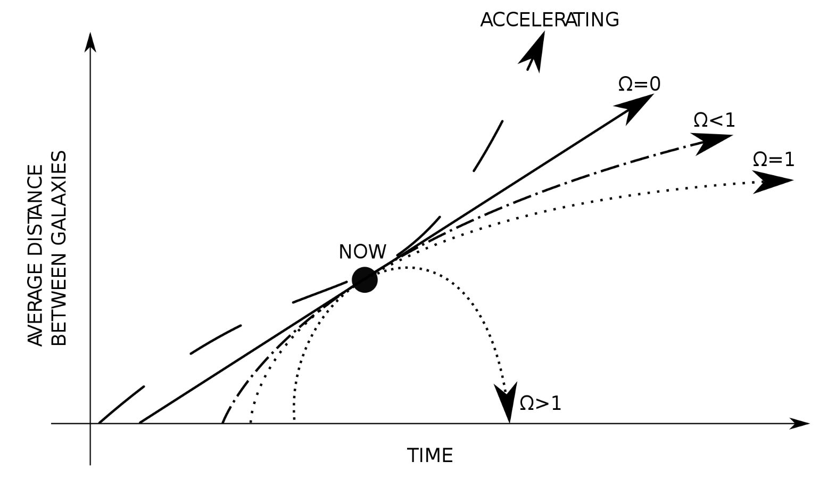
The Density Paramater (and Its Implications)
Since the __________________________that we discussed in D.3 is essentially the _____________________________, each of the ______ ____________ would have ___________________________________ __________________.
Cosmic scale factor (R)
https://upload.wikimedia.org/wikipedia/commons/thumb/4/4d/Universe.svg/2000px-Universe.svg.png

Slide 8
Open Sesame
For the _______________________, as scientists believe it is, there must be ________________________ in the Universe _____ there is ______________________.
Recently, scientists used _________________________ to determine that the _______________________________is in fact ___________!
This data helps to support the open model of the Universe

Slide 9
Shortcomings
Determining the fate of the Universe should be quite simple, assuming we can accurately calculate the mass of the entire Universe (simple!)
Unfortunately, we can _____________________________________________
The rest is comprised of _______________________
  Dark matter is so named because we _____________________________ not because it isn’t luminous!
  Similarly, there is a concept of “dark energy” that is ____________________________ of the energy but rather to its mysterious nature

Slide 10
Dark Matter
There are many ideas about what dark matter may be, including:
  MACHOs: ______________________________________________
  WIMPs: ________________________________________________
  Neutrinos
At this point we aren’t sure what dark matter actually is. But there is evidence of it and some scientists feel that they are making headway in understanding how dark matter and dark energy play a role in the universe.

Slide 11
Dark Matter – The Evidence
If we imagine a star, of mass m near the centre of a spiral galaxy at a radius of r, with total mass M, we can use Newtonian mechanics to _____________________ ________________________________________. We can ___________ the ___________________ with Newton’s ________________________:
Cancelling M and r, we get:

Slide 12
Dark Matter – The Evidence
Since the star is _________________ of the galaxy, we _______________________ but must ___________________________________. We can do this by _________ ___________________________ (assuming it is a sphere):
Rearranging and cancelling r:
So the _____________ is _______________________________________.

Slide 13
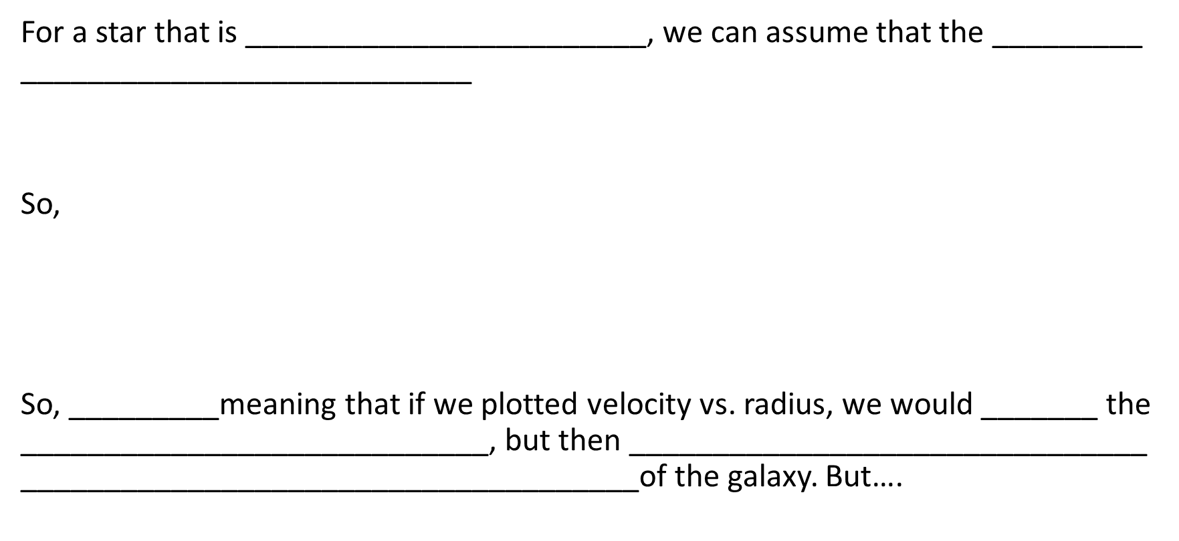
Dark Matter – The Evidence
For a star that is ________________________, we can assume that the _________ ___________________________
So,
So, _________meaning that if we plotted velocity vs. radius, we would _______ the ____________________________, but then _______________________________ _____________________________________of the galaxy. But….

Slide 14
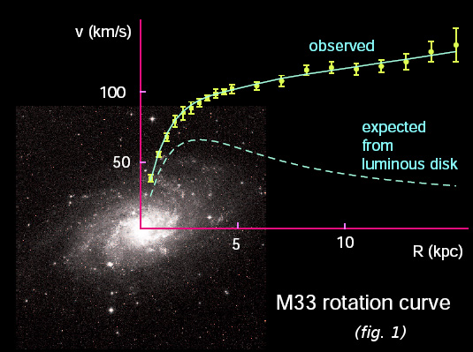
Dark Matter – The Evidence
…that isn’t what happens!
The star near the outer edge of the galaxy travels much faster than expected…But, why?

Slide 15
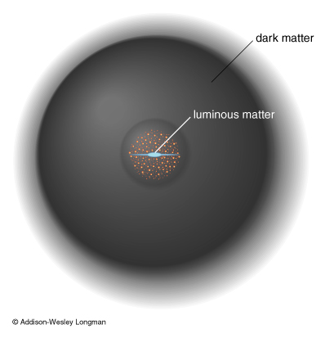
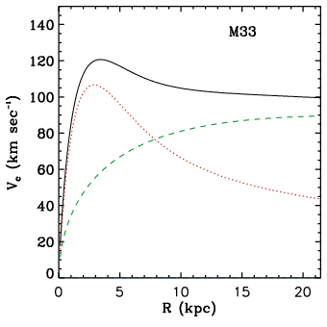
Dark Matter – The Evidence
One explanation is that _____________________ ___________________________. If there were a ________________________ surrounding the outer rim of the galaxy…
http://pandax.physics.sjtu.edu.cn/wp-content/uploads/2012/01/darkmatter.jpeg
This extra matter would _______________ _______________, allowing for ______ ____________________________________________________ of the galaxy.
http://inspirehep.net/record/1116598/files/vandermarel_fig1c.png

Slide 16
Dark Matter – There Has To Be More
There is more support for the idea of dark matter, all of it surrounding the idea that things in space are displaying _______________________ ________________________________________. This includes:
_________________________________________________
_________________________________________________
_____________________________________________________________________________________

Slide 17
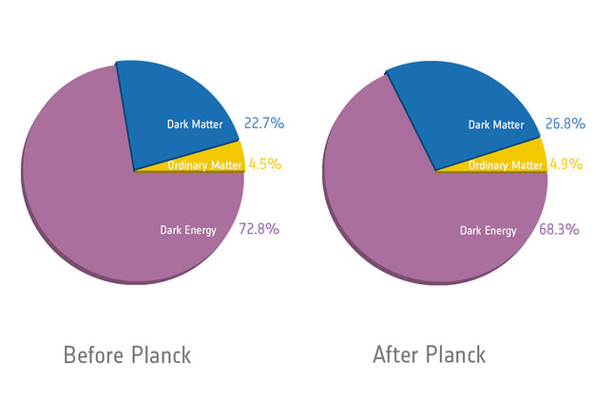
Dark Energy – The Last Frontier
Dark Energy is not a very well understood concept at this point in time. There is a lot of research going on at this time to try to understand how dark energy may play a role in our universe, but it’s currently thought that this dark energy is a major player. The ____ __________________ provided data to ______________________ _______________________________________________________.

Slide 18
Anisotropies in the CMB
In D.3, we made the assumption that the ________________________ (the same everywhere). This is true….mostly.
More recent missions have show __________________ in the universe where there are ___________________________ (also known as ___________________).
  These fluctuations are thought to be due to tiny ________________________ ________________, implanted during ______________________.
So the universe is the same everywhere…for the most part….as far as we currently know!

