Slide 1
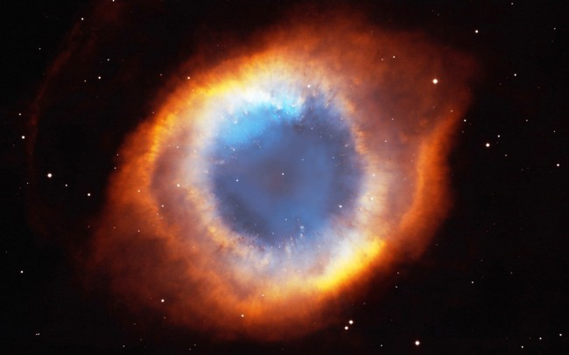
Steller Processes

Slide 2
The Jeans Criterion
Why do some nebulae remain nebulae, but some of them form stars?
It’s all about energy. If a nebula is _____________________, then the _________________ between particles will be ______________. The particles will ______________________and a star is not likely to form. (KE > PE)
If a nebula is ________, then even if it is somewhat dense, the particles will be _____________________________________________ a star is not likely to be formed. (KE > PE)

Slide 3
The Jeans Criterion
The _______________________ simply states that _______________ __________________________, the ___________________________ _________________________________________________________.
So what does this mean?
__________________________________________________________

Slide 4
Nuclear Fusion in Stars (Main Sequence)
Once force of gravity is strong enough, the _______________________ _______________________ forming the _______ of the star. This pressure _________________________________________. When the _________________________, the _______________ process begins.
If the ______ of the star is around the _________________, the fusion process will follow the _______________________________.

Slide 5
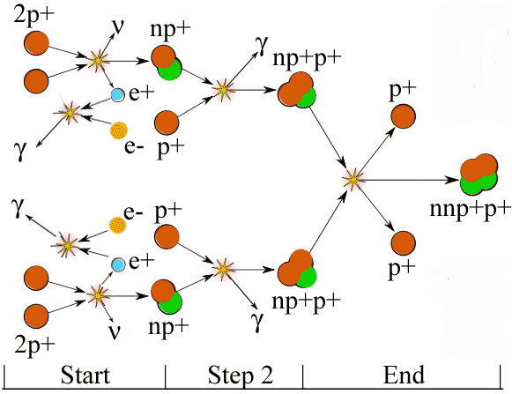
Proton – Proton Chain
http://cseligman.com/text/sun/ppcycle.gif

Slide 6
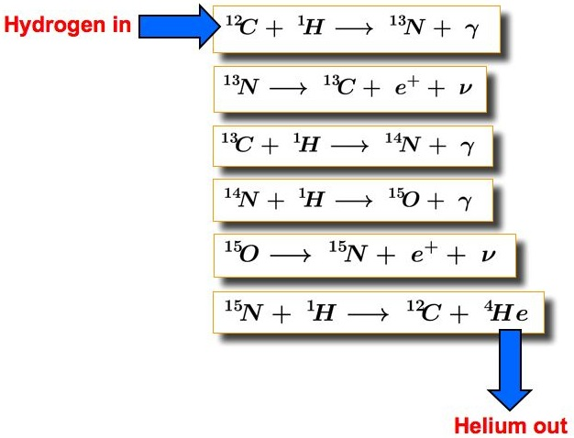
More massive stars and the CNO Cycle
For __________________, the fusion cycle looks different, following the ______________.
This cycle is followed because the ________________ leads to _________________________, facilitating ________________ __________________.
http://astronomy.swin.edu.au/cms/cpg15x/albums/userpics/m01a02-s20i01.jpg

Slide 7
After the Main Sequence
Once all of the _____________ has been ________, the star’s _______ ___________ and get _________. The higher temperature causes ____________________________ of the star as ____________ begins to ________________________. This is the beginning of the ____________ phase.
The ______ temperature gets ______________ to start the ________ _______________atoms to form unstable ___________. The beryllium will fuse with _______________ to form __________ and then with __________________ to form ___________.

Slide 8
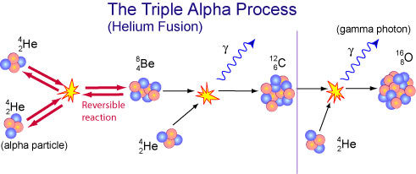
After the Main Sequence
http://www.atnf.csiro.au/outreach//education/senior/astrophysics/images/stellarevolution/triplealphaflash.jpg

Slide 9
When Will It End?
These nucleosynthesis processes will continue with _______________ ___________ undergoing _________ to form ____________________ _________________________. As we discussed before, __________ is very _________ and would need to _____________ for fusion to occur, instead of releasing energy upon fusion.
But there are heavier elements than Iron-56…

Slide 10
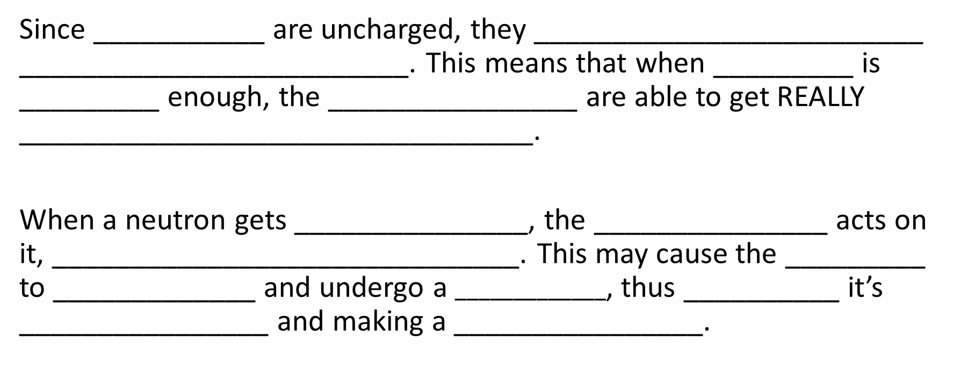
Neutron Capture
Since ___________ are uncharged, they _________________________ _________________________. This means that when _________ is _________ enough, the ________________ are able to get REALLY _________________________________.
When a neutron gets _______________, the _______________ acts on it, ______________________________. This may cause the _________ to _____________ and undergo a $_____________$, thus __________ it’s ________________ and making a ________________.

Slide 11
S-Process and R-Process
In _______________, _______________________can occur in the very aptly named ____________. This is when there is a fairly ___________ _______________ and there is _______________ to occur __________ _________________________________.
During a __________________, there is a ___________________. This bombardment of neutrons causes nuclides to undergo _____________ ____________________. There is ______________________________ ______________ before more neutrons are added, ________________ ____________________________. Nuclides heavier than bismuth-209 can be created within minutes!

Slide 12
Lifetimes of Main Sequence Stars
It would seem to make sense that the larger the star, the longer the star will live (since it has more fuel for fusion). However this is not true. In fact, it is the exact opposite!
The ____________ requires a _______________________ to produce ______________ and __________________ to ___________________ ___________________. This _______________________ results in the star ______________________________________ and ____________ _______________________________.

Slide 13
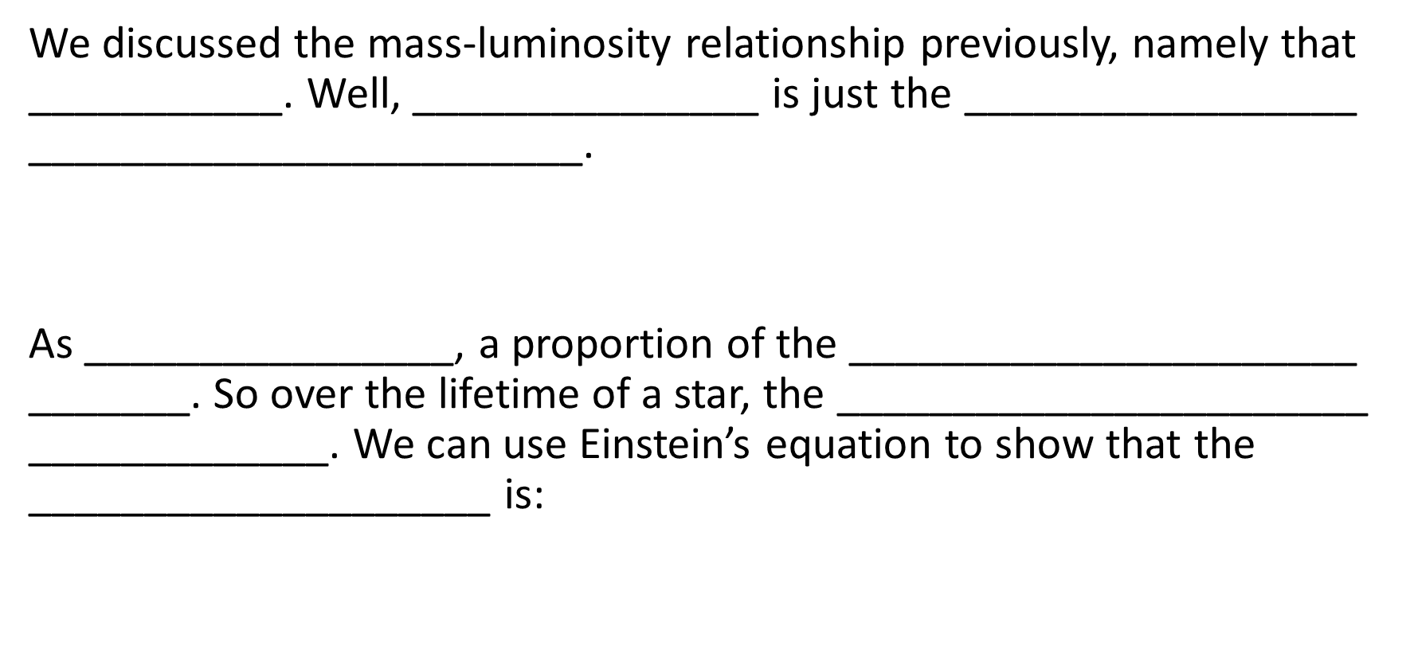
So How Much Time Does She Have?
We discussed the mass-luminosity relationship previously, namely that ___________. Well, _______________ is just the _________________ ________________________.
As ________________, a proportion of the ______________________ _______. So over the lifetime of a star, the _______________________ _____________. We can use Einstein’s equation to show that the ____________________ is:

Slide 14

So How Much Time Does She Have?
If the __________________________is represented by ___ then the ___________________________ is:
So, , and since L $∝$ M^{3.5} , t$hen$or
Often, __________________________________________________, yielding the equation:

Slide 15
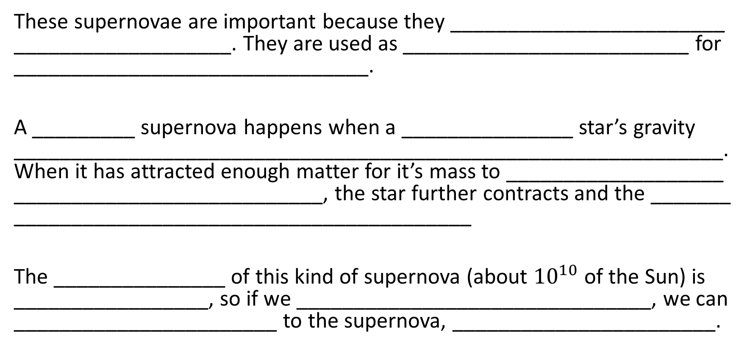
Type Ia Supernovae (A Thieving White Dwarf!)
These supernovae are important because they ________________________ ___________________. They are used as _________________________ for _______________________________.
A _________ supernova happens when a _______________ star’s gravity ______________________________________________________________. When it has attracted enough matter for it’s mass to ___________________ ___________________________, the star further contracts and the _______
________________________________________
The _______________ of this kind of supernova (about ${10}^{10}$ of the Sun) is _________________, so if we _______________________________, we can _______________________ to the supernova, _______________________.

Slide 16
Type II Supernovae (Cores Now Hydrogen Free!)
As discussed before, these supernovae happen when a _____________ _______ have run ____________________________and ____ of the __________ has be _____________________. For stars of _________ _______________ this ________________________________.
The ______ undergoes a _____________, ______________ the ______ ____________ and ___________________________(Helium, Carbon, Beryllium). This ________________________________.
This process ____________ with _______________________________ and taking ______________________, ending with __________ fusing into ___________. This takes only a _____________.

Slide 17
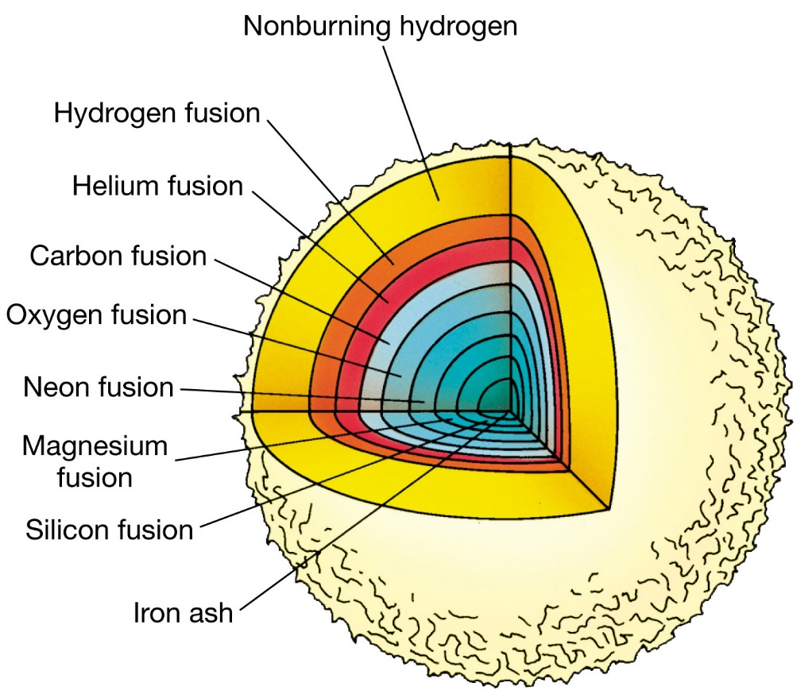
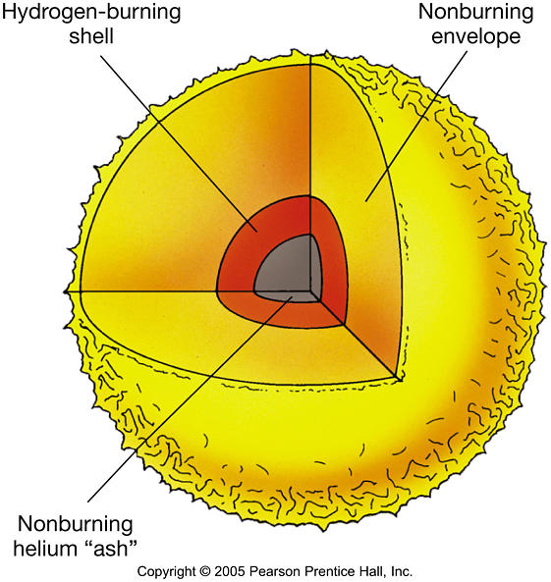
Type II Supernovae continued…
Upon the _______ reaching a ________________________ (the Chandrasekhar limit), the ____________________________________, with the __________________ in and a __________________ going outward, _____________________________.
http://physics.uoregon.edu/~jimbrau/BrauImNew/Chap20/FG20_03.jpg
http://www2.astro.psu.edu/users/cpalma/astro10/Images/FG12_17.JPG

Slide 18
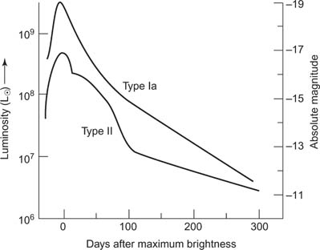
How Can We Tell the Difference?
Type Ia and Type II supernovae can be _______________________ _______________________
http://www.cliffsnotes.com/assets/23429.jpg

