Slide 1
Stellar Characteristics and Stellar Evolution

Slide 2
Atomic Spectra and You!
Passing a sufficiently high potential through a tube of a specific gas will cause it to glow, as we see in the fluorescent lights in the classroom
Different elements produce different discrete spectra, unlike an incandescent light source which produces a continuous range of colors

Slide 3
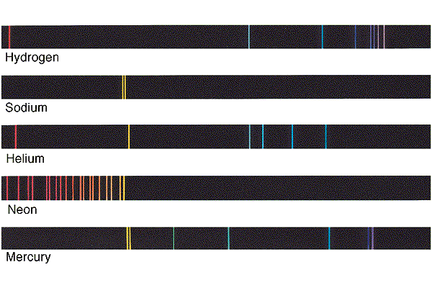
Emission/Absorption
If we shine light from an incandescent source through a tube made of a particular gas, only the wavelengths that would be emitted by that gas are absorbed

Slide 4
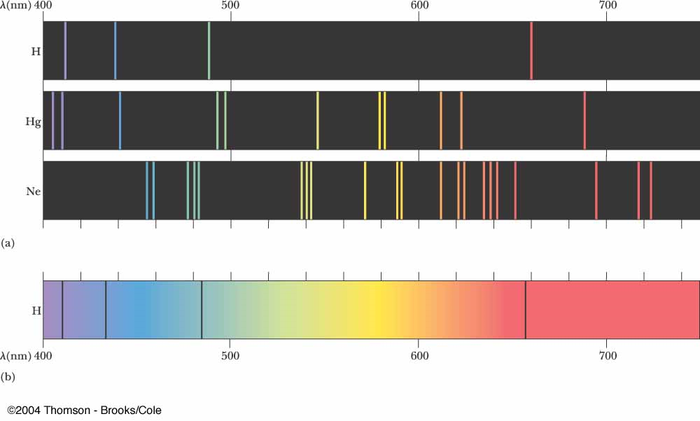
Absorption Spectra
Thus, we can ___________________________of a star based on the ______________________that we see when we look at that star.

Slide 5
Spectral Classification
Stars with similar spectra are grouped together into ___________ ____________, which relates directly to their surface temperatures.
_________________________ a star’s ____________________ or excite the atoms of its surface elements, thus impacting the spectrum we see.
Regardless of class, ________________________________________ __________________________.

Slide 6
OBAFGKM!
Spectral Class | Solar Masses | Solar Diameters | Approx. Temp. Range (K) | Color | Main Absorption Lines | Example
O | 20 - 100 | 12 - 25 | 30000 – 50000 | Bluest | Ionized Helium | Mintaka
B | 4 - 20 | 4 – 12 | 10000 – 30000 | bluish | Neutral Helium | Rigel
A | 2 - 4 | 1.5 – 4 | 7500 – 10000 | Blue-white | Hydrogen | Sirius A
F | 1.05 - 2 | 1.1 – 1.5 | 6000 – 7500 | White | Ionized Metals | Canopus
G | 0.8 – 1.05 | 0.85 – 1.1 | 5000 – 6000 | Yellow-white | Ionized Calcium | Sun
K | 0.5 – 0.8 | 0.6 – 0.85 | 3500 – 5000 | Orange | Neutral metals | Aldebaran
M | 0.08 – 0.5 | 0.1 – 0.6 | 2500 – 3500 | Red | Titanium Oxide | Betelgeuse

Slide 7
Wien’s Displacement Law
Wien discovered an empirical ________________________________ __________________________________________________________________________________ which can be stated as:

Slide 8
Wien’s Law
This law applies to the spectra of stars as well, which means that ____ ________________________________________________________________________________________________________________
Given that we can measure find a star’s luminosity as well, we can actually use the ___________________________________________ ________________________________________________________.

Slide 9
Types of Stars
_____________________– ordinary stars, similar to our sun, make up 90% of all stars
____________________ – very large, cooler temp than our sun
________________– much smaller than the sun (earth size) but much hotter

Slide 10
The Fate of Stars
________________– have undergone __________________ and are now mostly neutrons at their core. These will generally _____________________ after a supernova when the _____ of the collapsed star is between ____________________.
______________ – when a neutron star’s core cannot collapse further, the _________________________________ causing a huge _____________, ______________________________ ______________________________
FYI: In a supernova, the star will tear apart (mostly) and send out a shock wave. This can cause a flash of brightness over 100x greater than the whole universe!

Slide 11
The Fate of Stars
______________– the mass of the core of the dying star is so great that the _________________________________ to __________________________________, causing it to ________________. Their _________________ ______________ to _________________________ ____________ the surface

Slide 12
Types of Stars
Binary Stars – almost half of the stars we can see are in fact ________ ________________________________. These stars can be of different types.
Cepheid Variable – stars that have a ___________________________ over time, usually within a ________________________.
    The internal structure of the star actually causes it to vary in size and thus in L

Slide 13
The Cepheid Variable
As we have previously discussed, the Cepheid Variable is a type of star that has a luminosity that varies over time
Recall that this is due to the outer layers of the star undergoing a periodic expansion and contraction, causing a ___________________ ________________________________________________________.
The S-B law states:

Slide 14
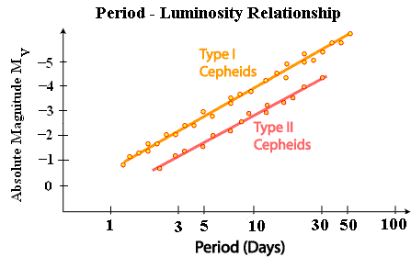
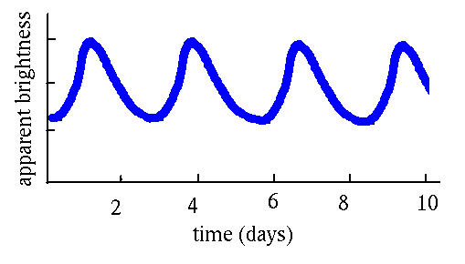
Period and Absolute Magnitude
We have discovered that a _________ exists between the _______ of a Cepheid Variable’s brightness __________________________ of the star
Cepheid Variables are quite bright (about 10000x the luminosity of the sun) and so are easy to locate

Slide 15
The Standard Candle
The ability to __________________ of the star __________________ means we ____________________________________ even if it is beyond the 10Mpc limits we usually encounter
It also means that we can _______________________ or __________ ____________ to compare the other stars in, say, another galaxy or to determine the distance to that galaxy
This method is ______________________.

Slide 16
A Cepheid Variable Distance Example
A Cepheid δ is known to be 300pc from Earth. Another Cepheid variable, Z, is seen in a different galaxy with the same period but with an apparent brightness of 10⁻⁹ of δ. How far is the other galaxy from Earth?

Slide 17
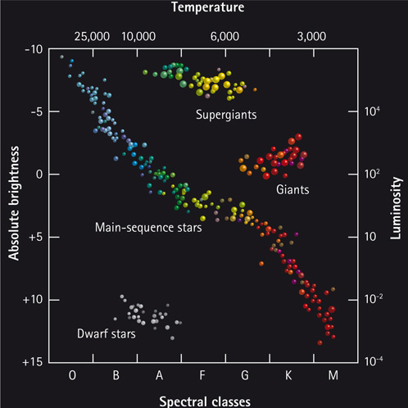
The Hertzsprung-Russell (HR) Diagram
A plot dealing with Spectral Class, Luminosity, Temperature, and Absolute Magnitude, and star type…or at least a few of these at a time

Slide 18
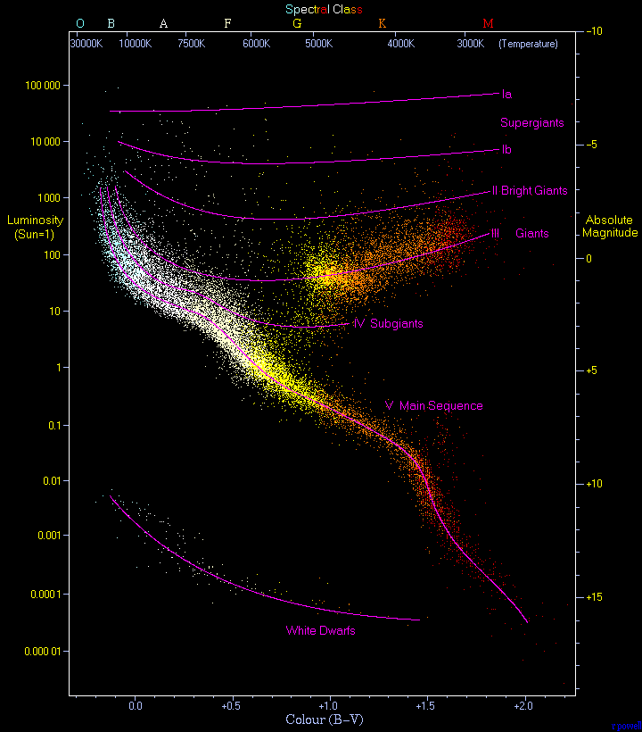
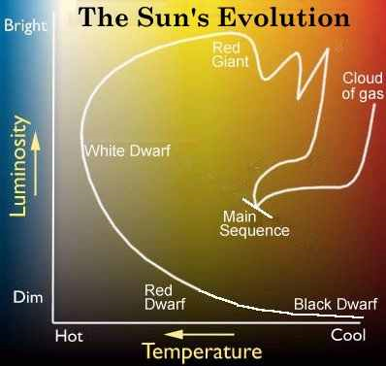
Notice that the Scales on the axes are non-linear and that temperature is plotted from high to low

Slide 19
Estimating Luminosity
For the stars beyond the distance at which parallax is useful,

Slide 20
The Mass-Luminosity Relation
There exists a mathematical relationship between the Mass of a main sequence star and the luminosity of it.
The _____________ in this relationship _______________________ and so values are often greater than 4 or less than 3.
The relationship, stated in terms of Solar Units (based on our Sun) is:

Slide 21
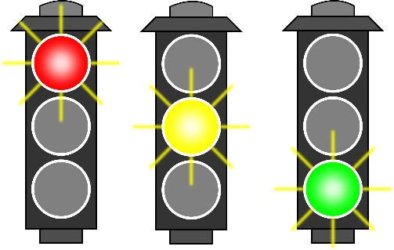
Start Me Up
A nebula is made of ____________ (74%), ____________ (24%), and ___________ (1%) which is made of many different elements.
These nebulae are _____________ and also ____________________ which __________________________________. If a nebula is very ____ and/or not ________, it is ___________________ because the ______________________________________________________________________________________________.

Slide 22
Start Me Up
The process of moving together causes these particles to lose ________________________and instead _____________________... thus we see the temperature ______________.
This yields an _____________________ amongst the particles and as they ionize the nebula gains its own ______________. This is called a _________________.
Protostars are considerably larger than stars. To have one with the same mass as our Sun would yield a protostar with 5000x the surface area and 100x the luminosity.

Slide 23
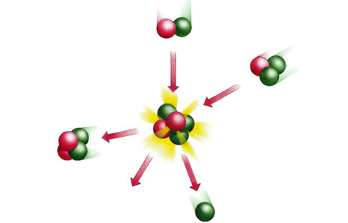
Fusion
As gravitational contraction continues the temperature at the core of the protostar rises until such a point that _______________________ ___________________________________________________.
Now that the core is a _________, ______________________ begins.
This officially makes a __________ which will be placed in the main sequence of the _________________________________________.
________________ yields ___________________________and thus _____________________.

Slide 24

Gestation Period
A protostar of ________________will become a star much ____________ than those of lower mass.
This will also have an ______________________ and _____________ as the star contracts.
Recall that there are lower and upper _______________________ ____________ that will result in a star forming (_________________)

Slide 25

It’s Better to Burn Out than to Fade Away
The ___________________ also has a _________________________ ________________________________________________________.
Our Sun has been burning for roughly __________________ and will continue to burn for another ___________________.
A star of ___________ would _________________________ in just about ________________. This is because the higher mass results in the ____________________________and so ___________ can occur.

Slide 26

Our Sun Can’t Live Forever
Our Sun represents a typical main sequence star that is destined to become a _________________.
This is a _________________ process that occurs at different layers within the star.
Our Sun will one day _______________________________________. However, throughout its life it _______________________________.
As such, _________________________________________________ ________________________________________________.

Slide 27

Core Values
Without fusion in the core, ______________________________________ and so the ________________________.
This will _________________________________ and in turn __________ _________________________________________.
This will mean that the __________________________________________ _______________________.
At this point, the ______________________ and the __________________ (2000x its present value).
The Sun’s ____________________________________________________.

Slide 28
It’s Not Over Yet
_________________________________________________ which in turn ___________________________, causing _________________.
This will ________________________________________ and _____ ___________________________________________, which is where most living tissue on Earth gets its Carbon from.
___________________________________________ and the ______ ______________________________________________________________________________________________________________.

Slide 29

Just Die Already...
This __________________________________________and produce a luminosty 10000x greater than the Sun had presently.
This phase is also associated with __________________________ in which the _________________________________________leaving an ________________________________________________.

Slide 30
Just Die Already...
The exposed core, which is now the ___________________, will have _______________________ and thus will simply _____________. It will _____________________________________________________ _________________________________________________ (electron repulsion because they can’t be in the same quantum state)
This __________________________________________________.

Slide 31

Limits
A star like our Sun will not have a core that contracts forever. At some point, ___________________________________________________.
A __________________________________________ at which point ________________________________________________________ _____________________________________________________________________________.
This __________, which is ________ is known as the _____________ _____________.

Slide 32

Other Limits
Generally speaking, stars of mass _____________________________ ______________________.
Stars with mass ___________________________________________ and thus ________________________________________________ _________________________________________________.
______________ have a special _______________________, just as White Dwarves do. This is known as the _______________________. We will come to this soon.

Slide 33

Giant vs. Supergiant
Stars of _____________________________________________ elements and thus yield _______________________________.
This ___________________________________ just as we saw in our own Sun with ___________________________________________.
_________________________ because _______________________ ________________________________ due to the massive coulomb forces that must be overcome.

Slide 34
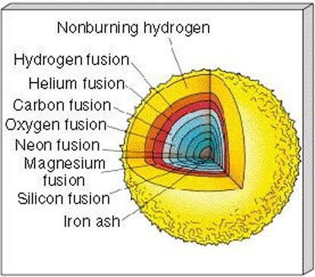
Like an Ogre, It has Layers

Slide 35
What’s Next For Our Giant Stars?
When the _______________________________________________ _______________. This ____________________________________ ________________________________________________________.
Almost instantly, there is ____________________________________ ______________________________________________________________________________________________________________.
This results in _____________________________________________ ________________________________________.

Slide 36

Regular Novas are Lame by Comparison
Here we see a ____________________________________________ ______________________________________________________. The ____________________ and accelerates outward ripping the star to pieces, resulting in a ____________________!
The _____________________________________________________ _________________________ and thus we see that _____________ _______________________________________________________.

Slide 37
What’s Left Over?
The _________________________________________ and is packed together as tightly as in a nucleus. (a cubic cm of a neutron star would have a mass of roughly 300 - 400 billion kilograms!)
The _______________________________________________ is the _____________________. If the _____ of the neutron star is _______ __________________(currently estimated to be 1.5 – 3 solar masses) then it will _______________________.
If the ____________________________________, the ___________ ___________________________________________________________________________________________________________.

Slide 38
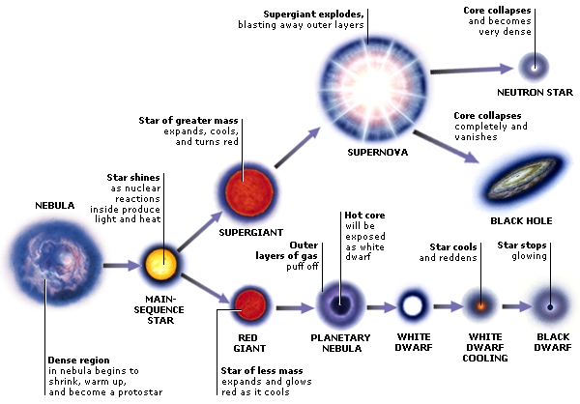
The Evolution of a Star

