Slide 1
Option B :Engineering physics b.2 – Thermodynamics
Option B.2 is an extension of Topic 3.
Essential idea: The first law of thermodynamics relates the change in internal energy of a system to the energy transferred and the work done. The entropy of the universe tends to a maximum.
Nature of science: Variety of perspectives : with three alternative and equivalent statements of the second law of thermodynamics, this area of physics demonstrates the collaboration and testing involved in confirming abstract notions such as this.
Notes:
© 2015 by Timothy K. Lund

Slide 2
Option B :Engineering physics
B.2 – Thermodynamics
Understandings:
The first law of thermodynamics
The second law of thermodynamics
Entropy
Cyclic processes and pV-diagrams
Isovolumetric, isobaric, isothermal and adiabatic processes
Thermal efficiency
Notes:
2
© 2015 by Timothy K. Lund

Slide 3
Option B :Engineering physics
B.2 – Thermodynamics
Applications and skills:
Describing the first law of thermodynamics as a statement of conservation of energy
Explaining sign convention used when stating the first law of conservation of energy as Q=ΔU + W
Solving problems involving the first law of thermodynamics
Describing the nature of the exponential discharge of a capacitor second law of thermodynamics in Clausius form, Kelvin form and as a consequence of entropy
Describing examples of processes in terms of entropy change
Notes:
3
© 2015 by Timothy K. Lund

Slide 4
Option B :Engineering physics
B.2 – Thermodynamics
Applications and skills:
Solving problems involving entropy changes
Sketching and interpreting cyclic processes
Solving problems for adiabatic processes for monoatomic gases using pV^{5/3} = constant
Solving problems involving thermal efficiency
Notes:
4
© 2015 by Timothy K. Lund

Slide 5
Option B :Engineering physics
B.2 – Thermodynamics
Guidance:
If cycles other than the Carnot cycle are used quantitatively, full details will be provided
Only graphical analysis will be required for determination of work done on a pV diagram when pressure is not constant
Notes:
5
© 2015 by Timothy K. Lund

Slide 6
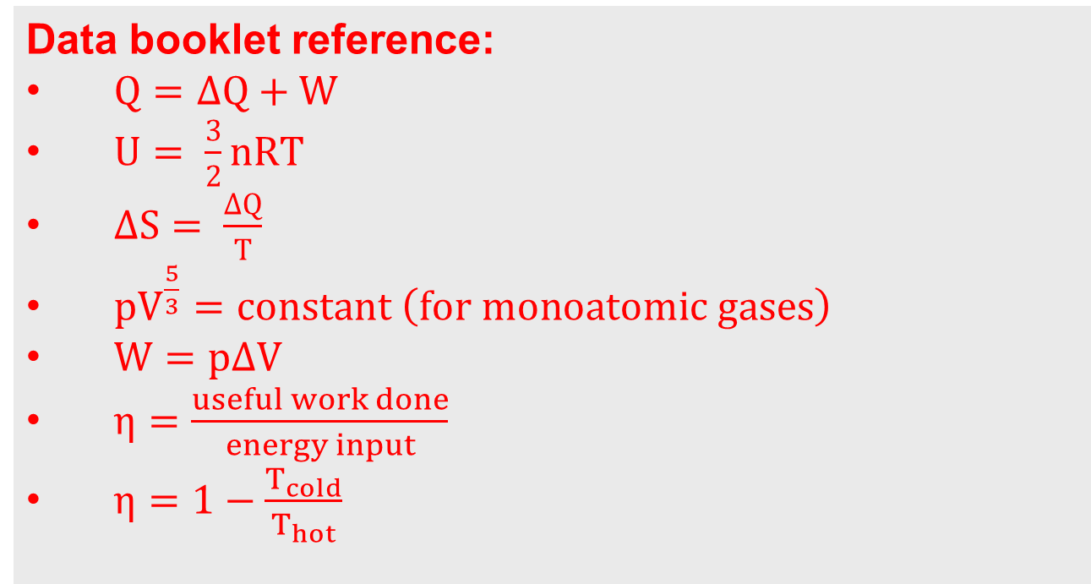
Option B :Engineering physics
B.2 – Thermodynamics
Data booklet reference:
$Q=∆Q+W$
$U= \frac{3}{2}nRT$
$∆S= \frac{∆Q}{T}$
$pV^{\frac{5}{3}}=constant \left(for monoatomic gases\right)$
$W=p∆V$
$η=\frac{useful work done}{energy input}$
$η=1−\frac{T_{cold}}{T_{hot}}$
Notes:
6
© 2015 by Timothy K. Lund

Slide 7
Option B :Engineering physics
B.2 – Thermodynamics
International-mindedness:
The development of this topic was the subject of intense debate between scientists of many countris in the 19th century.
Notes:
7
© 2015 by Timothy K. Lund

Slide 8
Option B :Engineering physics
B.2 – Thermodynamics
Utilization:
This work leads directly to the concept of the heat engines that played such a large role in modern society
The possibility of the heat death of the universe is based on ever-increasing entropy
Chemistry of entropy (see Chemistry sub-topic 15.2)
Notes:
8
© 2015 by Timothy K. Lund

Slide 9
Option B :Engineering physics
B.2 – Thermodynamics
Aims:
• Aim 5: Development of the second law demonstrates the collaboration involved in scientific pursuits
• Aim 10: The relationships and similarities between scientific disciplines are particularly apparent here
Notes:
9
© 2015 by Timothy K. Lund

Slide 10
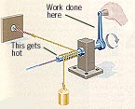
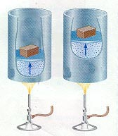
Option B :Engineering physics
B.2 – Thermodynamics
Thermodynamics =
The study on how energy can do work
Thermal energy …
can produce useful work
work can produce …
Thermal energy
Notes:
10
© 2015 by Timothy K. Lund

Slide 11
Option B :Engineering physics
B.2 – Thermodynamics
Thermodynamics =
The study on how energy can do work
Thermal energy …
can produce useful work
work can produce …
Thermal energy
Notes:
11
© 2015 by Timothy K. Lund

Slide 12
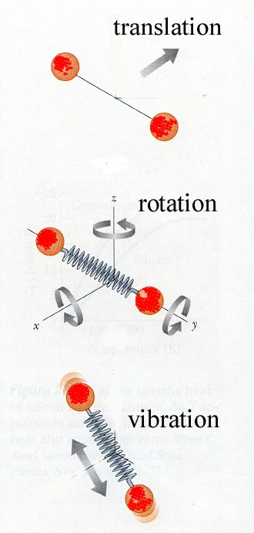
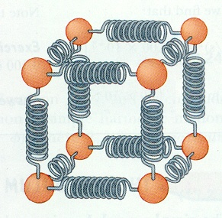
Option B :Engineering physics
B.2 – Thermodynamics
Materials have internal energy U =
This is the KE of random motions of atoms + PE due to forces between atoms
Can be modeled as vibrating springs joining atoms to each other in solids or within molecules
Energy is also stored as vibrational, rotational and translational motions

Slide 13
Internal energy
Option B :Engineering physics
B.2 – Thermodynamics
Materials have internal energy U,
(thermal energy + potential energy in bonds)
U is the sum of all KE and PE of atoms/molecules in the material
ΔU is the change of internal energy
If ΔU > 0 then internal energy has increased
If ΔU < 0 then internal energy has decreased

Slide 14

Internal Energy of Ideal gases
Option B :Engineering physics
B.2 – Thermodynamics
For each “degree of freedom” (different direction in 3D space) an atom (or molecule) can store energy:  kT
k is Boltzmann’s constant, 1.38 (10⁻²³) J/K, T is absolute temperature
→ U =  NkT for a monatomic gas with N molecules, since there are 3 dimensions (directions)
In an Ideal Gas U α T (in K)
In polyatomic gases the molecules can store energy in rotations, and vibrations, as well as translations and this adds more degrees of freedom increasing the internal energy at a given temperature so that complex gases are slower to warm up

Slide 15
Heat and Internal Energy
Option B :Engineering physics
B.2 – Thermodynamics
Heat is not Internal Energy
Heat is the flow of Thermal Energy from one object to another and will increase the Internal Energy of the receiver and decrease the Internal Energy of the donor
HEAT→ more random motion (<KE>)→ higher temperature
HEAT→ stretched bonds → higher PE, without changing T
(Like Work is not Mechanical Energy,
Work is the transfer of Mechanical Energy from one object to another)

Slide 16
Heat Engines and Refrigerators
Option B :Engineering physics
B.2 – Thermodynamics
The reasons for studying thermodynamics were mainly practical – engines and the Industrial Revolution
Efficient engines were needed which meant analyzing how fuel (thermal energy) may be harnessed to do useful work.
The earliest known engine is Hero’s – a Greek from Alexandria 2000 years ago.
Engines use a working fluid, often a gas, to create motion and drive equipment
Engines (and refrigerators) must repeat their cycles over and over to continue to do work

Slide 17
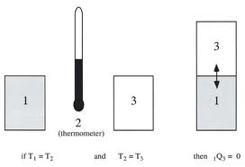
0th Law of Thermodynamics
(this is the 0th law because it was added after 1,2, and 3)
Temperature exists and can be measured
When 2 objects are in thermal equilibrium separately with a 3rd object then they are in thermal equilibrium with each other
T₁ = T₂ and T₂ = T₃ → T₁ = T₃
Thermal equilibrium means there is no net thermal energy flow between the objects

Slide 18
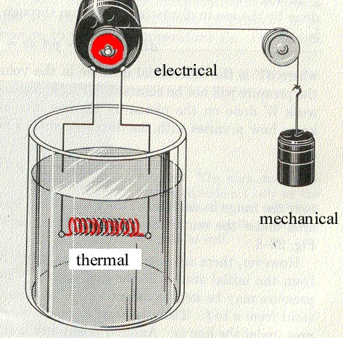
1st Law of Thermodynamics
Energy is conserved – it is neither created not destroyed
Internal energy of a system may change as any combination of
Doing work on the system
Transferring energy to or from the system as a result of a difference in temperature
Q = ΔU + W
When Q > 0 : energy transferred from surroundings to the system because T_{surroundings} > T_{system}
ΔU >0 : increase in internal energy
W>0 : work done by system as is expands
When Q < 0 …?

Slide 19
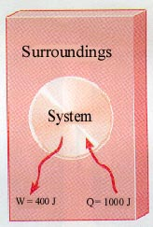
EXAMPLE
1000 J of thermal energy flows into a system (Q = 1000 J). At the same time, 400 J of work is done by the system (W = 400 J).What is the change in the system's internal energy U?
ΔU = Q –W
= 1000 - 400
= 600 J
Notes:
19

Slide 20
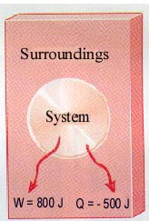
EXAMPLE
800 J of work is done by a system (W = 800 J) as 500 J of thermal energy is
removed from the system (Q = -500 J).What is the change in the system's internal energy U?
ΔU = Q –W
= -500 – 800
= -1300 J
NB: work done on the system is +, work done by the system is -
& heat into the system is +, heat out of the system is -
Notes:
20

Slide 21
Option B :Engineering physics
B.2 – Thermodynamics
Using the first law for ideal gases
A system can change its state
Considering an ideal gas enclosed in a cylinder by a moveable piston (gas = system, cylinder + piston = boundaries and walls)
A state is a unique set of values for P, V, n, & T
(so PV = nRT is also called a “State Equation”)
There are 4 basic processes with n constant
Isobaric, a change at constant pressure
Isochoric or isovolumetric, a change at constant volume, W = 0
Isothermal, a change at constant temperature (ΔU = 0, Q = W)
Adiabatic, a change at no heat (Q = 0)
“iso” means “same”

Slide 22
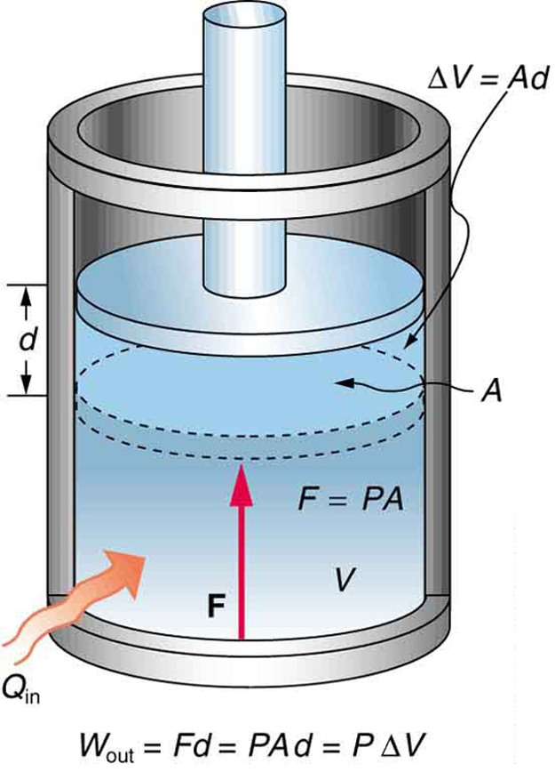
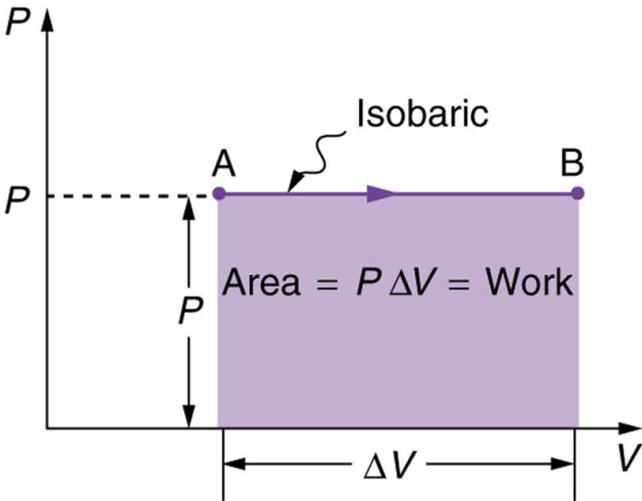
Option B :Engineering physics
B.2 – Thermodynamics
Work done in an isobaric change
Isobaric = constant p
Gas expands :
piston moves up a distance d
Volume increases ΔV = Ad
Force of the gas on piston
F=pA
Work done by the gas on
the surroundings :
W = Fd = pAd = pΔV

Slide 23
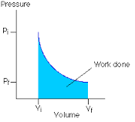
Option B :Engineering physics
B.2 – Thermodynamics
Work done in a non-isobaric change
W = area under graph
in pV-graph

Slide 24
Option B :Engineering physics
B.2 – Thermodynamics
Work done in an isothermal change
Isothermal = constant T
Internal energy = sum of mean KE of particles of gas = proportional to the temperature of the gas
IF T = constant :
Internal energy of the system = constant
For Q = ΔU + W with ΔU =0 → Q = W
If Q > 0 : work done by system on surroundings
→ expansion of gas
If Q < 0 : work done by surroundings on system
→ compression of gas

Slide 25
Option B :Engineering physics
B.2 – Thermodynamics
Work done in an isovolumetric change
Isovolumetric = constant V
When V = constant then NO work can be done
For Q = ΔU + W with W =0 → Q = ΔU
If Q > 0 : increase of internal energy of system
If Q < 0 : decrease of thermal energy of system
Equation of state : p/T = constant

Slide 26
Option B :Engineering physics
B.2 – Thermodynamics
Adiabatic change
Adiabatic = no energy is transferred
When V = constant then NO work can be done
For Q = ΔU + W with W =0 → Q = ΔU
If Q > 0 : increase of internal energy of system
If Q < 0 : decrease of thermal energy of system
Equation of state : p/T = constant

Slide 27
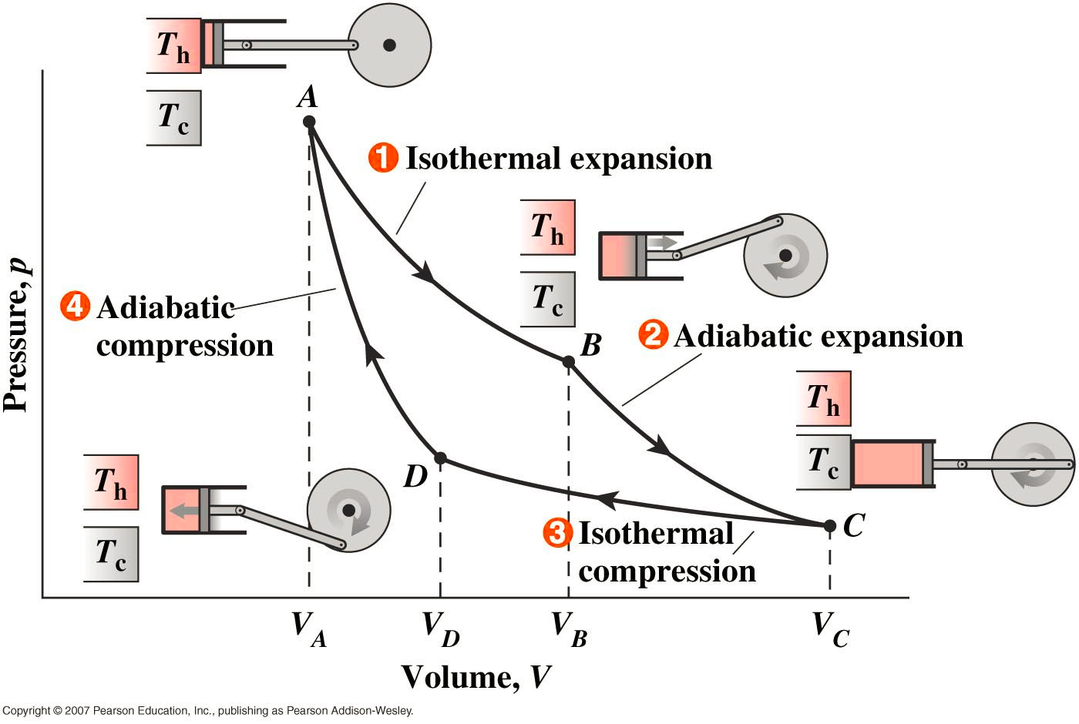
Option B :Engineering physics
B.2 – Thermodynamics

Slide 28
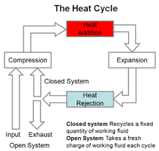
Option B :Engineering physics
B.2 – Thermodynamics

Slide 29
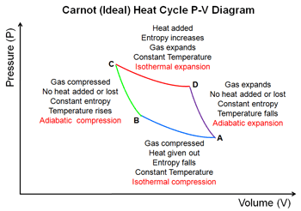
Option B :Engineering physics
B.2 – Thermodynamics

Slide 30
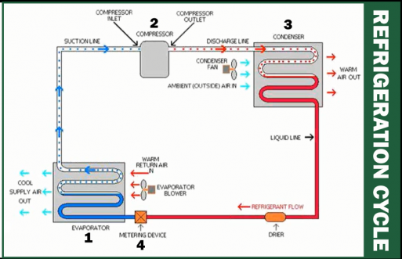
Option B :Engineering physics
B.2 – Thermodynamics

Slide 31
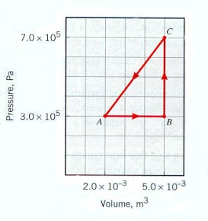
EXAMPLE
How much work is done by the system when the system is taken from:
(a) A to B (900 J)
(b) B to C (0 J)
(c) C to A (-1500 J)
Each rectangle on the graph represents 100 Pa-m³ = 100 J
(a) From A→ B the area is 900 J, isobaric expansion
(b) From B → C, 0, isovolumetric change of pressure
(c) From C→ A the area is -1500 J
Notes:
31

Slide 32
EXAMPLE
10 grams of steam at 100 C at constant pressure rises to 110 C:
P = 4 x 10⁵ Pa ΔT = 10 C
ΔV = 30.0 x 10⁻⁶ m³ c = 2.01 J/g
What is the change in internal energy?
ΔU = Q – W
ΔU = mcΔT – PΔV
ΔU = 189 J
So heating the steam produces a higher internal energy and expansion
Notes:
32

Slide 33
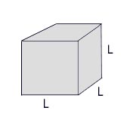
EXAMPLE
Aluminum cube of side L is heated in a chamber at atmospheric pressure. What is the change in the cube's internal energy if L = 10 cm and ΔT = 5 °C?
Q = mcΔT
m = ρV₀
V₀ = L³
W = PΔV
ΔV = βV₀ΔT
ΔU = Q – W
ΔU = mcΔT – PΔV
c_{Al} = 0.90 J/g°C
ΔU = ρV₀cΔT – PβV₀ΔT
β_{Al} = 72(10⁻⁶) °C⁻¹
ΔU = V₀ΔT (ρc – Pβ)
P_{atm} = 101.5 kPa
ρ_{Al} = 2.7 g/cm³
ΔU = L³ΔT (ρc – Pβ)
ΔU = 0.10³(5)((2700)(900) – 101.5(10³)(72(10⁻⁶))
ΔU = 12,150 J
NB: Pβ is neglible
Notes:
33

Slide 34
EXAMPLE
Find the work done for a cycle if P₁ = 1000 kPa, V₁ = 0.01 m³,
V₂ = 0.025 m³, V₃ = V₄ = 0.04 m³, T₁ = 400 K, T₂ = 600K, n = 2 mol
W = Area enclosed
= P₁ΔV₁₂
+  (P₂+P₃)ΔV₂₃
–  (P₁+P₄)ΔV₄₁
P
1, (P₁,V₁) T₁
2, (P₂,V₂) T₂
Isobar
Isotherm
Isotherm
3, (P₃,V₃) T₃
Isochore
4, (P₄,V₄) T₄
V
1. P₂ = P₁ = 1000 kPa
2. T₄ = T₁ = 400 K
W = Area enclosed
= P₁ΔV₁₂ +  (P₂+P₃)ΔV₂₃ +  (P₁+P₄)ΔV₄₁
= (15 + 12.188 – 18.75)(10³) = 8.44 kJ
3. T₃ = T₂ = 600 K
4. P₃ = P₂V₂/V₃ = 625 kPa
5. P₄ = P₁V₁/V₄ = 250 kPa

Slide 35
EXAMPLE
Find the internal energy for each state if P₁ = 1000 kPa, V₁ = 0.01 m³,
V₂ = 0.025 m³, V₃ = V₄ = 0.04 m³, T₁ = 400 K, T₂ = 600K, n = 2 mol
1. P₂ = P₁ = 1000 kPa
2. T₄ = T₁ = 400 K
P
3. T₃ = T₂ = 600 K
1, (P₁,V₁) T₁
2, (P₂,V₂) T₂
Isobar
4. P₃ = P₂V₂/V₃ = 625 kPa
5. P₄ = P₁V₁/V₄ = 250 kPa
Isotherm
Isotherm
3, (P₃,V₃) T₃
Isochore
4, (P₄,V₄) T₄
V
6. U₁ =  nRT₁ = 9972 J
7. U₄ = U₁ = 9972 J
8. U₂ =  nRT₂ = 14958 J
9. U₃ = U₂ = 14958 J

Slide 36
EXAMPLE
Find the thermal energy change Q for each state if P₁ = 1000 kPa,
V₁ = 0.01 m³, V₂ = 0.025 m³, V₃ = V₄ = 0.04 m³, T₁ = 400 K, T₂ = 600K, n = 2 mol
1. P₂ = P₁ = 1000 kPa
Q₁₂
2. T₄ = T₁ = 400 K
P
3. T₃ = T₂ = 600 K
1, (P₁,V₁) T₁
2, (P₂,V₂) T₂
Isobar
4. P₃ = P₂V₂/V₃ = 625 kPa
5. P₄ = P₁V₁/V₄ = 250 kPa
Q₄₁
Q₃₄
Isotherm
Isotherm
Q₃₄
3, (P₃,V₃) T₃
Isochore
4, (P₄,V₄) T₄
V
10. Q₁₂ = ΔU₁₂ + W₁₂ = 34986 J
6. U₁ =  nRT₁ = 9972 J
11. Q₂₃ = W₂₃ (ΔU₂₃ = 0) W₂₃ =  (P₂+P₃)ΔV₂₃ = 12.188 kJ
7. U₄ = U₁ = 9972 J
12. Q₃₄ = ΔU₃₄ = -4986 J
8. U₂ =  nRT₂ = 14958 J
13. Q₄₁ = W₄₁ (U₄₁ = 0) W41 =  (P₄+P₁)ΔV₄₁ = - 18.75 kJ
9. U₃ = U₂ = 14958 J

Slide 37
2nd Law of Thermodynamics
Clausius version :
It is impossible to transfer energy from a body at a lower temperature to one at higher temperature without doing work on the system.
Kelvin version :
It is impossible to extract energy from a hot reservoir and transfer this entirely into work
Explanation :
A hot cup of coffee gets colder after some time. We can heat it up again by transferring energy using a heating coil or by doing work on it (stirring very fast)

Slide 38
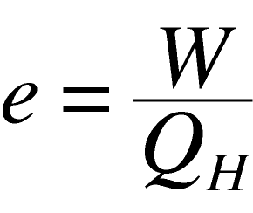
2nd Law of Thermodynamics
Explanation :
Internal energy of object is related with random motion of the molecules.
When we want to convert the internal energy into work we are trying to convert random motion into something more ordered : this is impossible !!!!
Explanation :
Efficiency can not =1 therefore some of the energy will always be degraded, not all the supplied energy can be converted into work.

Slide 39
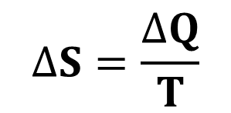
Entropy
Is a thermodynamic function of the state of the system
Can be interpreted as the amount of order or disorder of a system
As with internal energy, it is the change in entropy is important and not its absolute value.
The change in entropy ΔS of a system = an the amount of thermal energy Q absorbed by a system divided by the (constant) absolute temperature T at which this occurs
The units of the change in entropy are JK⁻¹
$$∆S=\frac{∆Q}{T}$$

Slide 40
2nd Law of Thermodynamics
Consequence of entropy:
In closed systems, ΔS > 0 for all real processes
The entropy, disorder, always increases in closed systems
Only in the ideal case of maximum efficiency would ΔS = 0
ΔSuniv = ΔSsys + ΔSsurr > 0
The total entropy of the universe increases !!!

Slide 41
Heat death
A final consequence of the second Law is the heat degradation of the Universe.
It can be reasoned that in any natural process, some energy becomes unavailable to do useful work.
An outcome of this suggests that the Universe will eventually reach a state of maximum disorder.
An equilibrium temperature will be reached and no work will be able to be done.
All change of state will cease as all the energy in the Universe becomes degraded to thermal energy.
This point in time is often referred to the heat death of the Universe.

Slide 42
EXAMPLE
Consider a hypothetical device that takes 1000 J of heat from a hot reservoir at 300K, ejects 200 J of heat to a cold reservoir at 100K, and produces 800 J of work. Is this possible?
The maximum efficiency is e_{max} = 1 – T_{L}/T_{H} = 67%,
but the proposed efficiency is e_{prop} = W/Q_{H} = 80%.
This violates the 2nd law – do not buy shares in the company designing this engine!

Slide 43
EXAMPLE
Consider a hypothetical refrigerator that takes 1000 J of heat from a cold reservoir at 100K and ejects 1200 J of heat to a hot reservoir at 300K. Is this possible?
The entropy of the cold reservoir decreases by ΔS_{C} = 1000 J / 100 K = 10 J/K
The entropy of the heat reservoir increases by ΔS_{H} = 1200 J / 300 K = 4 J/K
There would be a net decrease in entropy which would violate the 2nd Law, so this refrigerator is not possible
What is the minimum work needed?
≥ 2000 J, so that ΔS_{H} becomes at least 10 J/K

Slide 44
https://www.youtube.com/watch?v=870y6GUKbwc
https://www.youtube.com/watch?v=GOrWy_yNBvY#t=1614

