Slide 1
Option A: Relativity - AHL
A.4 – Relativistic mechanics
Essential idea: The relativity of space and time requires new definitions for energy and momentum in order to preserve the conserved nature of these laws.
Nature of science: Paradigm shift: Einstein realized that the law of conservation of momentum could not be maintained as a law of physics. He therefore deduced that in order for momentum to be conserved under all conditions, the definition of momentum had to change and along with it the definitions of other mechanics quantities such as kinetic energy and total energy of a particle. This was a major paradigm shift.
Notes:
© 2015 By Timothy K. Lund

Slide 2
Option A: Relativity - AHL
A.4 – Relativistic mechanics
Understandings:
• Total energy and rest energy
• Relativistic momentum
• Particle acceleration
• Electric charge as an invariant quantity
• Photons
• MeV c⁻² as the unit of mass and MeV c⁻¹ as the unit of momentum
Notes:
2
© 2015 By Timothy K. Lund

Slide 3
Option A: Relativity - AHL
A.4 – Relativistic mechanics
Applications and skills:
• Describing the laws of conservation of momentum and conservation of energy within special relativity
• Determining the potential difference necessary to accelerate a particle to a given speed or energy
• Solving problems involving relativistic energy and momentum conservation in collisions and particle decays
Notes:
3
© 2015 By Timothy K. Lund

Slide 4
Option A: Relativity - AHL
A.4 – Relativistic mechanics
Guidance:
• Applications will involve relativistic decays such as calculating the wavelengths of photons in the decay of a moving pion
• The symbol m₀ refers to the invariant rest mass of a particle
• The concept of a relativistic mass that varies with speed will not be used
• Problems will be limited to one dimension
Notes:
4
© 2015 By Timothy K. Lund

Slide 5
Option A: Relativity - AHL
A.4 – Relativistic mechanics
Data booklet reference:
• E = γm₀c²
• E₀ = m₀c²
• E_{K} = (γ - 1)m₀c²
• p = γm₀v
• E ² = p²c² + m₀²c⁴
• qV = ΔE_{K}
Theory of knowledge:
• In what ways do laws in the natural sciences differ from laws in economics?
Notes:
5
© 2015 By Timothy K. Lund

Slide 6
Option A: Relativity - AHL
A.4 – Relativistic mechanics
Utilization:
• The laws of relativistic mechanics are routinely used in order to manage the operation of nuclear power plants, particle accelerators and particle detectors
Aims:
• Aim 4: relativistic mechanics synthesizes knowledge on the behavior of matter at speeds close to the speed of light
• Aim 9: the theory of relativity imposes one severe limitation: nothing can exceed the speed of light
Notes:
6
© 2015 By Timothy K. Lund

Slide 7
Option A: Relativity - AHL
A.4 – Relativistic mechanics
Total energy and rest energy
●Recall E = mc². It has been slightly changed:
●We used this formula when we looked at mass defect in nuclear energy problems. It is the energy of a mass m₀ in its rest frame.
●We call m₀ the rest mass or the proper mass. The rest mass is an invariant.
E₀ = m₀c²
rest energy
PRACTICE: A nuclear power plant converts about 30. kg of matter into energy each year. How many joules is this? How many watts?
SOLUTION:
●E₀ = m₀c² = 30(3×10⁸)² = 2.7×10¹⁸ J.
●P = E₀ / t = 2.7×10¹⁸/ [365×24×3600] = 8.6×10¹⁰ W.
Much of this energy is wasted in conversion to electrical power.
Notes:
© 2015 By Timothy K. Lund

Slide 8
Option A: Relativity - AHL
A.4 – Relativistic mechanics
Total energy and rest energy
●It is beyond the scope of this course, but not only do time and length change with speed, but so does mass!
●We call m the relativistic mass. Recall that γ is the Lorentz factor, and it is instrumental in solving special relativity problems.
●We call m₀ the rest mass. This is the mass of the object as measured in a reference frame in which it is at rest.
m = γm₀
1
relativistic mass
where γ =
1 - v²/ c²
FYI
•Note that as v → c that γ → ∞.
●Thus as v → c we see that m → ∞.
Notes:
© 2015 By Timothy K. Lund

Slide 9
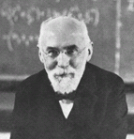
Option A: Relativity - AHL
A.4 – Relativistic mechanics
Total energy and rest energy
m = γm₀
1
relativistic mass
where γ =
1 - v²/ c²
PRACTICE: At CERN a proton can be accelerated to a speed such that its relativistic mass is that of U²³⁸. How fast is it going?
SOLUTION:
●First, find the Lorentz factor from m = γm₀.
238m_{p} = γm_{p} → γ = 238.
●Then solve for v:
(1 – v²/ c²)^{1/2} = 1/ 238
1 – v²/ c² = 1/ 238²
1 – 1/ 238² = v² / c²
0.9999823 = v² / c² → v = 0.9999912c.
Notes:
© 2015 By Timothy K. Lund

Slide 10
Option A: Relativity - AHL
A.4 – Relativistic mechanics
Total energy
●Since mass increases with velocity according to m = γm₀, clearly the total energy of a moving mass is E = γm₀c².
E₀ = m₀c²
1
total energy
where γ =
E = γm₀c²
1 - v²/ c²
PRACTICE: Show that the relativistic energy E reduces to the rest energy E₀ when v = 0.
SOLUTION:
●If v = 0 then γ = 1/ (1 - 0²/c²)^{1/2} = 1/ 1^{1/2} = 1.
●Then E = γm₀c² = 1m₀c² = m₀c² = E₀.
FYI
•Thus E = γm₀c² is the total energy of the object, whether the object is moving or not.
Notes:
© 2015 By Timothy K. Lund

Slide 11
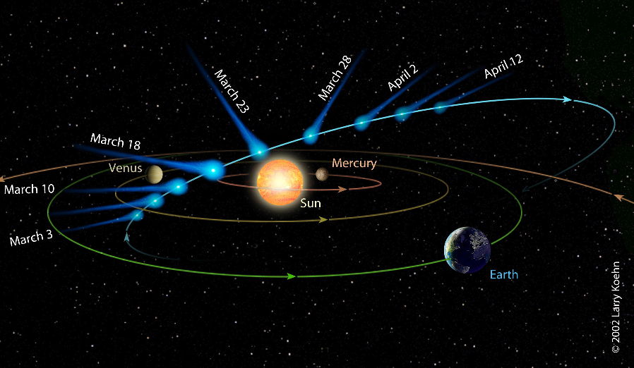
Option A: Relativity - AHL
A.4 – Relativistic mechanics
Total energy – optional for calculus students
●It has been observed that the tails of comets always point away from the sun. Thus the light from the sun is able to exert a force on the particles of the tail.
●Recall that F_{net} = dp / dt = d(mv) / dt.
●From the product rule of calculus we have
F_{net} = d(mv) / dt
= (dm / dt) v + m (dv / dt).
rocket thrust equation
mass×acceleration
Notes:
© 2015 By Timothy K. Lund

Slide 12
Option A: Relativity - AHL
A.4 – Relativistic mechanics
Total energy – optional for calculus students
●The second term of F = (dm / dt) v + m (dv / dt ) is just the familiar F = ma we learned in Topic 2.
●Recall that dE = dW = Fdx so that
dE = Fdx
dE = (dm / dt) v dx + m (dv / dt) dx
dE = dm (dx / dt) v + m(dx / dt) dv
dE = dm v² + mv dv
●Integrating produces
∫ dE = ∫ dm v² + ∫ mv dv
E = mv² + (1/ 2)mv².
●Note that the last term is the familiar kinetic energy.
Notes:
© 2015 By Timothy K. Lund

Slide 13
Option A: Relativity - AHL
A.4 – Relativistic mechanics
Total energy – optional for calculus students
●In the context of light, let’s go back to the expression dE = dm v² + mv dv from the previous slide.
●Because the speed of light is a constant v = c, we see that the dv term must be zero. Thus for light the equation dE = dm v² + mv dv becomes dE = dm c².
●Integrating produces
∫ dE = ∫ dm c² → E = mc².
●Just as DeBroglie hypothesized that mass particles and light acted the same, so too can we hypothesize that E = mc² works for both mass particles and light.
●Indeed, the discovery of antimatter established the validity of this generalization.
Notes:
© 2015 By Timothy K. Lund

Slide 14
Option A: Relativity - AHL
A.4 – Relativistic mechanics
Total energy
EXAMPLE: Explain why no object with a rest mass of m₀ can ever attain the speed of light in a vacuum.
SOLUTION: Assume its speed can equal c. Then since γ = 1/ (1 – v²/ c²)^{1/2}, we see that as v → c that γ → ∞.
Argument 1:
●Since m = γm₀ then m → ∞ with γ.
●But there is not an infinite amount of mass in the universe. (Reductio ad absurdum).
Argument 2:
●Since E = γm₀c² then E → ∞ with γ.
●But there is not an infinite amount of energy in the universe. (Reductio ad absurdum).
Notes:
© 2015 By Timothy K. Lund

Slide 15
Option A: Relativity - AHL
A.4 – Relativistic mechanics
Total energy
●Recall that the acceleration of a charge q through a potential difference V produces a kinetic energy change given by E_{K} = qV.
●The total energy E of a particle of rest mass m₀ is the sum of its rest energy E₀ and its kinetic energy E_{K} = qV.
E = E₀ + E_{K}
total energy of an accelerated particle
mc² = m₀c² + qV
where m = γm₀
γm₀c² = m₀c² + qV
FYI
•We can not use (1/2)mv² = qV at relativistic speeds to find v because it assumes all of the energy qV is going into the velocity change. But the mass also changes at large speeds.
Notes:
© 2015 By Timothy K. Lund

Slide 16
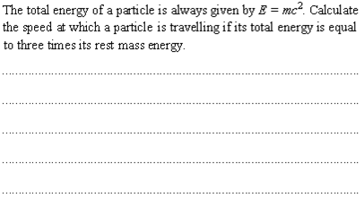
Option A: Relativity - AHL
A.4 – Relativistic mechanics
Total energy
●Use E = γm₀c² = γE₀. Then
3E₀ = γE₀ → γ = 3.
●Since γ = 1/(1 – v²/ c²)^{1/2} = 3, then
(1 – v²/ c²)^{1/2} = 1/ 3
1 – v²/ c² = 1/ 9
v²/ c² = 8/ 9
→ v = 0.94c.
Notes:
© 2015 By Timothy K. Lund

Slide 17

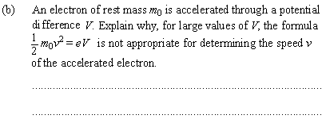
Option A: Relativity - AHL
A.4 – Relativistic mechanics
Total energy
●The mass as measured by an observer at rest with respect to the mass.
●The mass as measured by an observer in the rest frame of the mass.
●From the formula we see that v ∝ √V.
●Thus if V is large enough, v > c, which cannot happen.
Notes:
© 2015 By Timothy K. Lund

Slide 18
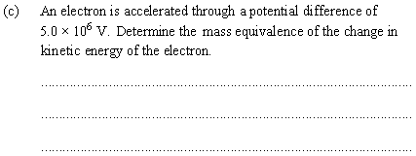
Option A: Relativity - AHL
A.4 – Relativistic mechanics
Total energy
●Use E = E₀ + E_{K}.
●Then mc² = m₀c² + eV.
mc² - m₀c² = eV.
Δmc² = eV
Δm = eV/ c²
Δm = e(5.0×10⁶ V) / c²
Δm = 5.0 MeV c⁻²
●Alternate method…
Δm = (1.6×10⁻¹⁹)(5×10⁶) / (3×10⁸)²
Δm = 8.9×10⁻³⁰ kg.
Notes:
© 2015 By Timothy K. Lund

Slide 19
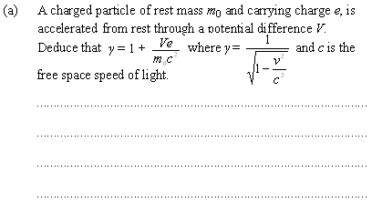
Option A: Relativity - AHL
A.4 – Relativistic mechanics
Total energy
●Use E = E₀ + eV. Then
mc² = m₀c² + eV
γm₀c² = m₀c² + eV
γ = 1 + eV/ (m₀c²).
Notes:
© 2015 By Timothy K. Lund

Slide 20
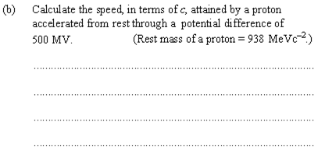
Option A: Relativity - AHL
A.4 – Relativistic mechanics
Total energy
●Use γ = 1 + eV/(m₀c²).
γ = 1 + e(500 MV)/ (938 MeVc⁻²c²)
γ = 1 + 500 MeV/ (938 MeV)
γ = 1 + 500/ 938 = 1.53
1.53 = 1/ (1 – v²/c²)^{-1/2}
1 – v²/ c² = 1/ 1.53² = 0.427
1 - 0.427 = v²/ c²
v² = 0.573c²
v = 0.76c.
Notes:
© 2015 By Timothy K. Lund

Slide 21
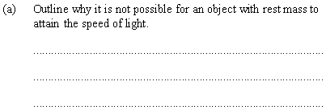
Option A: Relativity - AHL
A.4 – Relativistic mechanics
Total energy
●As v → c, γ → ∞.
●Since E = γm₀c² we see that
●as γ → ∞, E → ∞.
●Since there is not an infinite amount of energy in the universe, you cannot accelerate an object with a nonzero rest mass to the speed of light.
Notes:
© 2015 By Timothy K. Lund

Slide 22


Option A: Relativity - AHL
A.4 – Relativistic mechanics
Total energy
●For an electron, E₀ = m₀c² = 0.51 MeV.
●E_{K} = eV = e(6.00×10⁶) V = 6.00 MeV.
●E = E₀ + E_{K} = 0.51 MeV + 6.00 MeV = 6.51 MeV.
Notes:
© 2015 By Timothy K. Lund

Slide 23
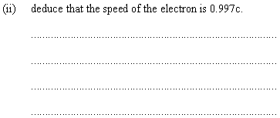
Option A: Relativity - AHL
A.4 – Relativistic mechanics
Total energy
●E = γm₀c² = γ (0.51 MeV) = 6.51 MeV
●γ = 6.51 MeV / 0.51 MeV = 12.17.
γ = 1/ (1 – v²/ c²)^{-1/2} = 12.17
1 – v²/ c² = 1/ 12.17² = 0.0067
1 - 0.0067 = v²/ c²
v² = 0.9933c²
v = 0.997c.
Notes:
© 2015 By Timothy K. Lund

Slide 24
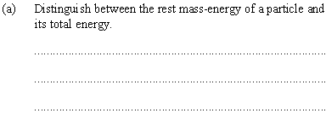
Option A: Relativity - AHL
A.4 – Relativistic mechanics
Total energy
●Rest mass energy is E₀ = m₀c² and is the energy that a particle has in its rest frame.
●Total energy is E = m₀c² + E_{K} and is the sum of the rest mass energy and the kinetic energy E_{K} = eV.
●For these problems we always assume there is no potential energy.
Notes:
© 2015 By Timothy K. Lund

Slide 25

Option A: Relativity - AHL
A.4 – Relativistic mechanics
Total energy
●E₀ = m₀c² = (938 MeV c⁻²)c² = 938 MeV.
Notes:
© 2015 By Timothy K. Lund

Slide 26
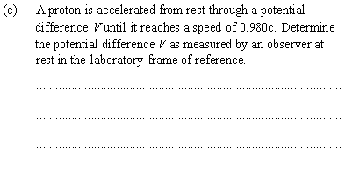
Option A: Relativity - AHL
A.4 – Relativistic mechanics
Total energy
●γ = 1/ (1 – v²/ c²)^{-1/2}
= 1/ (1 – 0.980²c²/ c²)^{-1/2} = 5.03.
●E = γm₀c² = m₀c² + eV
eV = (γ - 1)m₀c²
V = (γ - 1)m₀c²/e
V = (5.03 - 1)(938 MeV) / e
V = 3780 MV.
Notes:
© 2015 By Timothy K. Lund

Slide 27
Option A: Relativity - AHL
A.4 – Relativistic mechanics
Relativistic kinetic energy
●Recall the formulas for the total energy of an accelerated particle:
●From the third equation we have
γm₀c² = m₀c² + qV
γm₀c² – m₀c² = E_{K}
(γ – 1) m₀c² = E_{K}.
E = E₀ + E_{K}
total energy of an accelerated particle
mc² = m₀c² + qV
where m = γm₀
γm₀c² = m₀c² + qV
E_{K} = qV
kinetic energy of an accelerated particle
E_{K} = (γ – 1) m₀c²
Notes:
© 2015 By Timothy K. Lund

Slide 28
Option A: Relativity - AHL
A.4 – Relativistic mechanics
Relativistic kinetic energy
E_{K} = qV
kinetic energy of an accelerated particle
E_{K} = (γ – 1) m₀c²
EXAMPLE: Suppose proton is accelerated at Fermilab to 99.9991% of the speed of light. What is its relativistic kinetic energy? What p.d. will it have been accelerated through to reach this speed?
SOLUTION: γ = 1/ (1 – 0.999991²c²/ c²)^{1/2} = 235.703.
● E_{K} = (γ - 1)m₀c²
= (235.703 - 1)(1.673×10⁻²⁷)(3.00×10⁸)²
= 3.53×10⁻⁸ J.
● E_{K} = eV → 3.53×10⁻⁸ = (1.6×10⁻¹⁹)V so that
V = 2.21×10¹¹ V.
Notes:
© 2015 By Timothy K. Lund

Slide 29
Option A: Relativity - AHL
A.4 – Relativistic mechanics
Relativistic kinetic energy
●Mass m varies with velocity as m = γm₀.
●Therefore, at relativistic speeds (say greater than10% of the speed of light) the traditional E_{K} = (1/ 2)mv² fails, as the next slide will show.
●On the other hand, E_{K} = qV does not fail, even under relativistic conditions.
●In the language of relativity, we say that charge q is invariant.
E_{K} = qV
kinetic energy of an accelerated particle
E_{K} = (γ – 1) m₀c²
Notes:
© 2015 By Timothy K. Lund

Slide 30
Option A: Relativity - AHL
A.4 – Relativistic mechanics
Relativistic kinetic energy
PRACTICE: Suppose a proton is accelerated through the p.d. of the previous example. What speed (in terms of c) does classical physics predict. Explain.
SOLUTION: For classical use (1/2)mv² = eV. Then
v² = 2eV/ m
v² = 2(1.6×10⁻¹⁹)(2.21×10¹¹) / 1.673×10⁻²⁷
v = 6.50×10⁹ = 22c.
EXPLANATION:
●Since no particle with a non-zero rest mass can even reach the speed of light, much less 22c, classical physics obviously fails.
FYI Reminder: (1/2)mv² = eV assumes that all of the energy eV goes into the v, not m also.
Notes:
© 2015 By Timothy K. Lund

Slide 31
Option A: Relativity - AHL
A.4 – Relativistic mechanics
Relativistic momentum
●In Topic 2 we learned about momentum, the product of the mass and the velocity of a particle.
●Relativistic momentum has the same formula, provided that the relativistic mass is used:
p = mv = γm₀v
relativistic momentum
EXAMPLE: A proton is accelerated at Fermilab to 99.9991% of the speed of light. What are its relativistic mass and momentum?
SOLUTION: γ = 1/ (1 – 0.999991²c²/ c²)^{1/2} = 235.703.
●m = γm₀ = 235.703(1.673×10⁻²⁷) = 3.943×10⁻²⁵ kg.
●p = mv = (3.943×10⁻²⁵)(0.999991)(3.00×10⁸)
= 1.18×10⁻¹⁶ kgms⁻¹.
Notes:
© 2015 By Timothy K. Lund

Slide 32
Option A: Relativity - AHL
A.4 – Relativistic mechanics
Relativistic energy and momentum
EXAMPLE: Show that the following formula is correct:
SOLUTION: Note: E² = γ²m₀²c⁴ and p² = γ²m₀²v². So…
p²c² + m₀²c⁴ = γ²m₀²v²c² + m₀²c⁴
= m₀²c²( γ²v² + c² )
= m₀²c²[ v² / (1 – v²/ c²) + c² ]
= m₀²c²[ c²v² / (c² – v²) + c² ]
= m₀²c⁴[ v² / (c² – v²) + 1 ]
= m₀²c⁴[ v² / (c² – v²) + (c² – v²) / (c² – v²) ]
= m₀²c⁴[ (v² + c² – v²) / (c² – v²) ]
= m₀²c⁴[ c²/ (c² – v²) ]
= m₀²c⁴[ 1 / (1 – v²/c²) ] = γ²m₀²c⁴ = E².
E² = p²c² +m₀²c⁴
Relativistic momentum / energy
Notes:
© 2015 By Timothy K. Lund

Slide 33
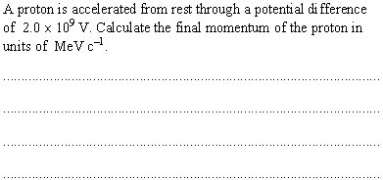
Option A: Relativity - AHL
A.4 – Relativistic mechanics
Relativistic energy and momentum
●First use E = E₀ + eV. Then
E = 938 MeV + 2.0×10³ MeV
= 2938 MeV.
●Now use E² = p²c² + m₀²c⁴. Then
p²c² = E² – (m₀c²)²
p²c² = 2938² – 938² = 7752000
pc = 2784 MeV
p = 2.8×10³ MeV c⁻¹.
Notes:
© 2015 By Timothy K. Lund

Slide 34
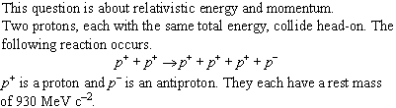
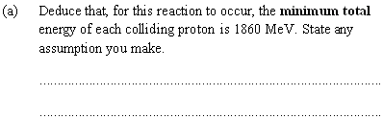
Option A: Relativity - AHL
A.4 – Relativistic mechanics
Relativistic energy and momentum
●The particle and antiparticle pair was created from the kinetic energy of the original protons.
●Thus each of the colliding protons must have a total energy of 2×930 MeV = 1860 MeV.
●Assume no extra kinetic energy in the products.
Notes:
© 2015 By Timothy K. Lund

Slide 35
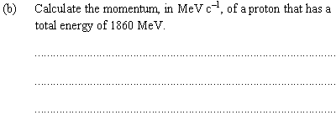
Option A: Relativity - AHL
A.4 – Relativistic mechanics
Relativistic energy and momentum
●Use E² = p²c² + (m₀c²)². Then
p²c² = E² - (m₀c²)²
p²c² = 1860² - (930)² = 2594700
p = 1610 MeV c⁻¹.
Notes:
© 2015 By Timothy K. Lund

Slide 36
Option A: Relativity - AHL
A.4 – Relativistic mechanics
Photons
●Because photons have a rest mass of zero, E² = p²c² + m₀²c⁴ becomes E² = p²c², which reduces to E = pc.
●Since c = λf we can then express the momentum of a photon in many ways.
p = E / c = hf / c = h / λ
momentum of photon
EXAMPLE: A photon has a wavelength of 275 nm. What is its momentum? What is its energy?
SOLUTION:
●p = h / λ = 6.63×10⁻³⁴/ 275×10⁻⁹ = 2.41×10⁻²⁷ kg ms⁻¹.
●E = pc = (2.41×10⁻²⁷)(3.00×10⁸) = 7.23×10⁻¹⁹ J.
FYI Note that the relation p = h / λ is none other than the De Broglie hypothesis for matter: λ = h / p.
Notes:
© 2015 By Timothy K. Lund

Slide 37
Option A: Relativity - AHL
A.4 – Relativistic mechanics
Photons
p = E / c = hf / c = h / λ
momentum of photon
EXAMPLE: A neutral pion π⁰ having a mass of 264m_{e} decays into an electron, a positron, and a photon, in about 10⁻¹⁶ s according to π⁰ → e⁻ + e⁺ + γ. What is the maximum energy of the photon? What is its momentum? Its wavelength?
SOLUTION:
●Assuming no E_{K} for the pion, electron, and positron, the photon must have an energy equivalent of 262m_{e}.
E = mc² = 262×9.11×10⁻³¹×(3.00×10⁸)² = 2.14×10⁻¹¹ J.
●p = E / c = 2.14×10⁻¹¹ / 3.00×10⁸ = 7.16×10⁻²⁰ kg ms⁻¹.
●λ = h / p = 6.63×10⁻³⁴/ 7.16×10⁻²⁰ = 9.26×10⁻¹⁵ m.
Notes:
© 2015 By Timothy K. Lund

