Slide 1
Option A: Relativity
A.3 – Spacetime diagrams
Essential idea: Spacetime diagrams are a very clear and illustrative way to show graphically how different observers in relative motion to each other have measurements that differ from each other.
Nature of science: Visualization of models: The visualization of the description of events in terms of spacetime diagrams is an enormous advance in understanding the concept of spacetime.
Understandings:
• Spacetime diagrams
• Worldlines
• The twin paradox
Notes:
© 2014 By Timothy K. Lund

Slide 2
Option A: Relativity
A.3 – Spacetime diagrams
Applications and skills:
• Representing events on a spacetime diagram as points
• Representing the positions of a moving particle on a spacetime diagram by a curve (the worldline)
• Representing more than one inertial reference frame on the same spacetime diagram
• Determining the angle between a worldline for specific speed and the time axis on a spacetime diagram
• Solving problems on simultaneity and kinematics using spacetime diagrams
• Representing time dilation and length contraction on spacetime diagrams
Notes:
2
© 2014 By Timothy K. Lund

Slide 3
Option A: Relativity
A.3 – Spacetime diagrams
Applications and skills:
• Describing the twin paradox
• Resolving of the twin paradox through spacetime diagrams
Guidance:
• Examination questions will refer to spacetime diagrams; these are also known as Minkowski diagrams
• Quantitative questions involving spacetime diagrams will be limited to constant velocity
• Spacetime diagrams can have t or ct on the vertical axis
• Examination questions may use units in which c = 1
Notes:
3
© 2014 By Timothy K. Lund

Slide 4
Option A: Relativity
A.3 – Spacetime diagrams
Data booklet reference:
• θ = tan⁻¹(v / c)
Theory of knowledge:
• Can paradoxes be solved by reason alone, or do they require the utilization of other ways of knowing?
Aims:
• Aim 4: spacetime diagrams allow one to analyze problems in relativity more reliably
Notes:
4
© 2014 By Timothy K. Lund

Slide 5
Option A: Relativity
A.3 – Spacetime diagrams
Spacetime diagrams
space diagram
EXAMPLE: As an example of the difference between a spacetime diagram and a traditional space diagram, contrast the plots of a particle in uniform circular motion in the x-y plane.
SOLUTION:
●In the traditional diagram note that the particle keeps repeating its coordinates.
●In the spacetime diagram the particle never repeats its coordinates.
●It will repeat spatial coordinates as regularly as the in the traditional diagram, but it’ll never repeat its time coordinate.
y
x
ct
y
x
spacetime diagram
Notes:
© 2014 By Timothy K. Lund

Slide 6


Option A: Relativity
A.3 – Spacetime diagrams
Spacetime diagrams
EXAMPLE: As a demonstration of the legitimacy of adding a fourth coordinate to the traditional 3D position, consider someone who is crossing a highway. Both the person and the van have (at some time) the same spatial coordinates, but they don’t collide because they have different time coordinates.
●Note that the time factor has a c attached to it. This gives the time coordinate dimensions of length, compatible with the spatial coordinates.
(x,y,z,ct₁)
(x,y,z,ct₂)
(x,y,z)
Notes:
© 2014 By Timothy K. Lund

Slide 7
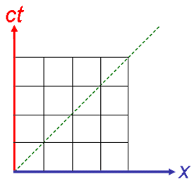
Option A: Relativity
A.3 – Spacetime diagrams
Spacetime diagrams
EXAMPLE: Draw a spacetime diagram for a particle at rest and for a particle traveling in the positive x-direction.
SOLUTION:
●A particle at rest does not move in the x-direction. Therefore it traces out a vertical line on the spacetime coordinate system.
●A particle traveling in the +x-direction will be tilted to the right as shown.
particle at rest at x = 0
particle at rest at x = 2
particle traveling in the +x-direction and having an initial position of x = 3.
Notes:
© 2014 By Timothy K. Lund

Slide 8
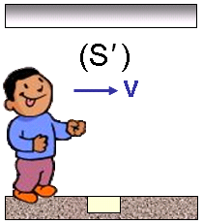

Option A: Relativity
A.3 – Spacetime diagrams
Spacetime interval – Minkowski spacetime
•Recall the relationship between times in S₀ and S we obtained from analyzing the light clock and invoking Einstein’s 2nd postulate:
(c∆t)² = (c∆t₀)² + (v∆t)².
•We can replace t₀ with t’, corresponding to the moving IRF, namely Dobson, in S’.
•Then since v∆t = ∆x we can write
(c∆t)² = (c∆t’ )² + (∆x)²
-(c∆t’ )² = -(c∆t)² + (∆x)²
•Then since the displacement between events in Dobson’s IRF (S’) is ∆x’ = 0, we can write
(Δx’ )² – (cΔt’ )² = (Δx)² – (cΔt)²
spacetime interval
Notes:
© 2014 By Timothy K. Lund

Slide 9
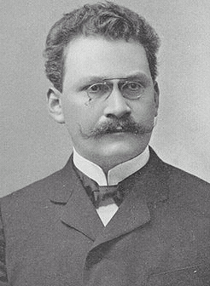
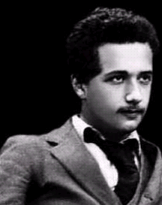
“I really wouldn't have thought that lazy dog Einstein capable of relativity.”
Option A: Relativity
A.3 – Spacetime diagrams
Spacetime interval – Minkowski spacetime
•Hermann Minkowski showed in 1907 that his former student Albert Einstein's special theory of relativity (1905), could be understood geometrically as a theory of four-dimensional spacetime, henceforth known as Minkowski spacetime.
•Minkowski had once said of Einstein the lazy student that he would not amount to much.
•According to Minkowski:
“Henceforth space by itself, and time by itself, are doomed to fade away into mere shadows, and only a kind of union of the two will preserve an independent reality.”
Notes:
© 2014 By Timothy K. Lund

Slide 10
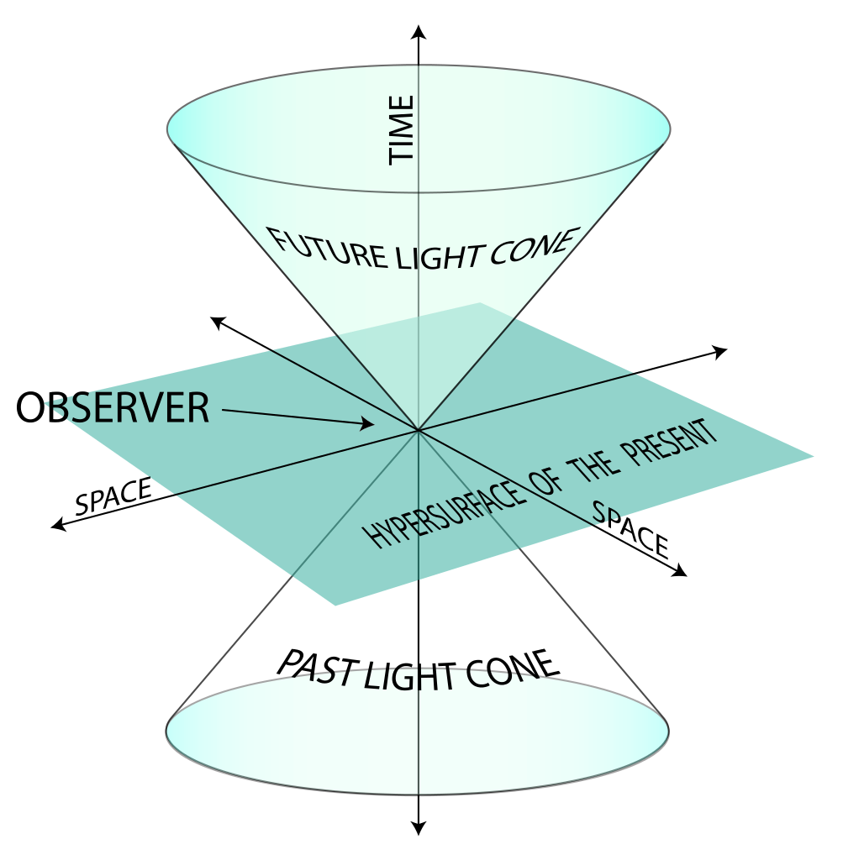
Option A: Relativity
A.3 – Spacetime diagrams
Spacetime interval – Minkowski spacetime
•Minkowski added the dimension ct to the spatial dimensions of x, y and z.
•The new geometry has as one of its key parts the invariance of the spacetime interval.
•According to the Newtonian view, distances ΔS between two events were not dependent on time or velocity.
(Δx)² + (Δy)² + (Δz)² = (ΔS)².
•According to Minkowski, distances Δs between two events were dependent on time and velocity.
(Δx)² + (Δy)² + (Δz)² – (cΔt)² = (Δs)².
ct
x
y
Notes:
© 2014 By Timothy K. Lund

Slide 11
The good news is that we will only be using the x and the ct axes.
Option A: Relativity
A.3 – Spacetime diagrams
Spacetime interval – Minkowski spacetime
•Einstein himself, perhaps still smarting from Minkowski’s tongue-lashing, poo-pooed Minkowski spacetime, calling it "banal" and "a superfluous learnedness."
•Later, he came to see that it was necessary for the development of general relativity.
ct
x
y
FYI
•You may be wondering where the z-axis is in the above diagram. Well, we simply can’t easily draw it, because we can’t draw four dimensions.
•That’s why the spatial “plane” is labeled hypersurface.
Notes:
© 2014 By Timothy K. Lund

Slide 12
The light line represents the path a particle would follow if its speed were c.
Option A: Relativity
A.3 – Spacetime diagrams
Spacetime interval – Minkowski spacetime
•We call the intersection of the light cones with the x-ct plane, the light line.
•A simplified version of Minkowski spacetime shows only the x axis, the ct axis, and the light line.
•A particle having a velocity of v = 0 would have a plot that looks like the purple line:
•Note that it still “travels” along the time axis.
•If v > 0 its graph would look like the cyan one: Note that it also travels in x.
ct
light line
x
ct
y
Since no particle can exceed the speed of light, slopes can never be below the green line
x
Notes:
© 2014 By Timothy K. Lund

Slide 13
Option A: Relativity
A.3 – Spacetime diagrams
Spacetime interval – Worldlines
•We call the path a particle follows through spacetime a worldline.
•Since the gradient of the light line represents the speed of light, it follows that mass particles must never have a gradient that lies below the light line.
•The orange region represents a “forbidden” region, that ordinary mass particles cannot enter (from the origin).
•Particles called tachyons have been postulated that can only travel faster than the speed of light, but these particles would violate causality and other laws of physics and so are not really taken seriously.
Worldline: v ≠ CONST
Worldline: v = CONST
Worldline: v = 0
Worldline: v = c
ct
Forbidden region
“Tachyons”
x
Notes:
© 2014 By Timothy K. Lund

Slide 14
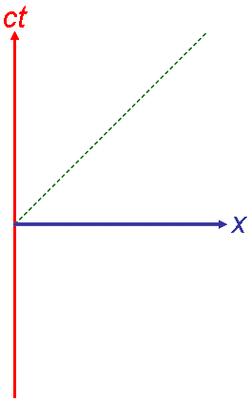
Option A: Relativity
A.3 – Spacetime diagrams
Your friend’s worldlines: v = 0
Your worldline: v = 0
Spacetime interval – Marking spacetime units
•What better way to mark spacetime units than with light – which seems to be the simplest constant in all IRFs.
•A radar gun and a friend with a mirror is all you need.
•Your friend moves down the x axis and you fire the radar gun, which measures the time it takes the light to travel to and from your friend’s mirror, according to the formula Δt = 2D / c, where D is the desired unit increment.
•For example, if you want 1-m increments, each meter would be Δt = 2(1) / 3×10⁸ seconds in elapsed time.
Notes:
© 2014 By Timothy K. Lund

Slide 15


Option A: Relativity
A.3 – Spacetime diagrams
Spacetime interval – Marking spacetime units
•You may be wondering how your friend knew where to stand for each interval. Well, he didn’t. It took many trials (and errors) before the correct spots were found.
•Once you and your friend have marked the axes, you simply draw in lines of constant x (already there) and lines of constant ct:
•We now have a spacetime grid!
FYI
•You and your friend can then place synchronized clocks everywhere on your grid for convenience.
Notes:
© 2014 By Timothy K. Lund

Slide 16
Option A: Relativity
A.3 – Spacetime diagrams
Spacetime interval – Spacetime geometry
EXAMPLE: Consider the points A, B and C in Minkowski spacetime marked in meter units.
(a) Find the square of the spacetime interval (Δs)² between each pair of points.
SOLUTION:
•Use (Δx)² – (cΔt)² = (Δs)².
(Δs_{AB} )² = (Δx)² – (cΔt)² = (1 – 2)² – (0 – 3)² = –8 m².
(Δs_{BC} )² = (Δx)² – (cΔt)² = (4 – 1)² – (3 – 0)² = 0 m².
(Δs_{AC} )² = (Δx)² – (cΔt)² = (4 – 2)² – (3 – 3)² = +4 m².
•Which paths are “legal” paths for a particle to follow?
A
C
B
Notes:
© 2014 By Timothy K. Lund

Slide 17
Option A: Relativity
A.3 – Spacetime diagrams
Spacetime interval – Point separation types
EXAMPLE: Consider the points A, B and C in Minkowski spacetime marked in meter units.
(b) Label each point pair with its correct separation type where
(Δs)² > 0 : spacelike separated.
(Δs)² = 0 : null separated.
(Δs)² < 0 : timelike separated.
SOLUTION:
(Δs_{AB} )² = –8 m² → A and B: timelike separated.
(Δs_{BC} )² = 0 m² → B and C: null separated.
(Δs_{AC} )² = +4 m² → A and C: spacelike separated.
A
C
B
Notes:
© 2014 By Timothy K. Lund

Slide 18
Option A: Relativity
A.3 – Spacetime diagrams
Spacetime interval – Spacetime distance
EXAMPLE: Consider the points A, B and C in Minkowski spacetime marked in meter units.
(c) If we define the distance D between two points in Minkowski spacetime to be D = | (Δs)² |^{1/2}, find the distances between the points.
SOLUTION:
D_{AB} = | (Δs_{AB} )² |^{1/2} = | –8 m² |^{1/2} = ( 8 m )^{1/2} = 2.83 m.
D_{BC} = | (Δs_{BC} )² |^{1/2} = | 0 m² |^{1/2} = ( 0 m )^{1/2} = 0.00 m.
D_{AC} = | (Δs_{AC} )² |^{1/2} = | +4 m² |^{1/2} = ( 4 m )^{1/2} = 2.00 m.
A
C
B
Notes:
© 2014 By Timothy K. Lund

Slide 19
Option A: Relativity
A.3 – Spacetime diagrams
Spacetime interval – Spacetime distance
EXAMPLE: Consider the points A, B and C in Minkowski spacetime marked in meter units.
(d) Find the shortest distance between A and B.
SOLUTION: Use the spacetime distances from the previous slide:
•If we go directly from A to B the spacetime distance is 2.83 m.
•However, if we go from from A to C (2.00 m) and then from C to B (0.00 m) we cut off 0.83 m!
A
2.00 m
C
2.83 m
0.00 m
B
FYI
•Euclidean and Minkowski spacetime are very different!
Notes:
© 2014 By Timothy K. Lund

Slide 20
Option A: Relativity
A.3 – Spacetime diagrams
Spacetime diagrams
•Minkowski’s view of space is non-Euclidean. In Euclidean space, which can also be four-dimensional, the distance formula would be
(ΔS)² = (Δx)² + (Δy)² + (Δz)² + (cΔt)².
•It is precisely the subtraction of the (cΔt)² term in
(Δs)² = (Δx)² + (Δy)² + (Δz)² – (cΔt)²,
required by Einstein’s 2nd postulate, that makes Minkowski spacetime non-Euclidean.
•The effects on the spacetime geometry of IRFs moving at great speed relative to a stationary IRF will be illustrated on the next slide.
Notes:
© 2014 By Timothy K. Lund

Slide 21
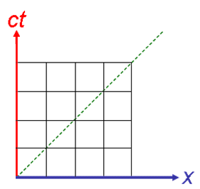
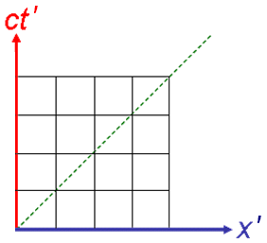
Option A: Relativity
A.3 – Spacetime diagrams
Spacetime diagrams – Euclidean (and incorrect)
•First we show Euclidean spacetime whose geometry is governed by the relationship
(ΔS)² = (Δx)² + (cΔt)².
•Suppose IRF S is stationary, and IRF S’ is moving to the right at a constant velocity. The world line for a stationary point at the origin in S’ would then look like this:
•This point is obviously moving along the ct’ axis of S’ (and not along the x’ axis).
•Because in Euclidean spacetime Δx and Δt are absolute, we superimpose S’ over S so that both quantities are invariant. Like this:
ct’
Notes:
© 2014 By Timothy K. Lund

Slide 22
Option A: Relativity
A.3 – Spacetime diagrams
Spacetime diagrams – Euclidean (and incorrect)
•First we show Euclidean spacetime whose geometry is governed by the relationship
(ΔS)² = (Δx)² + (cΔt)².
•The coordinates of the points A and B in S and S’ can be found.
•In S: (x_{A}, ct_{A} ) = (4, 3);
(x_{B}, ct_{B} ) = (0, 0).
Thus (ΔS)² = (0 – 4)² + (0 – 3)² = 25 m².
•In S’: (x’_{A}, ct’_{A} ) = (3, 4);
(x’_{B}, ct’_{B} ) = (0, 0).
Thus (ΔS)² = (0 – 3)² + (0 – 4)² = 25 m².
•In each IRF the distance between A and B is 5.0 m.
A
B
Notes:
© 2014 By Timothy K. Lund

Slide 23
Option A: Relativity
A.3 – Spacetime diagrams
Spacetime diagrams – Euclidean (and incorrect)
•First we show Euclidean spacetime whose geometry is governed by the relationship
(ΔS)² = (Δx)² + (cΔt)².
•There are two ways to determine that the orientation of the x’ axis is wrong.
•Firstly, the light line gradient in S’ shows that the speed of light in S’ is greater than c from the perspective of an observer in S. Its light line should coincide with that of S.
•Secondly, if its light line does coincide with that of S, as it should, the unit marks on the axes no longer line up.
Notes:
© 2014 By Timothy K. Lund

Slide 24
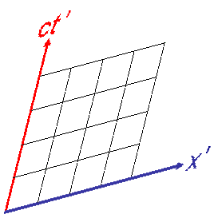
Option A: Relativity
A.3 – Spacetime diagrams
Spacetime diagrams – Minkowski (and correct)
•Now we show Minkowski spacetime whose geometry is governed by
(Δs)² = (Δx)² – (cΔt)².
•The geometries are no longer identical. From the perspective of S, the moving IRF no longer has 90° between its ct’ axis and its x’ axis.
•Note that the light lines work if x’ is above x by the same angle as ct’ is to the right of ct.
•It only remains to be seen if the distances between two points are invariant.
θ
θ
Notes:
© 2014 By Timothy K. Lund

Slide 25
Option A: Relativity
A.3 – Spacetime diagrams
Spacetime diagrams – Minkowski (and correct)
•Now we show Minkowski spacetime whose geometry is governed by
(Δs)² = (Δx)² – (cΔt)².
•The coordinates of the points A and B in S and S’ can again be found.
•In S: (x_{A}, ct_{A} ) = (4, 3);
(x_{B}, ct_{B} ) = (0, 0).
Thus (Δs)² = (0 – 4)² – (0 – 3)² = 7.00 m².
•In S’: (x’_{A}, ct’_{A} ) = (3.40, 2.15);
(x’_{B}, ct’_{B} ) = (0, 0).
Thus (Δs)² = (0 – 3.40)² – (0 – 2.15)² = 6.94 m².
•In each IRF the distance between A and B is 2.6 m.
A
B
Notes:
© 2014 By Timothy K. Lund

Slide 26
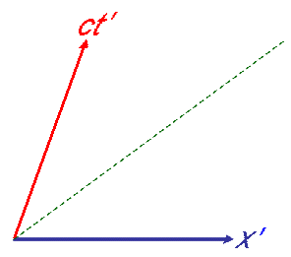
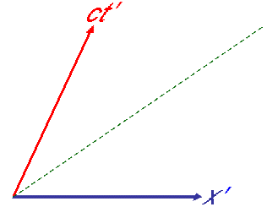
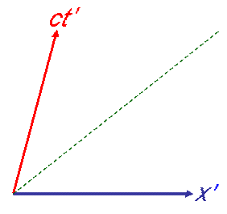
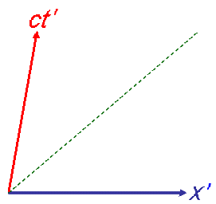
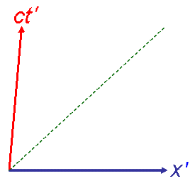
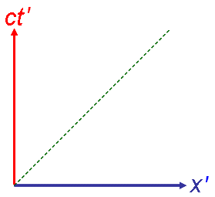
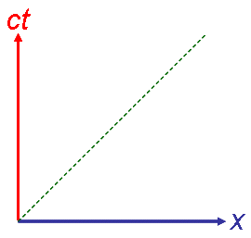
Option A: Relativity
A.3 – Spacetime diagrams
Spacetime diagrams – Minkowski (and correct)
•In fact, the “warpage” of Minkowski spacetime is proportional to the speed of the moving IRF S’:
•Because the speed of light c is the only reference common to all of these IRFs, the correct way to sketch them in comparison to one another is with their light lines aligned.
•Stationary IRF S is superimposed for comparison.
•Note that both the x’ and ct’ axes are sloped the same.
Notes:
© 2014 By Timothy K. Lund

Slide 27
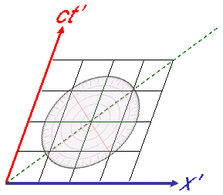
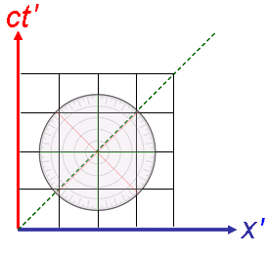
Option A: Relativity
A.3 – Spacetime diagrams
Spacetime diagrams – Minkowski (and correct)
•It is important to note here that observers in S’ still measure a right-angle geometry in their IRF, as illustrated with the relativistic protractor:
Notes:
© 2014 By Timothy K. Lund

Slide 28
Option A: Relativity
A.3 – Spacetime diagrams
Spacetime diagrams – Determining the angle θ
•Suppose S’ is moving to the right relative to S at a constant velocity v.
•We define θ as the angle between the ct’ and the ct axis.
•From the triangle we see that tan θ = Δx / cΔt.
•Since
v = Δx / Δt
we see that
tan θ = v / c.
•We can then solve for θ.
ct
ct’
If v = c we have
θ = tan⁻¹(1)
= 45°.
Δx
cΔt
θ
Thus the light line makes a 45° angle to both axes.
x
θ = tan⁻¹( v / c ).
angle between ct and ct’ axes
Notes:
© 2014 By Timothy K. Lund

Slide 29

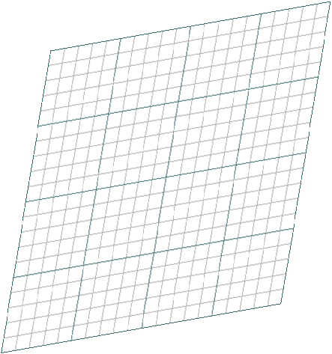

Option A: Relativity
A.3 – Spacetime diagrams
Spacetime diagrams – Lorentz transformations
EXAMPLE: Show that the Lorentz transformations work for a point located at x = 3 and ct = 2 in the rest frame.
SOLUTION:
•First find tan θ = v / c so that we can find the value of v:
tan θ = Δx / cΔt
= 0.70 / 3.90
= 0.1795.
•Thus v = 0.1795c.
Δx
cΔt
θ
Notes:
© 2014 By Timothy K. Lund

Slide 30
Option A: Relativity
A.3 – Spacetime diagrams
Spacetime diagrams – Lorentz transformations
EXAMPLE: Show that the Lorentz transformations work for a point located at x = 3 and ct = 2 in the rest frame.
SOLUTION:
•Now find the Lorentz factor:
γ = (1 – v² / c²)^{-1/2}
= (1 – 0.1795²)^{-1/2}
= 1.0165.
•Recall the transformations:
x’ = γ(x – vt),
t’ = γ(t – xv/c²).
Δx
cΔt
θ
Notes:
© 2014 By Timothy K. Lund

Slide 31
Option A: Relativity
A.3 – Spacetime diagrams
Spacetime diagrams – Lorentz transformations
EXAMPLE: Show that the Lorentz transformations work for a point located at x = 3 and ct = 2 in the rest frame.
SOLUTION:
•For x’:
x’ = γ(x – vt)
= γ(x – vct / c)
= γ(x – ct×v/c)
= 1.0165(3 – 2×0.1795)
= 2.68.
Δx
cΔt
θ
Notes:
© 2014 By Timothy K. Lund

Slide 32
Option A: Relativity
A.3 – Spacetime diagrams
Spacetime diagrams – Lorentz transformations
EXAMPLE: Show that the Lorentz transformations work for a point located at x = 3 and ct = 2 in the rest frame.
SOLUTION:
•For t’:
t’ = γ(t – xv/c²).
ct’ = γ(ct – xv/c)
= 1.0165(2 – 3×0.1795)
= 1.49.
Δx
cΔt
θ
Notes:
© 2014 By Timothy K. Lund

Slide 33
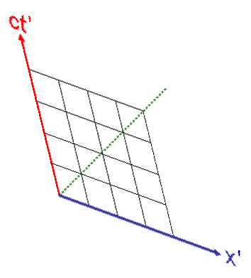
Option A: Relativity
A.3 – Spacetime diagrams
Spacetime diagrams – Determining the angle θ
•Suppose S’ is moving to the left relative to S at a constant velocity v.
•Then v / c becomes -v / c.
•From the identity
tan(-θ) = - tan θ
we have
-v / c = - ( tan θ ) = tan(-θ).
•We can then then sketch the transformed S’ axes.
•Note that the light lines still work to preserve the coordinate gridlines.
θ = tan⁻¹( v / c ).
angle between ct and ct’ axes
-θ
-θ
Notes:
© 2014 By Timothy K. Lund

Slide 34
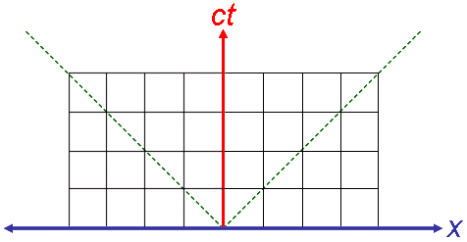
Option A: Relativity
A.3 – Spacetime diagrams
Spacetime diagrams – Simultaneity
EXAMPLE: An observer in IRF S is in the exact center of a train car. At the same instant, lights at each end of the car are turned on.
(a) Sketch the world lines of the lights in a spacetime diagram in S.
SOLUTION: Suppose the two events occur at the second unit of time ct and the first units of (+/-) x in S.
•Being light, the photons will travel at c, parallel to the light lines.
•The observer in S sees the lights simultaneously.
Notes:
© 2014 By Timothy K. Lund

Slide 35
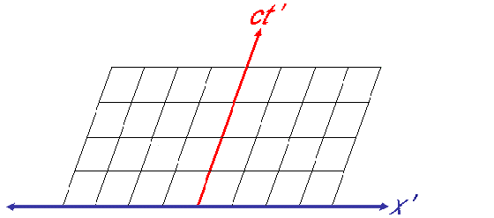
Option A: Relativity
A.3 – Spacetime diagrams
Spacetime diagrams – Simultaneity
EXAMPLE: An observer in IRF S is in the exact center of a train car. At the same instant, lights at each end of the car are turned on.
(b) Sketch the world line of the same lights in a spacetime diagram for an observer in S’, another IRF moving to the right relative to S. Assume the two observers are directly opposite to each other at the instant the lights are turned on.
•The photon on the right is observed at an earlier time than the one on the left.
Notes:
© 2014 By Timothy K. Lund

Slide 36
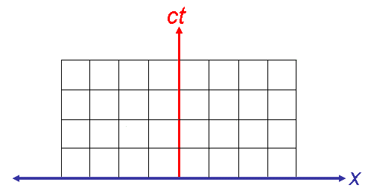
Option A: Relativity
A.3 – Spacetime diagrams
Spacetime diagrams – Simultaneity
EXAMPLE: Four flashes occur in IRF S as shown.
Determine the order in which the four flashes occur.
Determine the order in which an observer in S located at x = 0 would see the flashes.
SOLUTION
(a) The horizontal lines represent lines of equal time.
Thus B and C flash first, followed by D, followed by A.
(b) Draw the light lines from each flash:
The observer at x = 0 in S would see B first, followed by A, C and D simultaneously.
A
D
B
C
Notes:
© 2014 By Timothy K. Lund

Slide 37
Option A: Relativity
A.3 – Spacetime diagrams
Spacetime diagrams – Simultaneity
EXAMPLE: Four flashes occur in IRF S as shown.
(c) S’ is moving at velocity v to the right relative to S. Determine the order in which an observer in S’ located at x’ = 0 would see the flashes.
SOLUTION
(c) Draw in your light lines so they are at the correct angle.
The observer in S’ would first see C and D simultaneously, followed by B, and followed by A.
A
D
B
C
Notes:
© 2014 By Timothy K. Lund

Slide 38
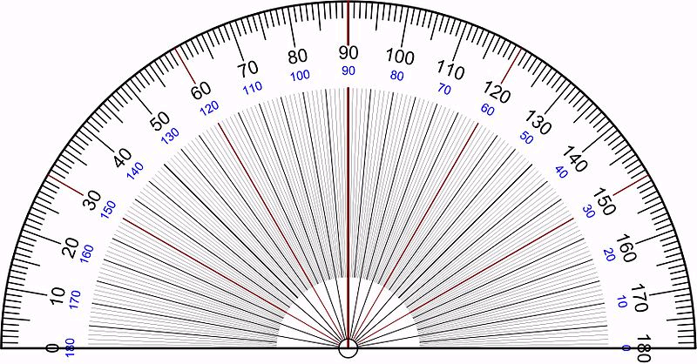
Option A: Relativity
A.3 – Spacetime diagrams
Spacetime diagrams – Relative velocities
EXAMPLE: Four flashes occur in IRF S as shown.
(d) Find the velocity of S’ relative to S, in terms of c.
SOLUTION
(d) Use θ = tan⁻¹( v / c ).
•The protractor shows that θ is about 11°.
11° = tan⁻¹( v / c ).
tan 11° = v / c
0.194 = v / c
v = 0.194 c.
θ
A
D
B
C
Notes:
© 2014 By Timothy K. Lund

Slide 39

Option A: Relativity
A.3 – Spacetime diagrams
Spacetime diagrams – Simultaneity
EXAMPLE: An observer in S is located on Spaceship A at x = 4 units from a star (x = 0). The spaceship and star have a relative velocity of zero.
(a) Sketch in the world lines of the star and the spaceship in the star’s IRF.
SOLUTION: Since both are stationary in that IRF, both have vertical world lines.
ct
x
Notes:
© 2014 By Timothy K. Lund

Slide 40
Option A: Relativity
A.3 – Spacetime diagrams
Spacetime diagrams – Simultaneity
EXAMPLE: An observer in S is located on Spaceship A at x = 4 units from a star (x = 0). The spaceship and star have a relative velocity of zero.
(b) Sketch in the ct’ and x’ axes of Spaceship B traveling at 3c / 4 which is at the star’s location at t’ = 0.
SOLUTION: Use slopes of 3 / 4 and 4 / 3:
ct
ct’
x’
x
Notes:
© 2014 By Timothy K. Lund

Slide 41
Option A: Relativity
A.3 – Spacetime diagrams
Spacetime diagrams – Simultaneity
EXAMPLE: An observer in S is located on Spaceship A at x = 4 units from a star (x = 0). The spaceship and star have a relative velocity of zero.
(c) An explosion occurs as shown. What are its spacetime coordinates in S?
SOLUTION: Use lines of constant time and position in S.
•The coordinates are (x, ct) = (6, 3) units.
ct
ct’
x’
x
Notes:
© 2014 By Timothy K. Lund

Slide 42
Option A: Relativity
A.3 – Spacetime diagrams
Spacetime diagrams – Simultaneity
EXAMPLE: An observer in S is located on Spaceship A at x = 4 units from a star (x = 0). The spaceship and star have a relative velocity of zero.
(d) An explosion occurs as shown. Which ship sees the explosion first?
SOLUTION: Remember that light travels at a 45° angle.
•Spaceship B is the ct’ line. So spaceship A sees the light first.
ct
ct’
x’
x
Notes:
© 2014 By Timothy K. Lund

Slide 43
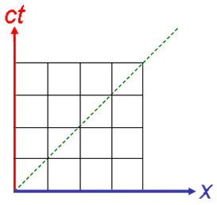
Option A: Relativity
A.3 – Spacetime diagrams
Spacetime interval – Length contraction
EXAMPLE: An observer in IRF S observes two stationary cones P and Q at located at x’ = 0 m and x’ = 4 m in IRF S’. Sketch the world lines of the two cones.
SOLUTION:
•Since the x’ coordinates never change, the world lines are just vertical (in S’).
•Note that the distance between P and Q in S’ is L₀ = 4 m.
•Note that the length L in S is less than 4 m, illustrating length contraction in a spacetime diagram.
L₀
L
Notes:
© 2014 By Timothy K. Lund

Slide 44
Option A: Relativity
A.3 – Spacetime diagrams
Spacetime interval – Time dilation
EXAMPLE: An observer in IRF S observes two events separated by 3 time units at the same spatial position x = 0. Show that an observer in IRF S’ measures a longer time between events.
SOLUTION:
•Sketch in lines of constant time in S’ that intersect S at its correct coordinates.
•Note that the observer in S’ measures more than 3 time units.
Notes:
© 2014 By Timothy K. Lund

Slide 45






Option A: Relativity
A.3 – Spacetime diagrams
Time dilation – the twin paradox
EXAMPLE: Suppose Einstein has a twin brother who stays on Earth while Einstein travels at great speed in a spaceship. When he returns to Earth, Einstein finds that his twin has aged more than himself! Explain why this is so.
SOLUTION: Since Einstein is in the moving spaceship, his clock ticks more slowly. But his twin’s ticks at its Earth rate. The twin is thus older than Einstein on his return!
By the way, this is NOT the paradox. The paradox is on the next slide…
Notes:
© 2014 By Timothy K. Lund

Slide 46
Option A: Relativity
A.3 – Spacetime diagrams
Time dilation – the twin paradox
EXAMPLE: The twin paradox: From Einstein’s perspective Einstein is standing still, but his twin is moving (with Earth) in the opposite direction. Thus Einstein’s twin should be the one to age more slowly. Why doesn’t he?
SOLUTION: The “paradox” is resolved by general relativity (which is the relativity of non-inertial reference frames). It turns out that because Einstein’s spaceship is the reference frame that actually accelerates, his is the one that “ages” more slowly.
•The situations are NOT symmetric.
•You can think of acceleration as the means to enter new time zones!
Notes:
© 2014 By Timothy K. Lund

Slide 47
Option A: Relativity
A.3 – Spacetime diagrams
Time dilation – the twin paradox
EXAMPLE: Illustrate the Twin Paradox scenario from the perspective of the twin on Earth (S).
SOLUTION:
•Note the accelerations (curves) of Einstein’s spacetime trajectory in S at the beginning, the turn-around, and the ending of his rocket trip.
•Note that at no point is the slope of the tangent of Einstein’s trajectory less than 1 (his speed is always v < c).
Notes:
© 2014 By Timothy K. Lund

Slide 48
Option A: Relativity
A.3 – Spacetime diagrams
Time dilation – the twin paradox
EXAMPLE: Show that in spacetime geometry, Einstein traveled a shorter distance than his twin on Earth did.
SOLUTION: Use D = | (Δs)² |^{1/2}.
•Simplify Einstein’s trajectory to straight line segments.
(Δs_{AB} )² = (Δx)² – (cΔt)²
= (1 – 0)² – (2 – 0)² = –3.
(Δs_{BC} )² = (Δx)² – (cΔt)²
= (0 – 1)² – (4 – 2)² = –3.
(Δs_{AC} )² = (Δx)² – (cΔt)²
= (0 – 0)² – (4 – 0)² = –16.
D_{AC} = |-3|^{1/2} + |-3|^{1/2} = 3.46. D_{AC} = |-16|^{1/2} = 4.00.
C
B
A
Notes:
© 2014 By Timothy K. Lund

Slide 49
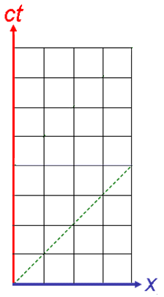
Option A: Relativity
A.3 – Spacetime diagrams
Time dilation – Another look at the twin paradox
•Superimposing S’ on S, during the outward journey we see the simple time dilation of the spacetime geometry.
•Now, instead of Einstein decelerating, turning around, and accelerating in the opposite direction to return, he hands off his clock to Max Planck, who is already traveling back to Earth at the return speed.
•Note the jump discontinuity at the clock hand-off. This is where the clock accelerated to a new “time zone” and the twin aged most rapidly.
Notes:
© 2014 By Timothy K. Lund

Slide 50
Option A: Relativity
A.3 – Spacetime diagrams
The speed of light – Setting c = 1
•Suppose we had chosen the metric system’s unit of length to be, for example,
1 “light-unit” = the distance light travels in 1 second.
•Then the speed of light c would be
c = 1 LU / 1 second = 1 LU s⁻¹.
•All of our equations and spacetime diagrams would simplify:
γ = (1 – v²)^{-1/2} ,
x’ = γ(x – vt),
t’ = γ(t – xv),
(Δs)² = (Δx)² – (Δt)²,
θ = tan⁻¹( v ).
Note that v would always be less than or equal to c.
Note the x’, t’ symmetry.
Note that the ct axis would become the t axis.
Notes:
© 2014 By Timothy K. Lund

Slide 51
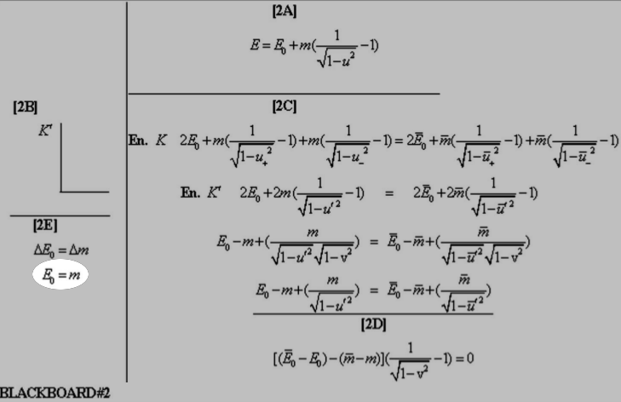
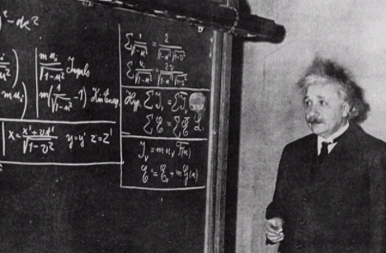
Option A: Relativity
A.3 – Spacetime diagrams
The speed of light – Setting c = 1
c²
c²
Note that c is 1 in Einstein’s 1934 Pittsburg presentation.
Notes:
© 2014 By Timothy K. Lund

