Slide 1
Option A: Relativity
A.2 – Lorentz transformations
Essential idea: Observers in relative uniform motion disagree on the numerical values of space and time coordinates for events, but agree with the numerical value of the speed of light in a vacuum. The Lorentz transformation equations relate the values in one reference frame to those in another. These equations replace the Galilean transformation equations that fail for speeds close to that of light.
Notes:
© 2014 By Timothy K. Lund

Slide 2
Option A: Relativity
A.2 – Lorentz transformations
Nature of science: Pure science: Einstein based his theory of relativity on two postulates and deduced the rest by mathematical analysis. The first postulate integrates all of the laws of physics including the laws of electromagnetism, not only Newton’s laws of mechanics.
Notes:
© 2014 By Timothy K. Lund

Slide 3
Option A: Relativity
A.2 – Lorentz transformations
Understandings:
• The two postulates of special relativity
• Clock synchronization
• The Lorentz transformations
• Velocity addition
• Invariant quantities (spacetime interval, proper time, proper length and rest mass)
• Time dilation
• Length contraction
• The muon decay experiment
Notes:
© 2014 By Timothy K. Lund

Slide 4
Option A: Relativity
A.2 – Lorentz transformations
Applications and skills:
• Using the Lorentz transformations to describe how different measurements of space and time by two observers can be converted into the measurements observed in either frame of reference
• Using the Lorentz transformation equations to determine the position and time coordinates of various events
• Using the Lorentz transformation equations to show that if two events are simultaneous for one observer but happen at different points in space, then the events are not simultaneous for an observer in a different reference frame
Notes:
© 2014 By Timothy K. Lund

Slide 5
Option A: Relativity
A.2 – Lorentz transformations
Applications and skills:
• Solving problems involving velocity addition
• Deriving the time dilation and length contraction equations using the Lorentz equations
• Solving problems involving time dilation and length contraction
• Solving problems involving the muon decay experiment
Notes:
© 2014 By Timothy K. Lund

Slide 6
Option A: Relativity
A.2 – Lorentz transformations
Guidance:
• Problems will be limited to one dimension
• Derivation of the Lorentz transformation equations will not be examined
• Muon decay experiments can be used as evidence for both time dilation and length contraction
Data booklet reference:
• γ = (1 – v² / c²)^{-1/2}
• x’ = γ (x – vt); ∆x’ = γ (∆x – v∆t)
• t’ = γ (t – vx / c²); ∆t’ = γ (∆t – v∆x / c²)
• u’ = (u – v) / (1 – uv / c²)
• ∆t = γ∆t₀
• L = L₀ / γ
• (ct’ )² – (x’ )² = (ct)² – (x)²
Notes:
© 2014 By Timothy K. Lund

Slide 7
Option A: Relativity
A.2 – Lorentz transformations
Utilization:
• Once a very esoteric part of physics, relativity ideas about space and time are needed in order to produce accurate global positioning systems (GPS)
Aims:
• Aim 2: the Lorentz transformation formulae provide a consistent body of knowledge that can be used to compare the description of motion by one observer to the description of another observer in relative motion to the first
• Aim 3: these formulae can be applied to a varied set of conditions and situations
• Aim 9: the introduction of relativity pushed the limits of Galilean thoughts on space and motion
Notes:
© 2014 By Timothy K. Lund

Slide 8
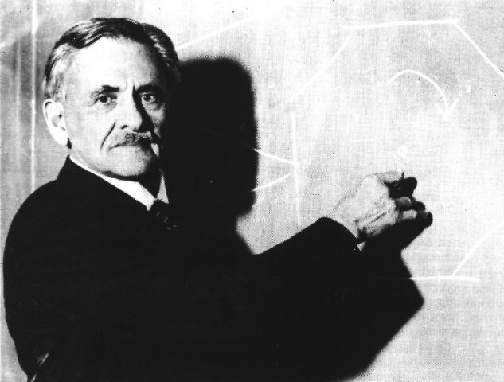

Option A: Relativity
A.2 – Lorentz transformations
The Lorentz-FitzGerald contraction
•In addition to Maxwell’s theory, another discovery leading up to special relativity was the Michelson-Morley experiment.
•A large vat was filled with liquid mercury on which was floated a slab of stone.
•On the slab was an interferometer which could be freely rotated with the slab.
•The interferometer used a beam splitter which insured that the two beams were coherent.
Michelson
Mirrors
Floating table of heavy marble
Vat of liquid mercury
Detector
Beam splitter
Source
FYI
•The mercury allowed easy rotation and absorbed vibrations from road traffic outside the lab.
Notes:
© 2014 By Timothy K. Lund

Slide 9
Option A: Relativity
A.2 – Lorentz transformations
The Lorentz-FitzGerald contraction
•The basic idea behind the device was that as the floating table was rotated, the beam parallel to the earth's orbital velocity would squish.
•The beam perpendicular to the earth's orbital velocity would act as the control – it would not be squished.
•In the region where the beams rejoined, interference would be detected.
•Destructive interference would result in seeing dark zones in the detector eyepiece during slab rotation.
•Constructive interference would result in seeing bright zones in the detector eyepiece during slab rotation.
v_{orb}
Doppler effect
Squished beam
Mirrors
Vat of liquid mercury
Detector
Beam splitter
Source
Region of interference
Control beam
Notes:
© 2014 By Timothy K. Lund

Slide 10
Option A: Relativity
A.2 – Lorentz transformations
The Lorentz-FitzGerald contraction
•The experiment showed that no amount of slab rotation produced any interference whatsoever.
•These “null” results baffled scientists who thought that being a wave, light must (a) travel through a medium and (b) be subject to the Doppler effect.
•They gave the particular medium through which the light wave propagated the name ether and assumed that the ether permeated all of space, and even matter itself (like glass, and other transparent materials).
•The MM experiment was really a method to determine how fast Earth was moving through the ether, and thus of establishing an absolute frame of reference, that of the ether.
Notes:
© 2014 By Timothy K. Lund

Slide 11
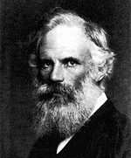
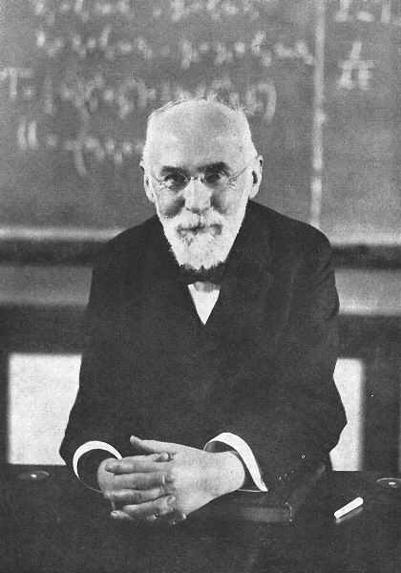
Option A: Relativity
A.2 – Lorentz transformations
The Lorentz-FitzGerald contraction
•An Irish physicist by the name of George FitzGerald proposed that if the length of an object contracted in the direction of motion by a factor that was dependent on the speed of the object, then the null result could be explained.
•At the same time a mathematician by the name of H. A. Lorentz determined the same thing.
•The Lorentz-FitzGerald contraction was determined to be given by
where L₀ is the “rest” length of the object.
L = L₀ 1 – v² / c²
Lorentz-FitzGerald contraction
Notes:
© 2014 By Timothy K. Lund

Slide 12


Option A: Relativity
A.2 – Lorentz transformations
The Lorentz-FitzGerald contraction
PRACTICE: According to the Lorentz-FitzGerald contraction, what would be the length of a rocket ship which was traveling at 0.5c in the direction of its length, if its rest length were 60 m?
SOLUTION:
•Simply substitute values into :
L = L₀ 1 – v² / c²
Lorentz-FitzGerald contraction
L = L₀ 1 – v² / c²
L = 60 1 – (.5c)² / c²
60 m
v = 0
L = 60 1 – .25c² / c²
L = 60 1 – .25
52 m
v = 0.5c
L = 60 0.75
L = 52 m
This is a 15% reduction in length!
Notes:
© 2014 By Timothy K. Lund

Slide 13
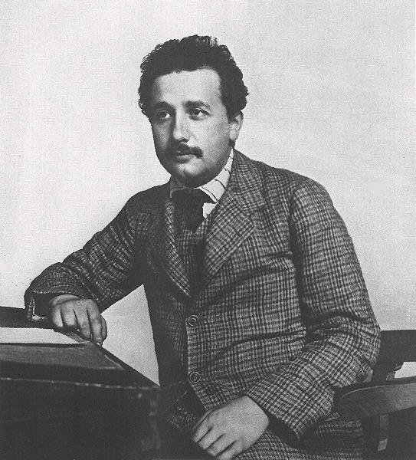
Option A: Relativity
A.2 – Lorentz transformations
The two postulates of special relativity
•Einstein, in the publication of his special theory of relativity, stated the following two postulates:
(1) The laws of physics are the same in all inertial reference frames (IRFs).
(2) The speed of light is the same in all inertial reference frames.
•His 1st postulate is the product of his philosophical beliefs (and probably yours, as well).
•His 2nd postulate is driven by Maxwell’s equations.
•A happy consequence of his 2nd postulate is that it also predicts the Lorentz-FitzGerald contraction.
Notes:
© 2014 By Timothy K. Lund

Slide 14

Option A: Relativity
A.2 – Lorentz transformations
The two postulates of special relativity
PRACTICE: How fast does the headlight beam travel in each of the reference frames according to the Galilean transformations?
SOLUTION:
•For someone on the ground the speed of each beam would be 1c + .5c = 1.5c, and the speeds at which the beams approach each other is 1.5c + 1.5c = 3c.
•For someone in a locomotive his own beam would have a speed of 1c and the beam from the other locomotive would be 0.5c + (0.5c + 1c) = 2c.
c
c
0.5c
0.5c
Notes:
© 2014 By Timothy K. Lund

Slide 15
Option A: Relativity
A.2 – Lorentz transformations
The two postulates of special relativity
PRACTICE: How fast does the headlight beam travel in each of the reference frames according to Einstein’s 2nd postulate?
SOLUTION:
•For someone on the ground each beam would be traveling at 1c!
•For someone in a locomotive his own beam would have a speed of 1c and the beam from the other locomotive would be 1c!
•The beams approach each other at 1c!
c
c
0.5c
0.5c
Postulate 2) The speed of light is the same in all inertial reference frames.
Notes:
15
© 2014 By Timothy K. Lund

Slide 16



Option A: Relativity
A.2 – Lorentz transformations
Time dilation – the light clock
•Dobson is standing in a room S₀ having a height L that has a light source on the floor and a mirror on the ceiling.
•When Dobson turns on the light he can measure the time ∆t₀ it takes the light to travel from the floor to the ceiling and back to the floor again.
•Since Dobson knows the speed of the light is c₀ and the distance traveled by the flash is L up and L back down, he uses c₀ = 2L / ∆t₀ and determines that his stopwatch will measure
This is a “light clock.”
L
(S₀)
∆t₀ = 2L / c₀
light clock time in S₀
Notes:
© 2014 By Timothy K. Lund

Slide 17
Option A: Relativity
A.2 – Lorentz transformations
Time dilation – the light clock
•Now suppose Dobson’s room (S₀) is traveling to the right at a velocity v while his twin brother Nosbod stands outside the room on the ground (S).
•Nosbod measures the same flash of light to travel from floor to ceiling and back to the floor to be a time ∆t.
L
L
(S)
(S₀)
v
(S₀)
v
Notes:
© 2014 By Timothy K. Lund

Slide 18
Option A: Relativity
A.2 – Lorentz transformations
Time dilation – the light clock
•For Nosbod (S) the light beam actually travels a distance of 2D. Thus
•The base of the triangle is given by v∆t.
•From the Pythagorean theorem D² = L² + (v∆t / 2)² or
(2D)² = (2L)² + (v∆t)².
L
D
D
D
D
L
v∆t
v∆t
2
2
(S)
v∆t
(S₀)
v
(S₀)
v
∆t = 2D / c
light clock time in S
Notes:
© 2014 By Timothy K. Lund

Slide 19
Option A: Relativity
A.2 – Lorentz transformations
Time dilation – the light clock
•From (2D)² = (2L)² + (v∆t)² and the two times measured in S₀ and S we can write the following:
2L = c₀∆t₀
2D = c∆t
(2D)² = (2L)² + (v∆t)²
(c∆t)² = (c₀∆t₀)² + (v∆t)²
∆t₀ = 2L / c₀
light clock time in S₀
∆t = 2D / c
light clock time in S
FYI
•This last formula gives the relationship between the times measured by the brothers and the speed of light in their respective coordinate systems.
Notes:
© 2014 By Timothy K. Lund

Slide 20
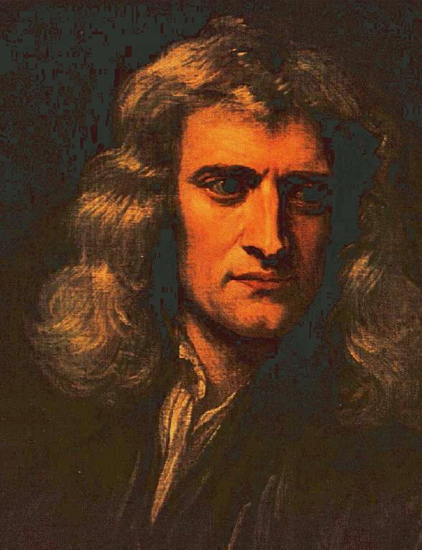
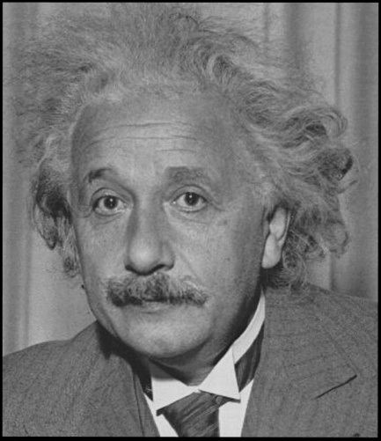
Option A: Relativity
A.2 – Lorentz transformations
Time dilation – the 2nd postulate
•According to Newton "Absolute, true time, of itself and from its own nature, flows equably without relation to anything external."
•Thus for Newton, ∆t = ∆t₀, regardless of speed.
•From (c∆t)² = (c₀∆t₀)² + (v∆t)², then, we can cancel the times and we arrive at c² = c₀² + v², which shows that c is greater than c₀.
•This is in violation of Einstein’s 2nd postulate, which says that the speed of light is the same in all IRFs.
FYI
•Newton’s belief in absolute time is incorrect! Time elapses differently in different inertial reference frames!
Notes:
© 2014 By Timothy K. Lund

Slide 21

Option A: Relativity
A.2 – Lorentz transformations
Time dilation – the 2nd postulate
•According to Einstein “The speed of light c is the same in all inertial reference frames."
•Thus for Einstein, c = c₀.
•Then (c∆t)² = (c₀∆t₀)² + (v∆t)² becomes
(c∆t)² = (c∆t₀)² + (v∆t)²
(c∆t)² - (v∆t)² = (c∆t₀)²
c²∆t ² - v²∆t ² = c²∆t₀²
(c² - v²)∆t ² = c²∆t₀²
(1 - v² / c²)∆t ² = ∆t₀²
∆t ² = ∆t₀² / (1 - v² / c²)
The IBO expects you to be able to derive this formula! Sorry :(
1
time dilation
∆t = γ ∆t₀
where γ =
1 – v² / c²
Notes:
© 2014 By Timothy K. Lund

Slide 22
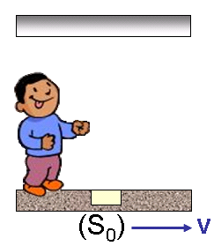

Option A: Relativity
A.2 – Lorentz transformations
Time dilation – proper time
•From the time dilation formula we see that each IRF has its own time. There is no absolute time!
•We will explore the differences between the two times in the following examples. But first…
•We define the proper time ∆t₀ as the time measured in the frame in which the events do not change spatial position. Dobson (S₀) is in the proper reference frame for the events (the light beam leaving the floor, and the light beam returning to the floor).
1
time dilation
∆t = γ ∆t₀
where γ =
1 – v² / c²
Spatial position does not change in S₀.
Thus Dobson measures proper time ∆t₀.
Notes:
© 2014 By Timothy K. Lund

Slide 23

Option A: Relativity
A.2 – Lorentz transformations
Time dilation
1
time dilation
∆t = γ ∆t₀
where γ =
1 – v² / c²
PRACTICE: Suppose S₀ has relative speed of v = 0.75c with respect to S. (a) Find the value of γ. (b) If Dobson measures the time to cook a 3-minute egg in S₀, how long does Nosbod measure the same event in S?
SOLUTION:
(a) γ = [ 1 - v² / c² ] ^{-1/2}
= [ 1 - (0.75c)² / c² ] ^{-1/2}
= [ 1 - 0.75²c² / c² ] ^{-1/2}
= [ 0.4375 ] ^{-1/2} = 1.5.
(b) ∆t = γ ∆t₀
= 1.5(3 min) = 4.5 min!
(S)
↑
Note that time elapses more quickly for Nosbod!
Notes:
© 2014 By Timothy K. Lund

Slide 24
Option A: Relativity
A.2 – Lorentz transformations
The Lorentz factor
•We call γ the Lorentz factor. The Lorentz factor shows up in all of the relativistic equations.
1
time dilation
∆t = γ ∆t₀
where γ =
1 – v² / c²
EXAMPLE: Sketch and annotate a graph showing the variation with relative velocity of the Lorentz factor γ.
SOLUTION: Note that γ = 1 when v = 0, and that γ approaches ∞ as v approaches c:
•Thus v / c = 0 when v = 0 and γ = 1.
•Thus v / c = 1 when v = c and γ = ∞.
•If v > c what happens to γ?
v / c
asymptote
1
0
1
∞
γ
Notes:
© 2014 By Timothy K. Lund

Slide 25
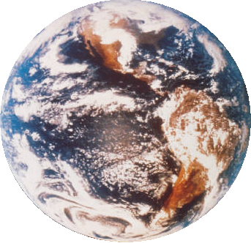

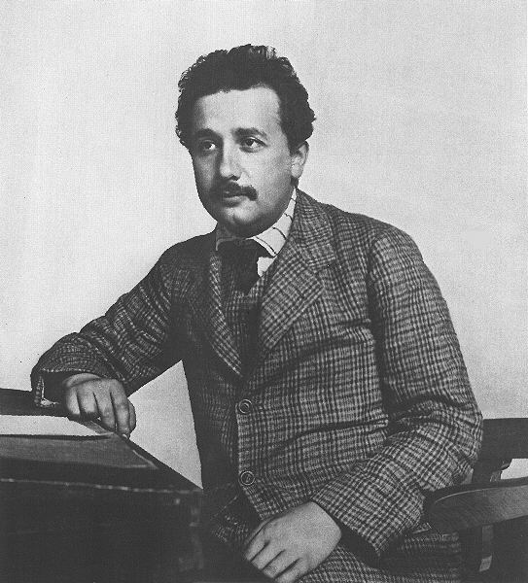
Option A: Relativity
A.2 – Lorentz transformations
Time dilation – the twin paradox
EXAMPLE: Suppose Einstein has a twin brother who stays on Earth while Einstein travels at great speed in a spaceship. When he returns to Earth, Einstein finds that his twin has aged more than himself! Explain why this is so.
SOLUTION: Since Einstein is in the moving spaceship, his clock ticks more slowly. But his twin’s ticks at its Earth rate. The twin is thus older than Einstein on his return!
By the way, this is NOT the paradox. The paradox is on the next slide…
Notes:
© 2014 By Timothy K. Lund

Slide 26
Option A: Relativity
A.2 – Lorentz transformations
Time dilation – the twin paradox
EXAMPLE: The twin paradox: From Einstein’s perspective Einstein is standing still, but his twin is moving (with Earth) in the opposite direction. Thus Einstein’s twin should be the one to age more slowly. Why doesn’t he?
SOLUTION: The “paradox” is resolved by general relativity (which is the relativity of non-inertial reference frames). It turns out that because Einstein’s spaceship is the reference frame that actually accelerates, his is the one that “ages” more slowly.
FYI
•The standard level IB papers do not require more general relativity than is in the twin paradox explanation.
Notes:
© 2014 By Timothy K. Lund

Slide 27

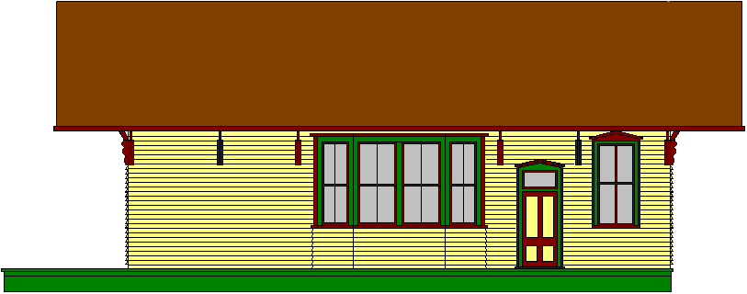


Option A: Relativity
A.2 – Lorentz transformations
Length contraction – proper length
•We define the proper length L₀ as the length of an object as measured in its rest frame.
•For example, Nosbod is able to measure the proper distance between the cones resting at the ends of the station platform to be L₀…
…but Dobson, on the moving train, is not.
v
(S₀)
(S)
L₀
Notes:
© 2014 By Timothy K. Lund

Slide 28
Option A: Relativity
A.2 – Lorentz transformations
Length contraction
•Both parties agree on the velocity v of the train.
•Furthermore, the time between the events (train at first cone, then train at second cone) can be timed by both parties.
v
(S₀)
(S)
L₀
Notes:
© 2014 By Timothy K. Lund

Slide 29
Option A: Relativity
A.2 – Lorentz transformations
Length contraction – proper time
•As you watch the animation, note that both events occur directly opposite Dobson (S₀), but they are spatially separated in Nosbod’s frame (S).
•Thus Dobson (S₀) measures proper time ∆t₀.
•For Dobson, the platform has length L = v∆t₀.
•For Nosbod, the platform has length L₀ = v∆t.
v
(S₀)
(S)
L₀
Notes:
© 2014 By Timothy K. Lund

Slide 30
Option A: Relativity
A.2 – Lorentz transformations
Length contraction
PRACTICE: Show that L = L₀ / γ.
SOLUTION: Use ∆t = γ∆t₀, L = v∆t₀, and L₀ = v∆t.
•From L₀ = v∆t and ∆t = γ∆t₀ we get L₀ = γ v∆t₀.
•Since L = v∆t₀ we can then write L₀ = γ L. Thus
L = L₀ / γ
Length contraction
Note that this is the same as the Lorentz-FitzGerald contraction!
v
(S₀)
(S)
L₀
Notes:
© 2014 By Timothy K. Lund

Slide 31
Option A: Relativity
A.2 – Lorentz transformations
Length contraction
PRACTICE: Nosbod (S) measures the length of the platform to be 15 m and the speed of the train to be 0.75c. What is the length of the platform in Dobson’s IRF (S₀)?
SOLUTION: Use L = L₀ / γ and γ = 1.5 (from before).
•L = 15 / 1.5 = 10 m.
v
(S₀)
(S)
L₀
Notes:
© 2014 By Timothy K. Lund

Slide 32

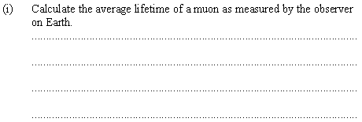
Option A: Relativity
A.2 – Lorentz transformations
Solving problems involving the muon decay
•2.2×10⁻⁶ is the proper time because it is measured in the frame of the muon.
•γ = 1 / (1 - 0.98²)^{1/2} = 1 / 0.0396^{1/2} = 5.025.
•∆t = γ ∆t₀ = 5.025(2.2×10⁻⁶) = 1.1×10⁻⁵ s.
Notes:
© 2014 By Timothy K. Lund

Slide 33
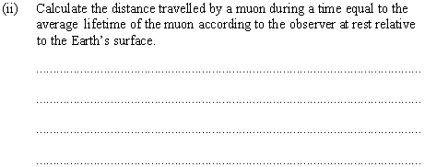
Option A: Relativity
A.2 – Lorentz transformations
Solving problems involving the muon decay
•For Earth observer use ∆t = 1.1×10⁻⁵ s.
•Then d = v ∆t = 0.98(3.00×10⁸)(1.1×10⁻⁵) = 3234 m.
Notes:
© 2014 By Timothy K. Lund

Slide 34
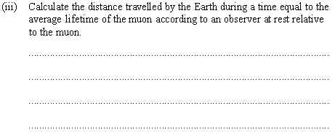
Option A: Relativity
A.2 – Lorentz transformations
Solving problems involving the muon decay
•For muon observer use ∆t₀ = 2.2×10⁻⁶ s.
•Then d = v ∆t = 0.98(3.00×10⁸)(2.2×10⁻⁶) = 647 m.
Notes:
© 2014 By Timothy K. Lund

Slide 35
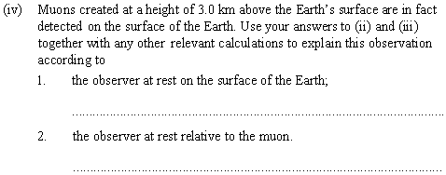
Option A: Relativity
A.2 – Lorentz transformations
Solving problems involving the muon decay
•The earth IRF allows the muon to make it 3 km (3234 m) and be observed because of time dilation.
•For the muon IRF, the distance to Earth is L = L₀/ γ so that L = 3234 / 5.025 = 643 m.
•Length contraction is occurring in the muon IRF.
Notes:
© 2014 By Timothy K. Lund

Slide 36
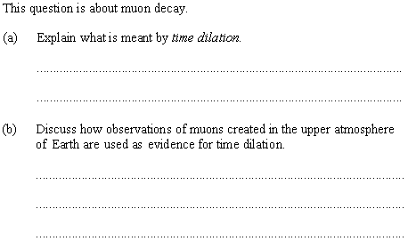
Option A: Relativity
A.2 – Lorentz transformations
Solving problems involving the muon decay
•Time dilation is the relativistic effect that causes time to elapse more slowly in a fast-moving IRF.
•As the previous example showed, if time dilation did NOT occur, a muon created at 3 km would not live long enough to be detected.
•But muons ARE detected, providing evidence that time dilation occurs.
Notes:
© 2014 By Timothy K. Lund

Slide 37
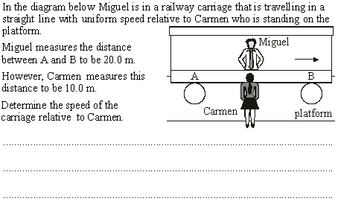
Option A: Relativity
A.2 – Lorentz transformations
Length contraction – proper length
•From L = L₀ / γ we see that γ = 2.
•But γ = (1 – v² / c²) ^{-1/2} = 2 so that (1 – v² / c²)^{+1/2} = 0.5.
•Thus 1 – v² / c² = 0.5² = 0.25.
•Then v² / c² = 0.75 so that v = 0.866c.
Notes:
© 2014 By Timothy K. Lund

Slide 38

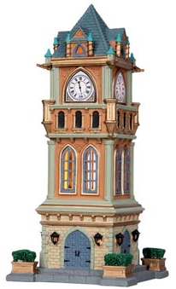

Option A: Relativity
A.2 – Lorentz transformations
The concept of simultaneity
•Consider a village clock tower that is just on the verge of striking noon.
•Consider two observers: A man standing on the village green, and an alien in a rocket skimming the green at high speed, both the same distance from the clock.
•At the stroke of noon, light from the clock reflects to both the man and the alien:
•Note that the alien “sees” noon later than the man!
Notes:
© 2014 By Timothy K. Lund

Slide 39
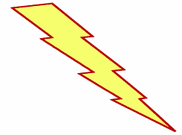



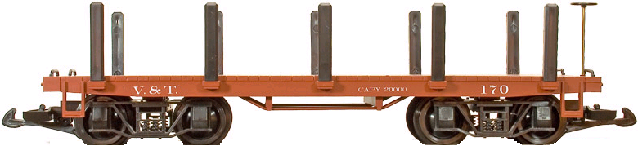
Option A: Relativity
A.2 – Lorentz transformations
The concept of simultaneity
•Consider a man centered on a moving flatcar and being observed by another man standing on the ground.
•At precisely the instant the two observers are opposite each other lightening bolts strike both ends of the flatcar.
•Note that the stationary observer saw the bolts simultaneously, but the moving one did not!
Notes:
© 2014 By Timothy K. Lund

Slide 40
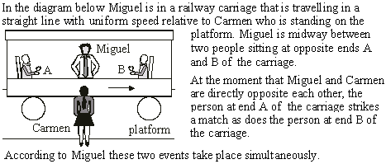

Option A: Relativity
A.2 – Lorentz transformations
The concept of simultaneity – events
•Since he is “midway” the light will reach him simultaneously from both matches.
Notes:
© 2014 By Timothy K. Lund

Slide 41

Option A: Relativity
A.2 – Lorentz transformations
The concept of simultaneity – events
•She will see light from A before light from B because her reference frame is “moving” toward A and away from B.
Notes:
41
© 2014 By Timothy K. Lund

Slide 42
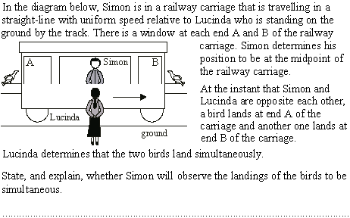
Option A: Relativity
A.2 – Lorentz transformations
The concept of simultaneity – events
•Simon will not see simultaneity but will see bird B first since he is approaching its light and receding from bird A’s light.
Notes:
© 2014 By Timothy K. Lund

Slide 43
Option A: Relativity
A.2 – Lorentz transformations
Clock synchronization
•In light of the concept of simultaneity, due to the finite speed of licht c, one can see that synchronizing clocks that are very far apart can be difficult.
•There are two ways to synchronize two clocks.
Method 1: With the two clocks very close together, synchronize them. Then move them very slowly to their final positions.
Method 2: Synchronize one clock with a third clock that is very close, then move the third clock to the other one very slowly and synchronize it.
FYI
•Why do we move the clocks very slowly?
Because of time dilation.
Notes:
43
© 2014 By Timothy K. Lund

Slide 44
Option A: Relativity
A.2 – Lorentz transformations
The Lorentz transformations
•Because time and distance comparisons between two IRFs are dependent on the relative velocity of the two frames, the Galilean transformations must be adjusted.
Galilean transformations |  | Lorentz transformations
Galilean | Inverse Galilean | Lorentz | Inverse Lorentz
x’ = x – vt | x = x’ + vt | x’ = γ(x – vt) | x = γ(x’ + vt’)
y’ = y | y = y’ | y’ = y | y = y’
z’ = z | z = z’ | z’ = z | z = z’
t’ = t | t = t’ | t’ = γ(t – vx / c²) | t = γ(t’ + vx’ / c²)
FYI
•These transformations assume v_{x} = v, and v_{y} = v_{z} = 0.
•To obtain the inverse transformations, simply change the sign of v and switch unprimed and primed symbols.
↑ In data booklet…
Notes:
44
© 2014 By Timothy K. Lund

Slide 45
Option A: Relativity
A.2 – Lorentz transformations
The Lorentz transformations
x’ = γ(x – vt)
t’ = γ(t – vx / c²)
Lorentz transformations
EXAMPLE: Show that Δx’ = γ(Δx – vΔt).
SOLUTION: Use x’ = γ(x – vt).
•Thus x₂’ = γ(x₂ – vt₂) and x₁’ = γ(x₁ – vt₁) so that
Δx’ = x₂’ – x₁’
= γ(x₂ – vt₂) – γ(x₁ – vt₁)
= γx₂ – γvt₂ – γx₁ + γvt₁
= γx₂ – γx₁ – γvt₂ + γvt₁
= γ(x₂ – x₁) – γv(t₂ – t₁)
= γ(Δx – vΔt).
← In data booklet…
Notes:
45
© 2014 By Timothy K. Lund

Slide 46
Option A: Relativity
A.2 – Lorentz transformations
The Lorentz transformations
x’ = γ(x – vt)
t’ = γ(t – vx / c²)
Lorentz transformations
EXAMPLE: Clocks in two IRFs S and S’ are synchronized so that x = x’ = 0.00 m at t = t’ = 0.00 s. Frame S’ has a speed of v = 0.50c relative to S.
Find the value of the Lorentz factor.
SOLUTION:
γ = [ 1 - v² / c² ] ^{-1/2}
= [ 1 – 0.50²c² / c² ] ^{-1/2}
= [ 1 – 0.50² ] ^{-1/2}
= [ 0.75 ] ^{-1/2}
= 1.15.
Notes:
46
© 2014 By Timothy K. Lund

Slide 47
Option A: Relativity
A.2 – Lorentz transformations
The Lorentz transformations
x’ = γ(x – vt)
t’ = γ(t – vx / c²)
Lorentz transformations
EXAMPLE: Clocks in two IRFs S and S’ are synchronized so that x = x’ = 0.00 m at t = t’ = 0.00 s. Frame S’ has a speed of v = 0.50c relative to S.
Two events occur in frame S:
Ev 1: x₁ = 10.0 m, y₁ = 0.00 m, z₁ = 0.00 m, t₁ = 0.35 μs.
Ev 2: x₂ = 50.0 m, y₂ = 0.00 m, z₂ = 0.00 m, t₂ = 0.55 μs.
Find the values of Δx and Δt.
SOLUTION:
Δx = x₂ – x₁ = 50.0 – 10.0 = 40.0 m.
Δt = t₂ – t₁ = 0.55 – 0.35 = 0.20 μs.
Notes:
47
© 2014 By Timothy K. Lund

Slide 48
Option A: Relativity
A.2 – Lorentz transformations
The Lorentz transformations
x’ = γ(x – vt)
t’ = γ(t – vx / c²)
Lorentz transformations
EXAMPLE: Clocks in two IRFs S and S’ are synchronized so that x = x’ = 0.00 m at t = t’ = 0.00 s. Frame S’ has a speed of v = 0.50c relative to S.
Two events occur in frame S:
Ev 1: x₁ = 10.0 m, y₁ = 0.00 m, z₁ = 0.00 m, t₁ = 0.35 μs.
Ev 2: x₂ = 50.0 m, y₂ = 0.00 m, z₂ = 0.00 m, t₂ = 0.55 μs.
Find the value of Δx’ for the same events in S’.
SOLUTION:
Δx’ = γ(Δx – vΔt)
= 1.15(40.0 – 0.50×3×10⁸×0.20×10⁻⁶) = 11.5 m.
Notes:
48
© 2014 By Timothy K. Lund

Slide 49
Option A: Relativity
A.2 – Lorentz transformations
The Lorentz transformations
x’ = γ(x – vt)
t’ = γ(t – vx / c²)
Lorentz transformations
EXAMPLE: Clocks in two IRFs S and S’ are synchronized so that x = x’ = 0.00 m at t = t’ = 0.00 s. Frame S’ has a speed of v = 0.50c relative to S.
Two events occur in frame S:
Ev 1: x₁ = 10.0 m, y₁ = 0.00 m, z₁ = 0.00 m, t₁ = 0.35 μs.
Ev 2: x₂ = 50.0 m, y₂ = 0.00 m, z₂ = 0.00 m, t₂ = 0.55 μs.
Find the value of t₁’ for the same event in S’.
SOLUTION:
t₁’ = γ(t₁ – vx₁ / c²)
= 1.15(0.35×10⁻⁶ – 0.50c×10.0 / c²) = 3.83 ×10⁻⁷ s.
Notes:
49
© 2014 By Timothy K. Lund

Slide 50
Option A: Relativity
A.2 – Lorentz transformations
The Lorentz transformations
x’ = γ(x – vt)
t’ = γ(t – vx / c²)
Lorentz transformations
EXAMPLE: Clocks in two IRFs S and S’ are synchronized so that x = x’ = 0.00 m at t = t’ = 0.00 s. Frame S’ has a speed of v = 0.50c relative to S.
Two events occur in frame S:
Ev 1: x₁ = 10.0 m, y₁ = 0.00 m, z₁ = 0.00 m, t₁ = 0.35 μs.
Ev 2: x₂ = 50.0 m, y₂ = 0.00 m, z₂ = 0.00 m, t₂ = 0.55 μs.
Find the value of t₂’ for the same event in S’.
SOLUTION:
t₂’ = γ(t₂ – vx₂ / c²)
= 1.15(0.55×10⁻⁶ – 0.50c×50.0 / c²) = 5.37×10⁻⁷ s.
Notes:
50
© 2014 By Timothy K. Lund

Slide 51
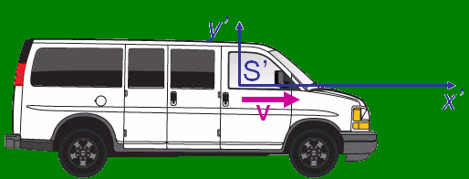

Option A: Relativity
A.2 – Lorentz transformations
Velocity addition
•Consider IRFs S and S’, as before, where S’ is moving at velocity v in S’s reference frame.
•If the ball is moving with a velocity u’ with respect to IRF S’, what will its speed u be wrt IRF S?
•From the Galilean formula for velocity addition, it will have a velocity u = u’ + v, or we can write u’ = u – v.
y
S
x
Notes:
51
© 2014 By Timothy K. Lund

Slide 52
Option A: Relativity
A.2 – Lorentz transformations
Velocity addition
•Since both distance and time are relative, u’ = u – v is not valid at high velocities.
•But we can still use the good old definition of velocity in each reference frame, and the Lorentz transformations, to derive the relativistic velocity addition formula.
•First of all, within each IRF, u = Δx / Δt and u’ = Δx’ / Δt’.
y
S
x
Notes:
52
© 2014 By Timothy K. Lund

Slide 53
Option A: Relativity
A.2 – Lorentz transformations
Velocity addition
•Recall that Δx’ = γ(Δx – v Δt) and Δt’ = γ(Δt – v Δx / c²).
•Then from u’ = Δx’ / Δt’ and Δx = uΔt we get
•The γ s and the Δt s cancel.
•Exchanging the roles of S and S’ we can write
Δx’
γ(Δx – v Δt)
γ(uΔt – v Δt)
u’ =
=
=
Δt’
γ(Δt – v Δx / c²)
γ(Δt – v uΔt / c²)
u’ = (u – v) / [1 – uv / c² ]
velocity addition
u = (u’ + v) / [1 + u’v / c² ]
velocity addition
FYI
•Compare with the Galilean velocity addition formula.
•Note that if uv << c² that the relativistic velocity addition formulas reduce to the Galilean formulas.
Notes:
53
© 2014 By Timothy K. Lund

Slide 54


Option A: Relativity
A.2 – Lorentz transformations
Velocity addition
EXAMPLE: The relative velocity between S’ and S is 0.75c. A satellite is launched from S’ with a speed of 0.50c relative to S’. Find the speed of the satellite relative to S.
SOLUTION: Use u = (u’ + v) / [1 + u’v / c² ]
•Note that u’ = 0.50c and v = 0.75c.
u = (u’ + v) / [1 + u’v / c² ]
= (0.50c + 0.75c) / [1 + 0.50c×0.75c / c² ]
= 1.25c / [1 + 0.375] = 0.91c.
•Note that the Galilean sum is 1.25c: Not possible!
Notes:
54
© 2014 By Timothy K. Lund

Slide 55
Option A: Relativity
A.2 – Lorentz transformations
Velocity addition
EXAMPLE: The relative velocity between S’ and S is 0.75c. A photon is launched from S’ with a speed of c relative to S’. Find the speed of the photon relative to S.
SOLUTION: Use u = (u’ + v) / [1 + u’v / c² ]
•Note that u’ = 1.00c and v = 0.75c.
u = (u’ + v) / [1 + u’v / c² ]
= (1.00c + 0.75c) / [1 + 1.00c×0.75c / c² ]
= 1.75c / [1 + 0.75] = c.
•Note that the light travels at exactly c in BOTH reference frames, in accordance with the 2nd postulate.
Notes:
55
© 2014 By Timothy K. Lund

Slide 56
Option A: Relativity
A.2 – Lorentz transformations
Velocity addition
EXAMPLE: The relative velocity between S’ and S is 0.75c. A satellite is launched from S’ with a speed of 0.50c relative to S. Find the speed of the satellite relative to S’.
SOLUTION: Use u’ = (u – v) / [1 – uv / c² ]
•Note that u = 0.50c and v = 0.75c.
u’ = (u – v) / [1 – uv / c² ]
= (0.50c – 0.75c) / [1 – 0.50c×0.75c / c² ]
= -0.25c / [1 – 0.375] = -0.40c.
•Note that it was launched toward S (the negative).
Notes:
56
© 2014 By Timothy K. Lund

Slide 57


Option A: Relativity
A.2 – Lorentz transformations
Velocity addition
EXAMPLE: Two rockets take off from Earth and travel in opposite directions, each at 0.750c relative to Earth. How fast are they traveling relative to one another?
SOLUTION: Because there are three reference frames in this problem instead of just S and S’, we can treat the left rocket as S (and stationary), Earth as S’ (and moving at v = 0.750c to the right), and the other rocket as the “satellite” (launched from Earth) with u’ = 0.750c.
The next slide shows the solution:
Notes:
57
© 2014 By Timothy K. Lund

Slide 58
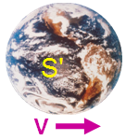


Option A: Relativity
A.2 – Lorentz transformations
Velocity addition
EXAMPLE: Two rockets take off from Earth and travel in opposite directions, each at 0.750c relative to Earth. How fast are they traveling relative to one another?
SOLUTION:
u = (u’ + v) / [1 + u’v / c² ]
= (0.750c + 0.750c) / [1 + 0.750c×0.750c / c² ]
= 1.50c / [1 + 0.5625]
= 0.960c.
Notes:
58
© 2014 By Timothy K. Lund

Slide 59
Option A: Relativity
A.2 – Lorentz transformations
Invariant quantities – the spacetime interval
•If we were in Newtonian space, the distance Δs between two points in 3-space would be given by the Pythagorean theorem:
•This formula would be valid an any IRF, regardless of relative speed. Thus the distance could be represented with primed letters, as well.
•It is the case, in Newtonian space, that (Δs)² = (Δs’)² and we say that the space interval is invariant in Newtonian space. Observers in both IRFs would agree on their respective measurements of the space interval.
(Δs)² = (Δx)² + (Δy)² + (Δz)²
space interval
(Δs’)² = (Δx’)² + (Δy’)² + (Δz’)²
space interval
Notes:
59
© 2014 By Timothy K. Lund

Slide 60
Option A: Relativity
A.2 – Lorentz transformations
Invariant quantities – the spacetime interval
•Now that we know that space is not Newtonian (at least at high speeds), we know that the Newtonian space interval formula fails.
•Instead we add a corrective factor to the Euclidean form of the Pythagorean theorem:
•It is the case, in “Einsteinian” space, that (Δs)² = (Δs’)² and we say that the spacetime interval is invariant in “Einsteinian” space. Observers in both IRFs would agree on their respective measurements of the spacetime interval.
(Δs)² = (Δx)² + (Δy)² + (Δz)²
space interval
(Δs)² = (Δx)² + (Δy)² + (Δz)² – (cΔt)²
spacetime interval
(Δs’)² = (Δx’)² + (Δy’)² + (Δz’)² – (cΔt’)²
Notes:
60
© 2014 By Timothy K. Lund

Slide 61
Option A: Relativity
A.2 – Lorentz transformations
Invariant quantities – the spacetime interval
•The data booklet assumes no y and z components.
•In fact the formulas are valid even for single times and positions in their respective IRFs:
(Δs)² = (Δx)² – (cΔt)²
spacetime interval
(Δs’)² = (Δx’)² – (cΔt’)²
(Δx)² – (cΔt)² = (Δx’)² – (cΔt’)²
(x)² – (ct)² = (x’)² – (ct’)²
spacetime interval
↑ In data booklet…
FYI
•The meaning of the above formulas is that in either IRF (primed or unprimed) both observers would agree on the value of the spacetime interval.
Notes:
61
© 2014 By Timothy K. Lund

Slide 62
Option A: Relativity
A.2 – Lorentz transformations
Invariant quantities – the spacetime interval
(x)² – (ct)² = (x’)² – (ct’)²
spacetime interval
EXAMPLE: Prove the spacetime interval is invariant.
SOLUTION: First off, note that γ² = c² / (c² – v²).
(x’)² – (ct’)² = γ²(x – vt)² – c² γ²(t – vx / c²)²
= γ²(x – vt)² – γ²(ct – vx / c)²
= γ²[x² – 2xvt + v²t² – (ct)²+ 2tvx – v²x²/c²]
= c²[x² + v²t² – (ct)² – v²x²/c²] / (c² – v²)
= [c²x² + v²c²t² – c²(ct)² – v²x²] / (c² – v²)
= {c²[x² – (ct)²] – v²[x² – (ct)²]} / (c² – v²)
= (c² – v²)[x² – (ct)²] / (c² – v²)
= (x)² – (ct)².
Notes:
62
© 2014 By Timothy K. Lund

Slide 63
Option A: Relativity
A.2 – Lorentz transformations
Invariant quantities – the spacetime interval
x’ = γ(x – vt)
t’ = γ(t – vx / c²)
Lorentz transformations
EXAMPLE: IRF S’ has a speed of v = 0.500c relative to IRF S. An event occurs in frame S having spacetime coordinates x = 10.0 m, t = 0.350 μs. Show that the spacetime interval in invariant.
SOLUTION: Show that (x)² – (ct)² = (x’)² – (ct’)².
γ = (1 – v² / c²) ^{-1/2} = (1 – 0.500² ) ^{-1/2} = 1.1547.
x’ = γ(x – vt)
= 1.1547(10.0 – 0.500×3.00×10⁸×0.350×10⁻⁶)
= -49.07 m.
Notes:
63
© 2014 By Timothy K. Lund

Slide 64
Option A: Relativity
A.2 – Lorentz transformations
Invariant quantities – the spacetime interval
x’ = γ(x – vt)
t’ = γ(t – vx / c²)
Lorentz transformations
EXAMPLE: IRF S’ has a speed of v = 0.500c relative to IRF S. An event occurs in frame S having spacetime coordinates x = 10.0 m, t = 0.350 μs. Show that the spacetime interval in invariant.
SOLUTION: Show that (x)² – (ct)² = (x’)² – (ct’)².
γ = (1 – v² / c²) ^{-1/2} = (1 – 0.500² ) ^{-1/2} = 1.1547.
t’ = γ(t – vx / c²)
= 1.1547(0.350×10⁻⁶ – 0.500×10.0 / 3.00×10⁸)
= 3.849×10⁻⁷ s.
Notes:
64
© 2014 By Timothy K. Lund

Slide 65
Option A: Relativity
A.2 – Lorentz transformations
Invariant quantities – the spacetime interval
x’ = γ(x – vt)
t’ = γ(t – vx / c²)
Lorentz transformations
EXAMPLE: IRF S’ has a speed of v = 0.500c relative to IRF S. An event occurs in frame S having spacetime coordinates x = 10.0 m, t = 0.350 μs. Show that the spacetime interval in invariant.
SOLUTION: Show that (x)² – (ct)² = (x’)² – (ct’)².
(x)² – (ct)² = (10.0)² – (3.00×10⁸×0.350×10⁻⁶)²
= -10925 m².
(x’)² – (ct’)² = (-49.07)² – (3.00×10⁸× 3.849×10⁻⁷)²
= -10925 m².
•Observers both agree on the spacetime interval.
Notes:
65
© 2014 By Timothy K. Lund

