Slide 1
Option A: Relativity
A.1 – The beginnings of relativity
Essential idea: Einstein’s study of electromagnetism revealed inconsistencies between the theory of Maxwell and Newton‘s mechanics. He recognized that both theories could not be reconciled and so choosing to trust Maxwell’s theory of electromagnetism he was forced to change long-cherished ideas about space and time in mechanics.
Notes:
© 2014 By Timothy K. Lund

Slide 2
Option A: Relativity
A.1 – The beginnings of relativity
Nature of science: Paradigm shift: The fundamental fact that the speed of light is constant for all inertial observers has far-reaching consequences about our understanding of space and time. Ideas about space and time that went unchallenged for more than 2,000 years were shown to be false. The extension of the principle of relativity to accelerated frames of reference leads to the revolutionary idea of general relativity that the mass and energy that spacetime contains determines the geometry of spacetime.
Notes:
2
© 2014 By Timothy K. Lund

Slide 3
Option A: Relativity
A.1 – The beginnings of relativity
Understandings:
• Reference frames
• Galilean relativity and Newton’s postulates concerning time and space
• Maxwell and the constancy of the speed of light
• Forces on a charge or current
Applications and skills:
• Using the Galilean transformation equations
• Determining whether a force on a charge or current is electric or magnetic in a given frame of reference
• Determining the nature of the fields observed by different observers
Notes:
3
© 2014 By Timothy K. Lund

Slide 4
Option A: Relativity
A.1 – The beginnings of relativity
Guidance:
• Maxwell’s equations do not need to be described
• Qualitative treatment of electric and magnetic fields as measured by observers in relative motion. Examples will include a charge moving in a magnetic field or two charged particles moving with parallel velocities. Students will be asked to analyze these motions from the point of view of observers at rest with respect to the particles and observers at rest with respect to the magnetic field.
Data booklet reference:
• x’ = x - vt
• u’ = u - v
Notes:
4
© 2014 By Timothy K. Lund

Slide 5
Option A: Relativity
A.1 – The beginnings of relativity
Theory of knowledge:
• When scientists claim a new direction in thinking requires a paradigm shift in how we observe the universe, how do we ensure their claims are valid?
Aims:
• Aim 3: this sub-topic is the cornerstone of developments that followed in relativity and modern physics
Notes:
5
© 2014 By Timothy K. Lund

Slide 6

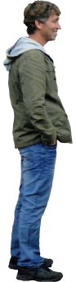

Option A: Relativity
A.1 – The beginnings of relativity
Reference frames
•Suppose you are standing by the side of the road and a van drives by with a velocity of v:
•In your frame of reference (the coordinate system S) the van is traveling at v in the positive x-direction.
•We can also attach a coordinate system (S’) to the moving van.
•In either frame (S or S’) we can measure the distance to the cone (x or x’).
y
y’
S
S’
v
x
x’
x’
x
Notes:
© 2014 By Timothy K. Lund

Slide 7
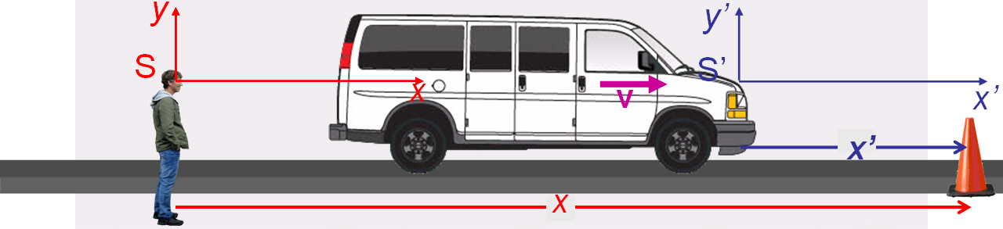
Option A: Relativity
A.1 – The beginnings of relativity
Galilean transformations
•We can find a relationship between the two cone distances (x and x’) as measured in S and S’.
•If the time is measured by you in S to be t, then the distance from you (S) to the moving reference frame (S’) is just vt. From the diagram we get the following:
vt
x = x’ + vt
The Galilean transformations for x and x’
x’ = x – vt
Notes:
© 2014 By Timothy K. Lund

Slide 8
Option A: Relativity
A.1 – The beginnings of relativity
Galilean transformations
•A Galilean transformation is just a way to convert distances in one reference frame to distances in another one.
vt
x = x’ + vt
The Galilean transformations for x and x’
x’ = x – vt
Notes:
© 2014 By Timothy K. Lund

Slide 9
Option A: Relativity
A.1 – The beginnings of relativity
Galilean transformations
vt
EXAMPLE: At the instant S’ is coincident with S you start your stopwatch. The cone is exactly 76.5 m from you. If the van is traveling at 25.75 m s⁻¹ how far is the van from the cone at t = 0.00 s and t = 2.75 s.
SOLUTION: We want x’ and we know x so we use
•x’ = x – vt = 76.5 – 25.75t = 76.5 – 25.75(0) = 76.5 m.
•x’ = 76.5 – 25.75(2.75) = 5.69 m.
Notes:
© 2014 By Timothy K. Lund

Slide 10
Option A: Relativity
A.1 – The beginnings of relativity
Galilean transformations
vt
EXAMPLE: What time does your stopwatch show when the van is exactly 25.0 m from the cone?
SOLUTION: We want t and we know x and x’ so we can use either form. From x’ = x – vt we get
25.0 = 76.5 – 25.75t
25.75t = 76.5 – 25.0 = 51.5
t = 51.5 / 25.75 = 2.00 s.
Notes:
© 2014 By Timothy K. Lund

Slide 11
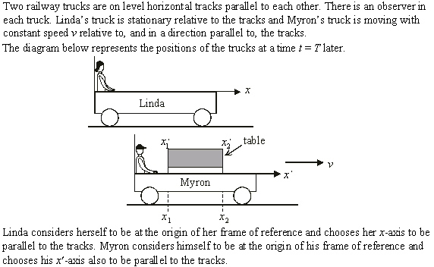
Option A: Relativity
A.1 – The beginnings of relativity
Galilean transformations
Notes:
© 2014 By Timothy K. Lund

Slide 12
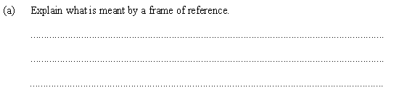
Option A: Relativity
A.1 – The beginnings of relativity
Galilean transformations
•A frame of reference is just a coordinate system chosen by any observer.
•The reference frame is then used by the observer to measure positions and times so that the positions, velocities and accelerations can all be referenced to something specific.
Notes:
© 2014 By Timothy K. Lund

Slide 13
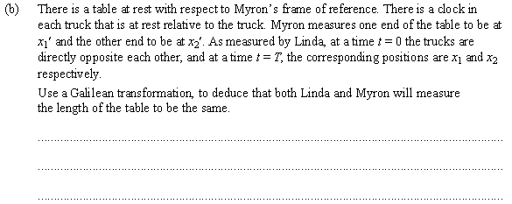
Option A: Relativity
A.1 – The beginnings of relativity
Galilean transformations
•Since the table is in Myron’s frame he will certainly measure its length to be x₂’ – x₁’.
•Linda can use the Galilean transformation which says that x = x’ + vt.
•For Linda the table has length x₂ - x₁.
•At t = T, x₁ = x₁’ + vT and x₂ = x₂’ + vT so
x₂ - x₁ = x₂’ + vT – (x₁’ + vT)
x₂ - x₁ = x₂’– x₁’.
They measure the same length.
Notes:
© 2014 By Timothy K. Lund

Slide 14
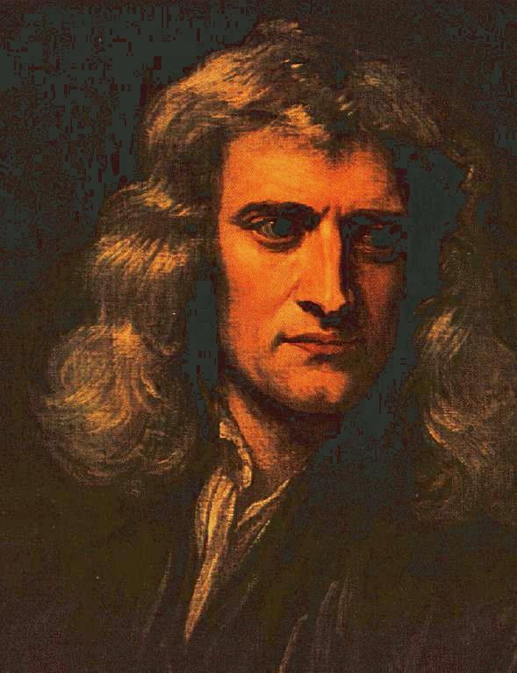
Option A: Relativity
A.1 – The beginnings of relativity
Newton’s postulates concerning time and space
•According to Newton "Absolute, true, and mathematical time, of itself and from its own nature, flows equably without relation to anything external."
•Thus for Newton t = t ’regardless of speed.
•Furthermore, Newton also believed that the geometry of space was Euclidean in nature, and that distances were also absolute.
•Thus the table in the previous example was the same size in either reference frame.
FYI
•Both of these “obvious” assumptions will be proven wrong in this Option!
Notes:
© 2014 By Timothy K. Lund

Slide 15
Option A: Relativity
A.1 – The beginnings of relativity
Galilean transformations
•If we divide each of the above transformations by the one and only “absolute” t we get
where u is the velocity of the cone in your reference frame (S), and u’ is the velocity of the cone in (S’).
•A Galilean transformation is just a way to convert velocities in S to velocities in S’.
x = x’ + vt
The Galilean transformations for x and x’
x’ = x – vt
u = u’ + v
The Galilean transformations for u and u’
u’ = u – v
FYI
•We found the transformations for a stationary object (the cone) but it could also have been moving.
Notes:
© 2014 By Timothy K. Lund

Slide 16
Option A: Relativity
A.1 – The beginnings of relativity
Galilean transformations
EXAMPLE: Show that if the cone is accelerating that both reference frames measure the same acceleration.
SOLUTION: Use u = u’ + v and kinematics.
•From kinematics
In S : u = u₀ + at
In S’: u’ = u₀’ + a’t.
•Then u = u’ + v becomes
u₀ + at = u₀’ + a’t + v.
•But u = u’ + v also becomes u₀ = u₀’ + v so that
u₀’ + v + at = u₀’ + a’t + v.
•Thus at = a’t so that a = a’.
• We say that a is invariant under the transformation.
a is acceleration in S.
a’ is acceleration in S’.
Notes:
© 2014 By Timothy K. Lund

Slide 17
Option A: Relativity
A.1 – The beginnings of relativity
Galilean transformations
PRACTICE: Explain why the laws of physics are the same in S and S’.
SOLUTION:
•Since a = a’ it follows that F = F ’ (since F = ma).
•Thus dynamics and everything that follows (say momentum and energy) is the same in S and S’.
FYI
•What this means is that neither reference frame is special, and that the two frames S and S’ are indistinguishable as far as physics experiments are concerned.
•A corollary to this result is that experimentation cannot tell you how fast your reference frame is moving!
Notes:
© 2014 By Timothy K. Lund

Slide 18

Option A: Relativity
A.1 – The beginnings of relativity
Galilean transformations
PRACTICE:
Suppose the cone is traveling at 30 ms⁻¹ to the right (it is on wheels!) and the van is traveling at 40 ms⁻¹ to the right (both relative to you). Find v, u, and u’.
SOLUTION:
•Since the van is traveling at 40 ms⁻¹ relative to you, v = 40 ms⁻¹.
•Since the cone is traveling at 30 ms⁻¹ relative to you, u = 30 ms⁻¹.
•The Galilean transformation u’ = u – v then becomes u’ = 30 – 40 = -10 ms⁻¹.
Expected?
Notes:
© 2014 By Timothy K. Lund

Slide 19
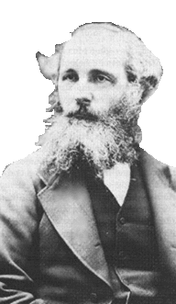
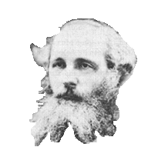
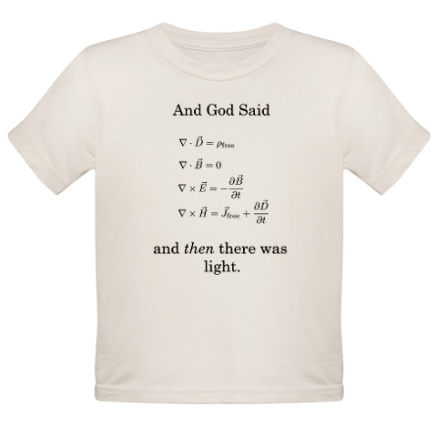
Option A: Relativity
A.1 – The beginnings of relativity
Maxwell and the constancy of the speed of light
•James Clerk Maxwell formulated his theory of electromagnetism in the late 1800s.
•In his theory, he predicted that the speed of light is the same for all reference frames.
•The part of Maxwell’s theory that we have studied is that moving charges produce and thus respond to magnetic fields, and that stationary charges don’t.
•The next two slides show what Maxwell’s theory predicted about light. It will probably bother you.
Typical college nerd tee-shirt!
Notes:
© 2014 By Timothy K. Lund

Slide 20
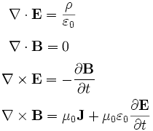
Option A: Relativity
A.1 – The beginnings of relativity
Maxwell and the constancy of the speed of light
EXAMPLE:
Consider Maxwell’s equations.
•Ignoring the weird symbols like ∇ and ∂ , you should at least recognize…
•ε₀ = 8.85×10⁻¹², the permittivity of free space.
•μ₀ = 4π×10⁻⁷, the permeability of free space.
•It turns out that μ₀ε₀ = 1 / c², and that the theory required the speed of light to be the same in all reference frames.
•This isn’t the part that should bother you!
Notes:
© 2014 By Timothy K. Lund

Slide 21
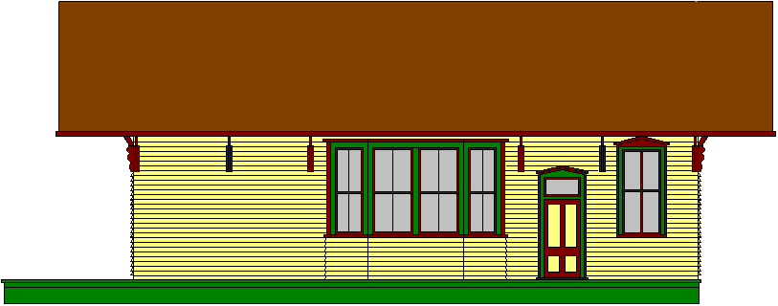


Option A: Relativity
A.1 – The beginnings of relativity
Maxwell and the constancy of the speed of light
EXAMPLE:
Consider the following scenario. A train is traveling down the tracks at 0.5c. Then the engineer turns on his headlight. How fast does the beam travel forward with respect to the ground?
•According to the Galilean transformation, the beam travels the speed of light c PLUS the speed of the train 0.5c. This is a total of 1.5c.
•According to Maxwell, light travels at exactly c in any reference frame. So who is right?
•Einstein thought Maxwell was right. And he was.
c
0.5c
Notes:
© 2014 By Timothy K. Lund

Slide 22
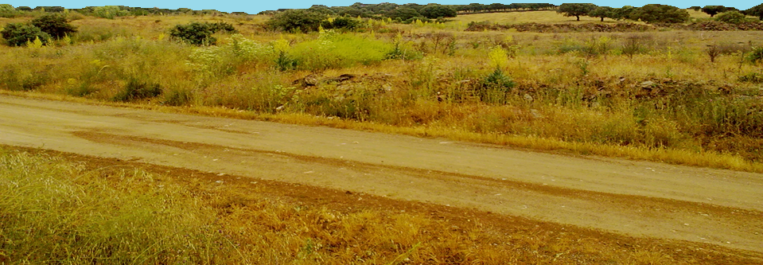
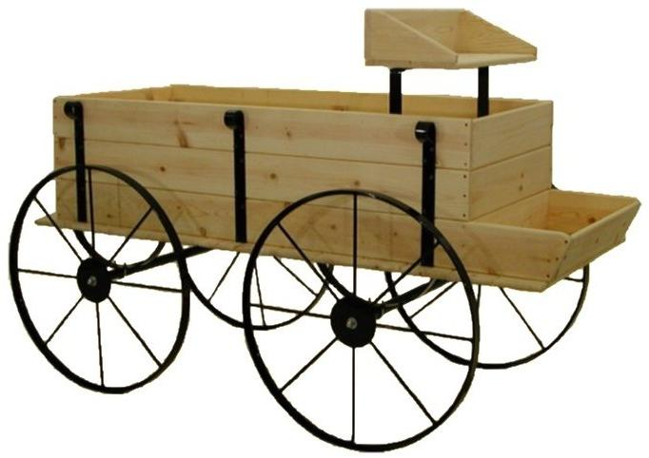
Option A: Relativity
A.1 – The beginnings of relativity
Maxwell and the constancy of the laws of physics
EXAMPLE: Consider two charges Q at rest in the CS of the road (and the observer). Since they are at rest in your reference frame they exert no magnetic force on each other.
•But in the CS of the moving wagon they each have a velocity, and thus each feels a magnetic force!
y
y
x
This conundrum bothered physicists who believed in the Galilean transformations. Why?
x
Because the magnetic force isn’t the same in both CSs!
Notes:
© 2014 By Timothy K. Lund

Slide 23
Option A: Relativity
A.1 – The beginnings of relativity
Relativity
•Although most people think of Einstein when they think of “relativity,” the term simply describes conversions between one reference frame and another.
•Thus there is what we could term classical relativity, which incorporates the Galilean transformations and Newton’s concepts of absolute time and space.
•Then there is what we call special relativity and general relativity, both authored by Albert Einstein, and both of which incorporate a deeper understanding of relativity than that of the classical physicists.
•In any relativity theory, there are two types of reference frames: inertial and non-inertial.
•These frames will be contrasted in the following slides.
Notes:
© 2014 By Timothy K. Lund

Slide 24
Option A: Relativity
A.1 – The beginnings of relativity
Inertial reference frames
•Clearly, there can be more than one reference frame in which to explore the laws of physics.
•Usually, the universe does not “care” what our choice of coordinate system is in which its laws are revealed.
•But, all reference frames are not created equal.
y
y
x
x
Notes:
© 2014 By Timothy K. Lund

Slide 25

Option A: Relativity
A.1 – The beginnings of relativity
Inertial reference frames
•Suppose the wagon, traveling at a constant speed, has a bowling ball fall from it.
•The WHITE x-coordinate of the ball doesn’t change.
•This is because v_{x,ball} = v_{x,wagon} for the whole fall.
y
y
y
x
x
x
•The observer in the non-accelerating wagon sees that the bowling ball is accelerating downward at g.
EXPECTED.
Notes:
© 2014 By Timothy K. Lund

Slide 26
Option A: Relativity
A.1 – The beginnings of relativity
Inertial reference frames
•Now suppose the wagon is decreasing its speed while the ball is falling.
•Note that in this case the x-coordinate of the ball does change (it increases).
•This is because v_{x,wagon} decreases during the drop.
y
y
y
x
x
x
•The observer in the decelerating wagon sees that the bowling ball is accelerating FORWARD!
UNEXPECTED.
Notes:
© 2014 By Timothy K. Lund

Slide 27
Option A: Relativity
A.1 – The beginnings of relativity
Inertial reference frames
•When the cs was not accelerating (as in the first example) the observer noted that the ball had but a single downward acceleration of g.
•When the cs was accelerating (decelerating, as in the second example) the observer noted that the ball not only accelerated downward at g, but it accelerated forward as well.
y
v = CONST
y
v ≠ CONST
Non-accelerating reference frame.
Accelerating reference frame.
x
x
Inertial reference frame
Non-inertial reference frame
Notes:
© 2014 By Timothy K. Lund

Slide 28
Option A: Relativity
A.1 – The beginnings of relativity
Inertial reference frames
•In both reference frames the observers would discover that the acceleration in the y-direction is g.
•In this respect, both frames yield the correct physical result.
•However, in the non-inertial frame, the observer “discovers” another acceleration in the x-direction, and thus assumes there is an additional force present.
y
v = CONST
y
v ≠ CONST
Non-accelerating reference frame.
Accelerating reference frame.
x
x
Inertial reference frame
Non-inertial reference frame
Notes:
© 2014 By Timothy K. Lund

Slide 29
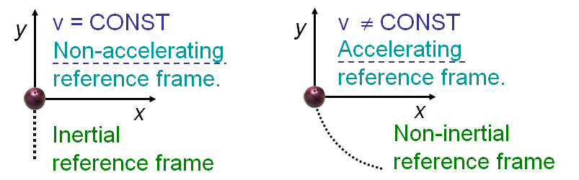
Option A: Relativity
A.1 – The beginnings of relativity
Inertial reference frames
•Because the non-inertial reference frame requires the observer to assume a non-existent additional force, the inertial reference frame is the preferred one.
•Einstein’s special relativity is the relativity of inertial reference frames.
•Einstein’s general relativity is the relativity of non-inertial frames.
Notes:
© 2014 By Timothy K. Lund

